Slide 1
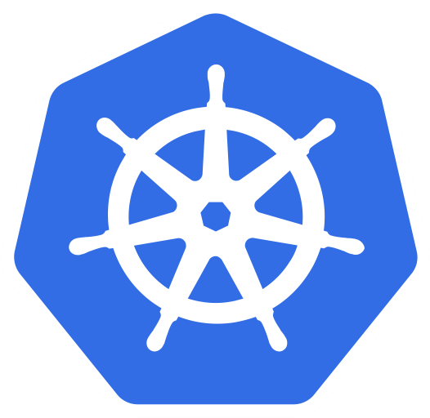
Kubernetes Icons
v0.1
Set of icons to create diagrams
Use them as SDK, feel free to create
Non official library
Kubernetes official blue color
#326ce5
RGB(50,108,229)
Maintainers:
Arnaud Mazin <amazin@octo.com>
Etienne Coutaud <ecoutaud@octo.com>

Slide 2
Table of contents
1...Compute
2...Storage
3...Network
4...RBAC Model
5...Pods Configuration
6...Cluster Configuration
7...Others
8...Infrastructure components
9...Control Plane components
10...Group and links
11...Kubernetes ressources map
12...Diagrams examples

Slide 3
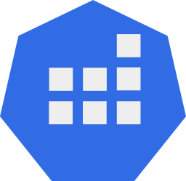

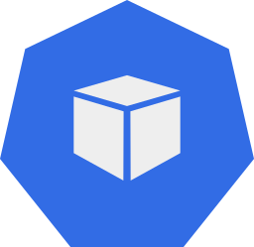

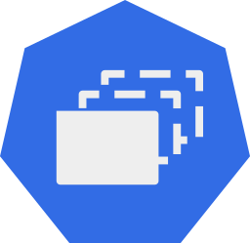
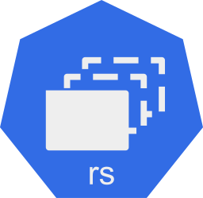
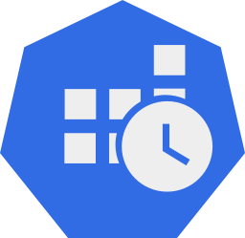

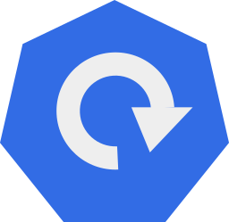
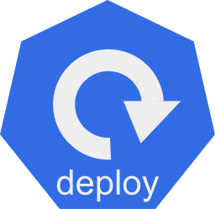
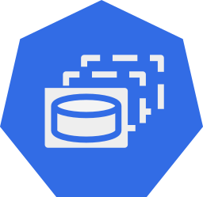
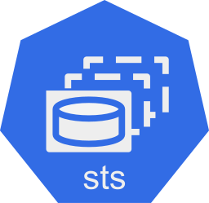
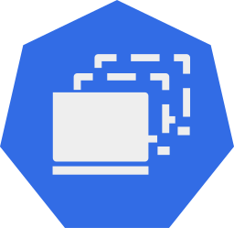
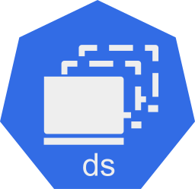
Compute
Pod: Pod is a collection of containers that can run on a host. This resource is created by clients and scheduled onto hosts.
Job: Job represents the configuration of a single job.
ReplicaSet: ReplicaSet ensures that a specified number of pod replicas are running at any given time.
CronJob: A CronJob manages time based Job, namely:
once at a specified point in time
repeatedly at a specified point in time
Deployment: Deployment enables declarative updates for Pods and ReplicaSets.
StatefulSet: StatefulSet represents a set of pods with consistent identities. Identities are defined as: network, storage.
DaemonSet: DaemonSet represents the configuration of a daemon set.

Slide 4
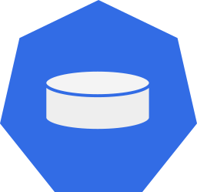
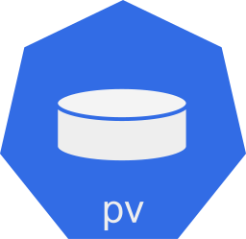
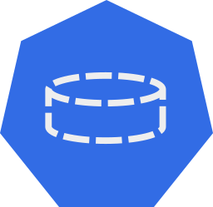
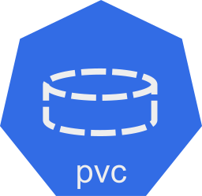
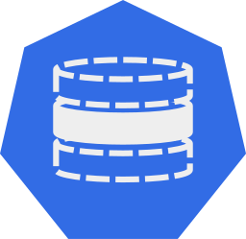
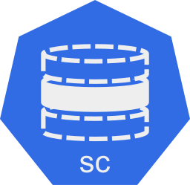
Storage
PersistentVolume: is a storage resource provisioned by an administrator.
PersistentVolumeClaim: PersistentVolumeClaim is a user's request for and claim to a persistent volume.
StorageClass: StorageClass describes the parameters for a class of storage for which PersistentVolumes can be dynamically provisioned.

Slide 5

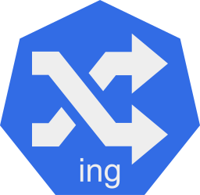
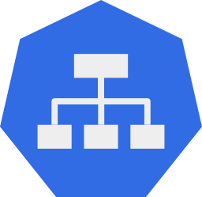
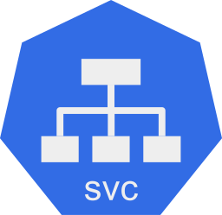
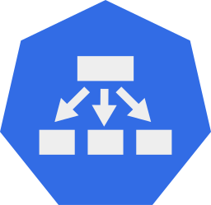
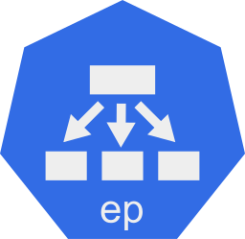
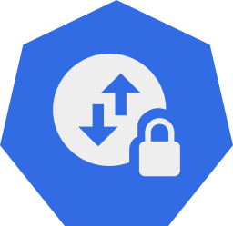

Network
Ingress: Ingress is a collection of rules that allow inbound connections to reach the endpoints defined by a backend. An Ingress can be configured to give services externally-reachable urls, load balance traffic, terminate SSL, offer name based virtual hosting etc.
Service: Service is a named abstraction of software service (for example, mysql) consisting of local port (for example 3306) that the proxy listens on, and the selector that determines which pods will answer requests sent through the proxy.
Endpoint: Endpoints is a collection of endpoints that implement the actual service.
NetworkPolicy: NetworkPolicy describes what network traffic is allowed for a set of Pods.

Slide 6


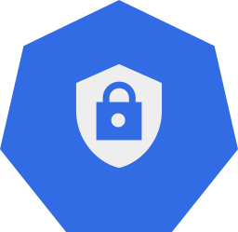
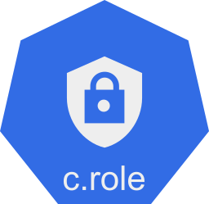


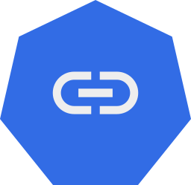
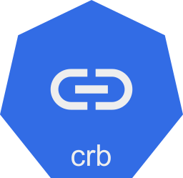

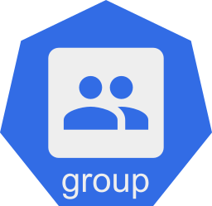
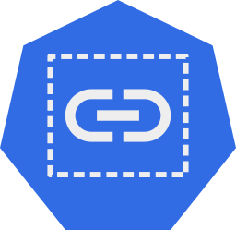
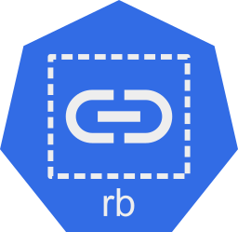
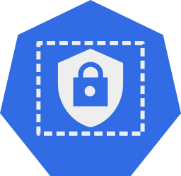
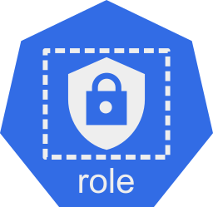
RBAC model
ServicaAccount: binds together: a name, a principal that can be authenticated and authorized * a set of secrets.
ClusterRole: ClusterRole is a cluster level, logical grouping of PolicyRules that can be referenced as a unit by a RoleBinding or ClusterRoleBinding.
User: Human user of Kubernetes cluster.
ClusterRoleBinding: A cluster role binding grants the permissions defined in a role/clusterrole to a user or set of users. Permissions are granted cluster-wide.
Group: Set of Service Accounts or Users.
RoleBinding: A role binding grants the permissions defined in a role/clusterrole to a user or set of users. Permissions are granted within a namespace.
Role: Role is a namespaced, logical grouping of PolicyRules that can be referenced as a unit by a RoleBinding.

Slide 7

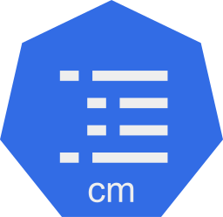
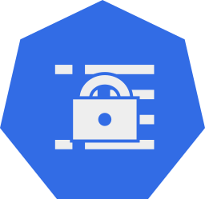

Pods Configuration
ConfigMap: ConfigMap holds configuration data for pods to consume.
Secret: Secret holds secret data of a certain type.

Slide 8
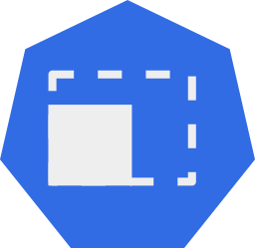
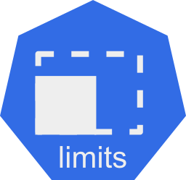
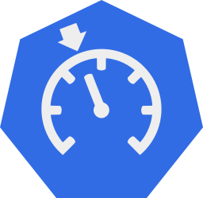

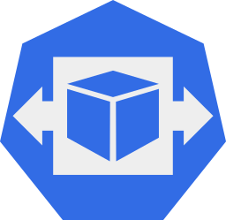
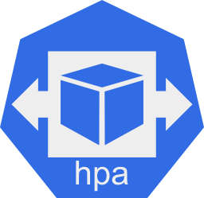
Cluster configuration
LimitRange: LimitRange sets resource usage limits for each kind of resource in a Namespace.
Quota: ResourceQuota sets aggregate quota restrictions enforced per namespace.
HorizontalPodAutoscaler: configuration of a horizontal pod autoscaler.

Slide 9

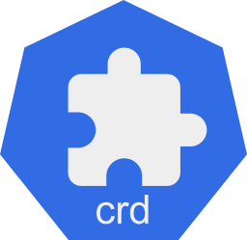
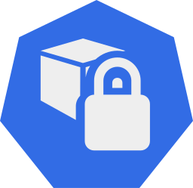
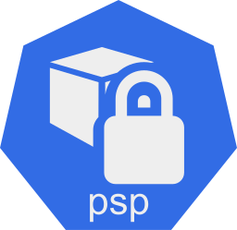
Others
CustomResourceDefinition: Extension of Kubernetes API.
PodSecurityPolicy: governs the ability to make requests that affect the Security Context that will be applied to a pod and container.

Slide 10
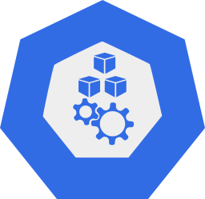

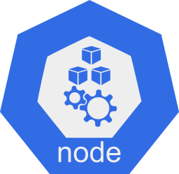
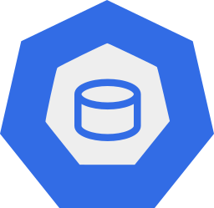
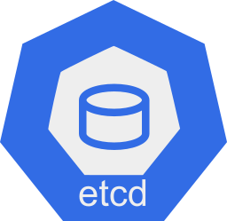
Infrastructure components
Cluster: Kubernetes cluster.
Master: Kubernetes Control Plane.
Node: Worker machine in Kubernetes cluster.
ETCD: Kubernetes’s backing store.

Slide 11

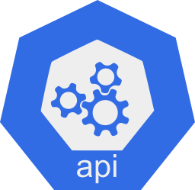
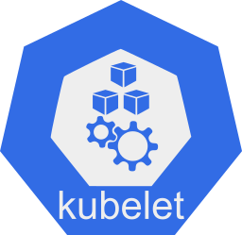
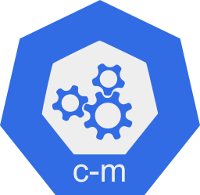



Control Plane components
K8s API Server: Kubernetes API.
Kubelet: The kubelet is the primary “node agent” that runs on each node.
Controller Manager: Kubernetes controller manager.
Kube-proxy: The Kubernetes network proxy runs on each node. This reflects services as defined in the Kubernetes API on each node.
Scheduler: In charge of ensuring Pods placement.
Cloud Controller Manager: Optional and External Cloud controller (experimental).

Slide 12


Groups and links
Namespace: Namespace provides a scope for Names. Use of multiple namespaces is optional.
Use to represent a reference between components, reference can be through various selector (label, name ...)
kubernetes
dashboard
dns
heapster
Use to represent a generation, resource generate other resource
kube-public
default
kube-system

Slide 13
Kubernetes Ressources Map
Creates
References
Resources mgt
Network / exposition
Configuration
Storage
IAM
Pod generator

Slide 14
Diagrams examples

Slide 15
Exposed Application
trololo.com

Slide 16
Application with configuration
trololo.com

Slide 17
Application with persistent storage
trololo.com

Slide 18
StatefulSet Architecture

Slide 19
RBAC model
Certificate
CN=ksz,O=dev-admins
Certificate
CN=etc,O=dev-admins
dev-admins
Certificate
CN=aug,O=dev-admins
dev-admins
admin
dev

Slide 20
Kube-dns example
kube-system
kube-dns
system:kube-dns
system:kube-dns
rules:
- apiGroups:
- ""
resources:
- endpoints
- services
verbs:
- list
- watch
kube-dns
(Static ClusterIP)

Slide 21
Server implementation
Minimal H-A design
Prod-ready design
ingress nodes
masters
masters
workload nodes
workload nodes
etcd
cluster
etcd cluster

Slide 22
K8s components startup
K8s cluster
default
kube-system
kubernetes
api
c-m
sched
k-proxy
mirror pods
static pods

Slide 23
Appendices

Slide 24


