Slide 1

SQL
DDL, DCL, DML, Joins, Subqueries and Functions

Slide 2
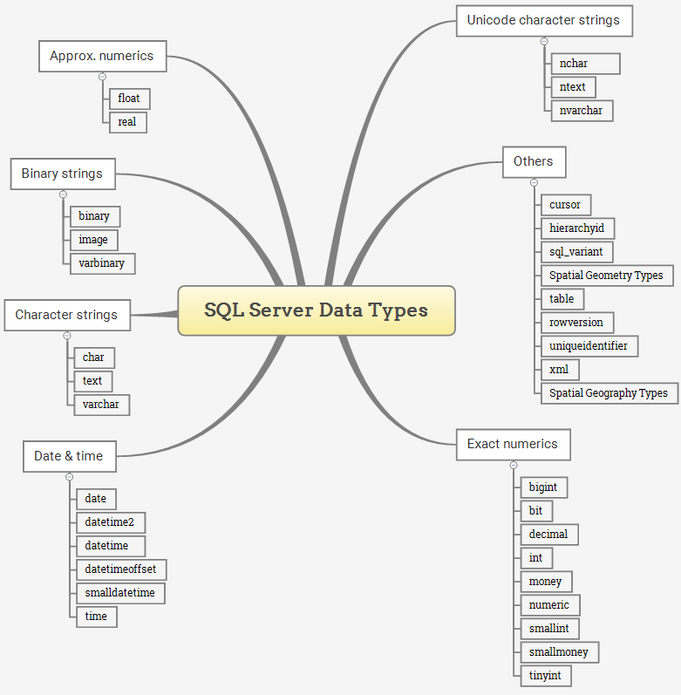
Data types
In SQL Server, a column, variable, and parameter holds a value that associated with a type, or also known as a data type. A data type is an attribute that specifies the type of data that these objects can store. It can be an integer, character string, monetary, date and time, and so on.
SQL Server provides a list of data types that define all types of data that you can use e.g., defining a column or declaring a variable.

Slide 3
Exact numeric data types
Data Type | Lower limit | Upper limit | Memory
bigint | −2^63 (−9,223,372, 036,854,775,808) | 2^63−1 (−9,223,372, 036,854,775,807) | 8 bytes
int | −2^31 (−2,147, 483,648) | 2^31−1 (−2,147, 483,647) | 4 bytes
smallint | −2^15 (−32,767) | 2^15 (−32,768) | 2 bytes
tinyint | 0 | 255 | 1 byte
bit | 0 | 1 | 1 byte/8bit column
decimal | −10^38+1 | 10^381−1 | 5 to 17 bytes
numeric | −10^38+1 | 10^381−1 | 5 to 17 bytes
money | −922,337, 203, 685,477.5808 | +922,337, 203, 685,477.5807 | 8 bytes
smallmoney | −214,478.3648 | +214,478.3647 | 4 bytes
Exact numeric data types store exact numbers such as integer, decimal, or monetary amount.
The bit store one of three values 0, 1, and NULL
The int, bigint, smallint, and tinyint data types store integer data.
The decimal and numeric data types store numbers that have fixed precision and scale. Note that decimal and numeric are synonyms.
The money and smallmoney data type store currency values.

Slide 4
Approximate numeric data types
Data Type | Lower limit | Upper limit | Memory | Precision
float(n) | −1.79E+308 | 1.79E+308 | Depends on the value of n | 7 Digit
real | −3.40E+38 | 3.40E+38 | 4 bytes | 15 Digit
The approximate numeric data type stores floating point numeric data. They are often used in scientific calculations.

Slide 5
Date & Time data types
Data Type | Storage size | Accuracy | Lower Range | Upper Range
datetime | 8 bytes | Rounded to increments of .000, .003, .007 | 1753-01-01 | 9999-12-31
smalldatetime | 4 bytes, fixed | 1 minute | 1900-01-01 | 2079-06-06
date | 3 bytes, fixed | 1 day | 0001-01-01 | 9999-12-31
time | 5 bytes | 100 nanoseconds | 00:00:00.0000000 | 23:59:59.9999999
datetimeoffset | 10 bytes | 100 nanoseconds | 0001-01-01 | 9999-12-31
datetime2 | 6 bytes | 100 nanoseconds | 0001-01-01 | 9999-12-31
The date and time data types store data and time data, and the date time offset.

Slide 6
Character strings data types
Data Type | Lower limit | Upper limit | Memory
char | 0 chars | 8000 chars | n bytes
varchar | 0 chars | 8000 chars | n bytes + 2 bytes
varchar (max) | 0 chars | 2^31 chars | n bytes + 2 bytes
text | 0 chars | 2,147,483,647 chars | n bytes + 4 bytes
Character strings data types allow you to store either fixed-length (char) or variable-length data (varchar). The text data type can store non-Unicode data in the code page of the server.

Slide 7
Unicode character string data types
Data Type | Lower limit | Upper limit | Memory
nchar | 0 chars | 4000 chars | 2 times n bytes
nvarchar | 0 chars | 4000 chars | 2 times n bytes + 2 bytes
ntext | 0 chars | 1,073,741,823 char | 2 times the string length
Unicode character string data types store either fixed-length (nchar) or variable-length (nvarchar) Unicode character data.

Slide 8
Binary string data types
The binary data types stores fixed and variable length binary data.
Data Type | Lower limit | Upper limit | Memory
binary | 0 bytes | 8000 bytes | n bytes
varbinary | 0 bytes | 8000 bytes | The actual length of data entered + 2 bytes
image | 0 bytes | 2,147,483,647 bytes

Slide 9
Data Type | Description
cursor | for variables or stored procedure OUTPUT parameter that contains a reference to a cursor
rowversion | expose automatically generated, unique binary numbers within a database.
hierarchyid | represent a tree position in a tree hierarchy
uniqueidentifier | 16-byte GUID
sql_variant | store values of other data types
XML | store XML data in a column, or a variable of XML type
Spatial Geometry type | represent data in a flat coordinate system.
Spatial Geography type | store ellipsoidal (round-earth) data, such as GPS latitude and longitude coordinates.
table | store a result set temporarily for processing at a later time
Other data types

Slide 10
Select - Syntax
SQL Server SELECT – retrieve some columns of a table example
SELECT
first_name,
last_name
FROM
sales.customers;
SELECT
select_list
FROM
schema_name.table_name;
SQL Server SELECT – sort the result set
SQL Server SELECT – group rows into groups example
SELECT
*
FROM
sales.customers
WHERE
state = 'CA';
SELECT city, COUNT (*)
FROM sales.customers
WHERE state = 'CA'
GROUP BY city
ORDER BY city;

Slide 11
Order By - Syntax
SELECT
first_name,
last_name
FROM
sales.customers
ORDER BY
LEN(first_name) DESC;
SELECT select_list
FROM table_name
ORDER BY
column_name | expression [ASC | DESC ];
SELECT
city,
first_name,
last_name
FROM
sales.customers
ORDER BY
city DESC,
first_name ASC;
SELECT
city,
first_name,
last_name
FROM
sales.customers
ORDER BY
state;
SELECT
first_name,
last_name
FROM
sales.customers
ORDER BY
1,
2;

Slide 12
Offset- Syntax
SELECT product_name,
list_price
FROM production.products
ORDER BY list_price,
product_name
OFFSET 10 ROWS;
ORDER BY column_list [ASC |DESC]
OFFSET offset_row_count {ROW | ROWS}
FETCH {FIRST | NEXT} fetch_row_count {ROW | ROWS} ONLY
SELECT
product_name,
list_price
FROM
production.products
ORDER BY
list_price,
product_name
OFFSET 10 ROWS
FETCH NEXT 10 ROWS ONLY;
SELECT
product_name,
list_price
FROM
production.products
ORDER BY
list_price DESC,
product_name
OFFSET 0 ROWS
FETCH FIRST 10 ROWS ONLY;

Slide 13
TOP - Syntax
SELECT TOP 10
product_name,
list_price
FROM
production.products
ORDER BY
list_price DESC;
SELECT TOP (expression) [PERCENT]
[WITH TIES]
FROM
table_name
ORDER BY
column_name;
SELECT TOP 3 WITH TIES
product_name,
list_price
FROM
production.products
ORDER BY
list_price DESC;
SELECT TOP 1 PERCENT
product_name,
list_price
FROM
production.products
ORDER BY
list_price DESC;

Slide 14
Distinct - Syntax
SELECT DISTINCT
column_name1,
column_name2 ,
...
FROM
table_name;
SELECT DISTINCT
city
FROM
sales.customers
ORDER BY
city;
SELECT DISTINCT
column_name
FROM
table_name;
SELECT
city,
state,
zip_code
FROM
sales.customers
GROUP BY
city, state, zip_code
ORDER BY
city, state, zip_code
SELECT
DISTINCT
city,
state,
zip_code
FROM
sales.customers;

Slide 15
Where - Syntax
SELECT product_id, product_name, category_id,
model_year, list_price
FROM production.products
WHERE category_id = 1
ORDER BY
list_price DESC;
SELECT
select_list
FROM
table_name
WHERE
search_condition;
SELECT product_id, product_name,
category_id, model_year, list_price
FROM
production.products
WHERE
category_id = 1 AND model_year = 2018
ORDER BY
list_price DESC;
SELECT product_id, product_name,
category_id, model_year, list_price
FROM
production.products
WHERE
list_price > 300 AND model_year = 2018
ORDER BY
list_price DESC;

Slide 16
SELECT product_id, product_name, category_id, model_year, list_price
FROM production.products
WHERE
list_price BETWEEN 1899.00 AND 1999.99
ORDER BY
list_price DESC;
SELECT product_id, product_name,
category_id, model_year, list_price
FROM
production.products
WHERE
list_price IN (299.99, 369.99, 489.99)
ORDER BY
list_price DESC;
SELECT product_id, product_name,
category_id, model_year, list_price
FROM
production.products
WHERE
product_name LIKE '%Cruiser%'
ORDER BY
list_price;

Slide 17
NULL and three-valued logic
SELECT customer_id, first_name,
last_name, phone
FROM sales.customers
WHERE
phone = NULL
ORDER BY
first_name,
last_name;
NULL = 0
NULL <> 0
NULL > 0
NULL = NULL
SELECT customer_id, first_name,
last_name, phone
FROM
sales.customers
WHERE
phone IS NULL
ORDER BY
first_name,
last_name;
SELECT customer_id, first_name,
last_name, phone
FROM
sales.customers
WHERE
phone IS NOT NULL
ORDER BY
first_name,
last_name;

Slide 18
AND operator
SELECT
*
FROM production.products
WHERE
category_id = 1AND list_price > 400
ORDER BY
list_price DESC;
boolean_expression AND boolean_expression
boolean_expression AND
…………………………….. boolean_expression AND boolean_expression
SELECT
*
FROM production.products
WHERE
category_id = 1
AND list_price > 400
AND brand_id = 1
ORDER BY
list_price DESC;
SELECT
*
FROM
production.products
WHERE
brand_id = 1
OR brand_id = 2
AND list_price > 1000
ORDER BY
brand_id DESC;

Slide 19
OR operator
SELECT product_name, list_price
FROM
production.products
WHERE
list_price < 200
OR list_price > 6000
ORDER BY
list_price;
boolean_expression OR boolean_expression
boolean_expression OR
…………………………….. boolean_expression OR boolean_expression
SELECT product_name, brand_id
FROM
production.products
WHERE
brand_id = 1
OR brand_id = 2
OR brand_id = 4
ORDER BY
brand_id DESC;
SELECT
product_name,
brand_id
FROM
production.products
WHERE
brand_id IN (1, 2, 3)
ORDER BY
brand_id DESC;

Slide 20
BETWEEN operator
column | expression BETWEEN start_expression AND end_expression
column | expression <= end_expression AND column | expression >= start_expression
column | expression NOT BETWEEN start_expression AND end_expresion
column | expression < start_expression AND column | expression > end_expression
SELECT
product_id,
product_name,
list_price
FROM
production.products
WHERE
list_price BETWEEN 149.99 AND 199.99
ORDER BY
list_price;
SELECT
product_id,
product_name,
list_price
FROM
production.products
WHERE
list_price NOT BETWEEN 149.99 AND 199.99
ORDER BY
list_price;

Slide 21
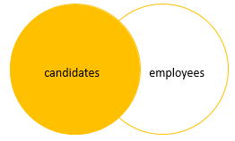
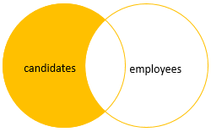
Left Join
SELECT c.id candidate_id, c.fullname candidate_name,
e.id employee_id, e.fullname employee_name
FROM
hr.candidates c
LEFT JOIN hr.employees e
ON e.fullname = c.fullname;
SELECT c.id candidate_id, c.fullname candidate_name,
e.id employee_id, e.fullname employee_name
FROM hr.candidates c
LEFT JOIN hr.employees e ON e.fullname = c.fullname
WHERE
e.id IS NULL;

Slide 22
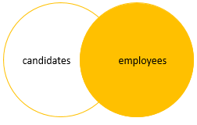
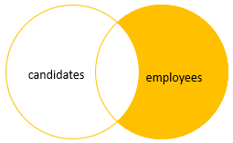
Right Join
SELECT c.id candidate_id, c.fullname candidate_name,
e.id employee_id, e.fullname employee_name
FROM
hr.candidates c
RIGHT JOIN hr.employees e
ON e.fullname = c.fullname;
SELECT c.id candidate_id, c.fullname candidate_name,
e.id employee_id, e.fullname employee_name
FROM hr.candidates c
RIGHT JOIN hr.employees e ON e.fullname = c.fullname
WHERE
c.id IS NULL;

Slide 23
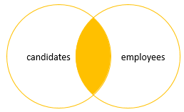
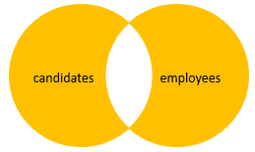
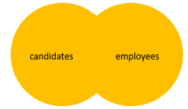
Inner Join
SELECT c.id candidate_id, c.fullname candidate_name,
e.id employee_id, e.fullname employee_name
FROM hr.candidates c
INNER JOIN hr.employees e ON e.fullname = c.fullname;
Full Join
SELECT c.id candidate_id, c.fullname candidate_name,
e.id employee_id, e.fullname employee_name
FROM hr.candidates c
FULL JOIN hr.employees e ON e.fullname = c.fullname
WHERE c.id IS NULL OR e.id IS NULL;
Full Join
SELECT c.id candidate_id, c.fullname candidate_name,
e.id employee_id, e.fullname employee_name
FROM hr.candidates c
FULL JOIN hr.employees e
ON e.fullname = c.fullname;

Slide 24
Self Join
A self join allows you to join a table to itself. It helps query hierarchical data or compare rows within the same table.
A self join uses the inner join or left join clause. Because the query that uses the self join references the same table, the table alias is used to assign different names to the same table within the query.
SELECT
e.first_name + ' ' + e.last_name employee,
m.first_name + ' ' + m.last_name manager
FROM
sales.staffs e
INNER JOIN sales.staffs m ON m.staff_id = e.manager_id
ORDER BY
manager;
SELECT
e.first_name + ' ' + e.last_name employee,
m.first_name + ' ' + m.last_name manager
FROM
sales.staffs e
LEFT JOIN sales.staffs m ON m.staff_id = e.manager_id
ORDER BY
manager;
SELECT
select_list
FROM
T t1
[INNER | LEFT] JOIN T t2 ON
join_predicate;

Slide 25
Using self join to compare rows within a table
SELECT
c1.city,
c1.first_name + ' ' + c1.last_name customer_1,
c2.first_name + ' ' + c2.last_name customer_2
FROM
sales.customers c1
INNER JOIN sales.customers c2 ON c1.customer_id > c2.customer_id
AND c1.city = c2.city
ORDER BY
city,
customer_1,
customer_2;
SELECT
c1.city,
c1.first_name + ' ' + c1.last_name customer_1,
c2.first_name + ' ' + c2.last_name customer_2
FROM
sales.customers c1
INNER JOIN sales.customers c2 ON c1.customer_id <> c2.customer_id
AND c1.city = c2.city
WHERE c1.city = 'Albany'
ORDER BY
c1.city,
customer_1,
customer_2;

Slide 26
Cross Join
The CROSS JOIN joined every row from the first table (T1) with every row from the second table (T2). In other words, the cross join returns a Cartesian product of rows from both tables.
Unlike the INNER JOIN or LEFT JOIN, the cross join does not establish a relationship between the joined tables.
Suppose the T1 table contains three rows 1, 2, and 3 and the T2 table contains three rows A, B, and C.
The CROSS JOIN gets a row from the first table (T1) and then creates a new row for every row in the second table (T2). It then does the same for the next row for in the first table (T1) and so on.
SELECT
select_list
FROM
T1
CROSS JOIN T2;
SELECT
product_id,
product_name,
store_id,
0 AS quantity
FROM
production.products
CROSS JOIN sales.stores
ORDER BY
product_name,
store_id;

Slide 27
Group By
SELECT customer_id, YEAR (order_date) order_year,
COUNT (order_id) order_placed
FROM sales.orders
WHERE customer_id IN (1, 2)
GROUP BY customer_id, YEAR (order_date)
ORDER BY customer_id;
SELECT
select_list
FROM
table_name
GROUP BY
column_name1,
column_name2 ,...;
SELECT city, state, COUNT (customer_id) customer_count
FROM sales.customers
GROUP BY state, city
ORDER BY city, state;
SELECT customer_id, YEAR (order_date) order_year
FROM sales.orders
WHERE
customer_id IN (1, 2)
GROUP BY
customer_id,
YEAR (order_date)
ORDER BY
customer_id;
SELECT order_id, SUM ( quantity * list_price * (1 - discount) ) net_value
FROM sales.order_items
GROUP BY order_id;

Slide 28
Having
SELECT
customer_id,
YEAR (order_date),
COUNT (order_id) order_count
FROM
sales.orders
GROUP BY
customer_id,
YEAR (order_date)
HAVING
COUNT (order_id) >= 2
ORDER BY
customer_id;
SELECT select_list
FROM table_name
GROUP BY group_list
HAVING conditions;
SELECT column_name1, column_name2,
aggregate_function (column_name3) column_alias
FROM table_name
GROUP BY column_name1, column_name2
HAVING column_alias > value;

Slide 29
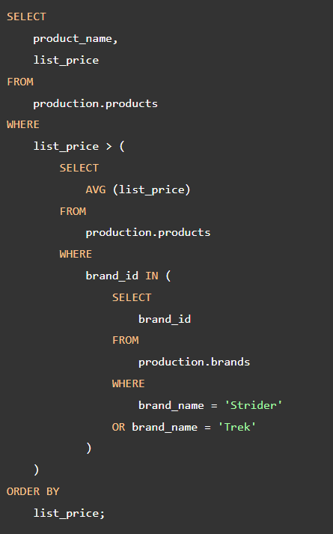
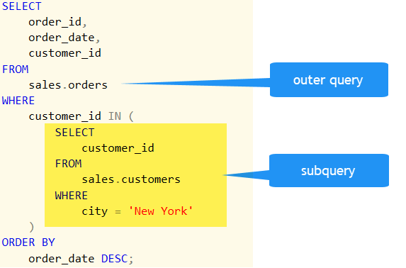
Sub Query

Slide 30
SELECT
product_id,
product_name
FROM
production.products
WHERE
category_id IN (
SELECT
category_id
FROM
production.categories
WHERE
category_name = 'Mountain Bikes'
OR category_name = 'Road Bikes'
);
SELECT
order_id,
order_date,
(
SELECT
MAX (list_price)
FROM
sales.order_items i
WHERE
i.order_id = o.order_id
) AS max_list_price
FROM
sales.orders o
order by order_date desc;

Slide 31
CTE in SQL Server
CTE stands for common table expression. A CTE allows you to define a temporary named result set that available temporarily in the execution scope of a statement such as SELECT, INSERT, UPDATE, DELETE, or MERGE.
The following shows the common syntax of a CTE in SQL Server:
In this syntax:
First, specify the expression name (expression_name) to which you can refer later in a query.
Next, specify a list of comma-separated columns after the expression_name. The number of columns must be the same as the number of columns defined in the CTE_definition.
Then, use the AS keyword after the expression name or column list if the column list is specified.
After, define a SELECT statement whose result set populates the common table expression.
Finally, refer to the common table expression in a query (SQL_statement) such as SELECT, INSERT, UPDATE, DELETE, or MERGE.
WITH expression_name[(column_name [,...])]
AS
(CTE_definition)
SQL_statement;

Slide 32
WITH cte_sales_amounts (staff, sales, year) AS (
SELECT
first_name + ' ' + last_name,
SUM(quantity * list_price * (1 - discount)),
YEAR(order_date)
FROM
sales.orders o
INNER JOIN sales.order_items i ON i.order_id = o.order_id
INNER JOIN sales.staffs s ON s.staff_id = o.staff_id
GROUP BY
first_name + ' ' + last_name,
year(order_date)
)
SELECT
staff,
sales
FROM
cte_sales_amounts
WHERE
year = 2018;
WITH cte_sales AS (
SELECT
staff_id,
COUNT(*) order_count
FROM
sales.orders
WHERE
YEAR(order_date) = 2018
GROUP BY
staff_id
)
SELECT
AVG(order_count) average_orders_by_staff
FROM
cte_sales;

Slide 33
WITH cte_category_counts ( category_id, category_name, product_count
AS ( SELECT c.category_id, c.category_name, COUNT(p.product_id)
FROM production.products p
INNER JOIN production.categories c ON c.category_id = p.category_id
GROUP BY c.category_id, c.category_name
),
cte_category_sales(category_id, sales) AS ( SELECT p.category_id,
SUM(i.quantity * i.list_price * (1 - i.discount))
FROM sales.order_items i
INNER JOIN production.products p ON p.product_id = i.product_id
INNER JOIN sales.orders o ON o.order_id = i.order_id
WHERE order_status = 4 -- completed
GROUP BY p.category_id
)
SELECT c.category_id, c.category_name, c.product_count, s.sales
FROM cte_category_counts c
INNER JOIN cte_category_sales s ON s.category_id = c.category_id
ORDER BY c.category_name;

Slide 34
Recursive CTE
A recursive common table expression (CTE) is a CTE that references itself. By doing so, the CTE repeatedly executes, returns subsets of data, until it returns the complete result set.
A recursive CTE is useful in querying hierarchical data such as organization charts where one employee reports to a manager or multi-level bill of materials when a product consists of many components, and each component itself also consists of many other components.
The following shows the syntax of a recursive CTE:
WITH expression_name (column_list)
AS
(
-- Anchor member
initial_query
UNION ALL
-- Recursive member that references expression_name.
recursive_query
)
-- references expression name
SELECT *
FROM expression_name

Slide 35
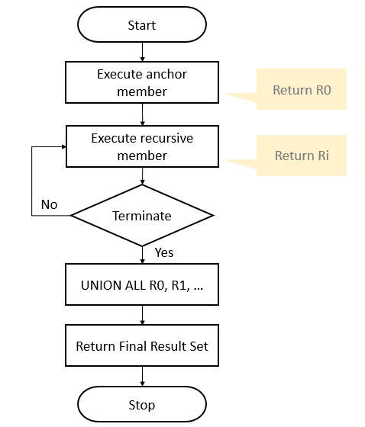
The execution order of a recursive CTE is as follows:
First, execute the anchor member to form the base result set (R0), use this result for the next iteration.
Second, execute the recursive member with the input result set from the previous iteration (Ri-1) and return a sub-result set (Ri) until the termination condition is met.
Third, combine all result sets R0, R1, … Rn using UNION ALL operator to produce the final result set.
The following flowchart illustrates the execution of a recursive CTE:

Slide 36
WITH cte_numbers(n, weekday)
AS (
SELECT
0,
DATENAME(DW, 0)
UNION ALL
SELECT
n + 1,
DATENAME(DW, n + 1)
FROM
cte_numbers
WHERE n < 6
)
SELECT
weekday
FROM
cte_numbers;
WITH cte_org AS (
SELECT
staff_id,
first_name,
manager_id
FROM
sales.staffs
WHERE manager_id IS NULL
UNION ALL
SELECT
e.staff_id,
e.first_name,
e.manager_id
FROM
sales.staffs e
INNER JOIN cte_org o
ON o.staff_id = e.manager_id
)
SELECT * FROM cte_org;

Slide 37
PIVOT operator
SELECT
category_name,
product_id
FROM
production.products p
INNER JOIN production.categories c
ON c.category_id = p.category_id
SQL Server PIVOT operator rotates a table-valued expression. It turns the unique values in one column into multiple columns in the output and performs aggregations on any remaining column values.
You follow these steps to make a query a pivot table:
First, select a base dataset for pivoting.
Second, create a temporary result by using a derived table or common table expression (CTE)
Third, apply the PIVOT operator.
Let’s apply these steps in the following example.
First, select category name and product id from the production.products and production.categories tables as the base data for pivoting:
SELECT * FROM (
SELECT
category_name,
product_id
FROM
production.products p
INNER JOIN production.categories c
ON c.category_id = p.category_id
) t

Slide 38
SELECT * FROM
(
SELECT
category_name,
product_id
FROM
production.products p
INNER JOIN production.categories c
ON c.category_id = p.category_id
) t
PIVOT(
COUNT(product_id)
FOR category_name IN (
[Children Bicycles],
[Comfort Bicycles],
[Cruisers Bicycles],
[Cyclocross Bicycles],
[Electric Bikes],
[Mountain Bikes],
[Road Bikes])
) AS pivot_table;

Slide 39
SQL Server Views
When you use the SELECT statement to query data from one or more tables, you get a result set.
For example, the following statement returns the product name, brand, and list price of all products from the products and brands tables:
SELECT
product_name,
brand_name,
list_price
FROM
production.products p
INNER JOIN production.brands b
ON b.brand_id = p.brand_id;

Slide 40
Next time, if you want to get the same result set, you can save this query into a text file, open it, and execute it again.
SQL Server provides a better way to save this query in the database catalog through a view.
A view is a named query stored in the database catalog that allows you to refer to it later.
So the query above can be stored as a view using the CREATE VIEW statement as follows:
SELECT
*
FROM (
SELECT
product_name,
brand_name,
list_price
FROM
production.products p
INNER JOIN production.brands b
ON b.brand_id = p.brand_id;
);
SELECT * FROM sales.product_info;

Slide 41
When receiving this query, SQL Server executes the following query:
SELECT
*
FROM (
SELECT
product_name,
brand_name,
list_price
FROM
production.products p
INNER JOIN production.brands b
ON b.brand_id = p.brand_id;
);

Slide 42
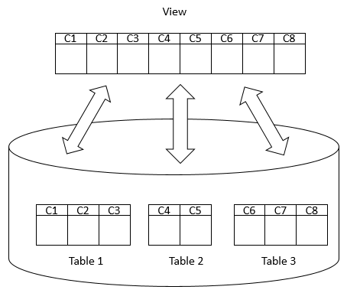
By definition, views do not store data except for indexed views.
A view may consist of columns from multiple tables using joins or just a subset of columns of a single table. This makes views useful for abstracting or hiding complex queries.
The following picture illustrates a view that includes columns from multiple tables:

Slide 43
CREATE VIEW [OR ALTER] schema_name.view_name [(column_list)]
AS
select_statement;
DROP VIEW [IF EXISTS] schema_name.view_name;
DROP VIEW [IF EXISTS]
schema_name.view_name1,
schema_name.view_name2,
...;
CREATE VIEW sales.daily_sales
AS
SELECT
year(order_date) AS y,
month(order_date) AS m,
day(order_date) AS d,
p.product_id,
product_name,
quantity * i.list_price AS sales
FROM
sales.orders AS o
INNER JOIN sales.order_items AS i
ON o.order_id = i.order_id
INNER JOIN production.products AS p
ON p.product_id = i.product_id;
DROP VIEW IF EXISTS sales.daily_sales;
SELECT
OBJECT_SCHEMA_NAME(v.object_id) schema_name,
v.name
FROM
sys.views as v;

Slide 44
Creating an SQL Server indexed view example
CREATE VIEW product_master
WITH SCHEMABINDING
AS
SELECT
product_id,
product_name,
model_year,
list_price,
brand_name,
category_name
FROM
production.products p
INNER JOIN production.brands b
ON b.brand_id = p.brand_id
INNER JOIN production.categories c
ON c.category_id = p.category_id;

Slide 45
Table 'Worktable'. Scan count 0, logical reads 0, physical reads 0, read-ahead reads 0, lob logical reads 0, lob physical reads 0, lob read-ahead reads 0.
Table 'Workfile'. Scan count 0, logical reads 0, physical reads 0, read-ahead reads 0, lob logical reads 0, lob physical reads 0, lob read-ahead reads 0.
Table 'products'. Scan count 1, logical reads 5, physical reads 1, read-ahead reads 3, lob logical reads 0, lob physical reads 0, lob read-ahead reads 0.
Table 'categories'. Scan count 1, logical reads 2, physical reads 1, read-ahead reads 0, lob logical reads 0, lob physical reads 0, lob read-ahead reads 0.
Table 'brands'. Scan count 1, logical reads 2, physical reads 1, read-ahead reads 0, lob logical reads 0, lob physical reads 0, lob read-ahead reads 0.
SET STATISTICS IO ON
GO
SELECT
*
FROM
production.product_master
ORDER BY
product_name;
GO

Slide 46
CREATE UNIQUE CLUSTERED INDEX
ucidx_product_id
ON production.product_master(product_id);
CREATE NONCLUSTERED INDEX
ucidx_product_name
ON production.product_master(product_name);
Table 'Worktable'. Scan count 0, logical reads 0, physical reads 0, read-ahead reads 0, lob logical reads 0, lob physical reads 0, lob read-ahead reads 0.
Table 'product_master'. Scan count 1, logical reads 6, physical reads 1, read-ahead reads 11, lob logical reads 0, lob physical reads 0, lob read-ahead reads 0.
Note that this feature is only available on SQL Server Enterprise Edition. If you use the SQL Server Standard or Developer Edition, you must use the WITH (NOEXPAND) table hint directly in the FROM clause of the query which you wanNote that this feature is only available on SQL Server Enterprise Edition. If you use the SQL Server Standard or Developer Edition, you must use the WITH (NOEXPAND) table hint directly in the FROM clause of the query which you want to use the view like the following query:t to use the view like the following query:
SELECT *
FROM production.product_master
WITH (NOEXPAND)
ORDER BY product_name;

Slide 47
Indexes are special data structures associated with tables or views that help speed up the query. SQL Server provides two types of indexes: clustered index and non-clustered index.
Clustered indexes
Non clustered indexes
CREATE CLUSTERED INDEX index_name
ON schema_name.table_name (column_list);
CREATE [NONCLUSTERED] INDEX index_name
ON table_name(column_list);

Slide 48
Stored Procedures
SQL Server stored procedures are used to group one or more Transact-SQL statements into logical units. The stored procedure is stored as a named object in the SQL Server Database Server.
When you call a stored procedure for the first time, SQL Server creates an execution plan and stores it in the cache. In the subsequent executions of the stored procedure, SQL Server reuses the plan to execute the stored procedure very fast with reliable performance.
CREATE PROCEDURE uspProductList
AS
BEGIN
SELECT
product_name,
list_price
FROM
production.products
ORDER BY
product_name;
END;
EXECUTE sp_name;

Slide 49
ALTER PROCEDURE uspProductList
AS
BEGIN
SELECT
product_name,
list_price
FROM
production.products
ORDER BY
list_price
END;
DROP PROCEDURE sp_name;

Slide 50
Creating a stored procedure with one parameter
CREATE PROCEDURE uspFindProducts
AS
BEGIN
SELECT
product_name,
list_price
FROM
production.products
ORDER BY
list_price;
END;
ALTER PROCEDURE uspFindProducts(@min_list_price AS DECIMAL)
AS
BEGIN
SELECT
product_name,
list_price
FROM
production.products
WHERE
list_price >= @min_list_price
ORDER BY
list_price;
END;
EXEC uspFindProducts 100;

Slide 51
Creating a stored procedure with multiple parameters
ALTER PROCEDURE uspFindProducts(
@min_list_price AS DECIMAL
,@max_list_price AS DECIMAL
)
AS
BEGIN
SELECT
product_name,
list_price
FROM
production.products
WHERE
list_price >= @min_list_price AND
list_price <= @max_list_price
ORDER BY
list_price;
END;
EXECUTE uspFindProducts 900, 1000;
EXECUTE uspFindProducts
@min_list_price = 900,
@max_list_price = 1000;

Slide 52
Creating text parameters
EXECUTE uspFindProducts
@min_list_price = 900,
@max_list_price = 1000,
@name = 'Trek';
ALTER PROCEDURE uspFindProducts(
@min_list_price AS DECIMAL
,@max_list_price AS DECIMAL
,@name AS VARCHAR(max)
)
AS
BEGIN
SELECT
product_name,
list_price
FROM
production.products
WHERE
list_price >= @min_list_price AND
list_price <= @max_list_price AND
product_name LIKE '%' + @name + '%'
ORDER BY
list_price;
END;

Slide 53
Creating optional parameters
ALTER PROCEDURE uspFindProducts(
@min_list_price AS DECIMAL = 0
,@max_list_price AS DECIMAL = 999999
,@name AS VARCHAR(max)
)
AS
BEGIN
SELECT
product_name,
list_price
FROM
production.products
WHERE
list_price >= @min_list_price AND
list_price <= @max_list_price AND
product_name LIKE '%' + @name + '%'
ORDER BY
list_price;
END;
EXECUTE uspFindProducts
@name = 'Trek';
EXECUTE uspFindProducts
@min_list_price = 6000,
@name = 'Trek';

Slide 54
Using NULL as the default value
EXECUTE uspFindProducts
@min_list_price = 500,
@name = 'Haro';
ALTER PROCEDURE uspFindProducts(
@min_list_price AS DECIMAL = 0
,@max_list_price AS DECIMAL = NULL
,@name AS VARCHAR(max)
)
AS
BEGIN
SELECT
product_name,
list_price
FROM
production.products
WHERE
list_price >= @min_list_price AND
(@max_list_price IS NULL OR list_price <= @max_list_price) AND
product_name LIKE '%' + @name + '%'
ORDER BY
list_price;
END;

Slide 55
DECLARE @model_year SMALLINT;
What is a variable
A variable is an object that holds a single value of a specific type e.g., integer, date, or varying character string.
We typically use variables in the following cases:
As a loop counter to count the number of times a loop is performed.
To hold a value to be tested by a control-of-flow statement such as WHILE.
To store the value returned by a stored procedure or a function
Declaring a variable
To declare a variable, you use the DECLARE statement. For example, the following statement declares a variable named @model_year:
DECLARE @model_year AS SMALLINT;
DECLARE @model_year SMALLINT,
@product_name VARCHAR(MAX);
SET @model_year = 2018;
SELECT
product_name,
model_year,
list_price
FROM
production.products
WHERE
model_year = @model_year
ORDER BY
product_name;

Slide 56
Storing query result in a variable
DECLARE
@product_name VARCHAR(MAX),
@list_price DECIMAL(10,2);
DECLARE @product_count INT;
SELECT
@product_name = product_name,
@list_price = list_price
FROM
production.products
WHERE
product_id = 100;
SET @product_count = (
SELECT
COUNT(*)
FROM
production.products
);
SELECT @product_count;
SELECT
@product_name AS product_name,
@list_price AS list_price;
PRINT @product_count;
PRINT 'The number of products is ' + CAST(@product_count AS VARCHAR(MAX));

Slide 57
Accumulating values into a variable
CREATE PROC uspGetProductList(
@model_year SMALLINT
) AS
BEGIN
DECLARE @product_list VARCHAR(MAX);
SET @product_list = '';
SELECT
@product_list = @product_list + product_name
+ CHAR(10)
FROM
production.products
WHERE
model_year = @model_year
ORDER BY
product_name;
PRINT @product_list;
END;

Slide 58
The IF statement
BEGIN
DECLARE @sales INT;
SELECT
@sales = SUM(list_price * quantity)
FROM
sales.order_items i
INNER JOIN sales.orders o ON o.order_id = i.order_id
WHERE
YEAR(order_date) = 2018;
SELECT @sales;
IF @sales > 1000000
BEGIN
PRINT 'Great! The sales amount in 2018 is greater than 1,000,000';
END
END
IF boolean_expression
BEGIN
{ statement_block }
END
IF Boolean_expression
BEGIN
-- Statement block executes when the Boolean expression is TRUE
END
ELSE
BEGIN
-- Statement block executes when the Boolean expression is FALSE
END

Slide 59
BEGIN
DECLARE @sales INT;
SELECT
@sales = SUM(list_price * quantity)
FROM
sales.order_items i
INNER JOIN sales.orders o ON o.order_id = i.order_id
WHERE
YEAR(order_date) = 2017;
SELECT @sales;
IF @sales > 10000000
BEGIN
PRINT 'Great! The sales amount in 2018 is greater than 10,000,000';
END
ELSE
BEGIN
PRINT 'Sales amount in 2017 did not reach 10,000,000';
END
END
BEGIN
DECLARE @x INT = 10,
@y INT = 20;
IF (@x > 0)
BEGIN
IF (@x < @y)
PRINT 'x > 0 and x < y';
ELSE
PRINT 'x > 0 and x >= y';
END
END

Slide 60
Overview of WHILE statement
WHILE Boolean_expression
{ sql_statement | statement_block}
DECLARE @counter INT = 1;
WHILE @counter <= 5
BEGIN
PRINT @counter;
SET @counter = @counter + 1;
END

Slide 61
SQL Server BREAK statement overview
DECLARE @counter INT = 0;
WHILE @counter <= 5
BEGIN
SET @counter = @counter + 1;
IF @counter = 4
BREAK;
PRINT @counter;
END
WHILE Boolean_expression
BEGIN
-- statements
IF condition
BREAK;
-- other statements
END
WHILE Boolean_expression1
BEGIN
-- statement
WHILE Boolean_expression2
BEGIN
IF condition
BREAK;
END
END

Slide 62
Introduction to the SQL Server CONTINUE statement
WHILE Boolean_expression
BEGIN
-- code to be executed
IF condition
CONTINUE;
-- code will be skipped if the condition is met
END
DECLARE @counter INT = 0;
WHILE @counter < 5
BEGIN
SET @counter = @counter + 1;
IF @counter = 3
CONTINUE;
PRINT @counter;
END

Slide 63
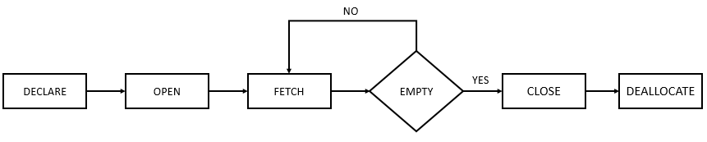
What is a database cursor
A database cursor is an object that enables traversal over the rows of a result set. It allows you to process individual row returned by a query.
SQL Server cursor life cycle
These are steps for using a cursor:

Slide 64
DECLARE cursor_name CURSOR
FOR select_statement;
SQL Server provides the @@FETCHSTATUS function that returns the status of the last cursor FETCH statement executed against the cursor; If @@FETCHSTATUS returns 0, meaning the FETCH statement was successful. You can use the WHILE statement to fetch all rows from the cursor as shown in the following code:
OPEN cursor_name;
FETCH NEXT FROM cursor INTO variable_list;
WHILE @@FETCH_STATUS = 0
BEGIN
FETCH NEXT FROM cursor_name;
END;
CLOSE cursor_name;
DEALLOCATE cursor_name;

Slide 65
DECLARE
@product_name VARCHAR(MAX),
@list_price DECIMAL;
DECLARE cursor_product CURSOR
FOR SELECT
product_name,
list_price
FROM
production.products;
FETCH NEXT FROM cursor_product INTO
@product_name,
@list_price;
WHILE @@FETCH_STATUS = 0
BEGIN
PRINT @product_name + CAST(@list_price AS varchar);
FETCH NEXT FROM cursor_product INTO
@product_name,
@list_price;
END;
OPEN cursor_product;
CLOSE cursor_product;
DEALLOCATE cursor_product;

Slide 66
SQL Server TRY CATCH overview
BEGIN TRY
--- statements that may cause exceptions
END TRY
BEGIN CATCH
-- statements to handle exception
BEGIN TRY
--- nested TRY block
END TRY
BEGIN CATCH
--- nested CATCH block
END CATCH
END CATCH
BEGIN TRY
-- statements that may cause exceptions
END TRY
BEGIN TRY
-- statements that may cause exceptions
END TRY
BEGIN CATCH
-- statements that handle exception
END CATCH

Slide 67
CREATE PROC usp_divide(
@a decimal,
@b decimal,
@c decimal output
) AS
BEGIN
BEGIN TRY
SET @c = @a / @b;
END TRY
BEGIN CATCH
SELECT
ERROR_NUMBER() AS ErrorNumber
,ERROR_SEVERITY() AS ErrorSeverity
,ERROR_STATE() AS ErrorState
,ERROR_PROCEDURE() AS ErrorProcedure
,ERROR_LINE() AS ErrorLine
,ERROR_MESSAGE() AS ErrorMessage;
END CATCH
END;
GO
DECLARE @r decimal;
EXEC usp_divide 10, 2, @r output;
PRINT @r;
DECLARE @r2 decimal;
EXEC usp_divide 10, 0, @r2 output;
PRINT @r2;

Slide 68
Introduction to Dynamic SQL
CREATE PROC usp_query (
@table NVARCHAR(128)
)
AS
BEGIN
DECLARE @sql NVARCHAR(MAX);
-- construct SQL
SET @sql = N'SELECT * FROM ' + @table;
-- execute the SQL
EXEC sp_executesql @sql;
END;
DECLARE
@table NVARCHAR(128),
@sql NVARCHAR(MAX);
SET @table = N'production.products';
SET @sql = N'SELECT * FROM ' + @table;
EXEC sp_executesql @sql;

Slide 69
CREATE OR ALTER PROC usp_query_topn(
@table NVARCHAR(128),
@topN INT,
@byColumn NVARCHAR(128)
)
AS
BEGIN
DECLARE
@sql NVARCHAR(MAX),
@topNStr NVARCHAR(MAX);
SET @topNStr = CAST(@topN as nvarchar(max));
-- construct SQL
SET @sql = N'SELECT TOP ' + @topNStr +
' * FROM ' + @table +
' ORDER BY ' + @byColumn + ' DESC';
-- execute the SQL
EXEC sp_executesql @sql;
END;
EXEC usp_query_topn
'production.products',
10,
'list_price';

Slide 70
SQL Server User-defined Functions
What are table variables
Table variables are kinds of variables that allow you to hold rows of data, which are similar to temporary tables.
INSERT INTO @product_table
SELECT
product_name,
brand_id,
list_price
FROM
production.products
WHERE
category_id = 1;
DECLARE @table_variable_name TABLE (
column_list
);
DECLARE @product_table TABLE (
product_name VARCHAR(MAX) NOT NULL,
brand_id INT NOT NULL,
list_price DEC(11,2) NOT NULL
);
SELECT
*
FROM
@product_table;

Slide 71
What are scalar functions
SQL Server scalar function takes one or more parameters and returns a single value.
The scalar functions help you simplify your code. For example, you may have a complex calculation that appears in many queries. Instead of including the formula in every query, you can create a scalar function that encapsulates the formula and uses it in each query.
Creating a scalar function
To create a scalar function, you use the CREATE FUNCTION statement as follows:
CREATE FUNCTION [schema_name.]function_name (parameter_list)
RETURNS data_type AS
BEGIN
statements
RETURN value
END

Slide 72
CREATE FUNCTION sales.udfNetSale(
@quantity INT,
@list_price DEC(10,2),
@discount DEC(4,2)
)
RETURNS DEC(10,2)
AS
BEGIN
RETURN @quantity * @list_price * (1 - @discount);
END;
SELECT
sales.udfNetSale(10,100,0.1) net_sale;

Slide 73
What is a table-valued function in SQL Server
A table-valued function is a user-defined function that returns data of a table type. The return type of a table-valued function is a table, therefore, you can use the table-valued function just like you would use a table.
Creating a table-valued function
The following statement example creates a table-valued function that returns a list of products including product name, model year and the list price for a specific model year:
CREATE FUNCTION udfProductInYear (
@model_year INT
)
RETURNS TABLE
AS
RETURN
SELECT
product_name,
model_year,
list_price
FROM
production.products
WHERE
model_year = @model_year;
SELECT
*
FROM
udfProductInYear(2017);

Slide 74
Multi-statement table-valued functions (MSTVF)
INSERT INTO @contacts
SELECT
first_name,
last_name,
email,
phone,
'Customer'
FROM
sales.customers;
RETURN;
END;
CREATE FUNCTION udfContacts()
RETURNS @contacts TABLE (
first_name VARCHAR(50),
last_name VARCHAR(50),
email VARCHAR(255),
phone VARCHAR(25),
contact_type VARCHAR(20)
)
AS
BEGIN
INSERT INTO @contacts
SELECT
first_name,
last_name,
email,
phone,
'Staff'
FROM
sales.staffs;
SELECT
*
FROM
udfContacts();

Slide 75
SQL Server Triggers
SQL Server triggers are special stored procedures that are executed automatically in response to the database object, database, and server events. SQL Server provides three type of triggers:
Data manipulation language (DML) triggers which are invoked automatically in response to INSERT, UPDATE, and DELETE events against tables.
Data definition language (DDL) triggers which fire in response to CREATE, ALTER, and DROP statements. DDL triggers also fire in response to some system stored procedures that perform DDL-like operations.
Logon triggers which fire in response to LOGON events

Slide 76
CREATE TRIGGER [schema_name.]trigger_name
ON table_name
AFTER {[INSERT],[UPDATE],[DELETE]}
[NOT FOR REPLICATION]
AS
{sql_statements}
The schema_name is the name of the schema to which the new trigger belongs. The schema name is optional.
The trigger_name is the user-defined name for the new trigger.
The table_name is the table to which the trigger applies.
The event is listed in the AFTER clause. The event could be INSERT, UPDATE, or DELETE. A single trigger can fire in response to one or more actions against the table.
The NOT FOR REPLICATION option instructs SQL Server not to fire the trigger when data modification is made as part of a replication process.
The sql_statements is one or more Transact-SQL used to carry out actions once an event occurs.

Slide 77
DML event | INSERTED table holds | DELETED table holds
INSERT | rows to be inserted | empty
UPDATE | new rows modified by the update | existing rows modified by the update
DELETE | empty | rows to be deleted
CREATE TABLE production.product_audits(
change_id INT IDENTITY PRIMARY KEY,
product_id INT NOT NULL,
product_name VARCHAR(255) NOT NULL,
brand_id INT NOT NULL,
category_id INT NOT NULL,
model_year SMALLINT NOT NULL,
list_price DEC(10,2) NOT NULL,
updated_at DATETIME NOT NULL,
operation CHAR(3) NOT NULL,
CHECK(operation = 'INS' or operation='DEL')
);

Slide 78
CREATE TRIGGER production.trg_product_audit
ON production.products
AFTER INSERT, DELETE
AS
BEGIN
SET NOCOUNT ON;
INSERT INTO production.product_audits(
product_id,
product_name,
brand_id,
category_id,
model_year,
list_price,
updated_at,
operation
)
SELECT
i.product_id,
product_name,
brand_id,
category_id,
model_year,
i.list_price,
GETDATE(),
'INS'
FROM
inserted i
UNION ALL
SELECT
d.product_id,
product_name,
brand_id,
category_id,
model_year,
d.list_price,
GETDATE(),
'DEL'
FROM
deleted d;
END

Slide 79
Testing the trigger
INSERT INTO production.products(
product_name,
brand_id,
category_id,
model_year,
list_price
)
VALUES (
'Test product',
1,
1,
2018,
599
);
SELECT
*
FROM
production.product_audits;

