Slide 1
全局ID生成
黄进兵

Slide 2
MySQL/Redis auto increment
MySQL/Redis
Web App
1,2,3,4…
Notes:
Numeric IDs
Go up with time
Not resilient

Slide 3
MySQL multi-master replication
DC 1
MySQL
1,3,5,7…
Web App
MySQL
2,4,6,8…
Notes:
Numeric IDs
Do not go up with time
Some resilience

Slide 4
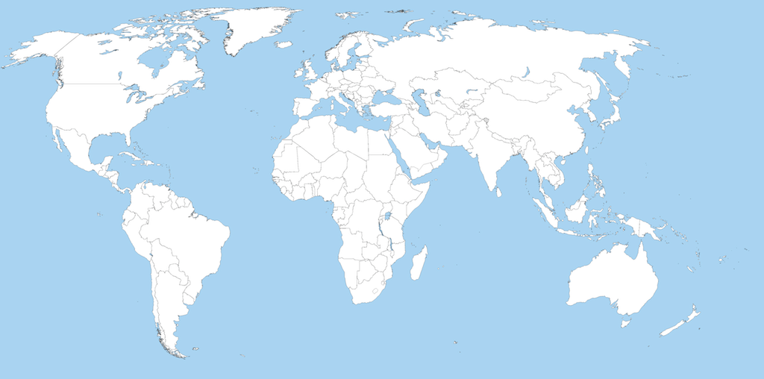
DC 1
DC 2
DC 4
DC 5
DC 6
DC 3
Going global…

Slide 5
MySQL in multi DC setup
DC 1
MySQL
Web App
1,2,3…
WAN LINK
DC 2
?
Web App

Slide 6

Flickr MySQL ticket server
DC 1
Ticket Server
Web App
1,3,5…
WAN link not required to generate an ID
WAN LINK
DC 2
Ticket Server
Web App
4,6,8…
Notes:
Numeric IDs
Do not go up with time
Resilient and distributed
ID generation separated from data store

Slide 7
The anatomy of a ticket server
DC
Web App
Web App
Web App
Web App
Ticket Server

Slide 8
Making things simpler
DC
Web App
Web App
Web App
Web App
ID gen
ID gen
ID gen
ID gen

Slide 9
UUID
128 bits
Could use type 4 (Random) or type 1 (MAC address with time component)
Can generate on each machine with no co-ordination

Slide 10
Type 4 – random
version
xxxxxxxx-xxxx-4xxx-yxxx-xxxxxxxxxxxx
f47ac10b-58cc-4372-a567-0e02b2c3d479
variant (8, 9, A or B)

Slide 11
5.3 x 10³⁶
possible values for a type 4 UUID

Slide 12
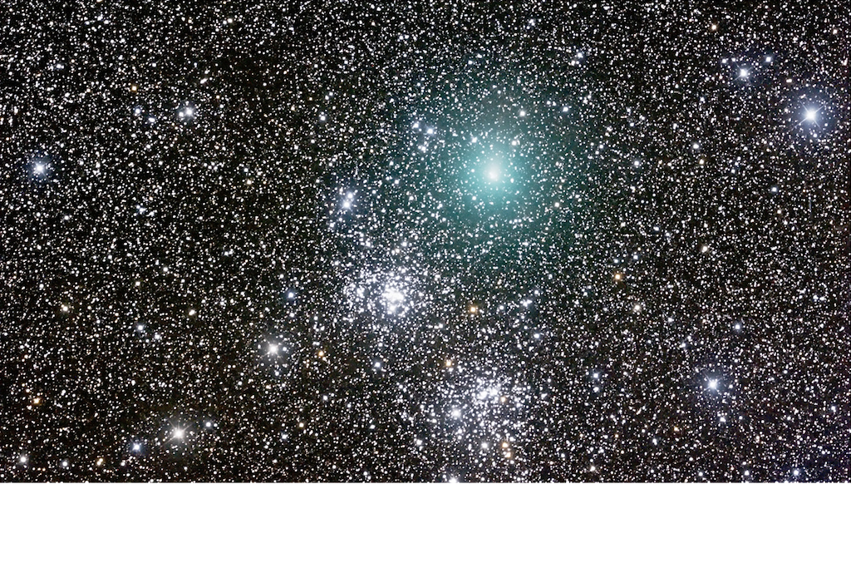
1.1 x 10¹⁹
UUIDs we could generate per second since the Universe began

Slide 13
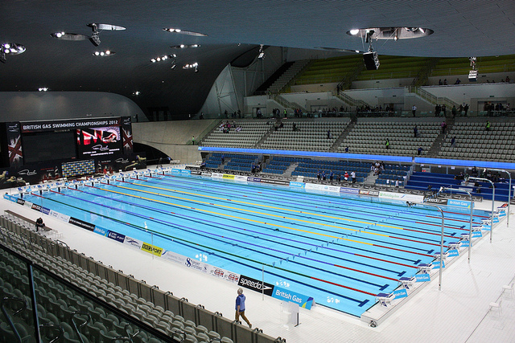
2.1 x 10²⁷
Olympic swimming pools filled if each possible value contributed a millilitre

Slide 14
Type 1 – MAC address
51063800-dc76-11e1-9fae-001c42000009
Time component is based on 100 nanosecond intervals since October 15, 1582
Most significant bits of timestamp shifted to least significant bits of UUID

Slide 15
Type 1 – MAC address
The address (MAC) of the computer that generated the ID is encoded into it
Lexical ordering essentially meaningless
Deterministically unique

Slide 16
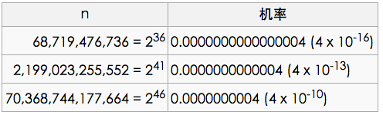
随机UUID的重复机率
http://zh.wikipedia.org/wiki/UUID
已知一个人每年被陨石击中的机率估计为170亿分之1(6 x 10⁻¹¹)，那么重复几率比这个大10倍。

Slide 17
There are some other options…

Slide 18
Under 64 bits
（64比特以下）
No co-ordination needed
（非协作的）
Deterministically unique
（确定唯一）
k-sorted (time-ordered lexically)
Notes:
http://blog.yxwang.me/2012/08/twitter-snowflake/
如果序列 A 要满足 k-sorted，当且仅当对于任意的 p, q，如果 1 <= p <= q - k (1 <= p <= q <= n)，则有 A[p] <= A[q]。换句话说，如果元素 p 排在 q 前面，且相差至少 k 个位置，那么 p 必然小于或等于 q。如果 tweet 序列满足这个条件，要获取第 r 条 tweet 之后的消息，只要从第 r - k 条开始查找即可。

Slide 19
Twitter Snowflake
Under 64 bits
No co-ordination (after startup)
K-ordered
Scala service, Thrift interface, uses Zookeeper for configuration

Slide 20
Twitter Snowflake
41 bits Timestamp millisecond precision, bespoke epoch
10 bits Configured machine ID
12 bits Sequence number

Slide 21
Twitter Snowflake
77669839702851584
= (timestamp << 22) | (machine << 12) | sequence

Slide 22
Boundary Flake
128 bits
No co-ordination at all
K-ordered
Erlang service

Slide 23
Boundary Flake
64 bits Timestamp millisecond precision, 1970 epoch
48 bits MAC address
16 bits Sequence number

Slide 24
PHP Cruftflake
Based on Twitter Snowflake
No co-ordination (after startup)
K-ordered
PHP, ZeroMQ interface, uses Zookeeper for configuration

Slide 25
References
Flickr distributed ticket server http://code.flickr.com/blog/2010/02/08/ticket-servers-distributed-unique-primary-keys-on-the-cheap/
UUIDs http://tools.ietf.org/html/rfc4122
How random are random UUIDs? http://stackoverflow.com/a/2514722/15318
Twitter Snowflake https://github.com/twitter/snowflake
http://blog.yxwang.me/2012/08/twitter-snowflake/
Boundary Flake https://github.com/boundary/flake
PHP Cruftflake https://github.com/davegardnerisme/cruftflake
Twitter的分布式自增ID算法Snowflake实现分析及其Java、Php和Python版http://www.dengchuanhua.com/132.html

Slide 26
My Opinion
42比特 毫秒数 最多4398046511103毫秒 约139.27年
10比特 任务号 最多1024个任务
11比特 序列号 每毫秒最多2048个，每新毫秒开始置零
共63位 最大值9223372036854775807，共19位
最大混合大写可识别字母X1ZF8G0R04MZB，共13位
Notes:
一天最大毫秒86400000，最大占用27比特
27+10+11=48位 最大值281474976710655(15字)，YK0XXHZ827(10字)
6位(YYMMDD)+15位，共21位
符合:
1) 64比特以下;
2) 必然全局唯一;
3) 不需要彼此协调;
4) K-SORTED.
首次启动，从服务器生成唯一任务ID，写入本地任务ID锁文件。
后续启动，先从锁文件找可用任务ID，找不到时当成首次访问。

Slide 27
9223372036854775807 这是个什么概念
9223372036854775807
÷ 每秒1亿个
÷ (60秒×60分×24小时)
÷ 365.5天
= 2920.71年

Slide 28
致命点：怎么保证任务号唯一
提供任务号生成服务
get ip=10.142.1.151
sync ip=10.42.1.151 wokers=0001,0101
本地生成任务号文件锁
.idworkers
|____10.142.1.151.lock.0001
|____10.142.1.151.lock.0101

