Slide 1


WanderLog
2025.10.15

Slide 2
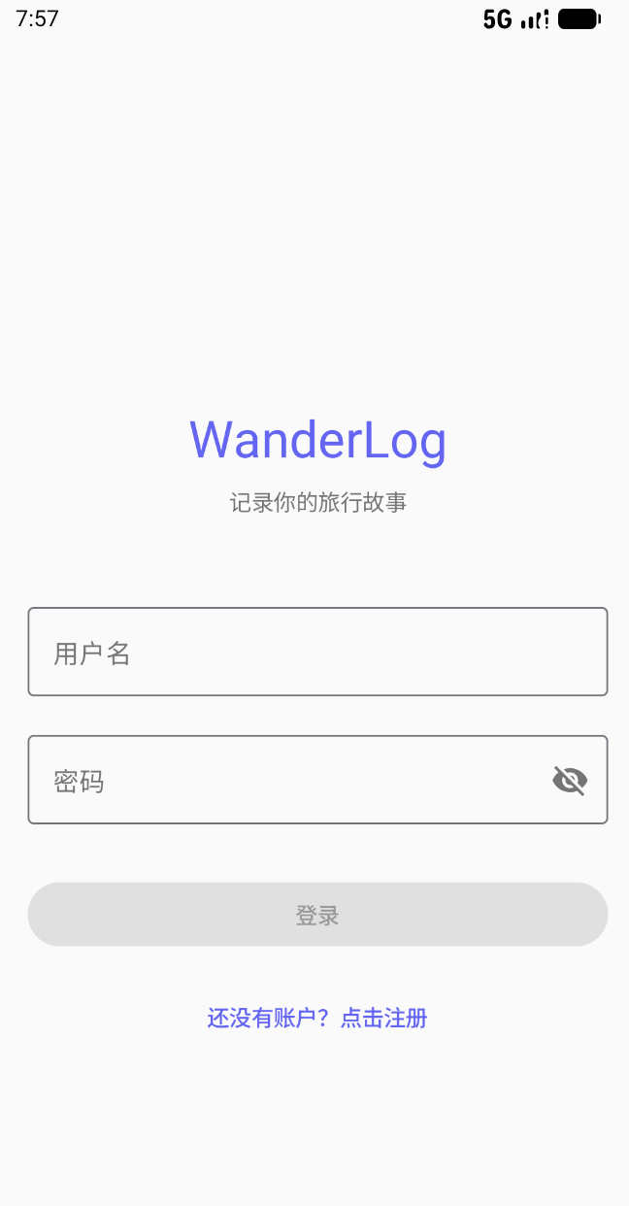

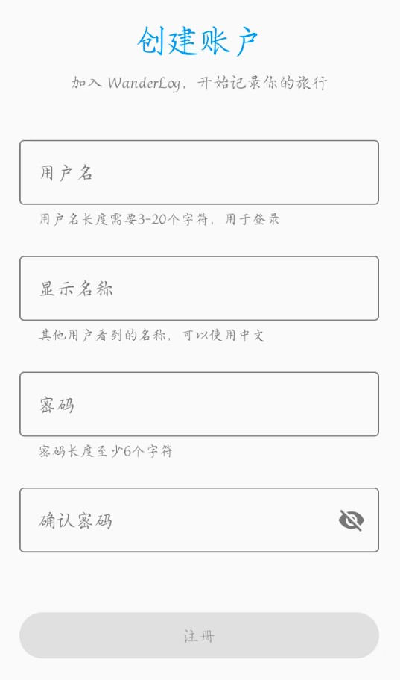

Welcome to WanderLog
Secure Login
Email and phone login for quick and secure access.
Seamless Transition
Direct access to the dashboard to quickly begin documenting travels.

Slide 3
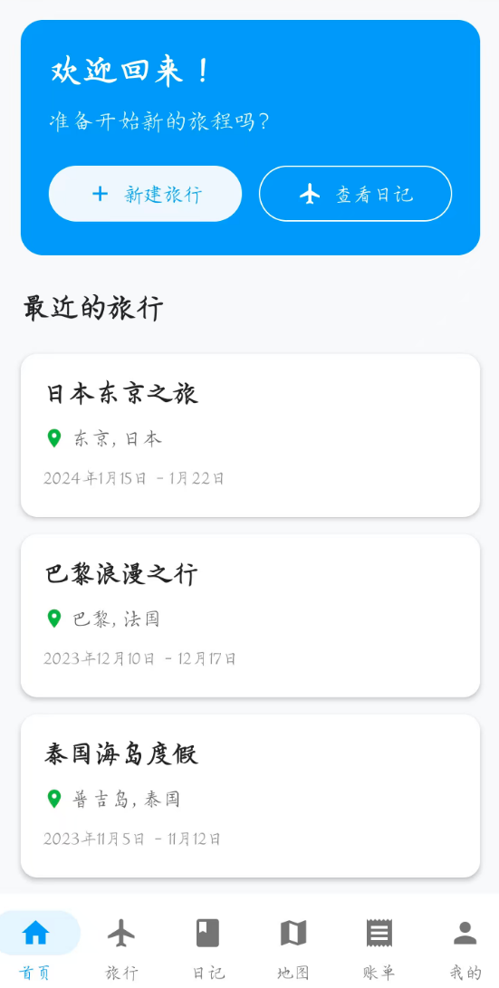
Home Overview
View Past Trips
Scroll through your travel history and revisit memories.
Start New Journey
Tap to quickly create a new trip and start planning.

Slide 4


Home Overview

Slide 5
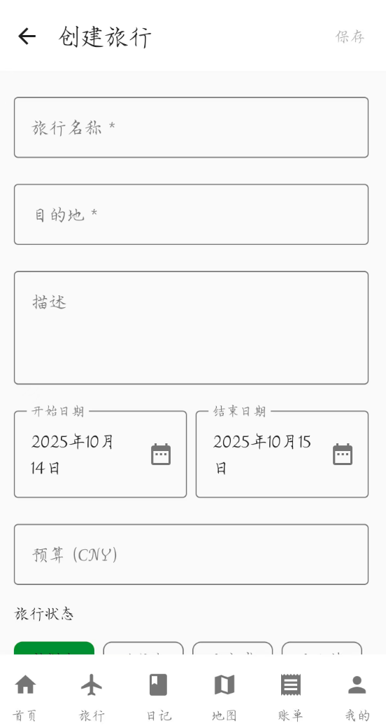
View Trip
Start a New Trip
Destination & Dates: The core information to get started.
Optional Budget: Helps track expenses throughout the trip.

Slide 6
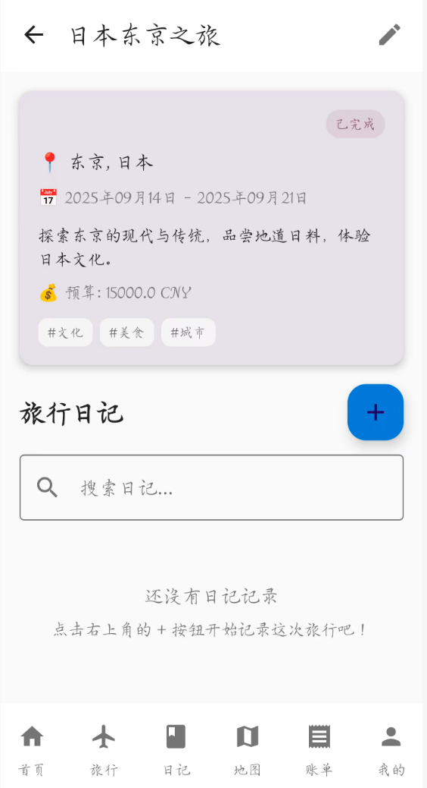
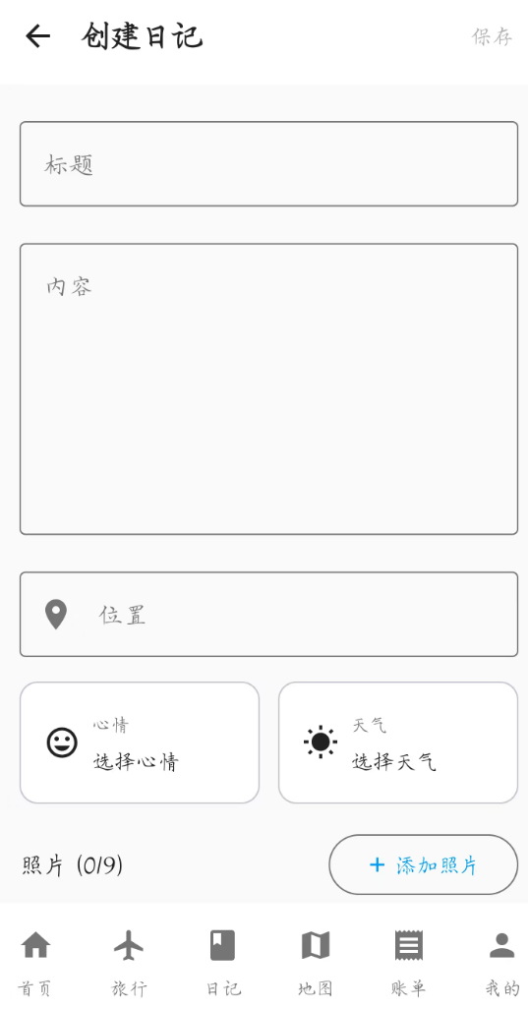
View Diary
Write Travel Diary
Rich Text Editor
Weather Info
Mood Tracking
Location Tags

Slide 7
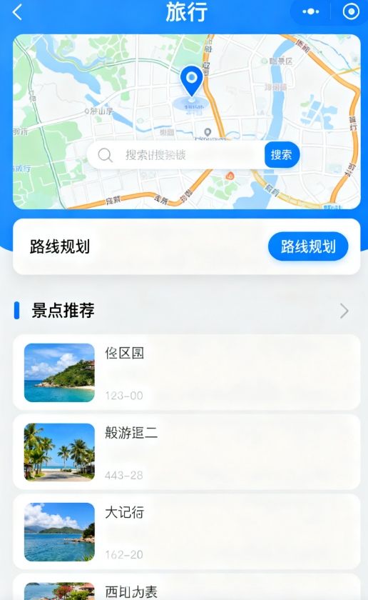
Add Itinerary & Places
Plan Daily Itinerary
Pin Places on Map
Organize activities for each day of your trip, creating a clear schedule.
Use the integrated map to search for locations, plan routes, and pin attractions.

Slide 8
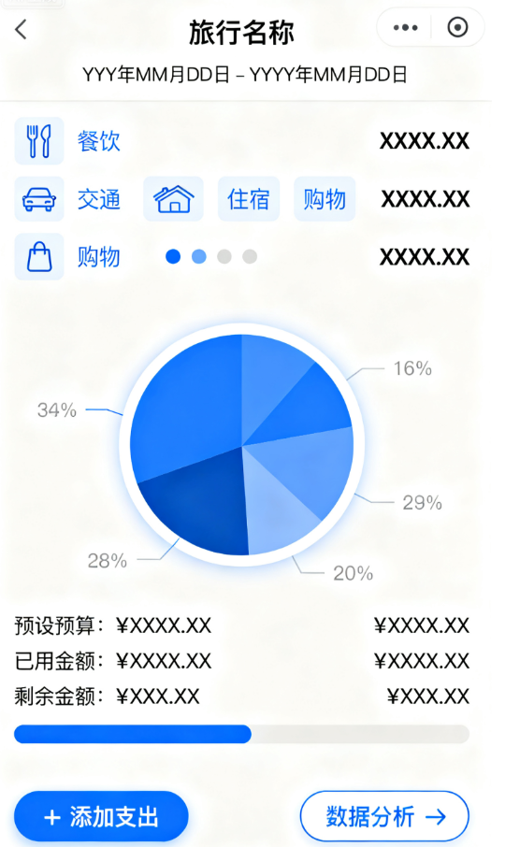
Log Expenses & View Stats
Categorized Tracking: Organize expenses by type (food, transport, etc.).
Visual Summary: Charts and insights show spending patterns at a glance.
Budget Management: Real-time comparison against the preset budget.

Slide 9
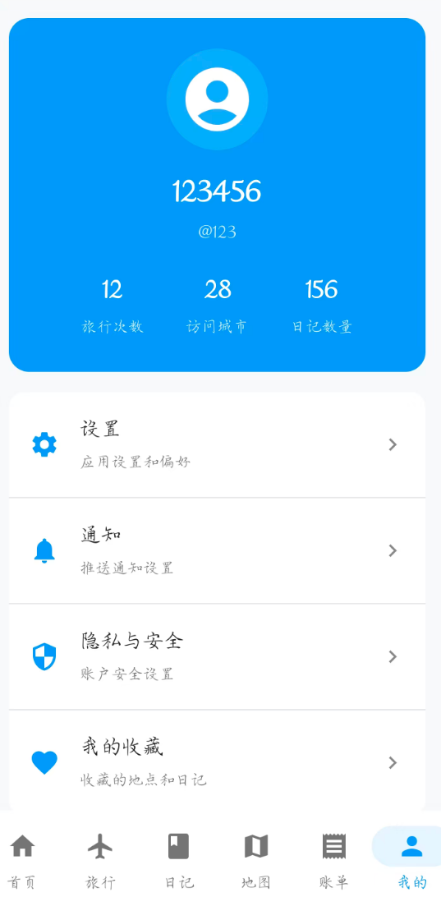
Myself

