Slide 1

Text to encrypt and decrypt tool
Name Roll no.
Utkarsh Singh 2401010099
Aayush 2401010042
Manan Sehgal 2401010043
Group ID - Y1-2024-25-G35

Slide 2

Text to encrypt and decrypt tool
This presentation explores the design,
implementation, and applications of a
Text to Encrypt and Decrypt Tool, a
fundamental component in ensuring data
security, privacy, and integrity in the
digital age.

Slide 3
Objectives and goals
Data Confidentiality
Protecting sensitive information from unauthorized access by converting plaintext into ciphertext (encrypted
text).
Data Integrity
Ensuring that the text has not been altered during transmission or storage.
Authentication
Verifying the authenticity of the sender, ensuring that the message comes from the expected source and is
not a forgery.
Secure Communication
Allowing users to securely communicate over untrusted channels, protecting messages from being
intercepted or accessed by malicious entities during transmission.

Slide 4
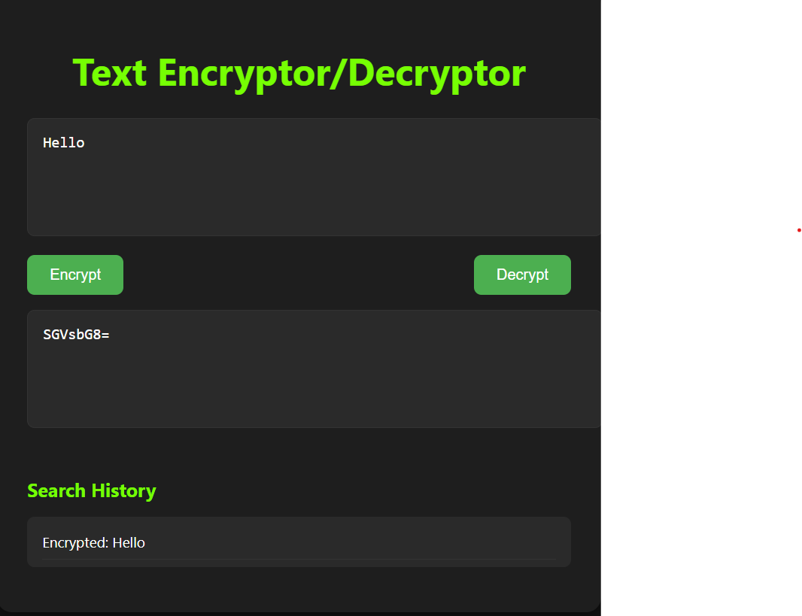

Slide 5
cryptographic algorithms
1 . AES (Advanced Encryption Standard)
Purpose: Symmetric encryption (same key to encrypt and decrypt)
Used for securely encrypting data.
Used in applications like file encryption, secure messaging, etc.
Key points:
Same key is used for both encryption and decryption.
Common key sizes: 128-bit, 192-bit, 256-bit.
2 . RSA (Rivest–Shamir–Adleman)
Purpose: Asymmetric encryption (public key to encrypt, private key to decrypt)
Slower than AES, but allows secure communication without sharing a secret key first.
Sending a message to a server using the server’s public key, so only the server can read it with its private key.
Key points:
Used in SSL/TLS, digital signatures, and secure logins.
3. SHA (Secure Hash Algorithm)
Purpose: Hashing (one-way transformation)
Converts data into a fixed-size string (hash).
Cannot be reversed (not encryption).
Used for verifying data integrity, passwords, etc.
Example Use: Storing a hashed version of a password so even if your database is leaked, the actual passwords remain secure.
Key points:
Common versions: SHA-256, SHA-512

Slide 6
Methodology
1. Choosing an Encryption Algorithm
Select an encryption method (symmetric, asymmetric, or simple ciphers) and choose the appropriate encryption mode.
2. Key Management
Decide whether symmetric or asymmetric encryption will be used, generate keys, and manage their storage and exchange.
3. Encryption Process
Accept plain text input, apply the chosen algorithm and key to encrypt the text, and generate ciphertext.
4. Decryption Process
Accept ciphertext input, apply the chosen algorithm and key to decrypt the text, and generate plaintext.
5. Handling Errors and Validations
Implement error handling mechanisms for incorrect keys, invalid ciphertext, or mismatched encryption/decryption algorithms.
6. Security Considerations
Encrypt keys or store them securely, ensure strong encryption standards are applied, and consider using additional mechanisms like
hashing

Slide 7
Problem Statements
Basic Encryption and Decryption
Design and implement a tool that can encrypt and decrypt text using a symmetric
encryption algorithm, such as the Caesar cipher or Vigenère cipher.
Secure Message Transmission
Create an encryption and decryption tool that allows users to securely transmit
messages using public key encryption (e.g., RSA).
File Encryption and Decryption
Build a tool that encrypts and decrypts text files or documents, providing the user with
the ability to select files, apply encryption with a chosen key, and later decrypt
the files to restore their original content.
User Authentication with Encryption
Develop a tool that encrypts user credentials (username and password) and stores them
securely using a hashing or encryption method (e.g., AES ).

Slide 8
Applications
1. Secure Communication
Protecting sensitive messages in email, instant messaging, and other forms of
communication.
2. Data Protection in File Storage
Encrypting files before storing them on a device, cloud, or external storage.
3. Financial and Payment Systems
Securing online financial transactions and payment details.
4. Secure Password Storage
Safely storing user credentials and passwords in password managers.

Slide 9
Challenges and Limitations
Key Management
Securely storing and managing encryption keys is crucial.
Compromised keys can lead to data breaches, making key
management a significant challenge.
.
Algorithm Evolution
As technology advances, encryption algorithms may become
vulnerable to attacks. Regularly updating and evolving
encryption methods is essential to maintain security.

Slide 10
Conclusion
A Text to Encrypt and Decrypt Tool is a fundamental
component in ensuring data security, privacy, and
integrity in an increasingly digital world. Its ability to
convert sensitive information into unreadable
ciphertext and restore it to its original form using
decryption is crucial across a variety of fields,
including secure communication, data storage,
financial systems, and compliance with regulatory
standards.

Slide 11
Thanks

