Slide 1
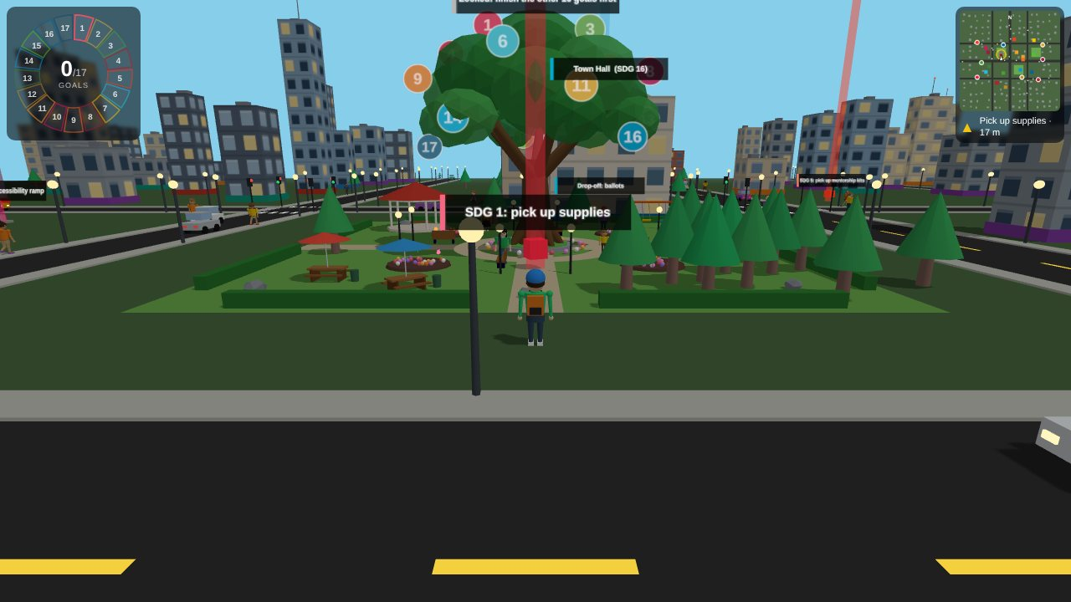
City Helper Adventure
TEAM
ctrl freaks
A 3D city game that teaches the 17 UN Sustainable Development Goals by doing them
Notes:
Hi everyone, we are team ctrl freaks, and this is City Helper Adventure: a 3D city game that teaches the seventeen UN Sustainable Development Goals by letting you actually do them.

Slide 2



The problem and our solution
PROBLEM
SOLUTION
People meet the 17 Sustainable Development Goals as a list of big words, not as things they can do.
City Helper Adventure turns every goal into a task you do.
Deliver
8 goals: carry medicine, food, books and more to real buildings
Posters and reports feel far away
It is hard to see how one person’s action links to a global goal
Nothing shows your progress
Fix
8 goals: repair, build, plant and clean around the city
Unite
Goal 17 unlocks last: all 17 balls on the Global Goals tree glow
Do it, learn a fact, watch your progress light up. A yellow arrow and a minimap always point to the next task.
Notes:
Here is the problem. Most people meet the Sustainable Development Goals as a list of big words on a poster: Zero Hunger, Climate Action, Clean Water. It is hard to see what one ordinary person can do about them, and nothing shows you any progress. Our solution is to turn each goal into a task. You run around a city and either deliver things, like medicine to a hospital or books to a school, or fix things, like repairing a water pump or planting a tree. Eight goals are deliveries, eight are fixes, and goal seventeen, Partnerships, unlocks only when you have done the other sixteen. Each time you finish a task you get a short fact about that goal, and you see your progress light up.

Slide 3
17 goals, 17 tasks
1
No Poverty
2
Zero Hunger
3
Good Health
4
Quality Education
5
Gender Equality
6
Clean Water
Deliver supplies
Deliver food
Deliver medicine
Deliver books
Deliver mentorship kits
Repair the water pump
7
Clean Energy
8
Decent Work
9
Industry & Innovation
10
Reduced Inequalities
11
Sustainable Cities
12
Responsible Consumption
Install a solar panel
Deliver work tools
Fix the cracked footpath
Build an accessibility ramp
Clean up litter
Deliver recycling
13
Climate Action
14
Life Below Water
15
Life on Land
16
Peace & Justice
17
Partnerships
Goal 17 unlocks after the other 16
Plant a tree
Clear plastic from the pond
Put up a birdhouse
Deliver ballots
Join hands at the Global Goals tree
Goal names and colours follow the UN Sustainable Development Goals.
Notes:
This is the full list: seventeen goals, seventeen tasks, each in its official goal colour. Goal three, Good Health, is delivering medicine to the hospital. Goal six, Clean Water, is repairing a water pump. Goal fourteen, Life Below Water, is clearing plastic from a pond. A yellow arrow and a minimap always point to the next job, so nobody gets lost.

Slide 4
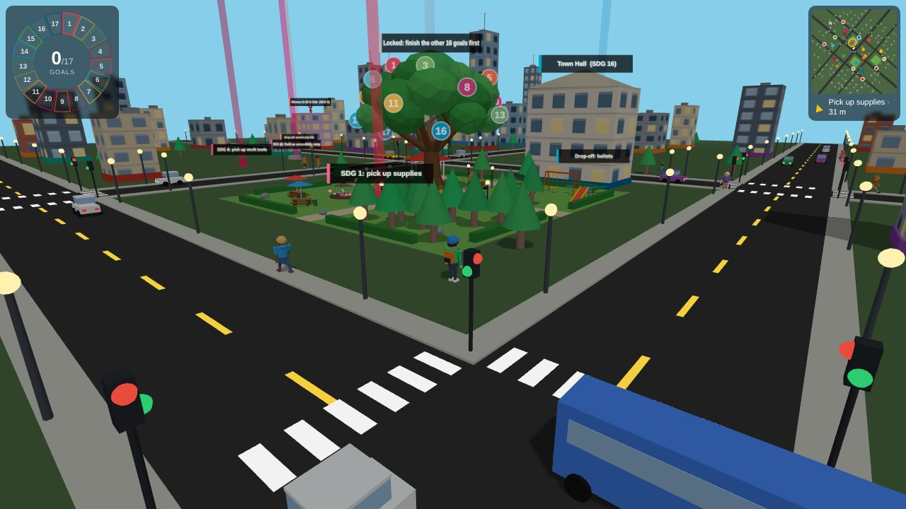
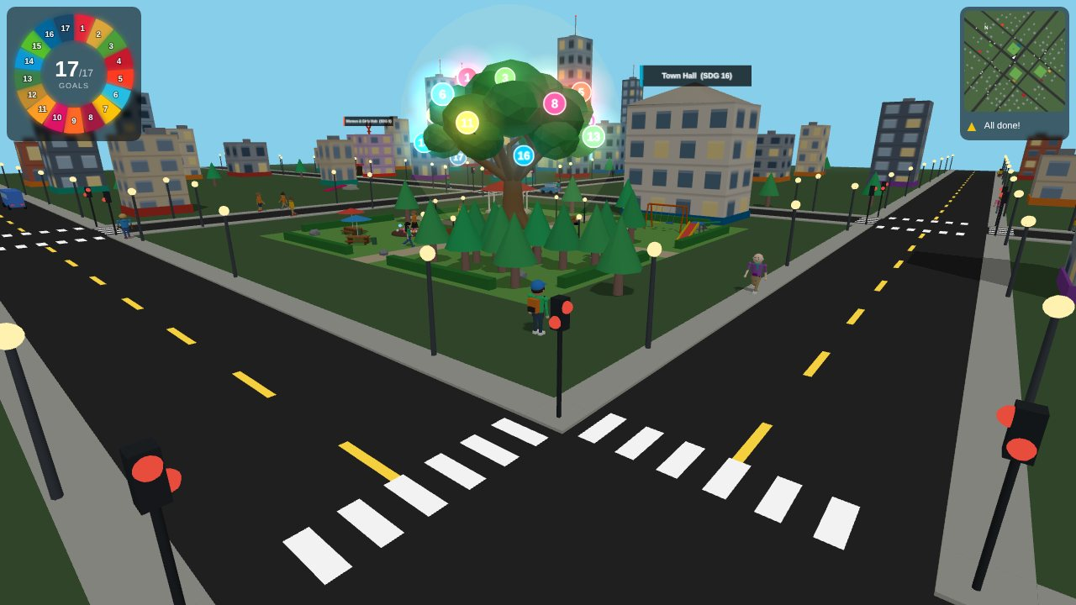
The Global Goals tree
Start: every ball is dim
Finished: all 17 glow in their goal colours
A big oak in the park doubles as a landmark and a progress meter. Each numbered ball belongs to one goal and lights up with a halo the moment you complete that task. The last ball is yours to earn: stand under the tree when the other 16 are shining.
Notes:
The centrepiece is the Global Goals tree, in the middle of a park. It starts with seventeen dim balls, one for each goal. Every task you finish makes its ball glow in that goal's colour. The last ball, goal seventeen, is earned by standing under the tree once the other sixteen are shining. So the tree is both a landmark and a progress meter.

Slide 5
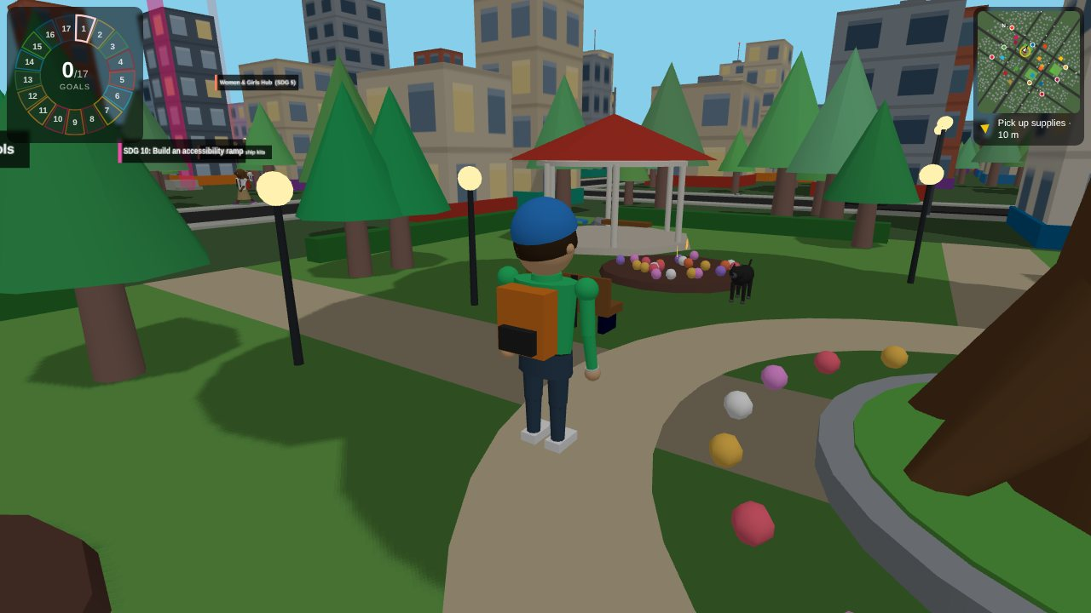
A city and parks that feel alive
8
24
landmark buildings with doors, signs and rooftop symbols
cars and buses obeying traffic lights
48
3
pedestrians, some walking dogs on a leash
parks with playgrounds, ducks, dogs, cats and birds
Notes:
We wanted the world to feel alive so the lessons feel real. There are eight landmark buildings like the hospital and the school, cars that obey traffic lights, forty-eight pedestrians, and parks with playgrounds, ducks, dogs, cats and birds. Some people even walk their dogs on a leash.

Slide 6
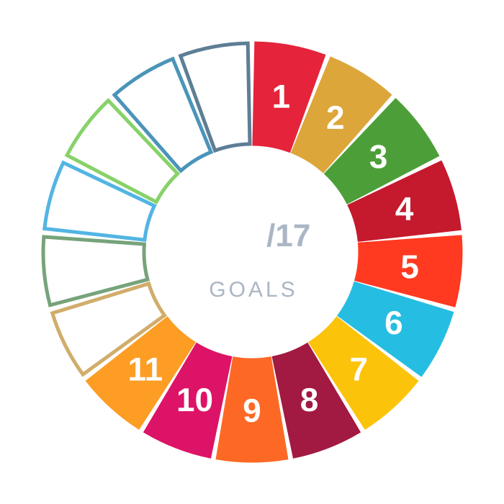
A small interface and a free camera
Action | Keyboard and mouse | Touch
Move | WASD or arrow keys | Left-side joystick
Look around | Drag; Q/E turn; R/F tilt | Drag right side; buttons
Camera behind you | Hold C (it starts there) | Starts there
Zoom | Scroll wheel | Not yet
Minimap and arrow: the map rotates with the camera, and a yellow arrow shows the way and the distance.
See-through walls: any building between the camera and you fades out, so a low camera never loses you.
The goal ring fills in as you play
Notes:
The interface is deliberately small. A ring of seventeen segments shows your progress, and the minimap rotates with the camera. You get a free third-person camera, and any building that blocks your view fades out, so you never lose your character.

Slide 7
Code: one list drives the game
game.html · task data
const TASKS = [
{ sdg: 1, type: 'deliver', item: 'supplies',
lm: 'Charity Center', pick: [-40, -30] },
{ sdg: 6, type: 'work', kind: 'pump',
title: 'Repair the water pump', pos: [-110, 50] },
// ...15 more tasks...
];
Every task is data
The game loops over this list to build the crates, door mats, beacons, minimap markers and the goal ring. Adding a goal means adding one entry.
game.html · completeAction()
function completeAction(task, title) {
checklist.find(c => c.key === task.id).done = true;
completedCount++;
lightBall(task.sdg); // tree ball glows
renderChecklist(task.id); // ring segment fills
toast(title, SDG[task.sdg].fact);
}
function lightBall(n) {
treeBalls[n].sprite.material.map = treeBalls[n].litTex;
treeBalls[n].halo.visible = true; // glow
}
One call updates it all
Finishing a goal ticks the list, fills the ring, lights its ball on the tree and shows its fact. Goal 17 unlocks when completedCount reaches 16.
Notes:
Now a little about how it works. Every task is just one entry in a list, so adding a goal means adding one line. When you finish a task, one function ticks it off, fills the ring, lights its ball on the tree, and shows the fact.

Slide 8
Code: moving and seeing
game.html · animate()
// screen-relative input -> world direction
const ca = Math.cos(camAngle), sa = Math.sin(camAngle);
const wx = ix * ca + iz * sa;
const wz = -ix * sa + iz * ca;
p.x += wx * SPEED * dt; p.z += wz * SPEED * dt;
const target = Math.atan2(wx, wz); // face the way you walk
Camera-relative movement
Keys give a direction on screen. Rotating it by the camera angle makes W always walk away from the camera. dt keeps speed the same on any screen.
game.html · updateOcclusion()
for (const b of buildings) {
let hit = false;
for (const o of [0, 2.4, -2.4]) // centre + both sides
if (segHitsBox(c.x, c.y, c.z,
pp.x + rx * o, 1.6, pp.z + rz * o, b))
{ hit = true; break; }
b.mesh.material = hit ? b.ghostMat : b.orig;
b.extras.forEach(e => { e.visible = !hit; });
}
See-through buildings
Three invisible lines run from the camera to the hero. Any building a line crosses swaps to a see-through material, and its rooftop details hide.
Notes:
Movement is relative to the camera: we rotate the keyboard direction by the camera angle, so W always walks away from you. For the see-through walls, we draw three invisible lines from the camera to the hero and fade any building they cross.

Slide 9
Code: traffic and walking
game.html · updateCity()
if (!green) for (const q of ROADS) {
const d = (q - c.s) * c.dir, stopD = roadW(q) / 2 + 5;
if (d > stopD - 1.5 && d < stopD + 30)
allowed = Math.min(allowed,
Math.sqrt(2 * DEC * Math.max(0, d - stopD)));
}
c.v = c.v > allowed ? Math.max(allowed, c.v - 16 * dt)
: Math.min(allowed, c.v + 6 * dt);
Cars brake for red
Each car works out the fastest speed that still lets it stop at the line: v = √(2 · deceleration · distance). The same rule keeps a gap and yields to you.
game.html · poseRig()
// the lowest foot always touches the ground
const depth = i => 0.66 * Math.cos(th[i])
+ 0.6 * Math.cos(th[i] + kn[i]) + 0.11;
r.pelvis.position.y = Math.max(depth(0), depth(1));
// step rate follows real speed, so feet don't skate
const gaitRate = (v, run, s) =>
Math.PI * v / (2.52 * s * Math.sin(legAmp(run)));
Feet that stay planted
The hips drop until the lowest foot just touches the floor, and the step rate is worked out from speed and leg length, so the feet never slide.
Notes:
Cars use one braking formula to stop at red lights, keep their distance, and even yield to you. For the walk, we lower the hips until the lowest foot touches the ground and tie the step rate to speed, so the feet never slide.

Slide 10
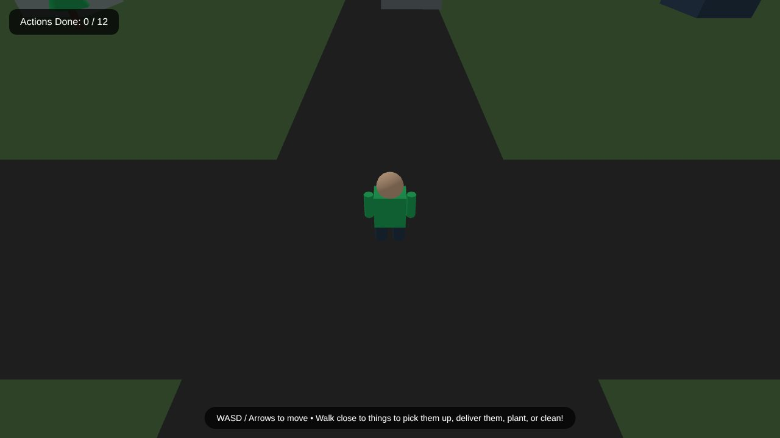
Built, tested, and what comes next
1
~1,500
102 KB
HTML file
lines of code
total size
Built with Three.js in one file. Every building, character and the oak is generated in code. Scripts played the full game in a headless browser, checking that every task is reachable, the finale stays locked until the end, and the tree ends fully lit with no errors.
First version: 4 tasks, unwinnable
Next
Quiz moments: one question per goal
Sound: footsteps, traffic, a chime per ball
Classroom mode: shared progress and scoreboard
More languages: starting with Hindi
Now: 17 tasks, a detailed city, a glowing finale
Notes:
The whole game is one HTML file built with Three.js, about fifteen hundred lines, and it runs in any browser. To test it, we wrote scripts that play the full game in a headless browser, checking that every task can be completed, the finale stays locked until the end, and the tree finishes fully lit. Our first version was actually unwinnable, and that testing is how we caught it. Next we would like to add quiz questions for each goal, sound, a classroom mode with a scoreboard, and more languages, starting with Hindi. Thank you, we are team ctrl freaks, and we would love you to play it.

