Slide 1

MySQL
SALES PROJECT

Slide 2

My name is M. Rama Gopala Krishna, and I would like to utilize SQL queries related to pizza sales.

Slide 3


I have datasets.
1.Order Details
2.Orders
3.Pizza_Types
4.Pizzas

Slide 4
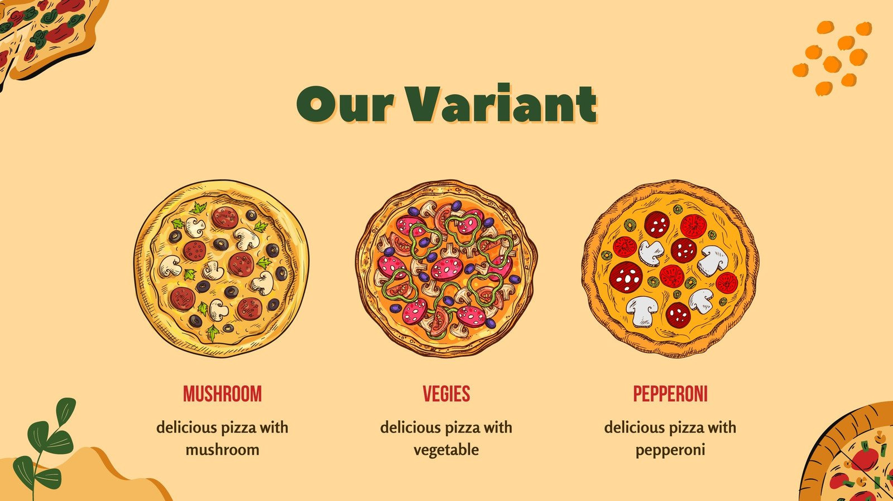


Retrieve the total number of orders placed.

Slide 5
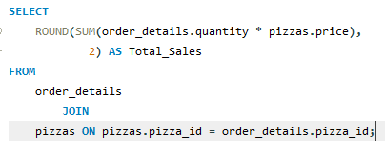

Calculate the total revenue generated
from pizza sales.

Slide 6
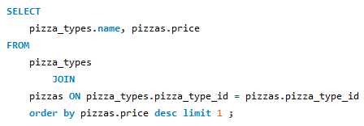

Identify the highest-priced pizza.

Slide 7
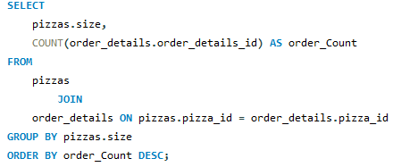
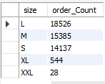
Identify the most common pizza size ordered.

Slide 8
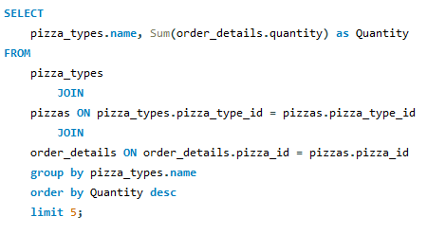
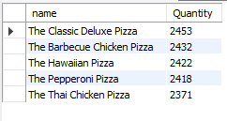
List the top 5 most ordered pizza types along with their quantities.

Slide 9
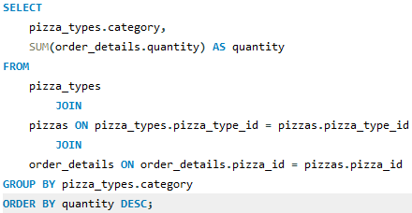

Join the necessary tables to find the total quantity of each pizza category ordered.

Slide 10
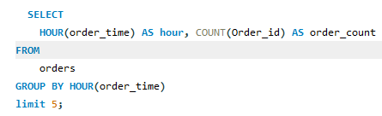
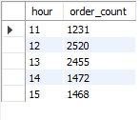
Determine the distribution of orders by hour of the day Limit 5.

Slide 11
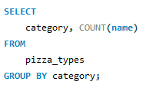
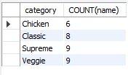
Join relevant tables to find the category-wise distribution of pizzas

Slide 12
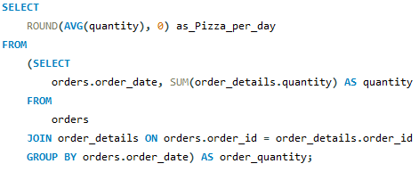

Group the orders by date and calculate the average number of pizzas ordered per day.

Slide 13
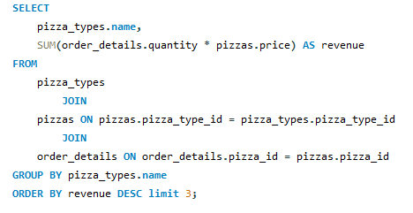

Determine the top 3 most ordered pizza types based on revenue.

Slide 14
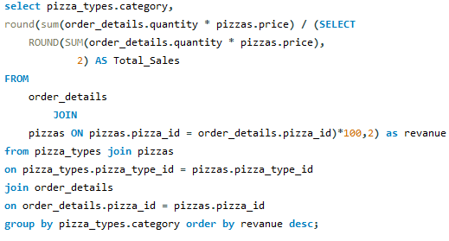
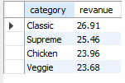
Calculate the percentage contribution of each pizza type to total revenue.

Slide 15
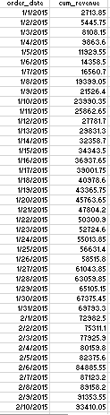
Analyze the cumulative revenue generated over time.

Slide 16
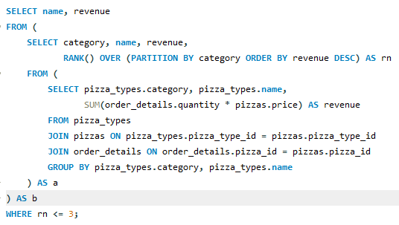
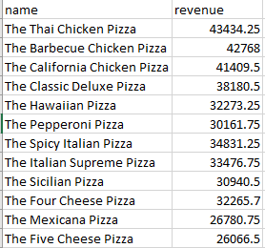
Determine the top 3 most ordered pizza types based on revenue for each pizza category.

Slide 17


