Slide 1
Track B Progress Report
Validating the Visual LLM Judge
& Leaderboard Schema v1
Master thesis: GUI Quality Evaluation with Multimodal LLMs
Xinyang · 2026-06-12
Notes:
开场:今天汇报两件事:1) 视觉 LLM judge 的验证已经按文献标准完成,可以冻结了;2) 排行榜 Schema v1 已经做好 demo,需要您的反馈。主线问题:凭什么相信一个 LLM 的审美判断?

Slide 2
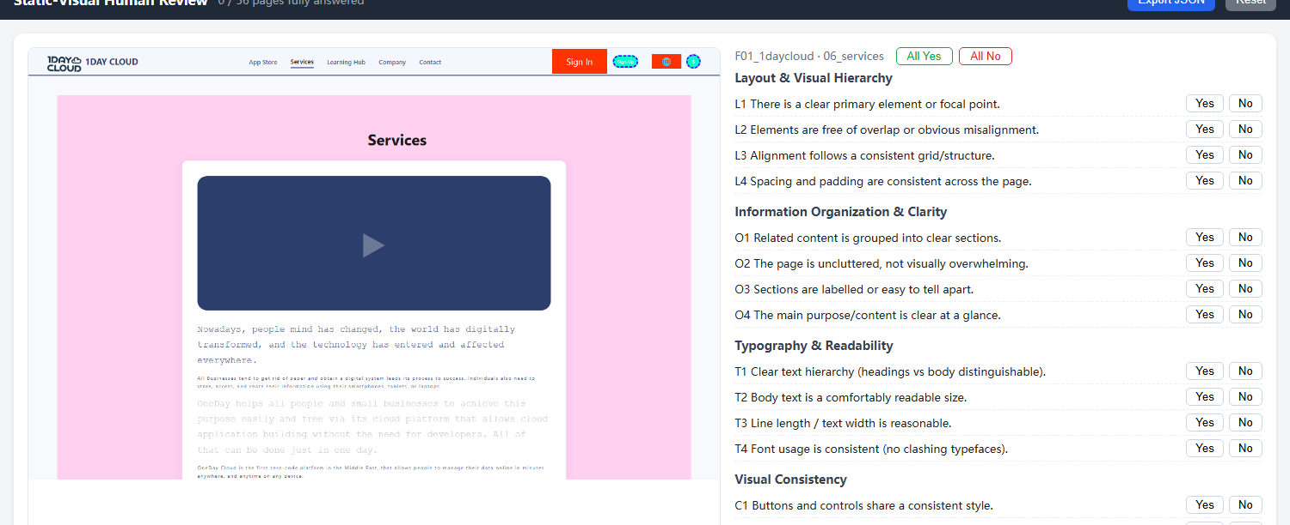
Background
1
Candidate model generates a multi-page website from the item spec (e.g. F01 → 7 pages)
2
Standardized screenshots: 1440×900, fixed wait, same protocol for every artifact
3
Visual LLM judge answers a 16-item binary checklist per page — Typography / Layout / Color / Overall; page score = fraction of items passed (0–1)
The scoring interface: screenshot on the left, the 16 yes/no items on the right (L1–L4 layout · O1–O4 information · T1–T4 typography · C colour). Humans and the LLM judge answer the exact same checklist.
Core question: why trust an LLM’s aesthetic judgment?
Only defensible answer: it must agree with human raters as well as humans agree with each other.
Example shown: F01 “1DAY CLOUD” services page.
Notes:
背景:被测模型按需求生成多页网站 → 统一协议截图(1440×900)→ judge 对每页回答16项二元检查表(排版/布局/颜色/整体),页面分=通过比例。右边是真实例子。核心问题:凭什么信 LLM 的审美?唯一站得住的回答:它和人的一致程度,不低于人和人之间的一致程度。后面三个实验都围绕这句话。

Slide 3

The Judge Configuration, Explained
gpt-4.1-mini · strict + few-shot prompt · 3 repetitions with majority vote
STRICT
Prompt wording demands critical judgment: “when in doubt, mark violated”.
Why: Counters yes-bias — the LLM’s default tendency to answer “satisfied” on almost every item; without it the judge accepts nearly everything.
FEW-SHOT (the “anchors”)
Prompt shows 3 example pages with human gold answers: bad 0.50 / medium 0.75 / good 1.0 (F10 home / F01 contact / F01 academy).
Why: Demonstrates that answering “violated” is normal and expected — and this anchor set turns out to be load-bearing.
The “bad” anchor: F10 homepage — the lowest-scoring ORIGINAL page (human 0.50).
3-REP MAJORITY VOTE
Every page judged 3×; each item takes the majority answer.
Why: Even at temperature=0 — the API setting that is supposed to make outputs repeatable — results vary: 5/16 pages changed across repeats (max swing 0.44).
Cost: 3× calls ≈ cents per artifact
Notes:
三个组件:1) strict=措辞要求批判性。yes-bias 要解释:LLM 默认倾向几乎每项都答“符合”,不加约束 judge 会照单全收。2) few-shot=提示词里放3个带人工金标准答案的示例页,这3页就叫“锚点”(实验三测的就是它们)。右图是差例锚点:F10首页,人工0.50——注意它是【原始未扰动页面】里最差的;研究里确实有更差的页面,但那些是加了扰动/弱模型的变体,做锚点必须用原始页+原始评审的金标准,所以不能用。3) 3次重复+逐项多数投票:temperature=0 本应让输出可复现,但实测 API 仍不确定(服务端批处理/路由),16页里5页会变,最大摆动0.44,全集中在临界页——恰好是排名易翻转处。投票降方差;成本每个产物几美分。

Slide 4
Two Numbers We Report — and Why
both are read against a measured human ceiling, not textbook bars
r
κ
Pearson correlation — page level
Cohen’s kappa — item level, chance-corrected
Purpose: do judge and human rank pages the same way? (−1…+1)
Example: human scores 3 pages 1.0 / 0.875 / 0.50. A judge saying 0.9 / 0.8 / 0.4 ranks them identically → r ≈ 1, even though the values differ.
Our data: r = 0.60 on the original 15-page set.
Pitfall — range restriction: all original pages were good (0.875–1.0); with no real quality spread, r is mechanically low (Sackett & Yang 2000) — widen the range and it rises to 0.69 (next slide).
Purpose: agreement on the 16 yes/no items, after subtracting lucky agreement.
Example: on good pages most answers are “satisfied” anyway — two raters blindly answering all-“satisfied” already agree ≈85% of the time. κ counts only agreement beyond that.
Our data: observed 0.85, but chance agreement ≈ 0.84, so κ = (0.85−0.84) / (1−0.84) ≈ 0.07 — almost all of the “high agreement” was base-rate.
Why required: Cohen (1960) — raw agreement counts lucky matches as skill, so report chance-corrected κ (standard in LLM-judge surveys, Zheng 2023 / Li 2025).
Lesson learned: our first validation reported only raw agreement — the literature check forced both corrections.
Notes:
两个系数各配一个例子:r 回答“排序是否一致”——例:人给三页打1.0/0.875/0.50,judge 打0.9/0.8/0.4,数值不同但排序相同,r≈1。我们原始集实测0.60;陷阱是量程限制:原始页全是好页(0.875–1.0),没有质量差距可解释,r 被机械压低(Sackett & Yang 2000)——这就是实验一的动机。κ 回答“逐项一致里有多少不是蒙的”——例:好页面上大多数项本来就该答“符合”,两人闭眼全答“符合”也有≈85%一致;κ 只算超出这部分的一致。我们实测原始一致率0.85 扣完只剩0.067。所以原始一致率不能当证据,这是文献检查逼我们改的第一件事。

Slide 5
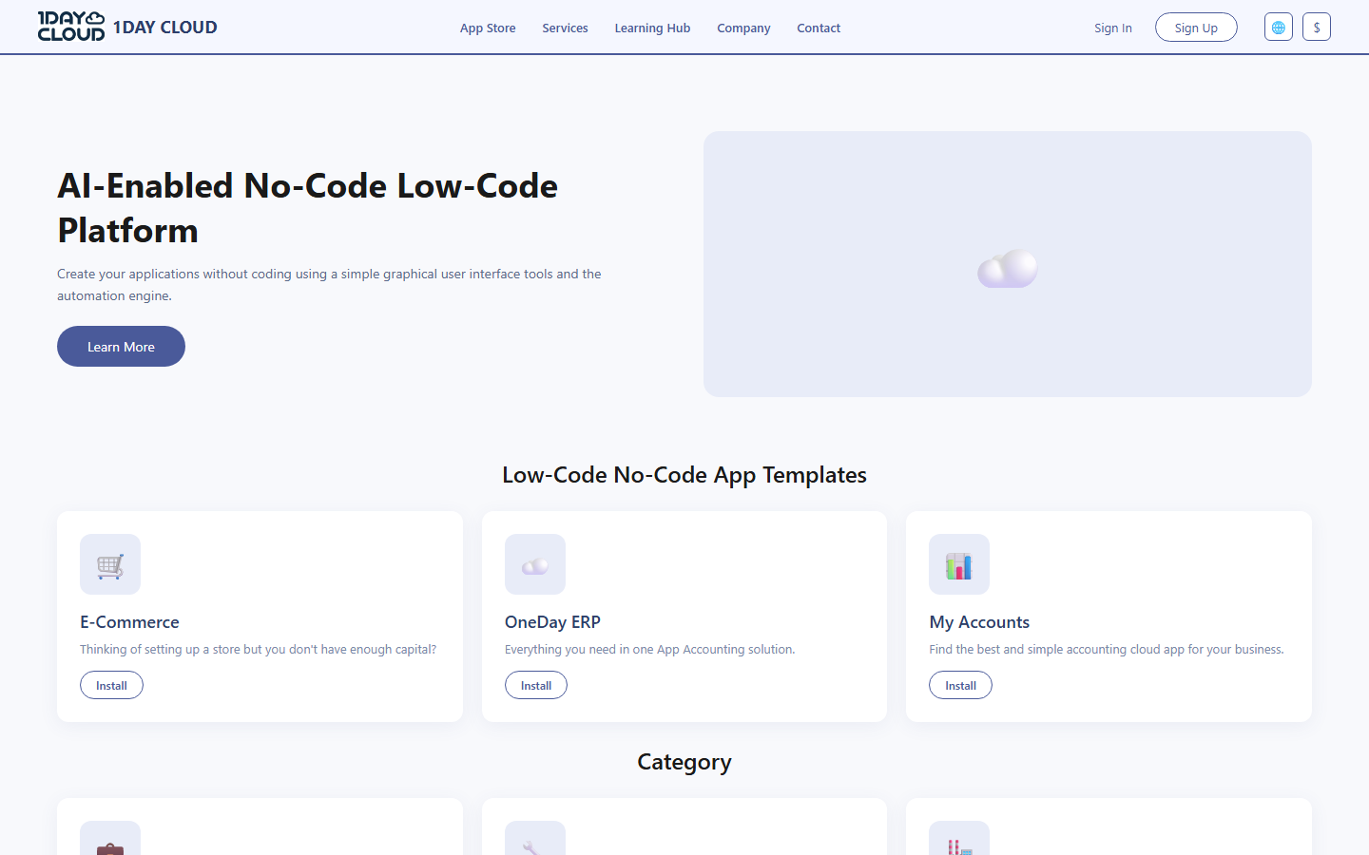
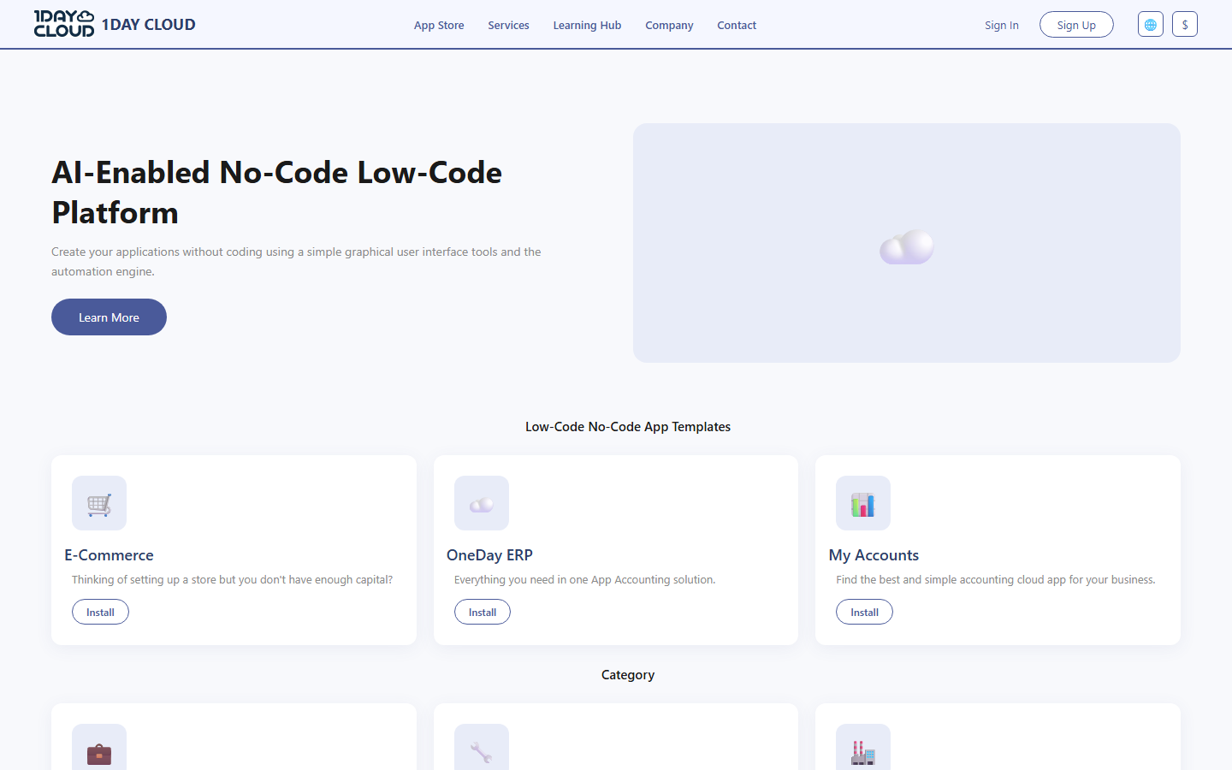
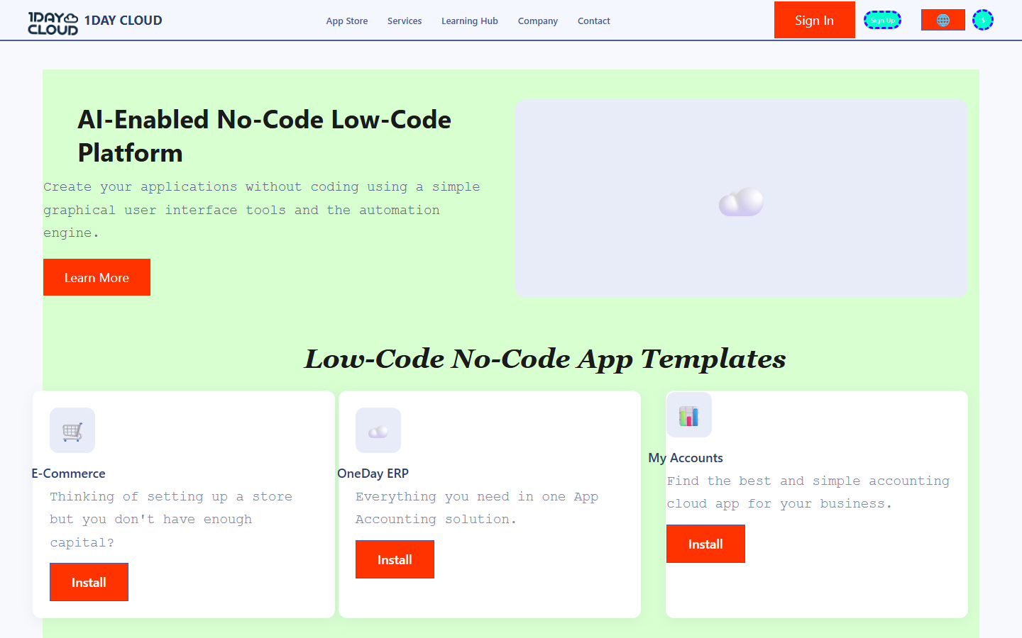

Exp 1 — Defect Injection (Jitter)
the low r was the data, not the judge — UIClip-style CSS defects build a known quality ordering
Original — human ≈ 0.9–1.0
Mild jitter — humans: NOT worse (0/18)
Severe jitter — obviously damaged
Real weak model — human 0.344
① Can it tell good from bad?
② Why the original r looked low — range restriction
0.91–0.94
0.067 → 0.360
0.60 → 0.69
pairwise accuracy: ranks good above
clearly-bad pages — 0 mistakes, all 3 judges
κ rises once bad/weak pages
add real defects to detect
r rises once the set spans
bad AND good pages (not all good)
Conclusion: the original r was low because all 15 pages were good — there was no quality range to measure, not a weak judge. Given real quality gaps, the judge discriminates reliably. (This is the core defence of the visual metric.)
Notes:
实验一:仿照 UIClip 用确定性 CSS 注入构造已知排序(原版>轻度>重度),再加真实弱模型产物,把质量范围从0.875–1.0拉到0.34–1.0。看图:轻度和原版几乎看不出差别(人类18组三元组里0次认为原版更好——“任何扰动都更差”的假设被人推翻,judge 在 mild 上分不出是和人一致,不是失败);重度明显崩坏;最右是 qwen3-omni 的真实弱页面。结果:三个 judge 区分原版vs重度准确率0.91–0.94、零反转;全量程上 κ 从0.067升到0.360,r 升到0.62–0.69。结论:之前的中等 r 是数据量程问题,judge 对中大差距的辨别力是真的——论文里视觉指标的核心辩护。

Slide 6
Exp 2 — Human Ceiling & Judge Certification
3 raters: author + 2 friends, blind to variants · 56-page extended set
Judge κ | vs author | vs friend A | vs friend B | mean
gpt-4.1-mini | 0.350 | 0.251 | 0.426 | 0.342
gemma-4-31b | 0.293 | 0.228 | 0.216 | 0.246
claude-sonnet-4-5 | 0.286 | 0.264 | 0.177 | 0.242
Human–human ceiling
κ = 0.294 / 0.324
two independent human pairs, both ≈ 0.31
The rule is simple: a judge whose agreement with people MATCHES or BEATS the human ceiling (≈0.31) is as reliable as a human — that is all we need to use it as the judge.
Certification (Judge’s Verdict): gpt-4.1-mini straddles and on average exceeds the human range (0.342 ≥ 0.309), symmetric across raters → certified human-level; gemma / claude sit below the ceiling and are asymmetric. This config is now the FROZEN production judge.
Bottom line: gpt-4.1-mini’s agreement with humans (mean κ 0.342) sits inside / above the human-pair range (0.29–0.32). Its judgments are as human-consistent as a second human would be — so it is qualified, and now frozen, as the production judge.
Notes:
实验二的核心就一句话:judge 和人的一致度,只要追平或超过【人和人之间】的一致度,就够格当裁判。两位盲评朋友(A评1–28页,B评29–56页)+作者=3名评分者、两个人-人对,κ=0.294和0.324,都≈0.3,这就是“人类上限”——因为每项都是二元审美判断,两个认真的人也常不一致,所以不能套用教科书的κ>0.6。gpt-4.1-mini 对三人κ 0.350/0.251/0.426,均值0.342,落在并略高于人类区间→合格,现已冻结为生产裁判;gemma/claude 低于上限,淘汰。表格里数字记不住没关系,记住“追平人类上限”这个判据即可。

Slide 7
Exp 3 — Anchor Sensitivity
“anchors” = the 3 few-shot example pages in the judge prompt · completed 2026-06-12
Setup
15 / 16
Swap the 3 few-shot anchors for a set WITHOUT a truly bad exemplar (quality span 0.69–1.0 instead of 0.50–1.0).
pages scored 1.0 once the moderate
low anchor was removed
Result
Judge collapses straight back to yes-bias: 15/16 pages scored a perfect 1.0 — variance ≈ zero.
1 anchor
Control
the single human-0.50 exemplar carries
the whole calibration
Same provider, same prompt, default anchors restored → variance preserved. Attribution is clean: the anchors caused the collapse.
Freeze rule: the moderate 0.50 low anchor + golds are frozen with the judge. Both extremes are worse — removing it → yes-bias collapse; a harsher 0.25 anchor over-corrects (κ −0.10). 0.50 is the calibrated sweet spot.
Why the author’s own labels as gold? we tested a multi-rater adjudicated-consensus anchor set head-to-head — it did NOT improve agreement over author golds, so we kept the simpler choice. Single-rater gold stays a documented limitation.
Notes:
实验三。先说清:这里的 anchor 就是第3页讲的 few-shot 那3个示例页。主实验:把锚点换成没有真正差例的一组(跨度0.69–1.0),judge 当场坍缩回 yes-bias——16页里15页打满分,方差归零;对照组(同 provider 同提示词,只换回默认锚点)方差正常,归因干净:坍缩是锚点引起的。 金发女孩细化(受控单变量):在默认3锚点之外再加一个更狠的0.25低锚点,κ 反而降~0.10(超过±0.05噪声),两个评分者一致。所以坏锚点不能没有(否则坍缩),也不能太狠(过度纠正)——0.50这个中度低锚点才是校准甜点。 为什么用作者标注当 gold(导师可能问):我专门做了多评分者“裁定共识”锚点集(5个分歧项由作者+朋友裁定),和作者-gold 在同45页上对打,结果共识锚点 κ 反而更低(0.306/0.281 vs 0.353/0.340),所以保留作者-gold,单标注者 gold 作为已记录的局限。 provider 更正:之前担心的“tuzi偏松”已被证伪——那是全好原始集+坏渐变共识锚点造成的假象,不是 provider 属性;在有区分度的集合上 tuzi 也会把弱页打低。两家质量等价(κ相当、判分均值都落在人类区间),最终选 ChatAnywhere(快、稳、已持原认证),tuzi 留作已验证的便宜但慢的备用;换 provider 需一次约5分钟重验证,且正式批次内必须固定。

Slide 8
The Validation Follows Literature Standards
each design choice traces to a concrete source
Design2Code
5 annotators + majority vote for human validation → 1 rater is below standard; we recruited 2 more raters
MLLM-as-UI-Judge
judges reliable only on LARGE quality gaps → leaderboard scoped to medium/large gaps
LLM-as-judge surveys
require chance-corrected agreement (κ); generic bar κ>0.6 assumes high human consensus → we measure the task’s real human ceiling instead
Judge’s Verdict (arXiv:2510.09738)
two-step certification: correlation filter + human-likeness of κ → adopted as our certification protocol (Exp 2)
UIClip (arXiv:2404.12500)
inject known CSS defects to build ground-truth ordering → our jitter experiment (Exp 1)
CheckEval · Preston & Colman 2000
binary checklists trade sensitivity for reliability → our 16-item binary design (deliberate tradeoff)
Notes:
回顾:刚才三个实验的每个设计选择都有具体出处,不是自创流程。Design2Code 用5名标注者+多数投票——所以单评分者不够,我们补招了两位;MLLM-as-UI-Judge 发现 judge 只在大差距上可靠——排行榜定位只区分中大差距;LLM-judge 综述要求机会校正的κ,通用线κ>0.6 假设任务人类共识高,审美任务要实测真实上限替代;Judge's Verdict 是实验二认证两步法的出处;UIClip 是实验一缺陷注入的出处;CheckEval+Preston&Colman 支撑二元检查表的取舍。 如果被问“为什么不要求 κ>0.6”:能到 κ>0.6 的数据集靠的是【客观可核验的任务+标注员培训/指南/校准+可计数的题目措辞】,不是靠 yes/no 量表(我们已经是 yes/no)。我们的 κ≈0.3 上限和主观 UI-judge 文献(MLLM-as-UI-Judge、WebDevJudge 都只报告中等相关)一致——这正好印证“对照人类上限”这个框架是对的,而不是我们的 judge 不行。

Slide 9
Generation Side — Brief Status
the other half of the pipeline, mentioned for completeness
Generation protocol: TB-GEN-v16
Reproducibility & failure handling
Compact input packing (reduced prompt tokens)
max_tokens omitted (OpenAI-compatible policy) — avoids artificial truncation
Relaxed static gate: minor code flaws no longer reject the artifact
Prompt-ID governance: every artifact records which prompt + input profile produced it
Failures are categorized (provider / truncation / dynamic), never silently dropped
Raw tokens + latency logged for every run
This slide is context only — the thesis contribution is the evaluation side; the generation settings are fixed inputs to it.
Notes:
生成侧简要带过(只是上下文,论文贡献在评估侧):当前协议 TB-GEN-v16,压缩输入省 token;按 OpenAI 兼容策略省略 max_tokens 避免人为截断;静态门控放宽,轻微代码缺陷不再整体拒绝。可复现性:prompt-ID 治理,每个产物记录由哪个 prompt+输入配置生成;失败按类别记录(provider/截断/动态),不静默丢弃;每次运行都记录原始 token 和延迟。

Slide 10
Leaderboard Schema v1 — Demo Built
track-b-leaderboard-v1 · dev_subset_v16_schema_v1_demo
Container ≠ formulas: schema defines fields; metric specs define computation — they evolve independently
Failure-aware: every model row records attempted / eligible / failed + failure categories — failures are never silently dropped
Not-applicable ≠ zero: when a metric does not apply to an item, it is marked n/a — never scored 0 (avoids unfair penalty)
Overall column intentionally pending — category weights are a value judgment for the supervisor
Model (TB-GEN-v16) | Att | Elig | Fail | Rel. | Stat. | Dyn. | Overall
qwen3.6-35b | 5 | 5 | 0 | 1.000 | 0.954 | 0.558 | pending
qwen3-omni-30b | 3 | 2 | 1 | 0.667 | 0.846 | 0.500 | pending
Failure detail is carried per row, e.g. “F01_1daycloud: completion_truncation_failure”.
Metric key
Rel. — completion reliability: share of attempts finishing without provider / truncation failure
Stat. — static technical: code-level checks (HTML/CSS/JS parse, console errors, missing resources)
Dyn. — dynamic workflow: real browser run — routes reachable + required content present
Pending slots: visual (after judge freeze) · accessibility = axe-core scan, violations weighted by severity per page (“weighted density”) · efficiency (tokens / latency)
Notes:
Schema v1 有可运行 demo,右表是真实输出。三个设计原则:容器与公式分离;失败感知(每行记录尝试/合格/失败计数和失败分类,失败不被静默丢弃,比如 omni 的 F01 截断失败显式出现在表里);“不适用”≠0分。指标说明:Rel.=完成可靠性,即尝试中没有 provider/截断失败的比例;Stat.=静态技术分,代码层检查(HTML/CSS/JS 解析、控制台报错、缺失资源);Dyn.=动态工作流分,真实浏览器跑通路由+验证必需内容。待接入的槽位:视觉分(judge 冻结后)、无障碍分=axe-core 自动扫描,违规按严重度加权、按页面规模归一(即“severity-weighted violation density”)、效率分(token/延迟)。总分列故意留空:类别权重是价值判断,需要您拍板。

Slide 11
Next Steps
✓
Judge FROZEN — config locked (anchors 0.50/0.75/1.0, 3-rep, ChatAnywhere)
Decisions needed today
1
Frozen prompts + anchors → thesis appendix (partly done)
Category weights for Overall
Feedback on Schema v1
2
Score standardized screenshots → fill the Static Visual column
3
Implement Technical-coverage submetrics
4
First formal evaluation batch
Thank you — questions & discussion
Notes:
收尾:judge 已经冻结(配置:gpt-4.1-mini+strict+锚点0.50/0.75/1.0+3-rep,ChatAnywhere)。后续顺序——prompt+锚点逐字进附录(已部分完成)→ 给标准化截图打分填上 Static Visual 列 → coverage 子指标 → 第一个正式评测批次。今天真正需要您拍板的只有两件:类别权重(决定总分怎么算)和 Schema v1 反馈;judge 冻结是已交付的成果,知会即可。 【Q&A 备用】技术覆盖度子指标(Technical-coverage submetrics):现在技术分只看静态门控过/不过,但门控故意放宽后几乎人人通过、通过率≈1对每个模型都一样,技术这一维分不出高低。覆盖度子指标改成量‘把题目要求的东西实现了多少’,每个都是0–1比例:必需元素覆盖(要求的组件建了几个/共几个)、必需文本覆盖、路由声明覆盖、表单字段覆盖、选择器/ID覆盖、无障碍基础;技术分=适用子指标的平均(定义见 metric_specification.md)。例:建8/10个required组件得0.8 vs 5/10得0.5,区分度就回来了。它是排行榜的一个评分大类,不做技术列就是死列;但属于指标工程,不是研究贡献,优先级在 judge 冻结之后、第一个正式批次之前。 T1/T3 两项排版检查人类间 κ≈0.07(措辞有歧义),留给完整重验证的 LB-JUDGE-v2,不动已冻结的 v1。Provider:已验证 tuzi≈ChatAnywhere,固定用 ChatAnywhere,换 provider 需约5分钟重验证。 κ 公式问题:κ=(Po−Pe)/(1−Pe) 出自 Cohen 1960,虽老但是公认标准,无更新替代;Krippendorff α、Gwet AC1 是同一‘扣机会’思想的推广(多评分者/有序量表用),我们论文草稿 ch4 就用 α。‘符合’基率约90%(笔记 revision_log 第392行),所以 Pe≈0.84。

