Slide 1
空白演示
单击输入您的封面副标题

Slide 2
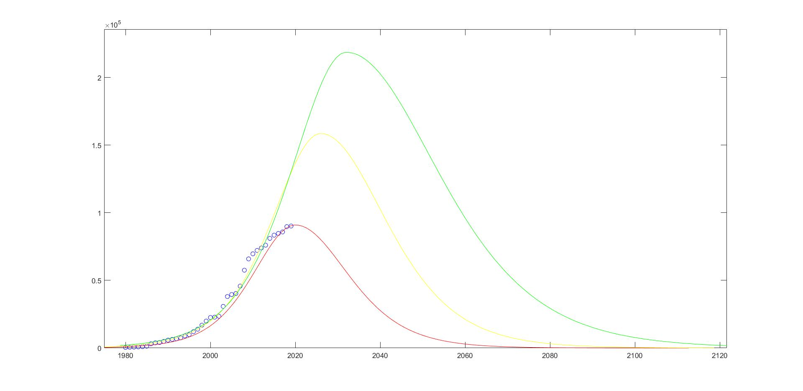
daily output/
Optimistic estimate
Neutral estimate
Oil depleted time
Pessimistic estimate
time/year

