Slide 1
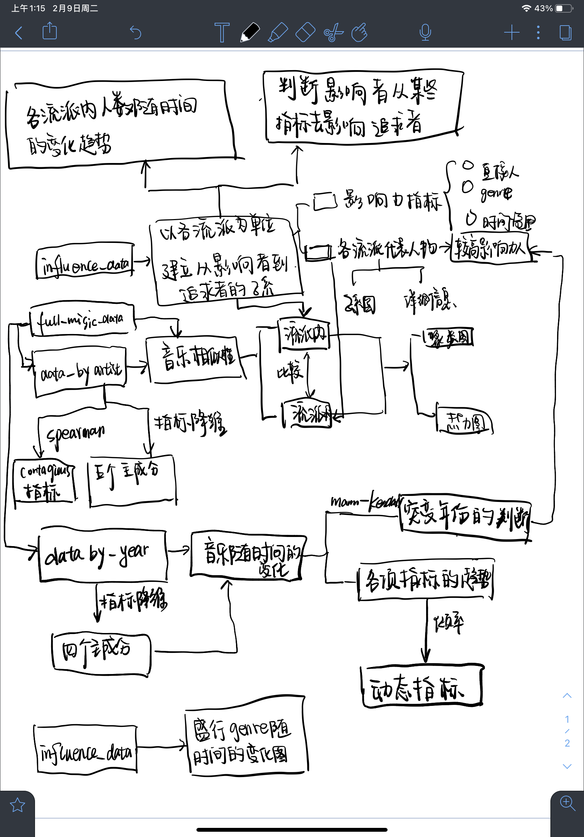
Find out the indicators of the suitor being influenced by the influencer
Trends of bands in each genre over time
Direct influencer
Take each genre as a unit to establish sub-systems from influencers to suitors
Range of time
subnetwork
Clustering map
Heat map
Five principal components
indicator
Mutation year
Index dimensionality reduction
Inclination rate
four principal components
Dynamic indicators
The prevailing genre changes over time

