Slide 1
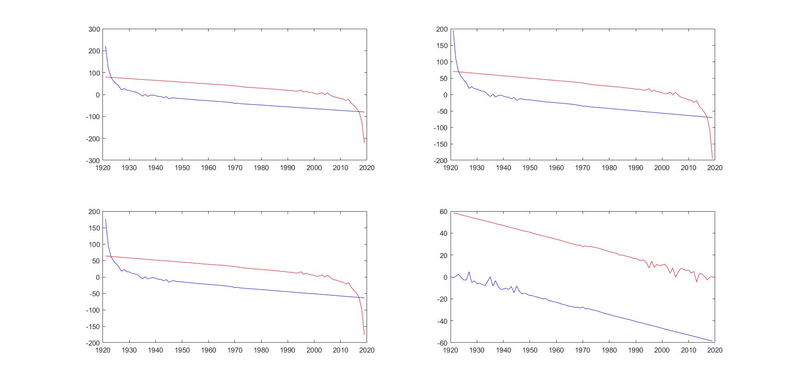
the First principal component
the Second principal component
the Third principal component
the Fourth principal component

