Slide 1
Global Superstore Sales Story
Day 4 • Data Visualization & Storytelling
Central question: What is driving sales performance, and where should the business focus?
12.64M
Total Sales
1.47M
Total Profit
1,590
Customers
51.29K
Orders
Context
The dashboard shows strong overall sales. The next step is to understand when sales peak, where they come from, and which customer groups contribute most.
Story structure
Trend → Region → Customer Segment → Profitability → Recommendation
KEY TAKEAWAY • Overall sales are strong, creating a clear baseline for deeper performance analysis.
Day 4 • Data Visualization & Storytelling • Global Superstore

Slide 2
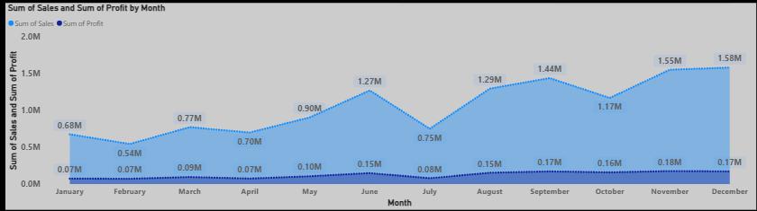
1. When are sales strongest?
Monthly sales trend from the Global Superstore dataset
KEY TAKEAWAY • Sales rise and fall across the year, with November and December among the strongest months.
Day 4 • Data Visualization & Storytelling • Global Superstore

Slide 3

2. Where are sales coming from?
Regional performance highlights geographic differences
KEY TAKEAWAY • Regional performance varies substantially, so high-performing regions offer the clearest opportunities for growth.
Day 4 • Data Visualization & Storytelling • Global Superstore

Slide 4
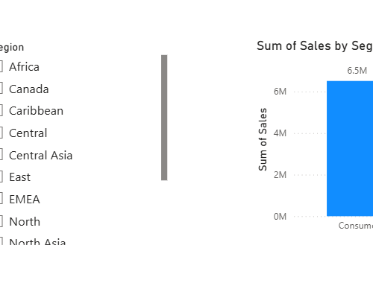
3. Which customer segment drives sales?
Sales contribution by customer segment
Consumer: 6.5M
Corporate: 3.8M
Home Office: 2.3M
KEY TAKEAWAY • Consumer is the largest sales segment, contributing about 6.5M in sales.
Day 4 • Data Visualization & Storytelling • Global Superstore

Slide 5
4. Are high sales translating into profit?
Revenue should be evaluated together with profitability
Why it matters
A region can generate substantial sales without delivering the same level of profit.
What to compare
Look for regions where sales are high but profit is comparatively weak.
Decision focus
Prioritize profitable growth rather than sales volume alone.
KEY TAKEAWAY • Sales and profit should be analyzed together before deciding where to invest or improve.
Day 4 • Data Visualization & Storytelling • Global Superstore

Slide 6
5. Business Recommendation
Turning the visual evidence into an action-oriented conclusion
1
Use peak months for planning
Prepare inventory, campaigns and resources around stronger sales periods.
2
Prioritize high-performing regions
Protect strong regional performance and investigate expansion opportunities.
3
Keep Consumer as a key focus
The Consumer segment is the largest contributor to sales.
4
Manage for profitable growth
Track profit alongside sales to avoid chasing revenue that adds limited value.
FINAL MESSAGE • Strong sales are the starting point; the goal is to understand the drivers and turn them into profitable action.
Day 4 • Data Visualization & Storytelling • Global Superstore

Slide 7
Submission Checklist
Use this slide only as a personal checklist; remove it if your portal requires exactly 4–6 story slides.
✓
Keep the 5 story slides focused on one central question.
✓
Each visual has a one-sentence takeaway.
✓
Avoid unrelated charts such as Gender, Age Category, Weekend/Weekday and Order Delay.
✓
Export the final PowerPoint as PDF if the internship portal asks for PDF.
✓
Upload the PPTX/PDF and your Power BI source file to GitHub if permitted.
Day 4 • Data Visualization & Storytelling • Global Superstore

