Slide 1
Pooja M J 2021503532 CT Dept. MIT, Anna University
TNSDC-Gen AI-Project
3/21/2024 Annual Review

Slide 2
PROJECT TITLE
Virtual Visions: The Art of Anime Faces
with DCGAN
3/21/2024 Annual Review

Slide 3


AGENDA
The agenda of the project is to leverage Deep Convolutional Generative Adversarial Networks (DCGANs) for generating anime faces.
By training a DCGAN on a dataset of anime face images, the project aims to create a model capable of generating realistic and novel anime-style faces.
3/21/2024 Annual Review

Slide 4

PROBLEM STATEMENT
Generating high-quality anime faces manually can be time-consuming and requires artistic skills. Additionally, there may be a limited supply of diverse anime face images available. The problem statement revolves around automating the process of anime face generation to overcome these challenges and provide a scalable solution for generating a variety of anime faces on demand.
3/21/2024 Annual Review

Slide 5

PROJECT OVERVIEW
Virtual Vision involves training a DCGAN using a dataset of anime face images. The DCGAN consists of a generator network and a discriminator network that are trained simultaneously in an adversarial manner. The generator learns to generate realistic anime face images, while the discriminator learns to distinguish between real and generated images. Through iterative training, the generator improves its ability to generate high-quality anime faces.
3/21/2024 Annual Review

Slide 6

WHO ARE THE END USERS?
Anime artists and enthusiasts who want to create custom anime characters or artwork.
Game developers looking to incorporate anime-style characters or artwork into their games.
Animation studios seeking to automate or enhance the character design process for anime productions.
Researchers and hobbyists interested in exploring generative models and computer vision techniques applied to anime art.
3/21/2024 Annual Review

Slide 7

YOUR SOLUTION AND ITS VALUE PROPOSITION
Anime artists and enthusiasts who want to create custom anime characters or artwork.
Game developers looking to incorporate anime-style characters or artwork into their games.
Animation studios seeking to automate or enhance the character design process for anime productions.
Researchers and hobbyists interested in exploring generative models and computer vision techniques applied to anime art.
3/21/2024 Annual Review

Slide 8

THE WOW IN YOUR SOLUTION
The wow factor in the solution lies in its ability to generate highly realistic and diverse anime faces that closely resemble those created by human artists. The generated faces exhibit intricate details, such as facial features, expressions, and hairstyles, making them indistinguishable from handcrafted artwork. Additionally, the solution offers unprecedented flexibility and control over the generated faces, allowing users to specify desired characteristics and styles.
3/21/2024 Annual Review
8

Slide 9
MODELLING
We can make use of the opendatasets library to download the dataset from Kaggle. (‘https://www.kaggle.com/datasets/splcher/animefacedataset’).
The modeling part involves training a DCGAN using the provided code. The generator network learns to transform random noise vectors into realistic anime face images, while the discriminator network learns to differentiate between real and generated images.
3/21/2024 Annual Review
9

Slide 10
MODELLING- CONTD.
Through adversarial training, both networks improve iteratively, resulting in a generator capable of producing high-quality anime faces. The model's architecture, loss functions, and optimization parameters are carefully designed to balance realism and diversity in the generated faces. Finally, the trained model is evaluated based on metrics such as image quality, diversity, and visual appeal.

Slide 11
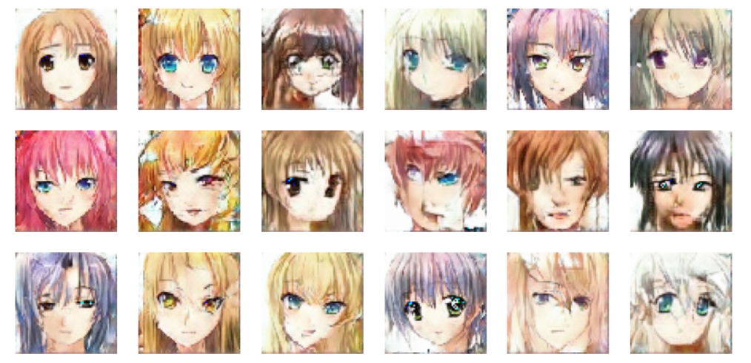
RESULTS
The model was executed for 30 epochs using learning rate = 0.0001.
Demo Link
3/21/2024 Annual Review
11

Slide 12
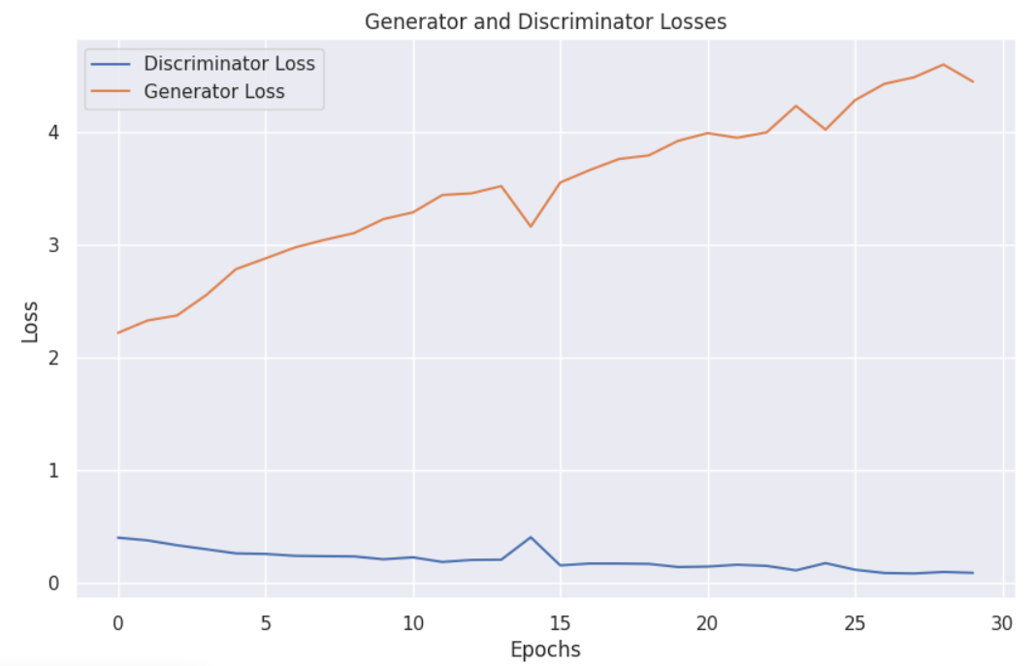
GRAPHS
Experimenting with different values for learning rate and number of epochs can generate high quality images.

