Slide 1
cANDY Sales Analysis
Group #2

Slide 2
Agenda
Seasonal Sales Insights - Which season wins the candy sales battle?
Trends Over Time - Analyzing sales patterns from 2021 to 2024
Top-Selling Candy Types - Identifying dominant products
Volume vs. Cost Analysis -Understanding the relationship between pricing and demand
State by State Analysis - Differences in sales and product by state
Overall Regional Analysis

Slide 3
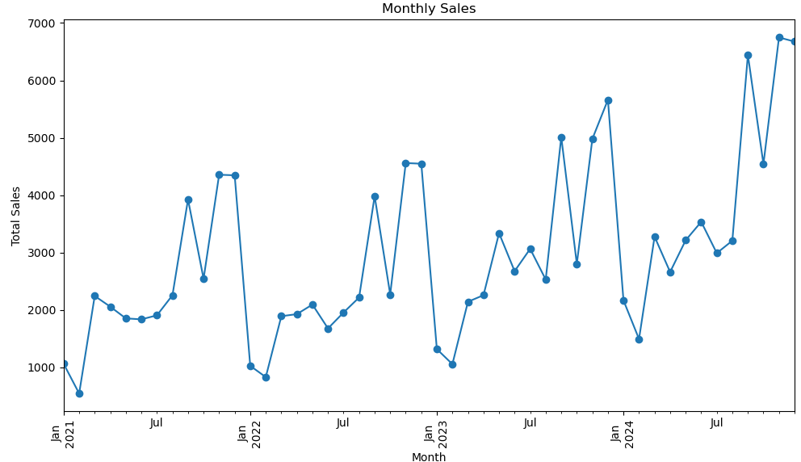
Which Season wins the Candy sales battle
Jose Moncada
Monthly Data Analysis (2021 - 2024)
The data reveals that February consistently records the lowest candy sales across four consecutive years.
Conversely, November and December are the peak sales months, likely influenced by:
Halloween (October 31), leading to increased sales as it precedes November.
The Christmas season, which drives consumer spending in December.

Slide 4
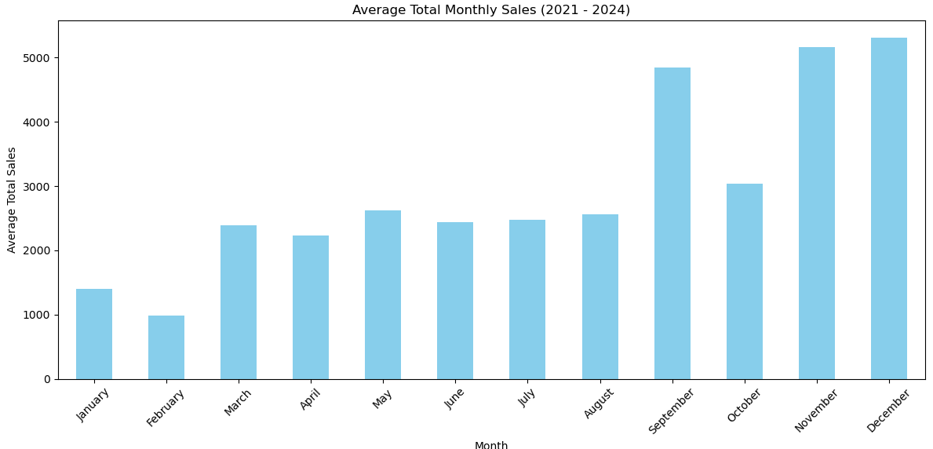
Which Season wins the Candy sales battle
Jose Moncada
Average Total Monthly Sales (2021 - 2024)
By analyzing the average total monthly sales data, we can clearly see that February is the month with the lowest candy sales. In contrast, the majority of sales occur towards the end of the year, highlighting a significant seasonal trend

Slide 5
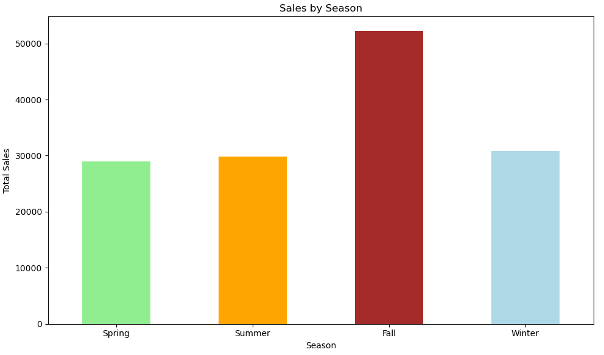
Which Season wins the Candy sales battle
Jose Moncada
Seasonal Sales Overview (2021 - 2024)
Spring: March, April, May
Summer: June, July, August
Fall: September, October, November
Winter: December, January, February
Our analysis reveals that Fall is the season with the highest sales, particularly from September to November, likely driven by Halloween. In contrast, the sales trends across the other seasons appear to be quite consistent.

Slide 6
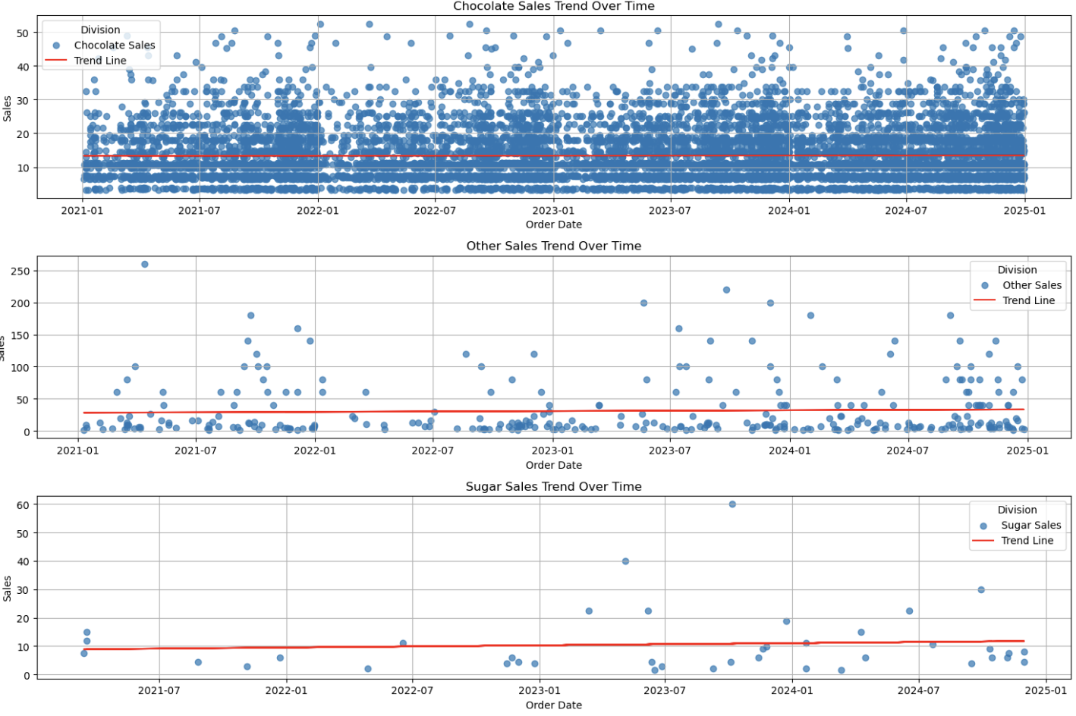
Chocolate sales trend over time
Nick Voltin
Notes:
This scatter plot represents every sale of chocolate from 2021-2024. The slope of the trend line very small(4.72e-05) Although small, it does indicate that chocolate sales are increasing over these four years. The P-value is 0.803 which means this trend is not statistically significant. Unfortunately, this means we can’t necessarily identify why the sales are increasing over time. It could be random.

Slide 7
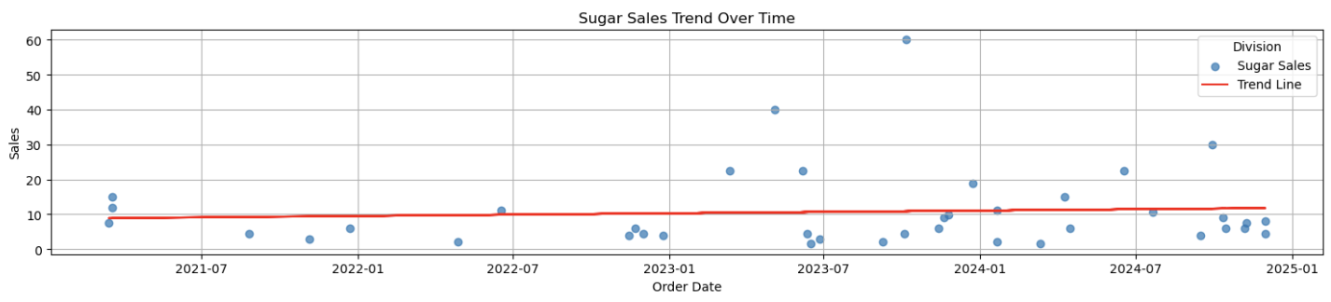
Sugar sales trend over time
Nick Voltin
Notes:
This is a scatter plot showing sugar sales over the same time period. Again, the slope is small at 0.0021 but it is at least positive. The P-value is 0.649 which again means that the trend is not statistically significant.

Slide 8
Other sales trend over time
Nick Voltin
Notes:
This last scatter plot shows the sales in the Other category. The slope is 0.0035 which is still small but at least positive. The P-value is 0.527 which is the smallest of the 3 but still tells us the trend is not statistically significant.

Slide 9
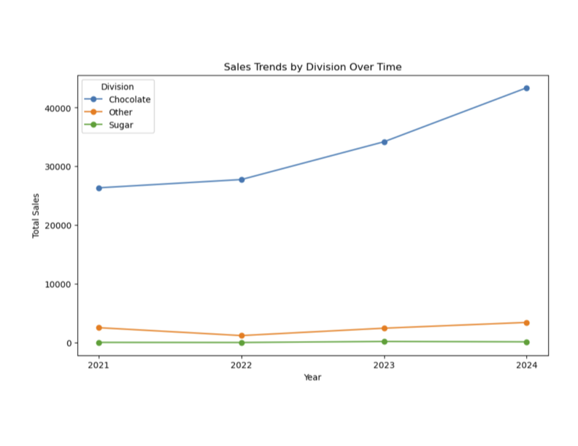
Sales trends by division over time
Nick Voltin
Notes:
This line graph shows the total sales of each category over the four years. It shows that chocolate is by far the best performer.

Slide 10
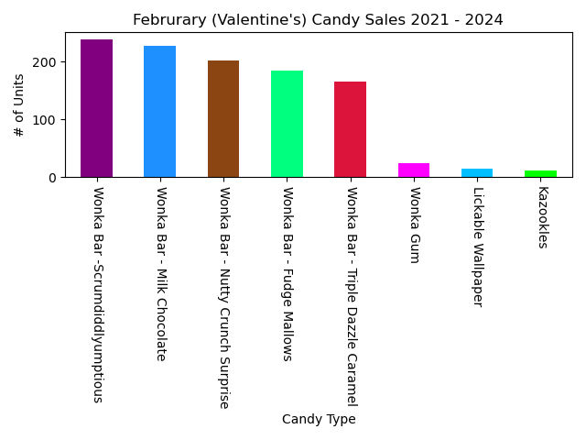
February Candy Type Preference?
Top 5 Candies:
Scrumdiddlyumptious
Milk chocolate
Nutty crunch surprise
Fudge mallows
Triple dazzle caramel
Eric dominguez

Slide 11
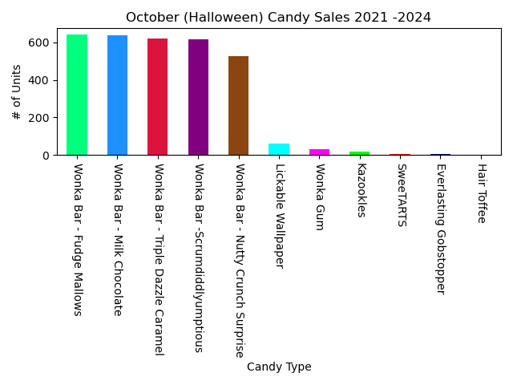
October Candy Type Preference?
Top 5 Candies:
Fudge mallows
Milk chocolate
Triple dazzle caramel
Scrumdiddlyumptious
Nutty crunch surprise
Eric dominguez

Slide 12
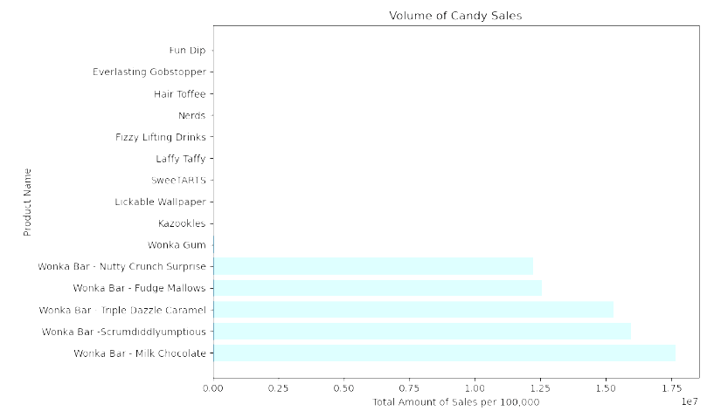
Volume Of Candy Sales
Over a 4 Year period
wonka bar (Milk Chocolate) had the highest Volume of Candy sales Followed by the other versions of wonka bars
Followed by the rest of the candy
AIDAn LYne

Slide 13
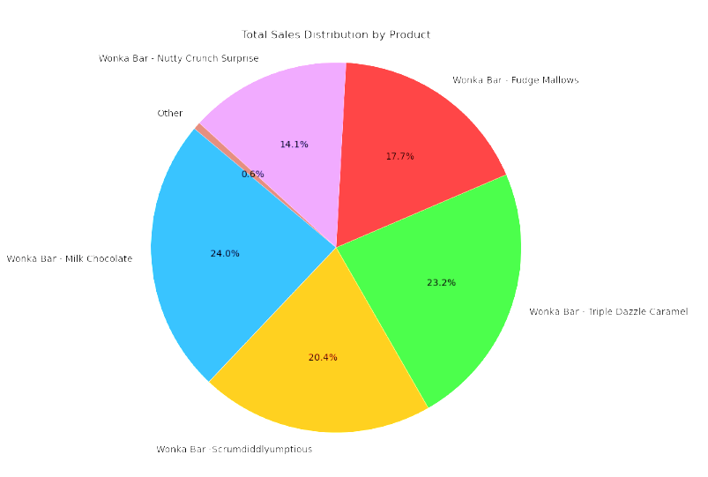
Dollar Amount of candy sales
The Pie chart shows us that the market has been dominated by Wonka bars with over 99% of total market sales being within the one company.
This shows us that the other candy companies in the market need to change their business strategies in order to have more competition within the candy market.
AIDAn LYne

Slide 14
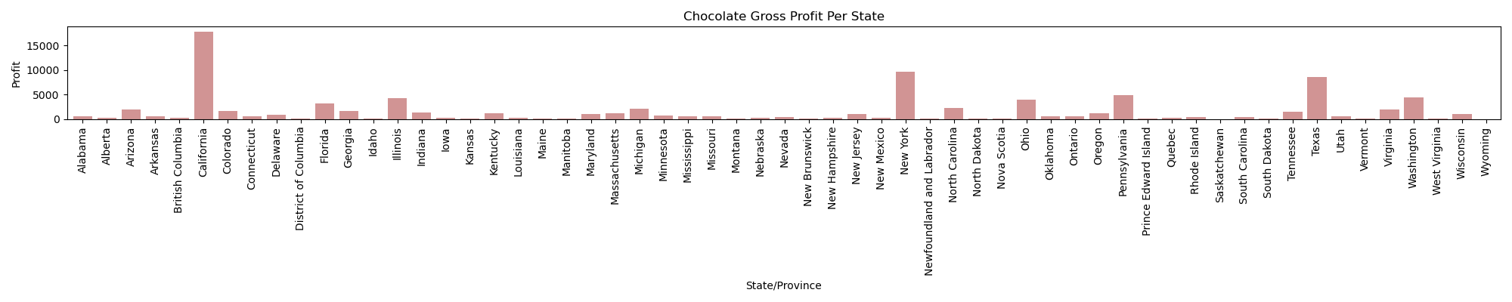
State Findings Based ofF Profit
Chocolate Profit Per State/Province
Bianca Torres
Notes:
Profit for Chocolate: CA, NY & TX, have the highest profit in chocolate, with CA dominating in chocolate profit compared to all other states.

Slide 15
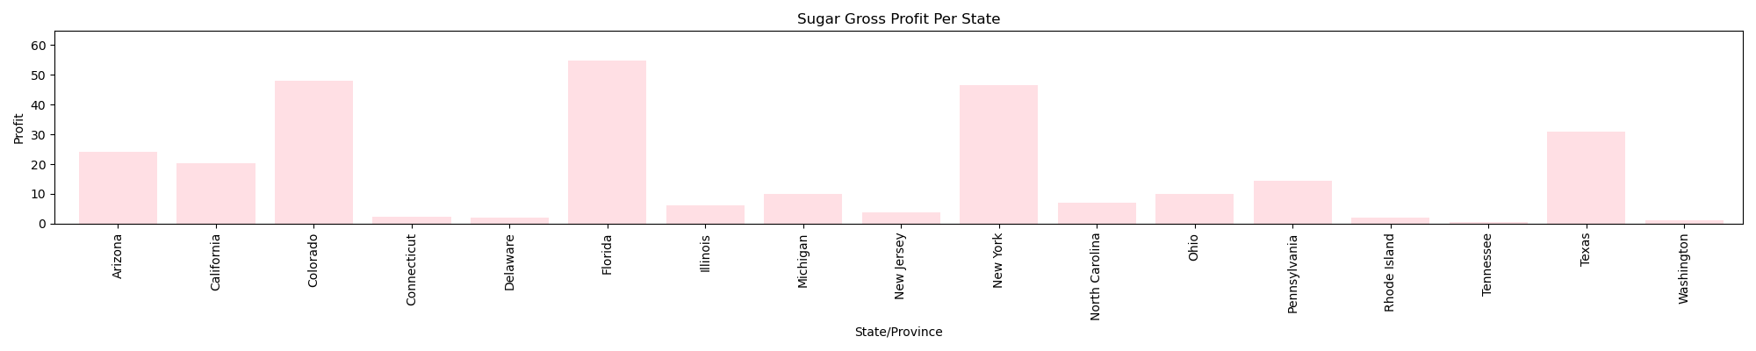
State Findings Based ofF Profit
Sugar Profit Per State/Province
BIanca Torres
Notes:
Sugar Profit: Florida has the highest profit made in sugar, but overall we can assume based off this graph that most states don’t make much profit off of sugary candies.

Slide 16
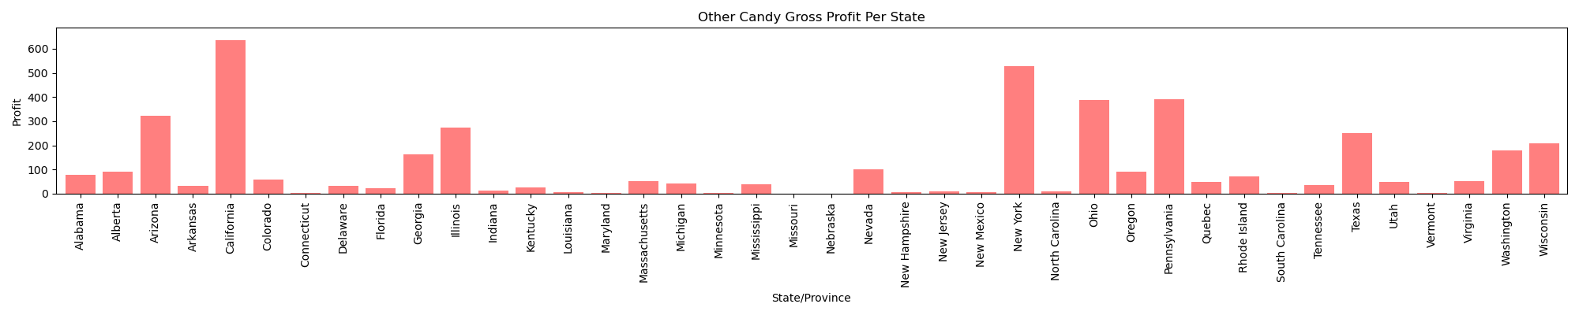
State Findings Based ofF Profit
Other Candy Profit Per sTATE/pROVINCE
Bianca Torres
Notes:
Other candy: based off this graph, we can see more states have a better profit in selling candies that are not sugar or chocolate base. CA & NY make the highest profit, with CA still making the most.
Overall: most states would invest in chocolate based candy, due to more states being involved with chocolate sales. Second favorite type of candy that states would invest in is other candy types that are not chocolate or sugary, due to having the second most states invest in other candies, and lastly sugary candy would come in last to invest in having the least amount of states invest in sugary candies.

Slide 17
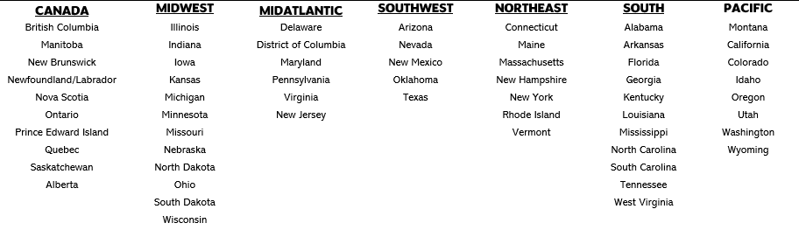
rEGIONAL lEGEND
YVETTE SAUL

Slide 18
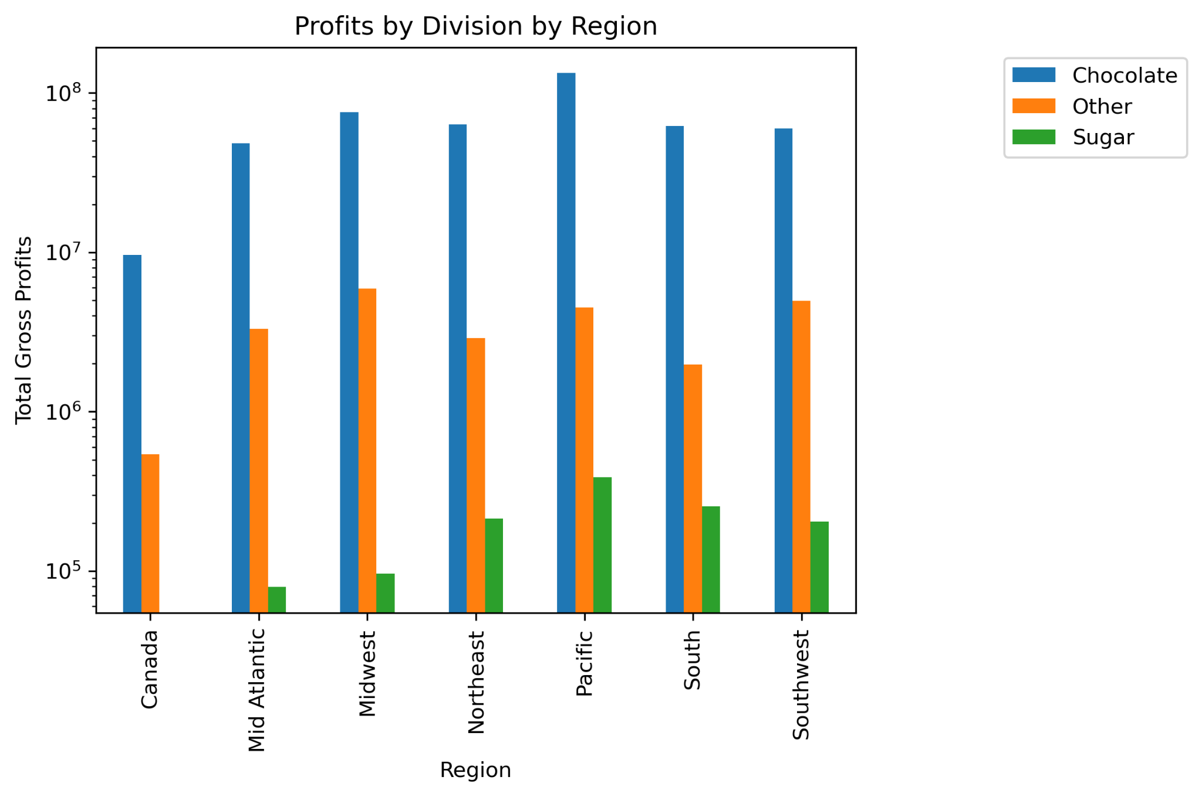
pROFITS PER TYPE OF CANDY BY REGION
YVETTE SAUL
Notes:
As evidenced by the chart, Chocolate type candies exponentially outperforms all other types of candy across the regions. It is clear that Marketing focused on Chocolate would deliver more bang for the buck. However, there is a lot of opportunity for growth in the other areas that could bear results with correct marketing and targeting.

Slide 19
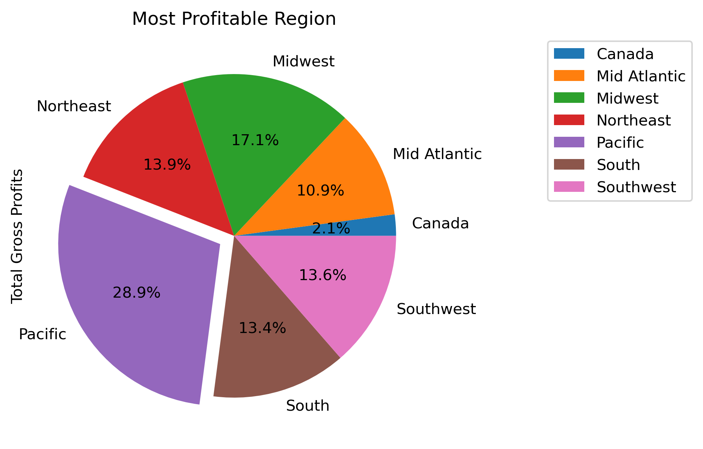
mOST pROFITABLE rEGIONS OVERALL
yVETTE SAUL
Notes:
As previously highlighted in our state by state analysis, each state has some specific preferences for the type candy. However, overall, the Pacific region (California, Colorado, Idaho, Oregon, Utah, Washington and Wyoming) outpaces the other regions with almost 30% of profits generated. Canada brings up the rear, generating only 2.1% of total profits. The remaining 69% of profits are evenly distributed across the opther 5 regions, randing from ~11% in MidAtlantic to 17% in the MidWest.. T

Slide 20
Candy Sales Summary 2021 - 2024
February: the lowest candy sales
October: higher sales than February (not the highest)
Season: Fall has the highest sales
Chocolate sales: trended up over time
Scrumdiddlyumptious = February winner!
Fudge Mallows = October winner!
California dominates in chocolate profit
Florida dominates the sugar profit margin
Chocolate has the most profit by Region
Most profitable region: Pacific

