Slide 1





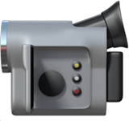






Content Opportunity Finder
NTU Module 3 · Congrui Liu
Turns YouTube comments into 3 video ideas a week for AI creators
TARGET USER
AI YouTube creator
AI Career · AI Tools · AI Agents
PAIN POINT
Too many comments
today: ~3 h a week reading by hand
GOAL
3 video ideas a week
backed by real viewer questions
My idea: a video is worth making when the comments show 3 signals
DEMAND
Many people ask it
+
GAP
Few videos on it
+
FRESHNESS
Rising this week
=
OPPORTUNITY
Worth filming now
→
score = 45% demand
+ 35% gap + 20% fresh
same question, many people
asked, but no/few video yet
topic last week ↑ vs the weeks before
How it works: 5 steps from raw comments to 3 videos
51,447 comments
→
25,226 clean
→
→
50 topics
→
3 videos / week
3,678 Y/N questions
YouTube API · 120 days
English, no spam
Supervised: classify comments
L03 · L04 · L09
Unsupervised: K-Means
L05 · L09
Score + back-test
L06 · L09
Notes:
Opening. Target user = AI YouTube creator. Pain: too many comments, same question in many wordings. Opportunity = Demand + Gap + Freshness (each measured on slide 9).
If asked 'why ML?': 51,447 comments cannot be read by hand; meaning-based grouping needs embeddings.

Slide 2


01 Overview
02 Data
cleaning · time split
03 Filter
04 Topics
05 Score & check
06 Result
2
Data: real, recent comments; half was noise; split by time
DATA 51,447 raw › 25,226 clean
▸
FILTER 493 labels › 356 train · 137 test › 3,678 questions
▸
TOPICS 2,574 Jul–Sep · 1,104 Oct › 50 topics
▸
SCORE 3 videos
1 Collect
2 Clean: 51,447 → 25,226
3 Split by time (L06)
1
Official YouTube Data API
120 days (fresh enough) · 28 Jun – 26 Oct 2026
Collected
51,447
Cut on 28 Sep
English videos only
langdetect (language library)*
40,805
Train
3 months · 16,523
Test
4 wk · 8,703
2
3 niches = my 3 content lines
AI Career · AI Tools · AI Agents
At least 5 words
27,131
3
5 real search words each
e.g. "how to get a job in AI"
28 Jun
28 Sep
26 Oct
English comments
langdetect*
25,658
Why not random?
51,447 comments
1,282 videos · 893 channels
names hashed (HMAC*)
Hindi-in-English removed
word list*
25,424
October comments would leak into training.
The tool only knows the past, so we test it that way.
Spam removed
same text 3+ times
25,226
≈ half was noise · * beyond the course
Key point
Real, recent comments; split by time so the model never sees the future (L06).
Notes:
Collect → clean → split.
Beyond the course: langdetect (guesses language from letter patterns), Hindi word list (patch for langdetect), HMAC hash (count people without storing names).
If asked 'why split by time?': random split leaks October into training; the real tool only knows the past (L06).

Slide 3

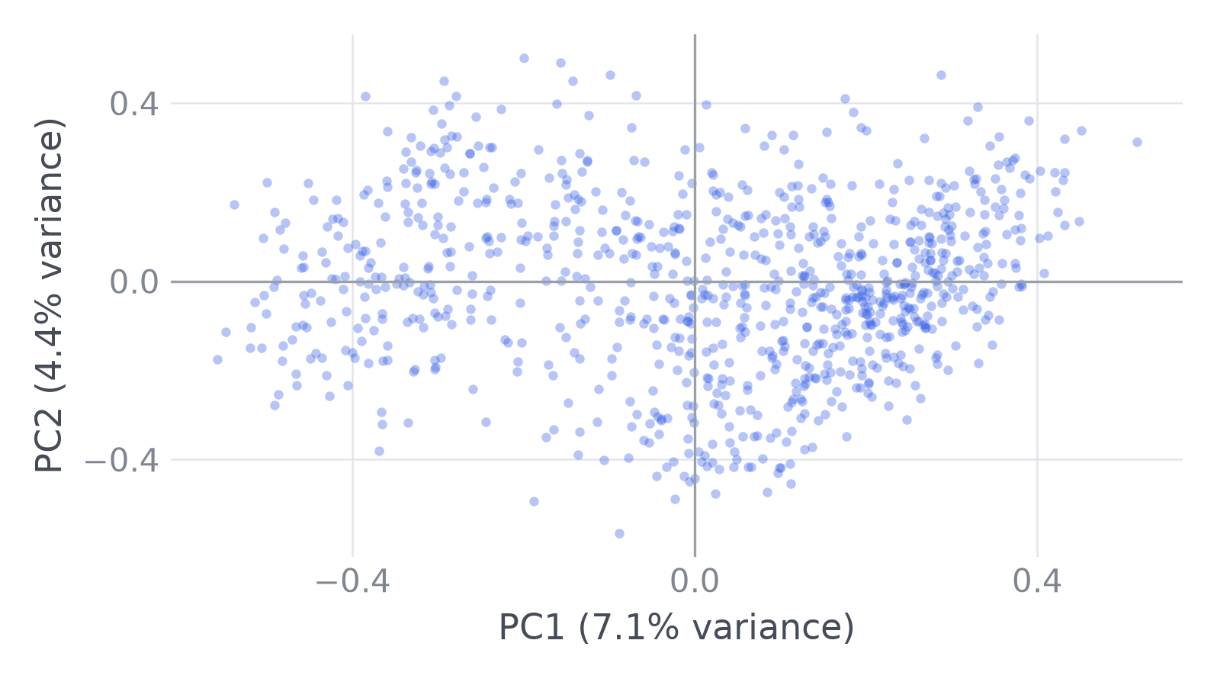
01 Overview
02 Data
EDA
03 Filter
04 Topics
05 Score & check
06 Result
3
EDA: 3 findings, each changed one step
What we saw → the evidence → what we changed
1 Wording
2 PCA
3 Viral
→ 04 Topics
→ 04 Topics
→ 05 Score
Finding
No clear groups
One video fakes a trend
Same meaning, different words
Evidence
"Is this really free?"
"Do I have to pay for it?"
e.g. AI Career · 6,170 comments
TF-IDF · 0 shared words
0 unrelated
MiniLM · meaning (L09)
0.54 similar
53% of the 16,523 training comments sit under just 10% of the videos
59% of 16,523 training comments: closest in meaning, almost no shared words (MiniLM, L09).
Example: AI Career, 6,170 comments. No clear groups. Silhouette score 0.02–0.09:
A popular video can look like a trend, so counting comments would mislead.
Change
→ Group by meaning (MiniLM)
→ No natural K: choose it in 04
→ Count people, max 3 per video
Key point
Group by meaning · K must be chosen, not found · count people, not comments.
Notes:
Model: all-MiniLM-L6-v2, the same pretrained sentence-transformer as Lesson 9 (22M params, 384 numbers); used as is, not retrained.
EDA, each finding changed one step. Findings 2 and 3 came from a first run of the pipeline, then changed the final build (iterative).
1 Wording: TF-IDF 0 vs MiniLM 0.54; 'Great video, thanks!' scores only 0.09. Cosine is a ranking signal, not a percentage (L09).
2 PCA: AI Career 912 questions, PC1 7.1% + PC2 4.7% of variance; one cloud → K must be chosen (slide 7).
3 Viral: 7 of 50 topics have >30% of questions from one video; e.g. 'Hardware to run AI locally': 10 of 19 people from one video → count people, max 3 per video.

Slide 4
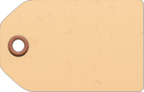

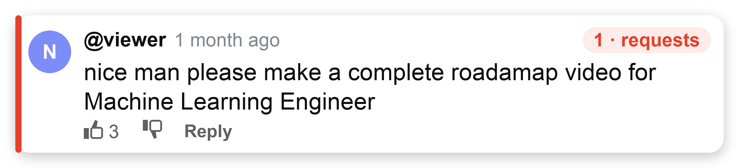
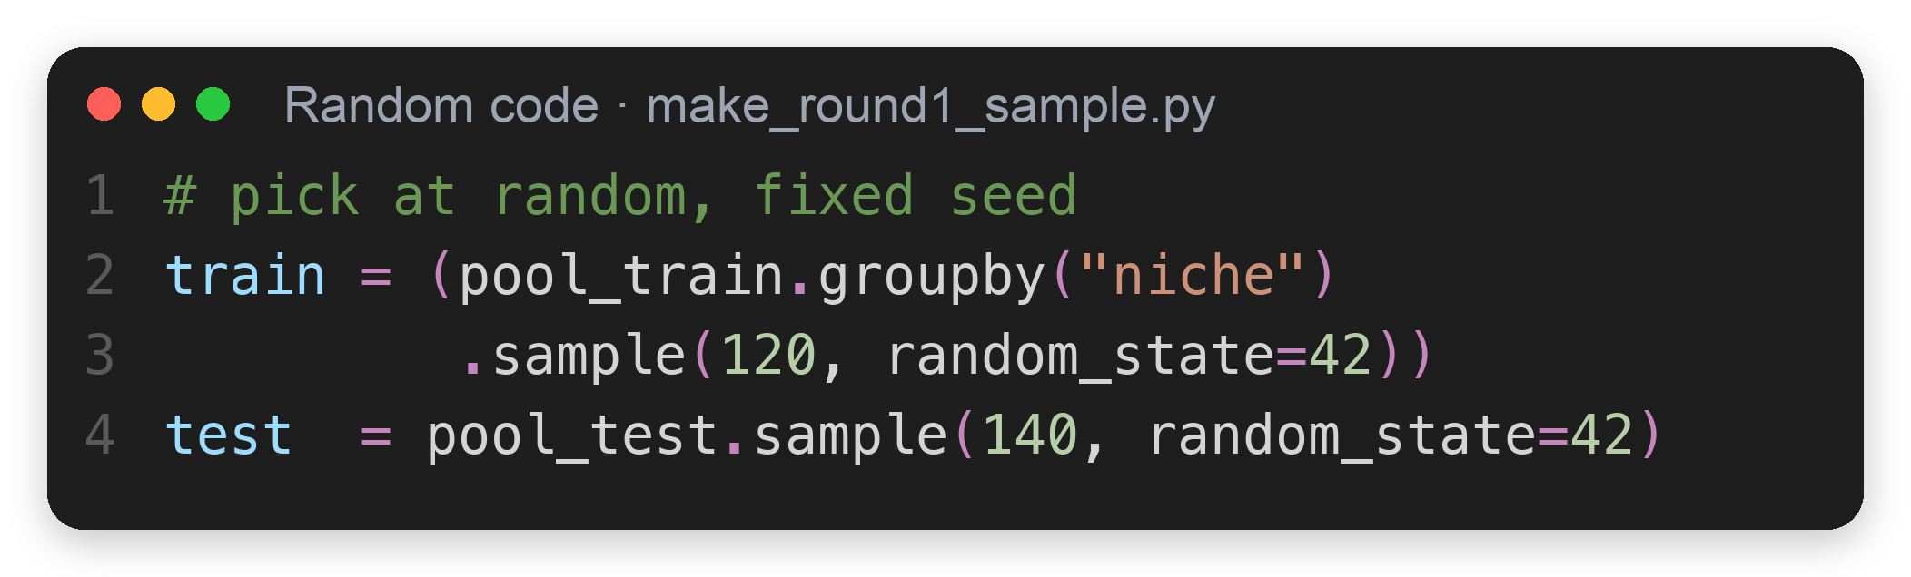
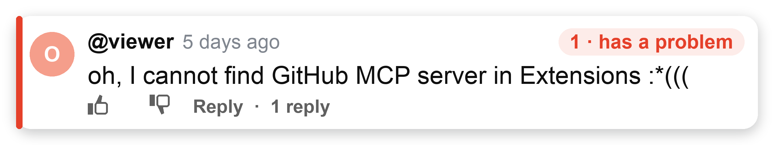
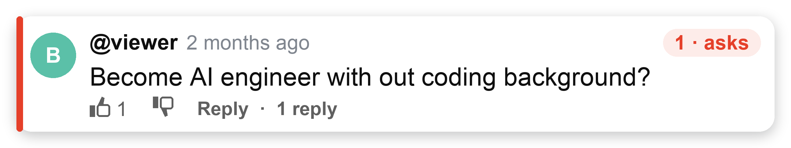
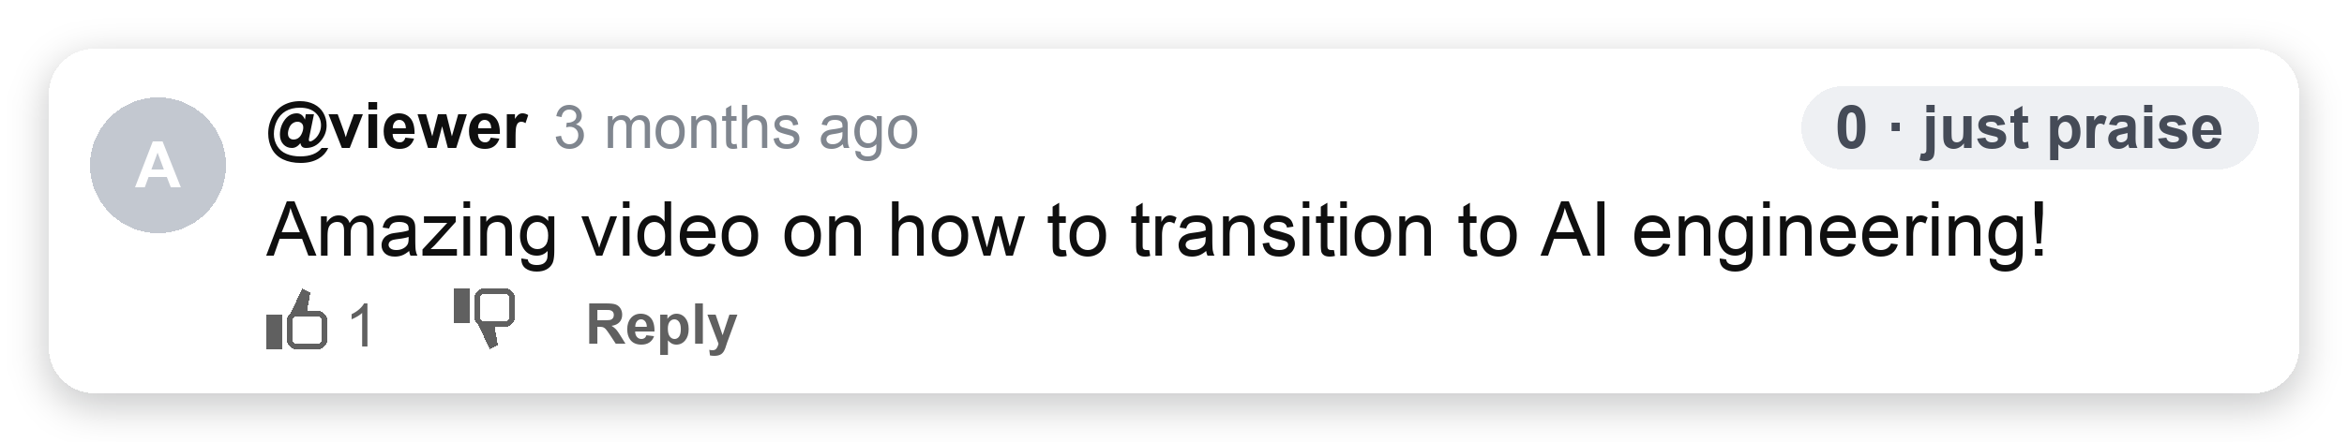
01 Overview
02 Data
03 Filter
Supervised · NLP
04 Topics
05 Score & check
06 Result
4
Find questions (supervised) ①: labels, the answer key
DATA 51,447 raw › 25,226 clean
▸
FILTER 493 labels › 356 train · 137 test › 3,678 questions
▸
TOPICS 2,574 Jul–Sep · 1,104 Oct › 50 topics
▸
SCORE 3 videos
1 What is a question?
2 How many labels?
3 Few labels: 2 checks
Question (1) = the viewer asks for something a video could give
493 comments to label 1 or 0
Check 1 · Unstable scores
↓ ① picked at random
If so: one model looks better just by luck
① CV
gap < SD of 5 fold scores → could be luck
slide 6
Check 2 · Works on new data?
↓ ② split by time (28 Sep)
If so: good on training comments, bad on new ones (overfitting)
Train
356
74 questions (21%)
① test
answered only by the unseen October test
slide 7
Jul–Sep · ~120 per niche
Test
137
19 questions (14%)
↓ ↓
Both checks: confirm on the unseen October test
slide 7
Oct
Key point
493 labels teach and test the filter.
Notes:
Labels = answer key for supervised learning.
Sampling: 360 Jul–Sep (120 per niche) + 140 Oct, random, seed 42 (src/make_round1_sample.py); 7 removed by the Hindi filter → 493.
Same-topic pair (AI engineer): MiniLM similarity 0.63 but one is a need, one is praise; sets up slide 5.

Slide 5


01 Overview
02 Data
03 Filter
Supervised · NLP
04 Topics
05 Score & check
06 Result
5
Find questions (supervised) ②: how we grade
DATA 51,447 raw › 25,226 clean
▸
FILTER 493 labels › 356 train · 137 test › 3,678 questions
▸
TOPICS 2,574 Jul–Sep · 1,104 Oct › 50 topics
▸
SCORE 3 videos
1 Score: F0.5 + a floor
2 Exam: 5-fold CV
3 Bar: baseline
What do we measure?
How do we test fairly? (356 training labels)
What must a model beat?
Only 21% are questions
1
grade
learn
learn
learn
learn
Rule: "?" = a question
21%
79% others
2
learn
grade
learn
learn
learn
actually yes
actually no
↓ causes
says yes
40
26
Class imbalance (L03): accuracy misleads
3
learn
learn
grade
learn
learn
↓ so use
4
learn
learn
learn
grade
learn
says no
34
256
Precision
kept ones are real?
Recall
found all real ones?
5
learn
learn
learn
learn
grade
each fold ≈ 71, 15 questions (21%, stratified)
Precision 40/66 = 0.61
Recall 40/74 = 0.54
↓ fakes inflate a topic, so precision first
↓
F0.5 = (1 + 0.5²) × P × R / (0.5² × P + R)
F0.5 precision counts ×2
average = CV score → pick the model
Baseline F0.5
0.59
every model must beat it
TO RANK
so the real test can wait:
October test closed until slide 7
Key point
Rank by F0.5 · pick by 5-fold CV · beat the "?" rule (0.59).
Notes:
5a. Only the 356 training labels; 137 test labels locked.
5-fold CV (L03): 5 rounds, each learns on ~285 and grades ~71 it never saw; the average is the CV score.
Baseline = common sense: a '?' means a need. Confusion matrix (L03) on the 356: correctly flagged 40, false alarm 26, missed 34, correctly ignored 256.
Precision 40/66 = 0.61, recall 40/74 = 0.54, F0.5 = 1.25×P×R/(0.25×P+R) = 0.59 (F-beta with beta 0.5, only if asked). A stronger hand-written keyword rule ('?' or request words) scores 0.65; only if asked.
Pipeline (L03): TF-IDF is fit inside each fold, so the graded fold never leaks into training.
Threshold: lowest cut-off with CV precision ≥ 75% → 0.50 for gradient boosting (slide 6).

Slide 6


01 Overview
02 Data
03 Filter
Supervised · NLP
04 Topics
05 Score & check
06 Result
6
Find questions (supervised) ③: features, then model
DATA 51,447 raw › 25,226 clean
▸
FILTER 493 labels › 356 train · 137 test › 3,678 questions
▸
TOPICS 2,574 Jul–Sep · 1,104 Oct › 50 topics
▸
SCORE 3 videos
1 Features: turn comments into numbers
2 Pick the model
all scores: CV on the 356 training labels
Baseline F0.5 0.59
Model
Precision
Recall
CV F0.5
CV gap vs 0.59
0.61
Word counts
TF-IDF (L09), keeps how / what / can
Baseline: "?" only
0.61
0.54
0.59
–
Logistic regression
0.75
0.41
0.64
+0.05
0.45
Meaning
all-MiniLM-L6-v2 (L09)
Random forest
0.79
0.30
0.59
±0
Gradient boosting ✓
0.75
0.49
0.68
+0.09
Why worse? It sees the topic, not the intent.
↓ tuned by grid search (L04): lr × depth · default 0.65 → 0.68 (+0.03, small)
0.64
Meaning + 3 rules ✓
Output Dimension 384 + 3 joined = 387
→ only 3 of 5 beat the baseline
5-fold CV: 5 scores of GB
0.55
0.59
0.71
0.77
0.80
the 3 rules are: simple yes/no signs of a question
baseline 0.59
average 0.68 ± SD 0.10
"?"
question mark
how
how / what / can
please
please / help
↓
✓
Check 1 · better or just lucky? → impact: small gaps only
gap 0.09 < SD 0.10 → CV can’t tell → decide on the test (slide 7)
Key point
GB was best by CV (0.68 vs 0.59), but within ±0.10: the final test decides.
Notes:
5b. Rule evidence: '?' in 54% of needs vs 9% of others; question word 34% vs 5%; request 27% vs 3%; 34 of 74 needs have no '?'.
MiniLM alone is low: it groups by topic, not by how it is asked. Stop-words kept in the filter (how/what/can are the signal).
Precision ≈ 0.75 for all models by design (cut-off keeps precision ≥ 75%). GB +0.09 over the '?' rule, close to the CV spread ±0.10, so the test decides.

Slide 7

01 Overview
02 Data
03 Filter
Supervised · NLP
04 Topics
05 Score & check
06 Result
7
Find questions (supervised) ④: the final exam
DATA 51,447 raw › 25,226 clean
▸
FILTER 493 labels › 356 train · 137 test › 3,678 questions
▸
TOPICS 2,574 Jul–Sep · 1,104 Oct › 50 topics
▸
SCORE 3 videos
3 Final exam on test data
✓ 🤔Answers to slide 4: small labels
TRAIN
Jul–Sep · 356 labels · learn + CV
TEST
Oct · 137
The 2 checks SD = how much the 5 CV scores swing
Check 1 · Better, or just lucky?
Check 2 · Works on new data?
locked during training → opened once, here · 19 real questions inside
slide 4
slide 4
Gradient boosting
caught 13 of 19 · 5 false alarms
slide 6: gap 0.09 < SD 0.10
CV 0.68 → test 0.71: yes
test: gap 0.26 > SD 0.10 → better
"?" rule
↓ why
caught 10 of 19 · 13 false alarms
Train vs test: what does the model do?
● caught ○ missed
TRAIN · 356 with answers
learns
MiniLM meaning + 3 rules → question?
TEST · 137, answers hidden
learns nothing
applies train's model
Gradient boosting F0.5 0.71
VS
"?" rule F0.5 0.45
→ Use gradient boosting: reads all 25,226 comments, keeps 3,678 questions
Both use MiniLM; only train learns.
Pre-trained (more than 1 billion training pairs) → 356 labels were enough.
Key point
October exam: gradient boosting wins (F0.5 0.71 vs 0.45).
Notes:
Grid search covered learning rate × depth only (4 combos); leaf size 20 is the default, checked separately.
Overfitting cause: 387 features, 356 rows. LR gap is smaller (0.13) but its CV 0.64 is below the rule.
Threshold 0.50 = lowest cut-off with CV precision ≥ 75%, a business choice (L03).
Test: 13 of 18 kept were needs = 72%; 95% range 49–88%; test F0.5 0.71 vs CV 0.68 is normal noise with 19 needs.
If asked 'CV shuffles but test is by time?': the filter classifies one comment at a time, it does not forecast; the real test is time-based.

Slide 8

01 Overview
02 Data
03 Filter
04 Topics
Unsupervised · NLP
05 Score & check
06 Result
8
Topics (unsupervised) ①: group by words or by meaning?
DATA 51,447 raw › 25,226 clean
▸
FILTER 493 labels › 356 train · 137 test › 3,678 questions
▸
TOPICS 2,574 Jul–Sep · 1,104 Oct › 50 topics
▸
SCORE 3 videos
1 Group 2,574 questions: 4 ways
2 Which way is steadiest? (Adjusted Rand Index, L05)
By words baseline
TF-IDF: same words → same group
short questions share few words → 1 leftover group (AI Tools: 24%)
ARI = do repeated runs give the same groups?
Run each way 5 times with different random starts; compare every pair of runs
0 = no better than random · 1 = identical groups · higher = steadier
By meaning L09
MiniLM: same meaning → same group
"Can I do the same with Claude?" ≈ "What tier Claude would I need?"
Career
Tools
Agents
Words
0.30
0.23
0.43
By meaning + PCA L05
384 → ~90 numbers, 80% of info kept
less noise before grouping
Meaning
0.37
0.47
0.58 ✓
+ PCA
0.49 ✓
0.53 ✓
HDBSCAN*
finds crowds by itself
but leaves 15–32% of questions in no group
0.49
HDBSCAN*
0.34
0.51
0.21
* beyond the course
✓ = steadiest
→ we use it
0 random
0.5
1 same
Key point
Grouping by meaning was steadiest in all 3 content lines (✓), so that is what we use.
Notes:
Topics learned on 2,574 Jul–Sep needs; October's 1,104 used only to check (78–88% fit).
K: silhouette 0.02–0.09 for every K, like NorthStar (L05) → choose K for actionability: each topic ≤ 12% (even split of 10–25 topics = 4–10%; without the rule one AI Agents topic held 41%).
HDBSCAN (beyond course): density clustering, picks its own number of groups, left 15–32% out. Angles: combining 20 runs = voting (beyond course). 37 of 50 judged filmable.

Slide 9


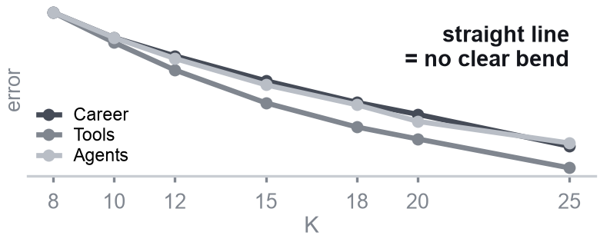
01 Overview
02 Data
03 Filter
04 Topics
Unsupervised · NLP
05 Score & check
06 Result
9
Topics (unsupervised) ②: how many topics? Choose K
DATA 51,447 raw › 25,226 clean
▸
FILTER 493 labels › 356 train · 137 test › 3,678 questions
▸
TOPICS 2,574 Jul–Sep · 1,104 Oct › 50 topics
▸
SCORE 3 videos
1 Natural K in the data?
2 So I set 2 rules for K
3 Result: K per line
AI Career · 912 questions
→ cut →
K = 15 topics
→
1 topic = 1 video idea
e.g. "Becoming an AI engineer without a coding background"
97 questions → 1 video
Elbow a natural K shows as a bend
The data can't pick K, so I set 2 rules:
each topic must work as 1 video idea
Break a rule → ✗ out · rest → highest silhouette
K tried
8
10
12
15
18
20
25
Rule ① 1 video can't cover too much: ≤ 12%
Career
✗
✗
✗
.044
.028
.044
.040
biggest topic ≤ 109 of 912 questions (12%) → else mixed
Tools
✗
✗
✗
.063
✗
.069
.063
✗ straight line: no bend
K = 8
✗ 16%
Silhouette a natural K scores near 1
143 of 912 questions → too mixed
Agents
✗
✗
.055
.059
.052
.039
.054
K = 15
✓ 11%
✗ ours 0.03–0.09
97 questions → 1 video
12%
✗ broke a rule · number = silhouette · red = chosen K
−1 wrong
0 overlap
1 clear
Why 12%? my choice: ≈ 2× an average topic (1/15 = 6.7%)
Career: 15 ≈ 20 (0.0438 vs 0.0437), almost a tie
No: the data can't tell us K
→ we must choose K ourselves
Rule ② Not too many: 10–25 topics
my choice: a creator can read the list each week
15 + 20 + 15 = 50 topics
Career · Tools · Agents → 50 video ideas to score
Key point
No natural K in the data, so we chose K so each topic = 1 video: 50 topics.
Notes:
Topics learned on 2,574 Jul–Sep needs; October's 1,104 used only to check (78–88% fit).
K: silhouette 0.02–0.09 for every K, like NorthStar (L05) → choose K for actionability: each topic ≤ 12% (even split of 10–25 topics = 4–10%; without the rule one AI Agents topic held 41%).
HDBSCAN (beyond course): density clustering, picks its own number of groups, left 15–32% out. Angles: combining 20 runs = voting (beyond course). 37 of 50 judged filmable.

Slide 10


01 Overview
02 Data
03 Filter
04 Topics
Unsupervised · NLP
05 Score & check
06 Result
10
Topics (unsupervised) ③ follow-up check: fit October?
DATA 51,447 raw › 25,226 clean
▸
FILTER 493 labels › 356 train · 137 test › 3,678 questions
▸
TOPICS 2,574 Jul–Sep · 1,104 Oct › 50 topics
▸
SCORE 3 videos
1 Draw a ring around each topic (Jul–Sep)
2 Do October questions land inside?
TRAIN
draw on 2,574 Jul–Sep questions
TEST
check 1,104 Oct questions = 3,678 − 2,574
Example
Each October question → nearest topic centre
T-shirt sizes: fit 90% of last year's customers → this year's still fit?
→ Our case: rings fit 90% of Jul–Sep → does October still fit?
inside = old topic ✓
outside = new theme
K-Means predict
October questions inside the ring
Jul–Sep 90%
least typical 10%
left out
① Centre = average of the topic
AI Career
88%
Centroid · L05
AI Tools
78%
② Distance = how similar to the centre
AI Agents
81%
centre
Cosine · L09
③ Ring = holds the 90% nearest
78–88% ≈ 90%: most October questions are inside
↓ viewers keep asking about the same things
↓ the 50 topics still work for new weeks: no rebuild
check weekly: below 75% → too many new themes → re-cluster
10th percentile
● = 1 Jul–Sep question
Jul–Sep = 90% inside, by design → our reference line
Why 90%? 100% = too loose (everything fits) · 50% = too tight
Key point
Viewers keep asking about the same things (78–88% inside vs 90%) → keep the 50 topics.
Notes:
Topics ②. K = topics per content line: AI Career 15, AI Tools 20, AI Agents 15 = 50. Silhouette was 0.02–0.09 for every K, so K was chosen for action: the biggest topic ≤ 12% (even split of 10–25 topics = 4–10%; without the rule one AI Agents topic held 41%).
October check: 90% of Jul–Sep questions fit a topic; in October 88% / 78% / 81%. Broad beginner topics grow, so refresh monthly. 37 of 50 topics judged filmable. Angles (only if asked): each topic split into 1-video angles; combining 20 runs lifts ARI from 0.32–0.42 to 0.60–0.69 (beyond course).

Slide 11
01 Overview
02 Data
03 Filter
04 Topics
05 Score & check
NLP · time-series test
06 Result
11
Score: who asks, not yet answered, rising
Every Monday: each topic gets 3 signals → one score → Top 3 per content line
1 Score each topic
2 Gap: is there already a video? (L09 Semantic search)
Example: "Data science & ML career roadmaps" · AI Career
viewer comment
video title (90 days)
Demand
people ask
83
× 0.45 weight
+
Gap
no video yet
67
× 0.35 weight
+
Fresh
rising
58
× 0.20 weight
=
Score
72
↓ MiniLM
↓ MiniLM
meaning numbers
meaning numbers
↘ ↙
cosine: how close?
↙ ↘
rank 0–100 = how many of the other 12 Career topics it beats
weight = how much each counts: 45% + 35% + 20% = 100% (our choice)
≥ 0.60
a video already answers it
< 0.60
no video yet = gap
→ #1 of 13 AI Career topics: film it
0.60 = the cut that worked best (F1) on 150 checked comment–title pairs
Gap: each question vs. video titles — no match by meaning (< 0.60) = gap
Key point
Asked by many, little video yet, rising → this week’s #1 in AI Career scores 72.
Notes:
Score = 0.45 D + 0.35 G + 0.20 F, each as rank 0–100; weights are a product choice (no label for 'a good video').
Gap uses semantic search (L09): question vs recent titles, cosine ≥ 0.60 = answered; checked on 150 labelled pairs (ROC-AUC 0.82, precision 0.47: a hint, not proof).
Back-test (L06 rolling origin): hit = pick ends in the top half of next-4-week askers. Most asked 86% beats ours 70%, but 46% of its picks were already answered vs 13% of ours. 28 Sep was seen in an earlier version, so not fully unseen.

Slide 12
01 Overview
02 Data
03 Filter
04 Topics
05 Score & check
NLP · time-series test
06 Result
12
Back-test (L06): are our top picks still hot a month later?
Pretend it is a past Monday, pick with our score, then check the next 4 weeks
1 How we test (L06: past → future, no peeking)
2 What is "hot"? A real example
① 7 past Mondays (3 Aug – 14 Sep): use only data before that day
3 Aug · AI Career: people asking in the next 4 weeks
Time split · L06
No-code path to AI engineer
25
AI engineer roadmap (beginners)
25
② Our score picks Top 3 in each line → 7 × 3 lines × 3 = 63 picks
Data science & ML career roadmaps
20 ✓ hit
From data/software into AI eng.
16 ✓ hit
AI for job applications
16
Entry-level AI jobs
15
③ Wait 4 weeks: count different people asking each topic (1 person = 1)
Which AI course is worth it
14
Becoming an AI product manager
14
India: which path into tech
12
④ Hot? more people than half the topics in its line → hit ✓
Agentic coding workflows
10
our rule
Agent skills and MCP
10 ✗ miss
Claude vs Claude Code
9
Single vs multi-agent
3
red = our 3 picks → 2 hits of 3 ┆ = half the topics (14): right of it = hot
3 Result: add up all 7 Mondays → our 63 picks vs random
Random
3 topics by chance
≈ 30 hits / 63
47%
Ours
picked by our score
44 hits / 63
70%
Ours beats random
7 in 10 picks still hot a month later (random: under 5 in 10)
final check 28 Sep: ours 67%, random 49%
Baseline · L06
Key point
Ours: 44 of 63 picks (70%) were still hot a month later, vs 47% at random.

Slide 13
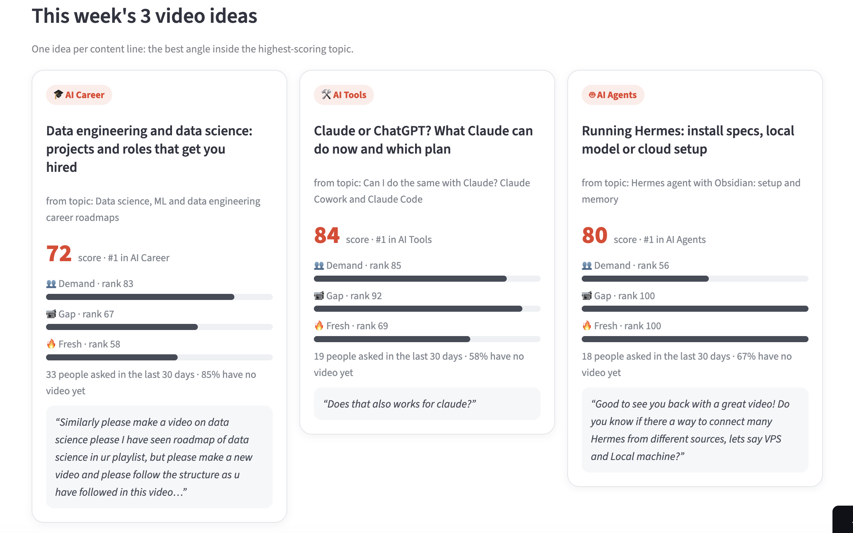


01 Overview
02 Data
03 Filter
04 Topics
05 Score & check
06 Result
deploy · next steps
13
Go live: the dashboard, its value, and what comes next
Streamlit dashboard: next week's 3 videos + 50 K-Means topics
Limit · opportunity · next step
LIMIT Few labels
Label more
OPPORTUNITY vs vidIQ / comment tools
they see searches or one video; mine finds what viewers across channels ask that no video answers, back-tested
SIZE (my time) Saves 2.5 h a week = 130 h a year
build ~50 h + 2 h a month upkeep → pays back in ~6 months
NEXT 8-week A/B test
A: most asked · B: ours · metric: 7-day views · roll out if B ≥ 1.1× A
Notes:
AI Tools pick: score 84 = 0.45×85 + 0.35×92 + 0.20×69.
If asked 'is Hermes a one-video trend?': in Jul–Sep 18 of 27 people came from one video, but this week it is 18 people from 9 videos and 7 channels (confidence High); demand also caps 3 people per video.
Limits: labels (kappa ≤ 0.31), small test (19 needs), ~70% gap is a trade-off and demand ≠ views (A/B test: ours vs most asked, 8 weeks, ≥1.1× views), drift (fit 90% → 78–88%; monitor weekly, < 75% → re-cluster).

