Slide 1
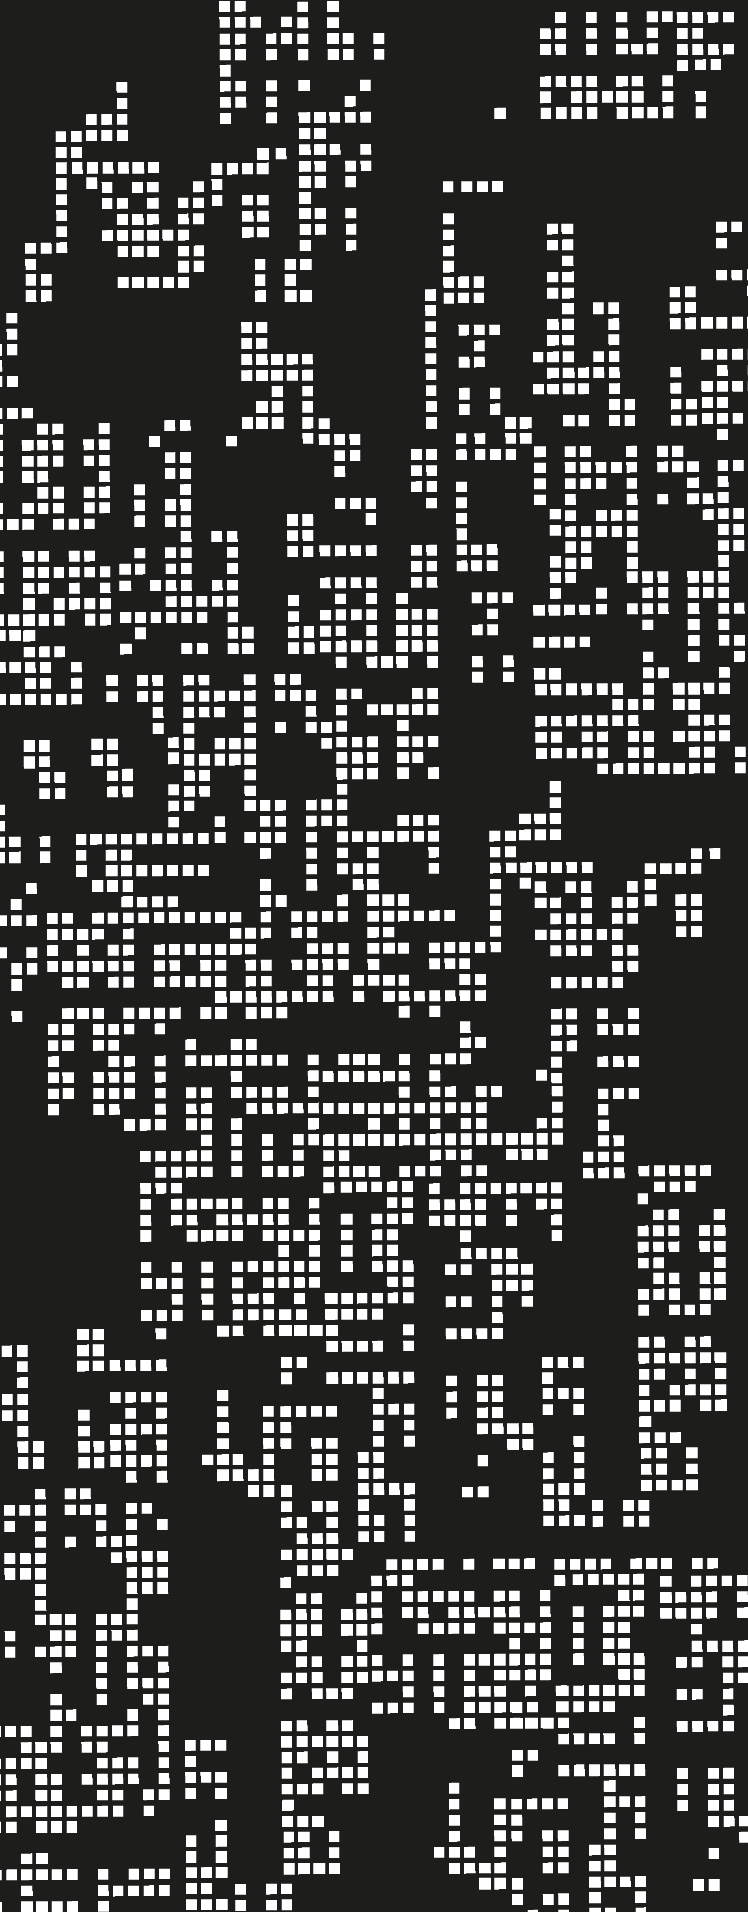
CPU
8_Above
Mentor: NGUYEN THI THIEN TRANG

Slide 2
Lê Tuấn Kiệt - 20200239
Nguyễn Tuấn Kiệt - 20200240
Phạm Tuấn Kiệt - 20200241
Dương Đình Linh - 20200246
Võ Thành Lộc - 20200251
Huỳnh Văn Vũ Luân - 20200252

Slide 3
CONTENTS
01
Definition
02
Structure
03
Specifications
04
Design
CPU 4-bit
MU, ALU, CU, …
Clk, integer range, …
Inspect, conclude, …
8_Above

Slide 4
DEFINITION
01
8_Above

Slide 5
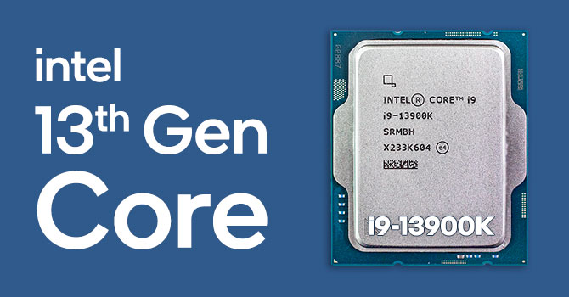
What is CPU?
8_Above

Slide 6
STRUCTURE
02
8_Above

Slide 7
Structure of CPU
Control Unit
INPUT
ALU
OUTPUT
Memory Unit
CPU
8_Above

Slide 8
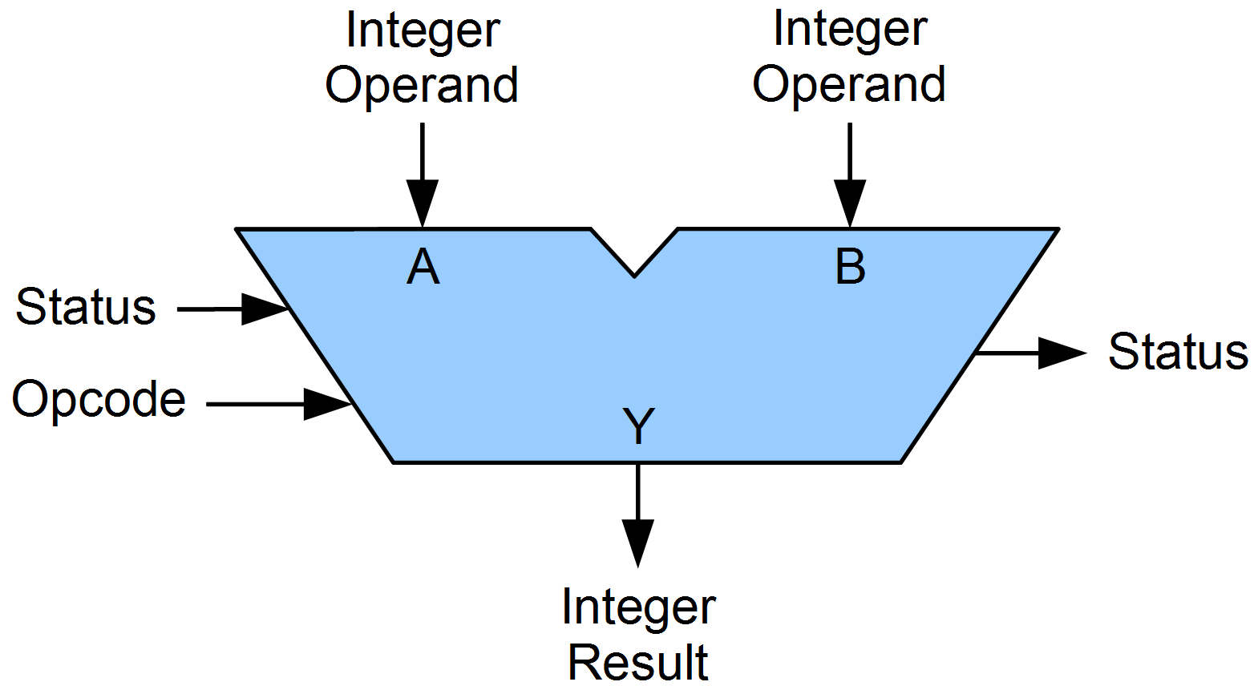
ALU
8_Above

Slide 9
Outstanding
Full adder
Decoder 3 to 8
Muxtiplexer 4 to 1
Muxtiplexer 8 to 1
8_Above

Slide 10
FULL ADDER
8_Above

Slide 11
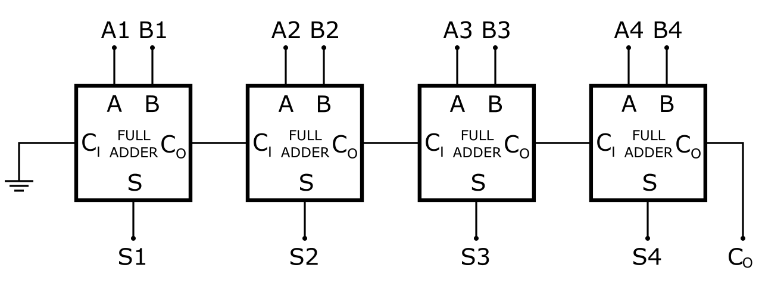
8_Above

Slide 12
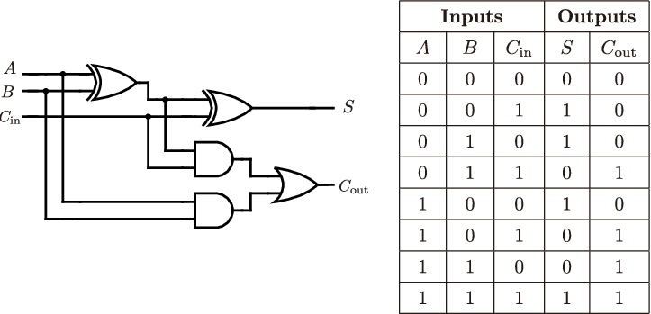
S = A⊕B⊕Cin
Cout = A.B+A.Cin+B.Cin
8_Above

Slide 13
DECODER 3 to 8
8_Above

Slide 14
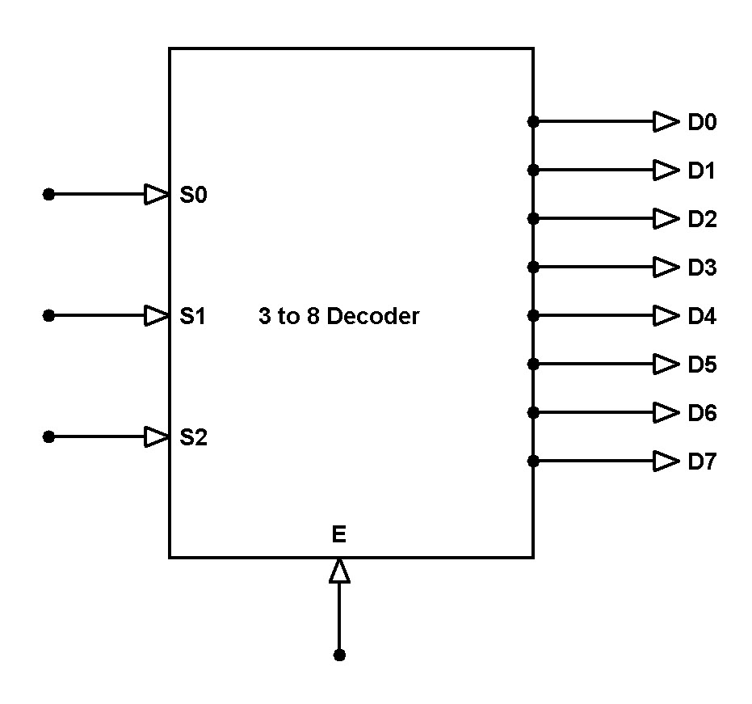
8_Above

Slide 15
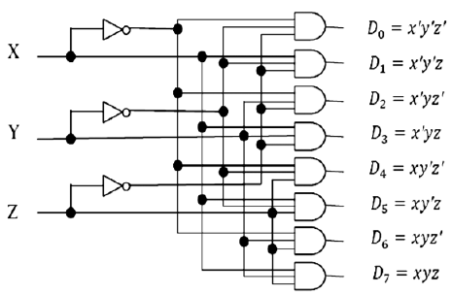
8_Above

Slide 16
MUX 4 to 1
8_Above

Slide 17
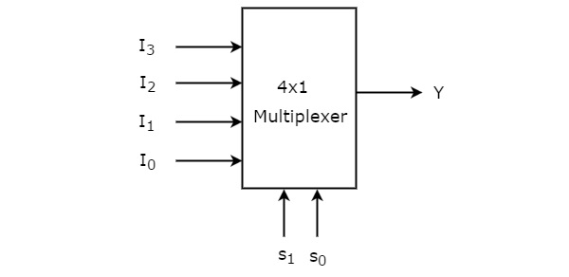
8_Above

Slide 18
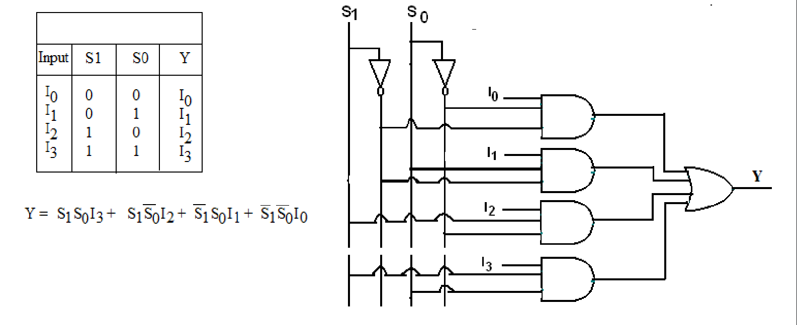
8_Above

Slide 19
MUX 8 to 1
8_Above

Slide 20
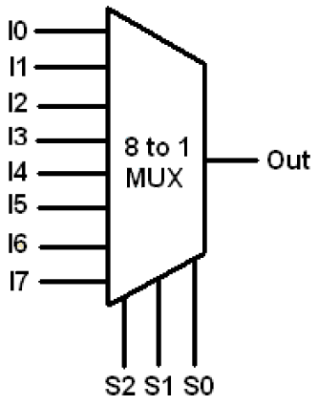
8_Above

Slide 21
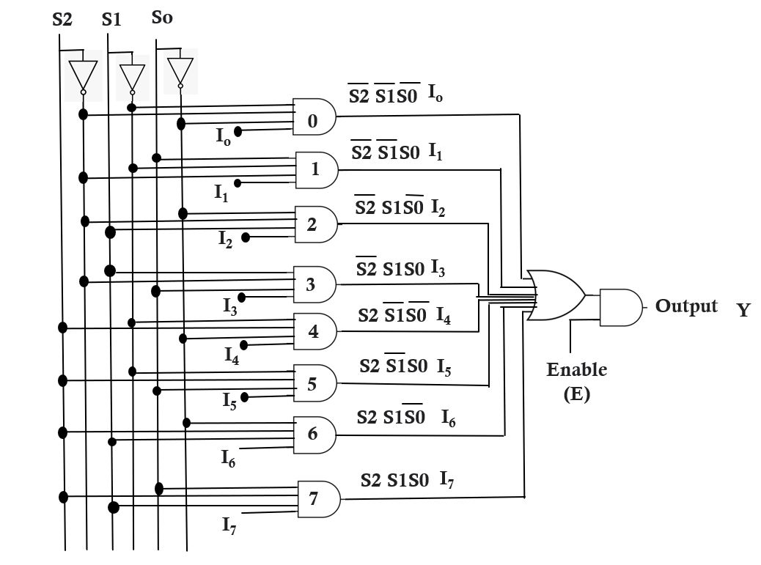
8_Above

Slide 22
RISC vs CSIC
8_Above

Slide 23
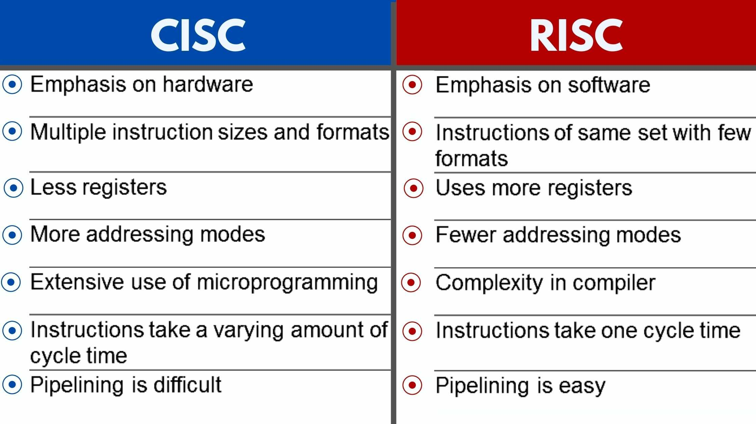

Slide 24
SPECIFICATIONS
03
8_Above

Slide 25
Clock rate
Integer range
8_Above

Slide 26
DESIGN
04
8_Above

Slide 27
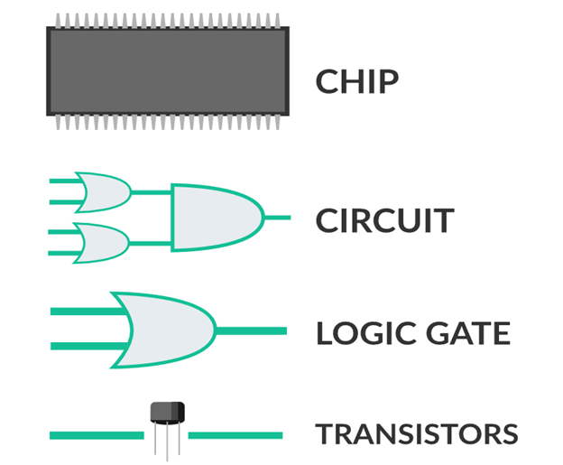


Slide 28
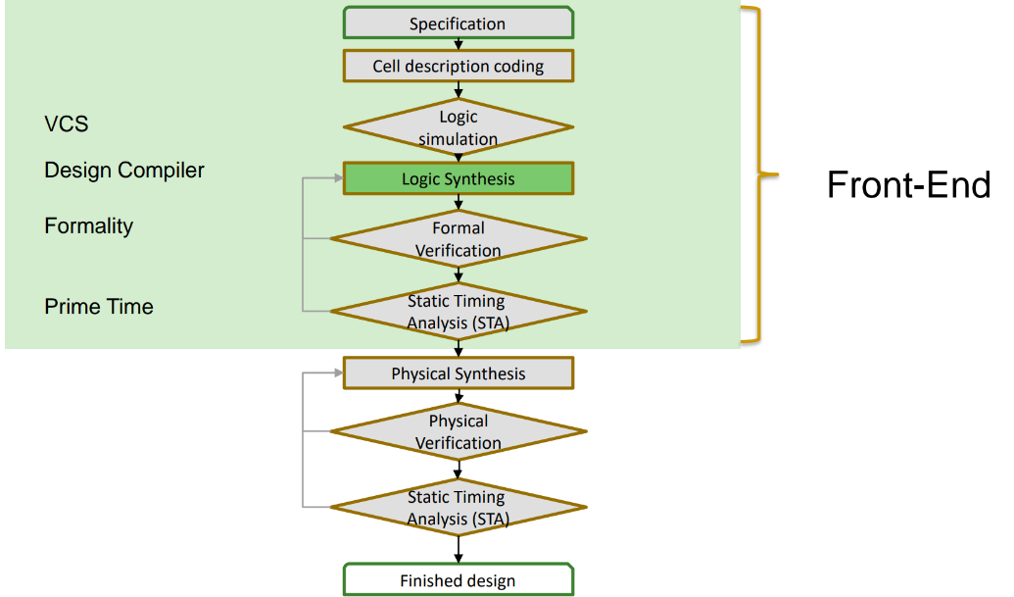

Slide 29
CELL CODING
8_Above

Slide 30
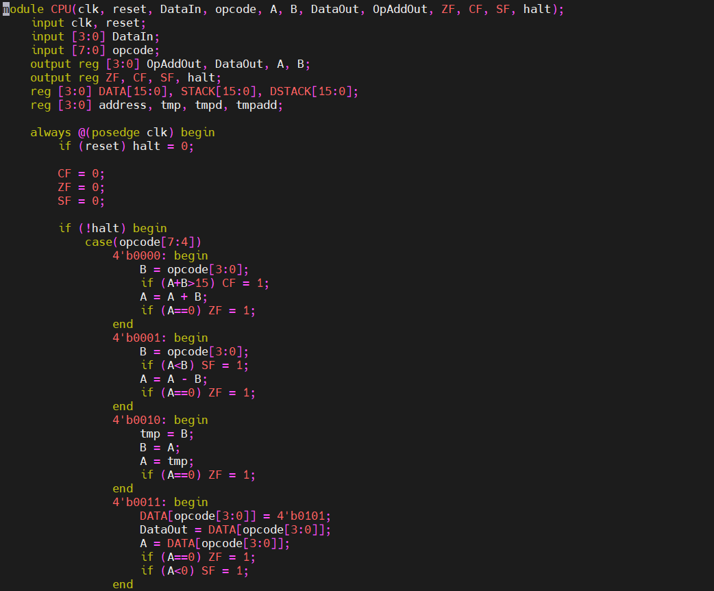

Slide 31
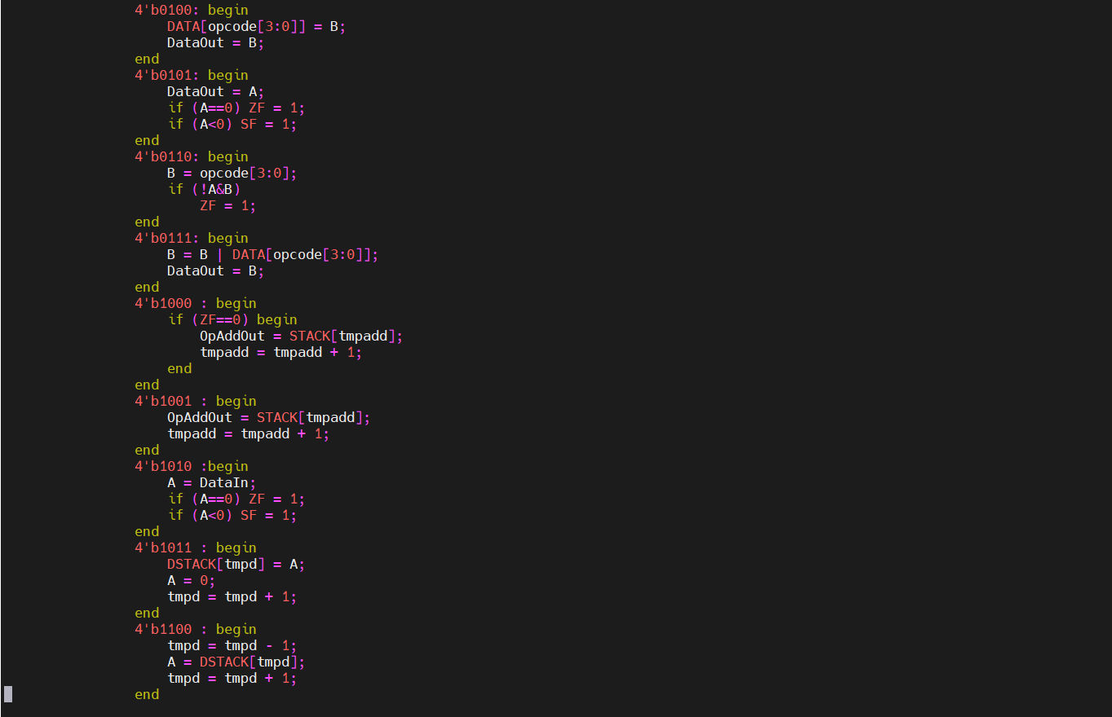

Slide 32
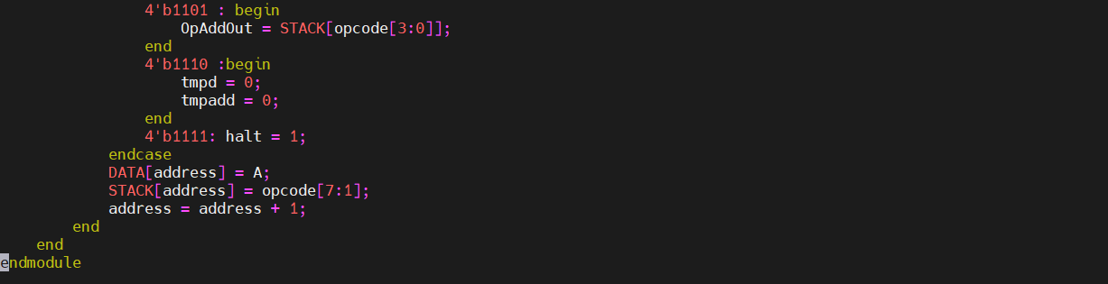

Slide 33
DC COMPILER
8_Above

Slide 34
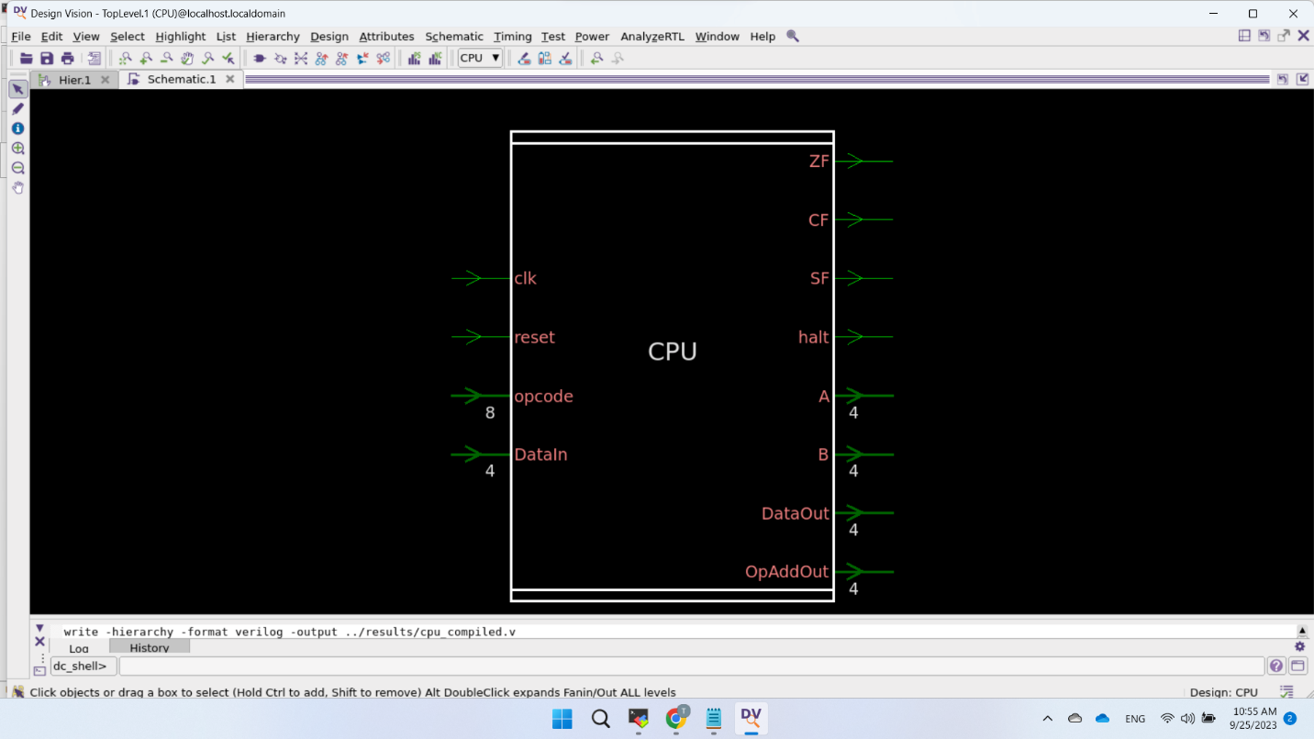

Slide 35
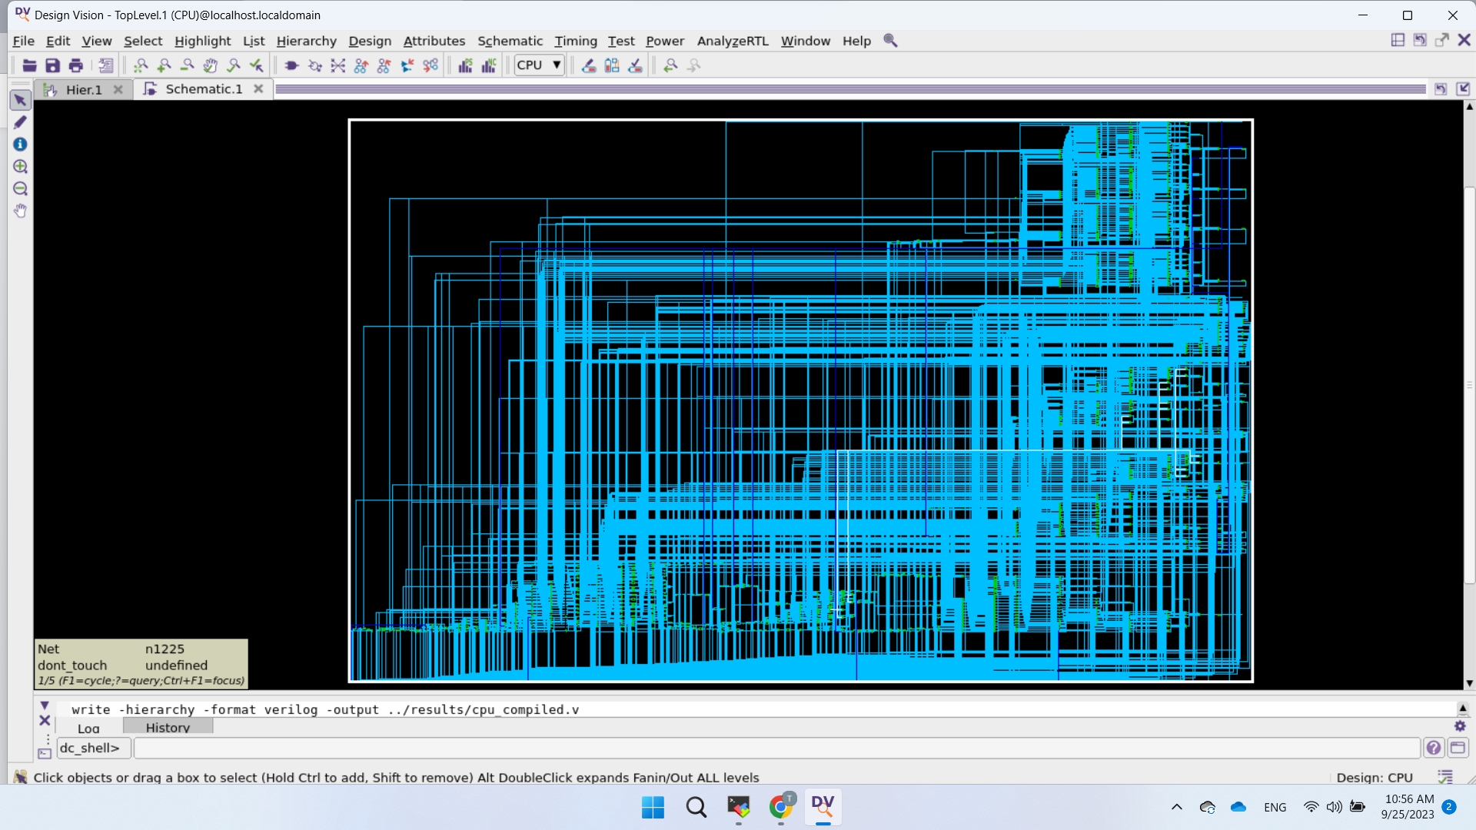

Slide 36
DESIGN CONSTRAINST
8_Above

Slide 37
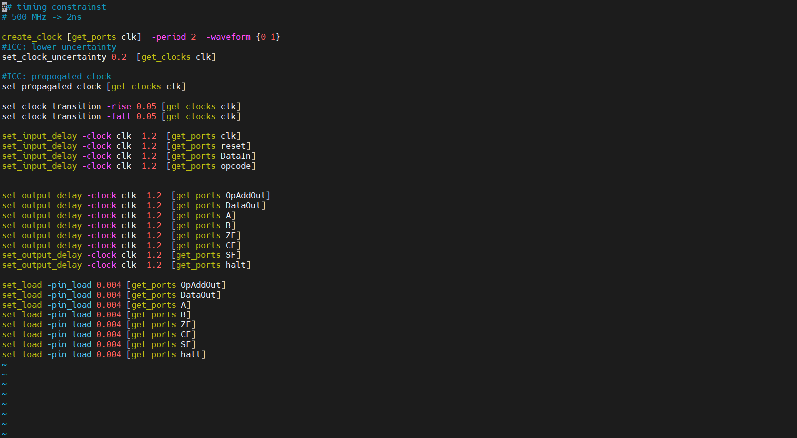

Slide 38
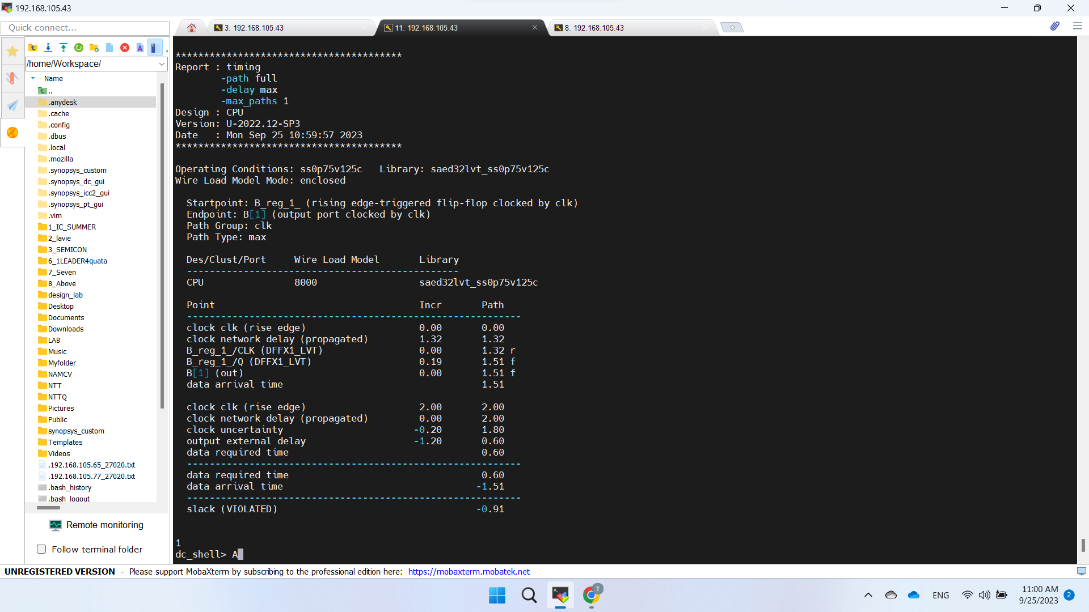

Slide 39
Thanks!
8_Above

