Slide 1
The Comparison of Optimizers
Student Name: YANG Jing
Student ID: 22425284

Slide 2
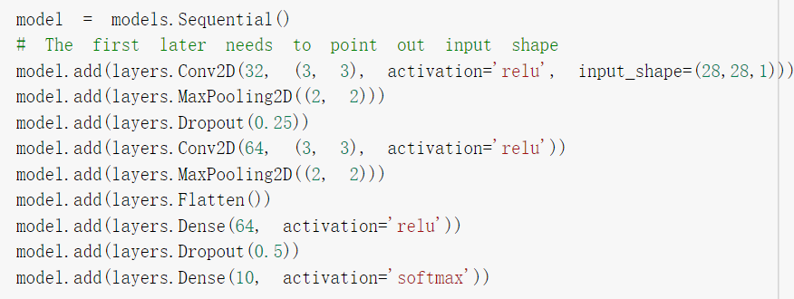
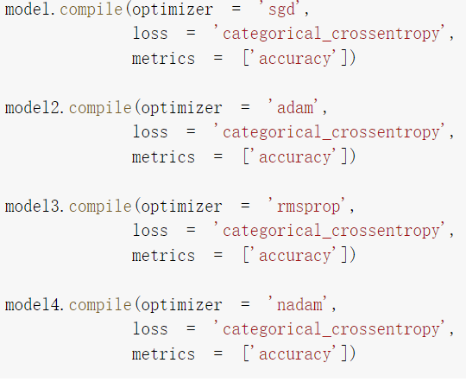
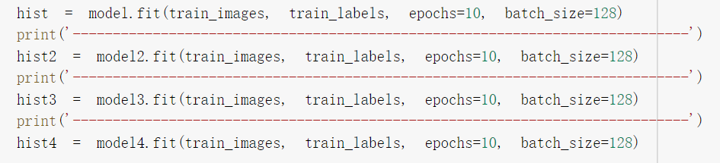
Introduction
Prepare: two datasets; SGD; RMSProp; Adam; Nadam, CNN
Experimental steps: Download the dataset; Data preprocess; Construct models; Compile; Train and test; Visualize the results
Here is the relevant part of code:

Slide 3
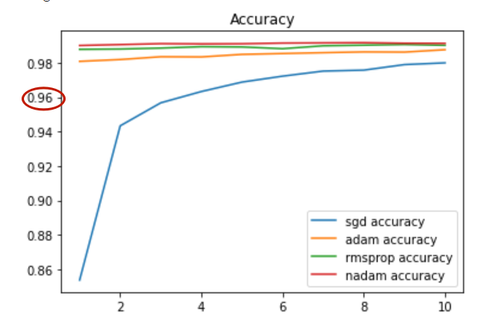
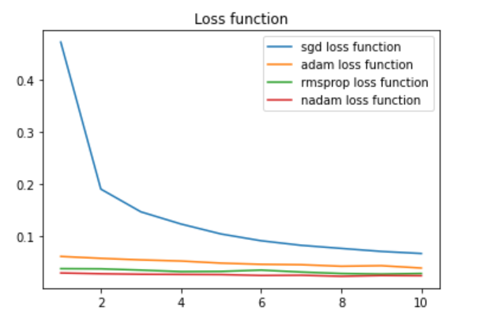
Experimental result
MNIST dataset:
In these two graphs, the lines of different colors represent different optimizers. We can see that the accuracy of the Nadam is the highest and more stable, and the accuracy of the SGD is gradually increased, but it is not as good as the other three. And in the end, their accuracy is all greater than 96%.
In addition, similarly, the loss function of SGD declines gradually and eventually becomes stable. The Adam and RMSProp’s are always stable around 0.04, while the Nadam is the one with the lowest loss function value, around 0.03.

Slide 4
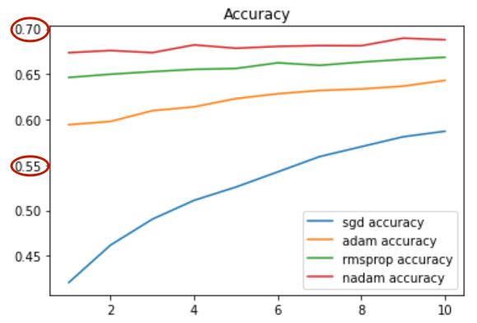
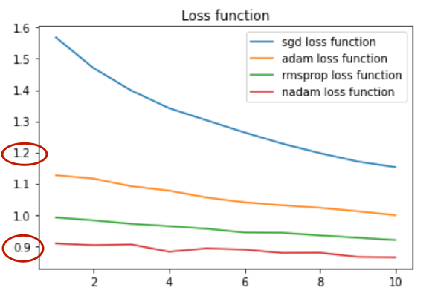
Experimental result
CIFAR10 dataset:
In these two graphs, we can see that, similar to the results of the previous task, the SGD has a stable increase in accuracy, and the Nadam has the highest accuracy, but their accuracy is not as high as that of the previous task, with the highest accuracy less than 70% and the lowest just over 55%.
Moreover, the SGD has the highest loss function, which reaches about 1.2, and the Nadam has the lowest loss function, which is still about 0.9. The overall situation is not as good as the performance of the previous task.

Slide 5
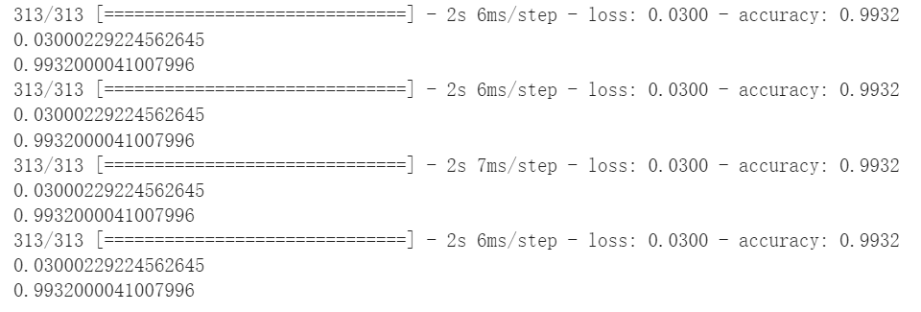
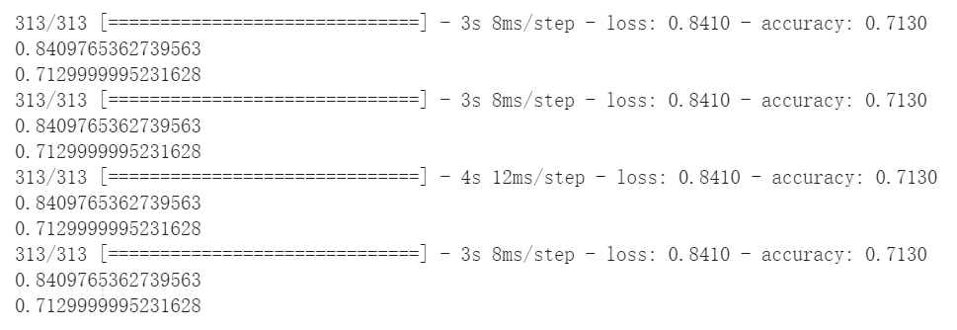
Experimental result
Testing results:
In conclusion, for MNIST dataset and CIFAR10 dataset, the loss function of SGD decreases the fastest, but the accuracy is not high. RMSProp has the characteristics of adaptive learning and strong practicability. Adam performs well in the tasks, while Nadam has a higher accuracy and lower loss function which is better.

