Slide 2
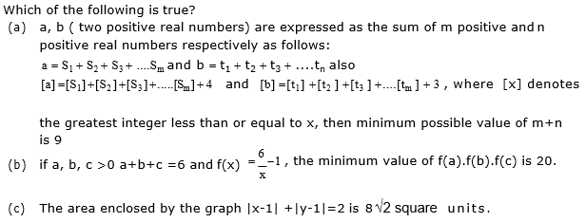

$$\frac{6}{x} −1$$

