Slide 1
Employee Data Analysis using Excel
STUDENT NAME:Yuvarani.k
REGISTER NO:122204084
DEPARTMENT: B.com (corporate secretaryship)
COLLEGE:Shri Krishnaswamy college for women

Slide 2
PROJECT TITLE
Employee Gender Analysis using Excel

Slide 3


AGENDA
Problem Statement
Project Overview
End Users
Our Solution and Proposition
Dataset Description
Modelling Approach
Results and Discussion
Conclusion
3/21/2024 Annual Review

Slide 4

PROBLEM STATEMENT
"Our organization seeks to promote diversity, equity, and inclusion in the workplace, but we lack a clear understanding of our current gender demographics. We need to analyze our employee data to identify:
1.The current gender distribution across the organization
2.Gender disparities in hiring, promotion, and retention rates
3. Departments or teams with significant gender imbalances
4. Trends and patterns in gender representation over time

Slide 5

PROJECT OVERVIEW
II. Objective: Analyze employee gender demographics
III. Scope:Employee data analysis (gender, department, job title, hire date, promotion/termination dates) Identification of gender disparities in hiring, promotion, and retention
IV. Methodology:Data collection from HR systems
V. Deliverables: Written report with findings and recommendations
VI. Timeline: [Insert timeline, e.g., 4 weeks, 8 weeks]
VII. Resources: HR data and systems access
VIII. Expected Outcomes: Comprehensive understanding of employee gender demographics

Slide 6

WHO ARE THE END USERS?
HR Department: To inform diversity and inclusion initiatives, track progress, and make data-driven decisions.
Diversity and Inclusion Team: To identify areas for improvement and develop targeted programs to promote gender equality.
Leadership and Management: To understand gender demographics and disparities, make informed decisions, and drive organizational change.
Department Heads: To identify gender imbalances in their teams and develop strategies to address them.
Employee Resource Groups (ERGs): To understand gender demographics and advocate for initiatives supporting gender equality.
Organizational Development Team: To use insights to inform organizational change initiatives and improve overall workplace culture.

Slide 7

OUR SOLUTION AND ITS VALUE PROPOSITION
A comprehensive Employee Gender Analysis that provides insights into gender demographics, disparities, and trends within the organization.
Value Proposition:-
1.Data-driven insights: Accurate and actionable data to inform diversity and inclusion initiatives, talent management, and business decisions.- 2.Identify areas for improvement: Pinpoint gender disparities in hiring, promotion, retention, and pay to develop targeted programs for improvement.
3.Enhance diversity and inclusion: Foster a more inclusive workplace culture by addressing gender imbalances and promoting equal opportunities.-
4.Inform talent management: Make data-driven decisions on talent development, succession planning, and leadership pipeline development
5.Improve business outcomes: Drive business success by leveraging diverse perspectives, improving employee engagement, and enhancing brand reputation.

Slide 8
Dataset Description
Description: This dataset contains employee-level data for [Company Name], including gender demographics, job information, and employment history. The dataset is used to analyze gender disparities in hiring, promotion, retention, and pay, and to inform diversity and inclusion initiatives.
Variables:
1. Employee ID: Unique identifier for each employee
2. Gender: Employee gender (Male, Female, Non-binary, etc.)
3. Job Title: Employee job title
4.Department: Employee department
5.Hire Date: Employee hire date
6.Promotion Date: Date of last promotion
7.Termination Date: Date of termination (if applicable)
8.Salary: Employee salary
9.Performance Rating: Employee performance rating (if applicable)
10..Years of Service: Employee years of service.

Slide 9

THE "WOW" IN OUR SOLUTION
Predictive Analytics: Utilize machine learning algorithms to forecast employee turnover, identifying at-risk individuals and enabling proactive retention strategies.
Personalized Insights: Deliver tailored recommendations for each employee, enhancing engagement and growth opportunities.
Real-time Dashboards: Provide intuitive, interactive visualizations for instant access to key metrics and trends.
AI-driven Coaching: Offer actionable guidance and development advice through AI-powered coaching tools.
Diversity and Inclusion Metrics: Track and analyze metrics on diversity, equity, and inclusion to foster a more inclusive workplace culture.
3/21/2024 Annual Review
9

Slide 10
MODELLING
Modelo de análisis de datos: Utiliza técnicas estadísticas y de minería de datos para identificar patrones y tendencias en los datos de los empleados.
Modelo de evaluación del desempeño: Evalúa el desempeño de los empleados en función de objetivos y métricas establecidas.
Modelo de satisfacción y engagement: Mide la satisfacción y el compromiso de los empleados con la organización.
Modelo de análisis predictivo: Utiliza algoritmos de machine learning para predecir el comportamiento y el desempeño de los empleados.
Modelo de segmentación: Divide a los empleados en segmentos basados en características y comportamientos similares.
10

Slide 11
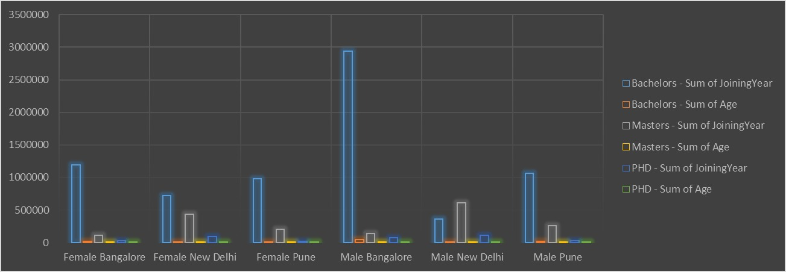
RESULTS

Slide 12
conclusion
•To conclude, a job analysis is a crucial tool to provide organisations with a detailed understanding of the nature and requirements of a job for developing accurate job descriptions, set performance standards, designing effective training programs, and making informed decisions about recruitment, selection, promotion, and compensation.
•Various individuals like HR professionals, managers, supervisors, or subject matter experts can conduct it.
•There are several methods that can be used to conduct a job analysis, including interviews, observation, questionnaires, work sampling, and the critical incident technique. The choice of method will depend on the nature of the job and the information needed.
•Job analysis has become more critical in today’s rapidly changing business landscape. As jobs evolve and new roles emerge, organisations must continually update their understanding of the job and its requirements.

