Slide 1
Anime Face Generation using
Deep Conversational Generative Adversarial Network
PRESENTED BY:UDHAYAPRAKASH.S
REGISTER NO:711721243118
DEPARTMENT: ARTIFICIAL INTELLIGENCE & DATA SCIENCE
3/21/2024 Annual Review

Slide 2
PROJECT TITLE Anime Face Generation using DCGAN
3/21/2024 Annual Review

Slide 3


AGENDA 1.Problem Statement 2.Project Overview 3.End Users 4.Our Solutions and Proposition 5.Key Features 6.Modelling Approach 7.Results and Evaluation 8.Conclusion
AGENDA
3/21/2024 Annual Review

Slide 4

PROBLEM STATEMENT
Develop a Deep Convolutional Generative Adversarial Network (DCGAN) capable of generating
realistic anime faces from random noise vectors.
Address the challenge of generating anime faces with diverse styles, features, and expressions, while ensuring high visual quality and realism.
Provide a solution for automating the creation of anime characters, enabling artists, game developers, and content creators to generate unique characters efficiently and cost-effectively
3/21/2024 Annual Review

Slide 5

PROJECT OVERVIEW
Implementing a DCGAN architecture capable of producing anime faces with a wide range of styles, expressions, and features, enhancing creativity and enabling exploration of diverse character concepts.
Emphasizing the importance of visual quality and realism in generated anime faces through meticulous model training and optimization techniques, aiming to closely resemble professionally crafted character designs.
Introducing an automated tool for anime character generation to expedite the character design process, allowing for rapid iteration and customization, thereby enhancing efficiency and productivity in character design endeavors.
3/21/2024 Annual Review

Slide 6

WHO ARE THE END USERS?
Artists and Illustrators
Game Developers
Animation Studios
Educators and Students
3/21/2024 Annual Review

Slide 7

YOUR SOLUTION AND ITS VALUE PROPOSITION
Our DCGAN generates anime faces spanning a vast spectrum of styles, expressions, and features, providing creators with an expansive palette for character development.
With a meticulous focus on visual fidelity, our generated anime faces exhibit an unparalleled level of realism and detail, rivaling handcrafted character designs.
Our automated anime character generation tool revolutionizes the design process, accelerating workflows and reducing production overhead. By automating repetitive tasks and expediting iteration cycles, our solution empowers creators to streamline their production pipeline, maximizing efficiency and productivity.
3/21/2024 Annual Review

Slide 8

THE WOW IN YOUR SOLUTION
Advanced DCGAN Architecture for high-quality anime face generation.
Style Transfer for personalized character customization.
Intuitive Interface for real-time manipulation of generated characters.
Batch Generation for efficient creation of multiple characters.
3/21/2024 Annual Review

Slide 9
MODELLING
1.Data Collection and Preprocessing:
Gather a comprehensive dataset of anime face images from various sources.
Preprocess the dataset to ensure consistency in size, format, and quality, including tasks such as resizing, cropping, and normalization.
2. Model Architecture Design:
Design the architecture of the Deep Convolutional Generative Adversarial Network (DCGAN) tailored for anime face generation.
Determine the structure of the generator and discriminator networks, including the number of layers, kernel sizes, and activation functions.
3. Model Training:
Train the DCGAN model on the preprocessed dataset using techniques such as mini-batch stochastic gradient descent.
Experiment with different hyperparameters, learning rates, and optimization algorithms to optimize the training process.
Monitor the training progress and adjust parameters as needed to ensure convergence and stability.
3/21/2024 Annual Review

Slide 10
Fine-tuning:
Fine-tune the trained model based on evaluation results and user feedback.
Adjust model parameters, architecture, or training strategies to further improve the quality and diversity of generated anime faces.
Iterate on the fine-tuning process until satisfactory results are achieved.
Evaluation and Validation:
Evaluate the quality of the generated anime faces using metrics such as visual inspection, inception score, and Frechet Inception Distance (FID) score.
Validate the model's ability to generate diverse anime characters with realistic features and expressions.
Use evaluation results to assess the performance of the model and guide further iterations or improvements.

Slide 11
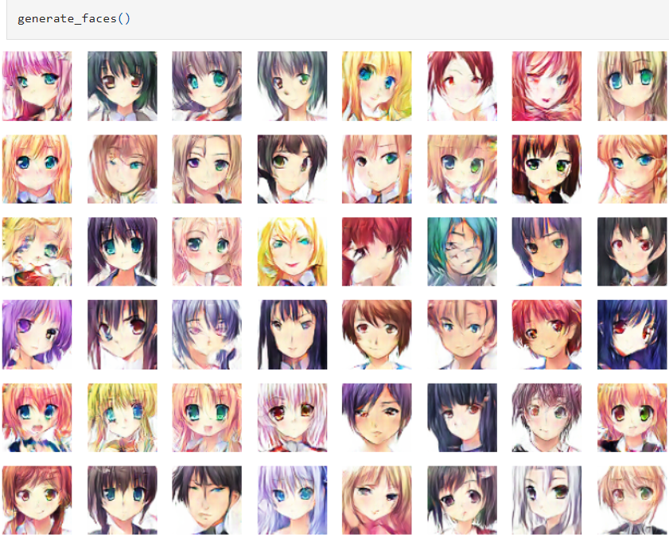
RESULTS
Demo Link
3/21/2024 Annual Review

