Slide 1


CRMSON Chatbot
Involo - Bluering:
Junbo Liang 1019905
Yutao Zhou 1001087
Yifeng Su 1254859
Xiang Zhou 1166507
Hongkun Zhang 1318423
Final Presentation

Slide 2

Introduction
Goal: The goal of this project is to develop CRMSON, a multi-agent AI chatbot designed to enhance team resilience in high-stakes environments such as aviation.
Highlights: Aviation safety, team resilience, personnel training, real-world scenarios, extensible
Client’s Needs: Must have scene retrieval and an AI-based chatbot.
Should have role selection, tone adjustment, strong workflow logic, and cloud deployment.
Notes:
Aviation safety is always one of the biggest human concerns. By leveraging our system, we not only bolster team resilience but also train personnel to respond effectively across a wide range of scenarios. We draw on an extensive database of official incident reports to ensure every simulation reflects real-world events. Moreover, this framework is fully extensible—by supplying the appropriate data, it can be adapted to any other high-stakes environment.
We must include the ability to retrieve analogous real-world incidents and, using the AI engine, simulate them in an interactive chat. Users can choose their role in each scenario and customize the chatbot’s tone. A robust workflow ensures the AI never strays beyond predefined boundaries, and the entire system is deployed on the Melbourne Research Cloud.

Slide 3
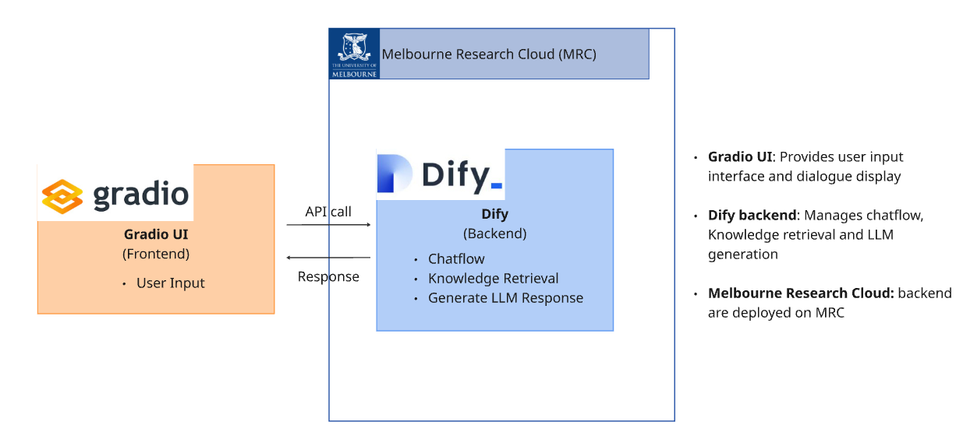
System Architecture

Slide 4
Demonstration: CRMSON ChatBot
Retrieve Scenarios: The user enters the case, and the system automatically retrieves 3 related cases for the user to choose from.
Select Role Identity: Each scenario provides two identities, from which users can choose to simulate
Adjust Conversation Tone: Supports users to select the tone intensity, supports 1-5 levels
Simulate Multi-turn Dialogue: The system conducts multiple rounds of real dialogue based on the selected cases and roles

Slide 5
Sprint 2 Planned & Delivered Features:
1. Build a basic terminal for scenario input
2. Implement case retrieval function
3. Integrate a language model for multi-turn conversations
→ All 3 were completed and released in our first prototype (V1).

Slide 6
Sprint 3 Planned & Delivered Features:
1. Custom front-end (with API integration)
2. Tone & emotion adjustment
3. More accurate case matching
4. Smarter back-end logic for unexpected input
5. Model fine-tuning for better simulation
6. Guidance for best practices in scenarios → We completed 5 out of 6. The last one is pending.

Slide 7
Key Outcomes
Dedicated front-end developed and deployed on MRC platform
Users can choose from three relevant cases for scenario simulation reference
Improved accuracy and better handling of unexpected inputs
Supports tone adjustment and role switching for realistic interactions

Slide 8
Reflection
Gained practical experience in model deployment and integration
Learned how to fine-tune language models for real application needs
Understood the value of cross-functional teamwork
Saw how knowledge sharing improves problem-solving and product quality

Slide 9
Handover
Product Deliverables
CRMSON Web Application (v2)
Deployed on a virtual machine via Dify workflow
Core functionality completed and accessible via public URL
Implemented Features
Input Conflict Scenario
Retrieve Similar Case Suggestions
Multi-turn Conversation Simulation
Role Selection
Tone customization and user-controlled conversation end
Notes:
At the end of Week 14, we will deliver the following project assets and completed features to the client:

Slide 10
Handover
Documentation
README.md with full project overview, system structure, and changelog
Data cleaning instruction
Model fine tunning instruction
Frontend design
Deployment instructions for both backend (dify) and frontend
Wiki pages detailing:
Personas & user stories
Use case mapping
Client Feedback and Features
Code Review
Client Training
Deliver a short 10–15 min handover demo to the client (recorded video + live Q&A)
Notes:
At the end of Week 14, we will deliver the following project assets and completed features to the client:

