Slide 1
DATA STRUCTURES AND ALGORITHMS PROJECT
Smart Document Search System
A Java search engine with a browser frontend
Nishok 2510030201
Sharan 2510039435
Vasthav 2510030297
Aman Pasha 2501130428
Guide: Dr. Anitha P
Computer Science and Engineering
KLH Aziz Nagar
01 / 18
Notes:
Project evidence: Java source and datasets at C:/Users/EREN/SmartSearchEngine. Local verification with assertions enabled, Microsoft OpenJDK 21.0.12.1. Team and institution details confirmed by the user.
All cover details come from the user.

Slide 2
DATA STRUCTURES AND ALGORITHMS PROJECT
Introduction
Background
Reading every file again for each search repeats the same work. An index stores where each word appears.
Need for the project
Users need a simple way to find relevant documents and handle phrases or spelling mistakes.
DSA focus
The project connects classroom data structures to a working document search system.
02 / 18
Notes:
Project evidence: Java source and datasets at C:/Users/EREN/SmartSearchEngine. Local verification with assertions enabled, Microsoft OpenJDK 21.0.12.1. Team and institution details confirmed by the user.
Implemented lexical retrieval over local .txt/.md files.

Slide 3
DATA STRUCTURES AND ALGORITHMS PROJECT
Problem Statement
Document search
Find files that match words, Boolean expressions, or exact phrases.
Useful result order
Show the most relevant matching documents first, with a chosen result limit.
Learning goal
Make the index, query tree, and heap decisions visible so users can understand the DSA behind search.
03 / 18
Notes:
Project evidence: Java source and datasets at C:/Users/EREN/SmartSearchEngine. Local verification with assertions enabled, Microsoft OpenJDK 21.0.12.1. Team and institution details confirmed by the user.
SearchEngine, QueryParser, PhraseNode, RankingEngine and frontend inspectors implement this scope.

Slide 4
DATA STRUCTURES AND ALGORITHMS PROJECT
Objectives
Build the index
Use a HashMap and linked posting lists to store document IDs and word positions.
Search and assist
Support Boolean and phrase queries, Trie autocomplete, and BK-Tree spelling suggestions.
Rank and demonstrate
Use BM25 with a bounded min-heap. Provide a frontend that displays the actual DSA structures.
04 / 18
Notes:
Project evidence: Java source and datasets at C:/Users/EREN/SmartSearchEngine. Local verification with assertions enabled, Microsoft OpenJDK 21.0.12.1. Team and institution details confirmed by the user.
Implemented objectives. Tests verify core search and frontend integration.

Slide 5
DATA STRUCTURES AND ALGORITHMS PROJECT
Literature Review
Existing approach | Main idea | Limit or trade-off
Sequential file search | Read files for every query | Repeats work across searches
Inverted index [1] | Store term postings and positions | Needs extra memory and updates
BM25 ranking [2] | Score lexical relevance | Does not understand meaning
BK-Tree search [3] | Prune by edit distance | Worst case may visit all terms
This project implements these ideas directly for a DSA demonstration.
05 / 18
Notes:
Project evidence: Java source and datasets at C:/Users/EREN/SmartSearchEngine. Local verification with assertions enabled, Microsoft OpenJDK 21.0.12.1. Team and institution details confirmed by the user.
[1] Manning, Raghavan and Schütze (2008), Introduction to Information Retrieval, https://nlp.stanford.edu/IR-book/ . [2] Robertson and Zaragoza (2009), https://doi.org/10.1561/1500000019 . [3] Burkhard and Keller (1973), https://doi.org/10.1145/362003.362025 . No comparative benchmark against commercial systems.

Slide 6
DATA STRUCTURES AND ALGORITHMS PROJECT
Proposed System
Input
Add text or Markdown files, open a local folder, or choose a built-in collection.
Search workflow
The Java engine matches documents using an index, then ranks matches with BM25 and a min-heap.
Frontend features
View ranked results and complete documents. Inspect postings, the query AST, and Top-K decisions.
06 / 18
Notes:
Project evidence: Java source and datasets at C:/Users/EREN/SmartSearchEngine. Local verification with assertions enabled, Microsoft OpenJDK 21.0.12.1. Team and institution details confirmed by the user.
LocalServer serves HTML/CSS/JavaScript and the real Java engine. Uploads add to current collection. Opening a collection replaces it.

Slide 7
DATA STRUCTURES AND ALGORITHMS PROJECT
System Architecture
Files
.txt / .md
Tokenizer
Word positions
Index
HashMap + postings
→
→
Matching uses this index
Browser frontend
Local Java server
Query parser
Stacks + AST
→
→
↕
↓
Trie / BK-Tree
Query suggestions
Ranked results
BM25 + min-heap
Boolean / phrase
Matching documents
←
07 / 18
Notes:
Project evidence: Java source and datasets at C:/Users/EREN/SmartSearchEngine. Local verification with assertions enabled, Microsoft OpenJDK 21.0.12.1. Team and institution details confirmed by the user.
Editable architecture diagram. Files feed Tokenizer and InvertedIndex. The frontend sends requests to LocalServer, which calls SearchEngine. QueryParser creates the AST and matcher uses indexed postings. RankingEngine applies BM25 and a bounded min-heap. Trie and BKTree assist user input. Arrows describe data flow, not network services.

Slide 8
DATA STRUCTURES AND ALGORITHMS PROJECT
Methodology
1. Prepare documents
Read files, convert text to lowercase tokens, and store each word position in the index.
2. Match the query
Use Shunting-Yard stacks to build an AST. Merge postings for Boolean queries and check positions for phrases.
3. Rank and assist
Score matches with BM25. Keep the best K in a min-heap. Use Trie and edit-distance tree search for suggestions.
08 / 18
Notes:
Project evidence: Java source and datasets at C:/Users/EREN/SmartSearchEngine. Local verification with assertions enabled, Microsoft OpenJDK 21.0.12.1. Team and institution details confirmed by the user.
BM25 k1=1.2, b=0.75. Intersection worst case O(L1+L2). Heap selection O(M log K), excluding scoring and final K sort. Trie O(P) to reach prefix plus enumeration. BK-Tree can visit all vocabulary terms. Levenshtein DP O(a*b) time. Skip pointers help some traversals without changing worst-case bound.

Slide 9
DATA STRUCTURES AND ALGORITHMS PROJECT
Tools & Technologies
Programming languages
Java for the engine and local server. HTML, CSS, and JavaScript for the browser interface.
Software
JDK 16+ features. Full build tested on OpenJDK 21. PowerShell starts the app, and a browser displays it.
Hardware and storage
A computer with enough RAM for the selected files. The index and full documents stay in memory. No tested minimum RAM or processor is established.
09 / 18
Notes:
Project evidence: Java source and datasets at C:/Users/EREN/SmartSearchEngine. Local verification with assertions enabled, Microsoft OpenJDK 21.0.12.1. Team and institution details confirmed by the user.
No external runtime libraries, framework, or database. JDK16 feature basis: records, instanceof patterns and Stream.toList. https://docs.oracle.com/en/java/javase/17/migrate/significant-changes-jdk-release.html . Files.readString and walkFileTree: https://docs.oracle.com/en/java/javase/17/docs/api/java.base/java/nio/file/Files.html . Tested Windows, Microsoft OpenJDK21.0.12.1.

Slide 10
DATA STRUCTURES AND ALGORITHMS PROJECT
Implementation
Indexing modules
CorpusIngestor and Tokenizer read files. InvertedIndex stores postings. Trie and BKTree store the vocabulary.
Search modules
QueryParser creates the AST. Boolean nodes and PhraseNode find matches. RankingEngine selects and orders the results.
Frontend integration
LocalServer connects browser requests to SearchEngine. The interface shows real results and structure snapshots. Start with .\start-web.ps1.
10 / 18
Notes:
Project evidence: Java source and datasets at C:/Users/EREN/SmartSearchEngine. Local verification with assertions enabled, Microsoft OpenJDK 21.0.12.1. Team and institution details confirmed by the user.
Frontend files: index.html, styles.css, app.js, favicon.svg. LocalServer and Json use Java Standard Library. start-web.ps1 compiles src and launches port8765 by default. Existing CLI remains available.

Slide 11
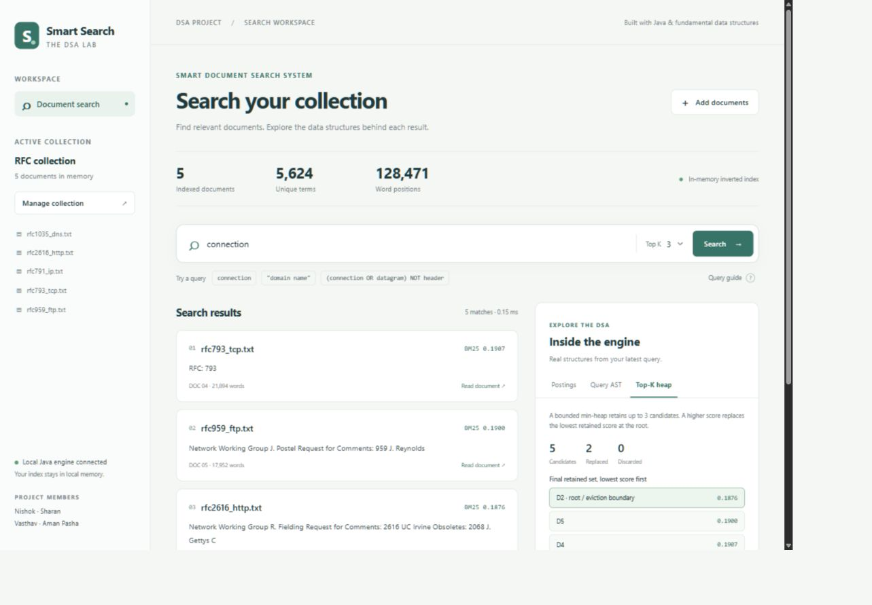
DATA STRUCTURES AND ALGORITHMS PROJECT
Results and Screenshots
RFC collection
5 documents
5,624 unique terms
128,471 word positions
Query: connection
5 matches, Top K = 3
Heap replaced 2 roots
Highest BM25: 0.1907
One local run showed 0.15 ms.
This is not a benchmark.
11 / 18
Notes:
Project evidence: Java source and datasets at C:/Users/EREN/SmartSearchEngine. Local verification with assertions enabled, Microsoft OpenJDK 21.0.12.1. Team and institution details confirmed by the user.
Actual browser capture on the local server. Collection status5 documents5624terms128471tokens. Search connection top3 IDs4,5,2 scores0.1907,0.1900,0.1876. All5candidate documents considered;2root replacements. Displayed elapsed0.15ms measures engine search in one run, excluding network/render. No repeated timing study.

Slide 12
DATA STRUCTURES AND ALGORITHMS PROJECT
Testing
Test area | Checks or groups | Result
Indexing and Boolean search | 8 original checks | Pass
Phrases, ranking, suggestions | 9 original checks | Pass
Repeated live ingestion | 5 regression checks | Pass
Frontend and API integration | 6 verification groups | Pass
Test cases include malformed queries, sparse IDs, upload/search,
collection switching, heap decisions, and rejected inputs.
12 / 18
Notes:
Project evidence: Java source and datasets at C:/Users/EREN/SmartSearchEngine. Local verification with assertions enabled, Microsoft OpenJDK 21.0.12.1. Team and institution details confirmed by the user.
Counts represent test methods (Phase1=3,Phase2=5,Phase3=4,Phase4=2,Phase5=3,LiveIngestion=5). FrontendVerificationTest contains6groups with multiple assertions. All suites passed with java -ea. Browser checks: RFC collection switch, connection search, AST and heap/postings tabs, spell conection->connection, desktop/mobile layout.

Slide 13
DATA STRUCTURES AND ALGORITHMS PROJECT
Advantages
Reusable search index
Queries reuse stored postings and word positions instead of rereading all files.
Clear DSA demonstration
The frontend helps users see how linked lists, stacks, trees, and heaps support search.
Simple local setup
The app runs locally with Java and a browser. Users can add their own text and Markdown documents.
13 / 18
Notes:
Project evidence: Java source and datasets at C:/Users/EREN/SmartSearchEngine. Local verification with assertions enabled, Microsoft OpenJDK 21.0.12.1. Team and institution details confirmed by the user.
Supported advantages from implementation. No production scale or speed comparison claimed.

Slide 14
DATA STRUCTURES AND ALGORITHMS PROJECT
Applications
DSA classroom demonstrations
Explain data structures using real queries and visible search results.
Study notes and project files
Search a local collection of text or Markdown notes.
Technical document exploration
Find words and phrases in the included RFC collection. Other local text collections are possible uses.
14 / 18
Notes:
Project evidence: Java source and datasets at C:/Users/EREN/SmartSearchEngine. Local verification with assertions enabled, Microsoft OpenJDK 21.0.12.1. Team and institution details confirmed by the user.
Academic and local-document use cases. No external deployment or users claimed.

Slide 15
DATA STRUCTURES AND ALGORITHMS PROJECT
Challenges Faced
Document ID ordering
Posting lists need increasing IDs. Sequential allocation now supports repeated additions and avoids ID collisions.
Query parsing errors
Implicit AND, unary NOT, and malformed inputs needed careful handling. The parser now uses actual stored IDs for NOT.
Showing real DSA behavior
The frontend needs engine data. Search responses now include the actual AST, posting snapshots, and heap selection trace.
15 / 18
Notes:
Project evidence: Java source and datasets at C:/Users/EREN/SmartSearchEngine. Local verification with assertions enabled, Microsoft OpenJDK 21.0.12.1. Team and institution details confirmed by the user.
Resolved changes verified in LiveIngestionVerificationTest and FrontendVerificationTest. InvertedIndex validates monotonic IDs before mutation, getDocumentIds supports sparseIDs, parser rejects malformed expressions. Existing memory and repeated skip rebuild cost remain limits.

Slide 16
DATA STRUCTURES AND ALGORITHMS PROJECT
Future Enhancements
Save and update the index
Add persistent storage so users can keep the index after closing the app. Support document edits and deletion.
Improve efficiency
Reduce repeated posting scans during BM25 scoring. Measure larger collections and optimize skip-pointer rebuilds.
Expand supported input
Consider PDF extraction and OCR. Improve snippets to show the text around the matching words.
16 / 18
Notes:
Project evidence: Java source and datasets at C:/Users/EREN/SmartSearchEngine. Local verification with assertions enabled, Microsoft OpenJDK 21.0.12.1. Team and institution details confirmed by the user.
Proposals only. Persistence, edit/delete, PDF/OCR and query-centered snippets are not implemented. Current snippets show document prefixes. No semantic AI feature needed for current DSA scope.

Slide 17
DATA STRUCTURES AND ALGORITHMS PROJECT
Conclusion
A working document search system
built around DSA concepts
The Java engine supports Boolean and phrase search, BM25 ranking, prefix completion, and spelling suggestions.
The browser frontend displays real results and the data structures behind them. The verification suites pass.
Current scope: local text/Markdown collections with an index in memory.
17 / 18
Notes:
Project evidence: Java source and datasets at C:/Users/EREN/SmartSearchEngine. Local verification with assertions enabled, Microsoft OpenJDK 21.0.12.1. Team and institution details confirmed by the user.
Conclusion bounded by local verification and included datasets. No scalable production deployment claimed.

Slide 18
DATA STRUCTURES AND ALGORITHMS PROJECT
References
[1] Information retrieval
Manning, Raghavan and Schütze (2008). Introduction to Information Retrieval. Stanford University Press.
[2] Ranking and [3] spelling search
Robertson and Zaragoza (2009). The Probabilistic Relevance Framework: BM25 and Beyond.
Burkhard and Keller (1973). Some Approaches to Best-Match File Searching.
Java and project materials
Oracle Java documentation. Local Java source, datasets, verification suites, and the original Review 2 presentation.
18 / 18
Notes:
Project evidence: Java source and datasets at C:/Users/EREN/SmartSearchEngine. Local verification with assertions enabled, Microsoft OpenJDK 21.0.12.1. Team and institution details confirmed by the user.
[1] https://nlp.stanford.edu/IR-book/
[2] https://doi.org/10.1561/1500000019
[3] https://doi.org/10.1145/362003.362025
https://docs.oracle.com/en/java/javase/17/docs/api/java.base/java/nio/file/Files.html
https://docs.oracle.com/en/java/javase/17/migrate/significant-changes-jdk-release.html
Original Review2 PowerPoint at C:/Users/EREN/Documents/College/2-1/DSA/Project/Smart_Document_Search_System Review 2.pptx

