Slide 1
Neuro-Financial FusionNet
Temporal Transformer and graph attention
for financial forecasting
PBL Project Presentation
Eswar Sharan Gunamoni, Vasthav Vijay Chowdary, Nishok Reddy
Sushama Rani Dutta
Koneru Lakshmaiah Education Foundation, Hyderabad
01
Notes:
Source: Neuro-Financial-FusionNet-Final-Submission.pdf, supplied PBL report. Title and authors from report page 1.

Slide 2
Research question
Motivation
Market forecasting combines numerical history with information contained in financial news.
Research question
Does adding a semantic asset graph improve predictions over a temporal Transformer alone?
Evaluation
Compare Temporal-Only, Spatial GNN-Only, and cross-attention FusionNet across three runs.
02
Notes:
Source: Neuro-Financial-FusionNet-Final-Submission.pdf, supplied PBL report. Report pages 1–3. Fusion performance is an empirical question, not an assumed improvement.

Slide 3
Data and preprocessing
Financial inputs
Five ETF nodes: SPY, XLK, XLF, XLV and XLE. Numerical inputs include market variables and three macroeconomic indicators.
News inputs
Daily DJIA headlines encoded with FinBERT into one 768-dimensional embedding per day.
Alignment
1,989 trading days in the report. A 30-day lookback and min-max scaling to [-1, 1].
03
Notes:
Source: Neuro-Financial-FusionNet-Final-Submission.pdf, supplied PBL report. Report sections 3.1, 3.2 and 4.1. The report describes 1,989 aligned trading days. Repository code uses Close and Volume for five ETFs plus three macro variables.

Slide 4
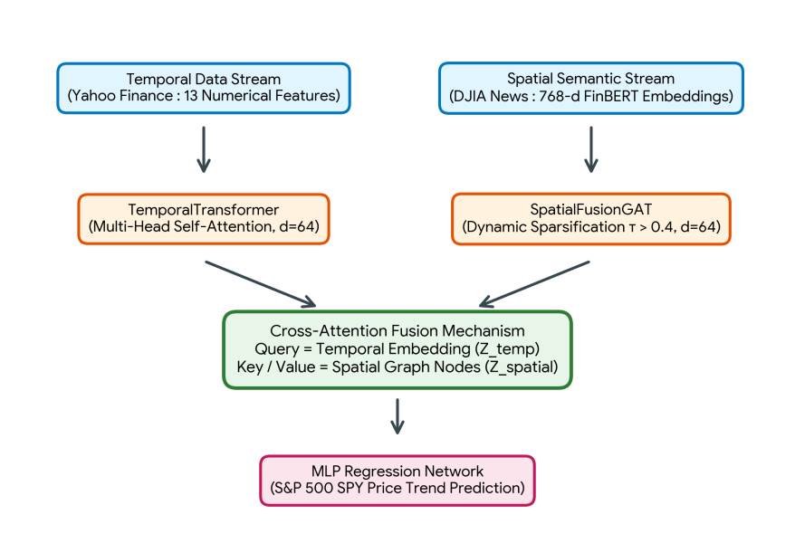
Dual-stream architecture
Temporal context queries the graph representations through cross-attention.
04
Notes:
Source: Neuro-Financial-FusionNet-Final-Submission.pdf, supplied PBL report. Figure 1, report page 3. Original source figure preserved.

Slide 5
Temporal Transformer
Input
A batch of 30 trading days with 13 numerical features per day.
Encoder
Project to 64 dimensions, add sinusoidal position encoding, then apply two Transformer layers with four attention heads.
Output
The final time-step representation supplies the query for the fusion mechanism.
05
Notes:
Source: Neuro-Financial-FusionNet-Final-Submission.pdf, supplied PBL report. Report section 3.1.

Slide 6
Spatial graph and semantic features
Node features
773 dimensions: 2 local price/volume features, 3 macro variables, and 768 news embedding values.
Graph topology
Keep edges whose cosine similarity exceeds 0.4. The design aims to remove weak connections.
Graph attention
Two GAT layers produce five node representations of 64 dimensions each.
06
Notes:
Source: Neuro-Financial-FusionNet-Final-Submission.pdf, supplied PBL report. Report section 3.2 and Algorithm 1. Algorithm 1 selects node-specific price and volume for topology. Current repository graph function computes cosine similarity on the full node vector. Reconcile this before reproducing the report.

Slide 7
Cross-attention fusion
Query
The temporal encoder supplies a 64-dimensional representation of recent market history.
Keys and values
The spatial encoder supplies five sector-node representations for attention.
Regression head
The fused representation passes through 64-to-32 and 32-to-1 linear layers with ReLU and 20% dropout.
07
Notes:
Source: Neuro-Financial-FusionNet-Final-Submission.pdf, supplied PBL report. Report section 3.3. Attention is Softmax(QK^T / sqrt(d_k))V.

Slide 8
Training and ablation design
Optimization
PyTorch on NVIDIA hardware with automatic mixed precision. AdamW uses learning rate 0.0001 and weight decay 0.0001.
Loss and metrics
Training minimizes MSE. The report evaluates test RMSE and explained variance, R².
Comparison
Three independent runs for each of the temporal, spatial, and fused architectures.
08
Notes:
Source: Neuro-Financial-FusionNet-Final-Submission.pdf, supplied PBL report. Report sections 4.1–4.2. Three independent runs remain after the authors discard one duplicate. Current repository allows up to 50 epochs with patience 5. The displayed source training curves cover 15 epochs.

Slide 9
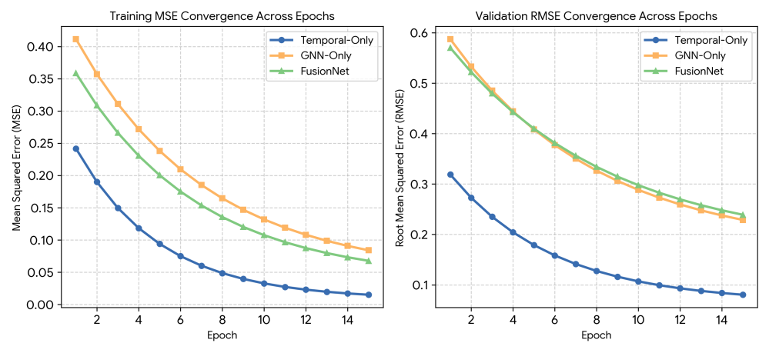
Training and validation convergence
The temporal baseline reaches the lowest error floor in the reported curves.
09
Notes:
Source: Neuro-Financial-FusionNet-Final-Submission.pdf, supplied PBL report. Original Figure 2, report page 6. Curves shown as published, without inferred raw epoch values.

Slide 10
Results across three independent runs
Architecture / run | Test RMSE | R² (%)
Temporal / 1 | 0.075218 | 99.43
Temporal / 2 | 0.068198 | 99.54
Temporal / 3 | 0.058068 | 99.66
Spatial GNN / 1 | 0.160945 | 97.41
Spatial GNN / 2 | 0.155095 | 97.60
Spatial GNN / 3 | 0.144723 | 97.91
FusionNet / 1 | 0.151034 | 97.72
FusionNet / 2 | 0.166739 | 97.22
FusionNet / 3 | 0.160577 | 97.42
R² measures variance explained. Lower RMSE indicates better predictions.
10
Notes:
Source: Neuro-Financial-FusionNet-Final-Submission.pdf, supplied PBL report. Source: Table 1, report page 7. Values copied from the numerical table. Figure 3 has a GNN Run 2 bar label inconsistent with Table 1 (0.1596 versus 0.155095). The prose GNN mean 0.155089 also differs from the table mean 0.153588. Abstract metrics differ from the consolidated table. No values were invented or silently reconciled.

Slide 11
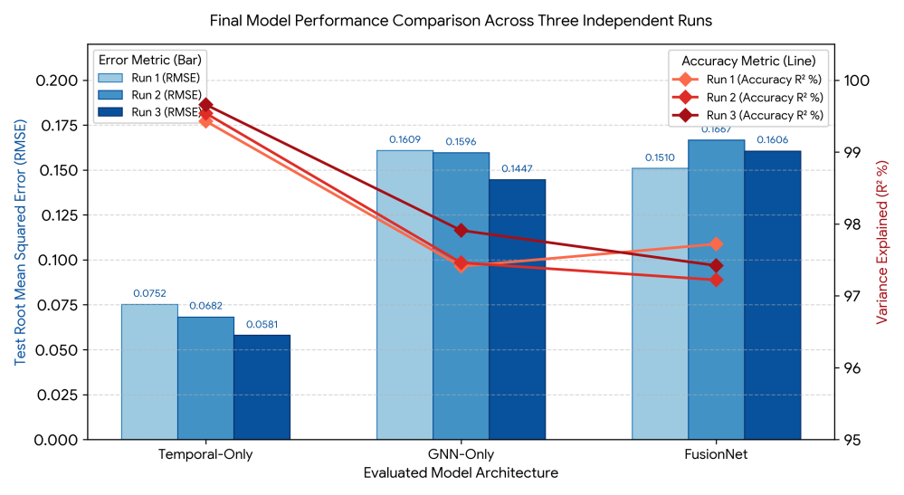
Published performance comparison
Temporal-Only performs best in all runs. For exact GNN Run 2 RMSE, use the results table.
11
Notes:
Source: Neuro-Financial-FusionNet-Final-Submission.pdf, supplied PBL report. Original Figure 3, report page 7. Preserve the original graph. Caution: GNN Run 2 bar label reads approximately 0.1596, while Table 1 lists 0.155095. Use Table 1 for exact values. R² percentages are not classification accuracy.

Slide 12
Interpretation and limitations
Observed result
Adding the spatial semantic stream did not improve the temporal baseline in these experiments.
Possible explanation
News representations may introduce noise or competing gradients. The report interprets this as multimodal negative transfer.
Scope
One target asset, one headline source and one historical period. Three runs do not establish formal statistical significance.
12
Notes:
Source: Neuro-Financial-FusionNet-Final-Submission.pdf, supplied PBL report. Report sections 4.2–5. Negative transfer describes the observed performance gap. Modality dominance and optimization noise are proposed explanations, not proven causal mechanisms.

Slide 13
Reproducibility and next steps
Experiment record
Keep the completed report results, original graphs and run-specific metrics as the reference experiment.
Reproduction checks
Match the prediction target and graph inputs to the reported experiment. Fit preprocessing on training data and reserve a separate validation set.
Further work
Evaluate more markets and time periods, test news timing, and investigate gradient balancing or gated fusion.
13
Notes:
Source: Neuro-Financial-FusionNet-Final-Submission.pdf, supplied PBL report. Cross-check against repository source. data_loader.py defines the target as the standard deviation of future log returns over horizon=7, while the report describes a SPY price trend target. Its scaler fits all aligned data before splitting. kaggle_main.py uses the test loader for early stopping. These details limit direct reproduction and interpretation of reported metrics. Existing experiments remain reported evidence, but the updated code has not independently reproduced them.

Slide 14
Conclusion
The temporal baseline is the strongest
model in the reported experiment.
FusionNet demonstrates a working multimodal architecture,
while its ablations expose the risk of negative transfer.
Repository: github.com/863344/neuro-financial-fusioinnet
14
Notes:
Source: Neuro-Financial-FusionNet-Final-Submission.pdf, supplied PBL report. Based on the supplied report, especially Table 1 and section 5.

