Slide 1


The Sparks Foundation
Graduate Rotational Internship Program
Data Science & Business Analytics Tasks1.
Author: Priyanka Biswas

Slide 2
Business Problem:
From the given ‘Iris’ dataset, predict the optimum number of clusters and represent it visually.
Objective :
Associate each remaining item in the dataset with the nearest cluster representative, using a Euclidean distance calculated by a similarity function.

Slide 3
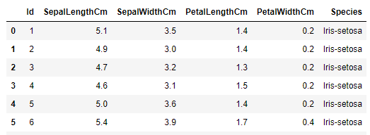
Data set details
The dataset contains total 150 records of columns contains Sepal Length, Sepal Width, Petal Length, Petal Width, Species.

Slide 4
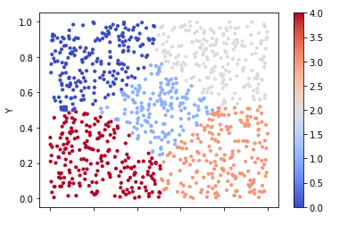
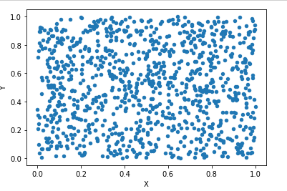
Eda:
EDA — exploratory data analysis - does this for machine learning enthusiast. It is a way of visualizing, summarizing and interpreting the information that is hidden in rows and column format. ... Once EDA is complete and insights are drawn, its feature can be used for supervised and unsupervised machine learning modelling.

Slide 5
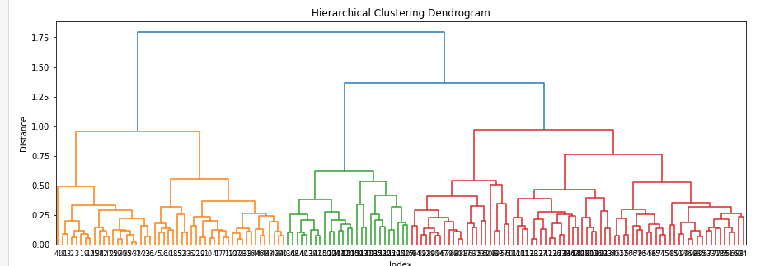
Model Building
Hierarchical clustering, also known as hierarchical cluster analysis, is an algorithm that groups similar objects into groups called clusters. The endpoint is a set of clusters, where each cluster is distinct from each other cluster, and the objects within each cluster are broadly similar to each other.

Slide 6
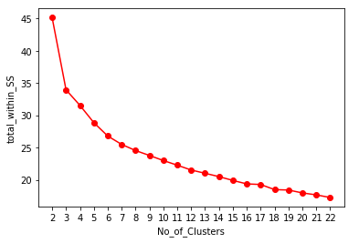
Model Building
k-means clustering is a method of vector quantization, originally from signal processing, that aims to partition n observations into k clusters in which each observation belongs to the cluster with the nearest mean, serving as a prototype of the cluster.

Slide 7
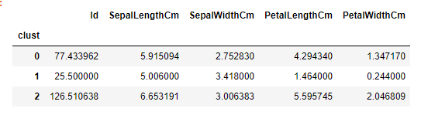
Model Predictions

Slide 8
Thank you

