Slide 1
Paper1: Linkages between vegetation properties, soil temperatures and active layer depth across seasons
Merle Scheiner

Slide 2
Introduction
Climate change on Svalbard dramatic
Permafrost has huge potential to release greenhouse gases
Plants interact with permafrost
(Bryophytes known to be better insulators than vasc. Plants?)

Slide 3
Knowledge gap
Limited understanding of processes in the uppermost layer affecting frozen ground

Slide 4
Objectives
Explore relationships between deeper permafrost temperatures and surface properties of vegetation and soil by monitoring surface information in selected borehole-network sites
Identify (a)biotic traits that correlate with superficial and deeper soil temperature profiles and thaw depth, distinguishing between
above- and belowground components
vascular plant, bryophyte, lichen

Slide 5
Research Question
How do processes in the uppermost layer of permafrost impact the frozen ground underneath?
What are the relationships between deeper permafrost temperatures and surface properties of vegetation and soil?
How do species-specific differences in insulation capacity and soil moisture influence active layer thickness (ALT)?
What are the localized impacts of plant-species and associated soil conditions on permafrost stability?
How do seasonal changes in vegetation dominance affect active layer thickness (ALT)?

Slide 6
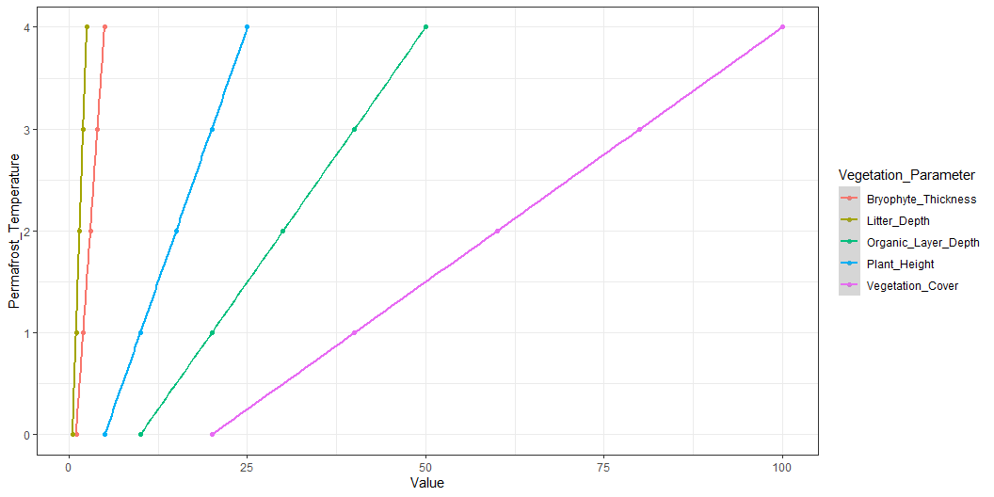
Hypotheses
The temperature of deeper permafrost layers integrates the overall effects of the plant community.
ALT is influenced by local factors such as species-specific differences in insulation capacity and soil moisture.
Increased vegetation cover, plant height, bryophyte thickness and litter, and organic layer depth decrease (deeper) permafrost temperatures.
factors determining insulation change during the growing season.
Bryophytes have the same influence throughout the growing season
Grasses insulates more towards the end of the season
More specific:
Higher and denser (more hits per point) vegetation has a higher insulative capacity than shorter and looser vegetation.
Litter and standing dead are excellent insulators.

