Slide 1



I decided to apply to Simon-Kucher due to my personal connection to the company, your unique consulting offer and pleasant work culture
Reasons I am interested in Simon-Kucher as a potential employer
  Positive personal impressions of the company
  Valuable insights through speed interview with
  Mr. Lau during Mannheim Forum 2023
  Positive feedback from former interns at SK
  (e.g. interesting projects, high trust in interns)
1
  Distinguished and unique consulting offer
  Leading consultancy in marketing, sales and pricing with nearly 40 years of experience
  Science-and growth-oriented approach since day one securing client trust and satisfaction
2
  Entrepreneurial spirit fosters positive work culture
  Pleasant, positive and collaborative team atmosphere
  High degree of accountability ensures timely and optimal delivery of project objectives
3

Slide 2
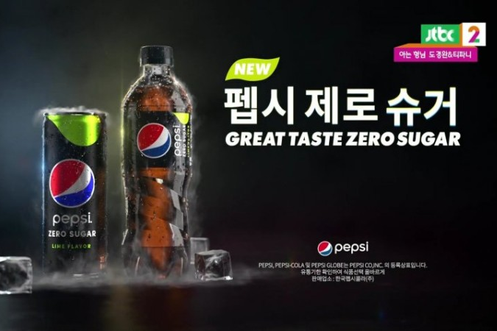
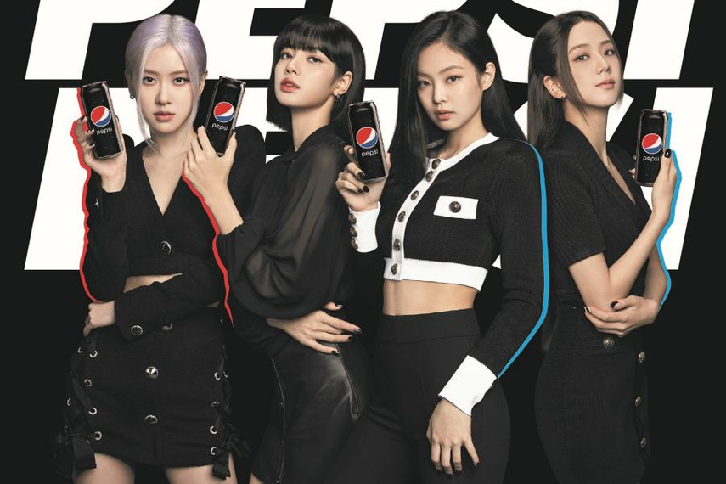
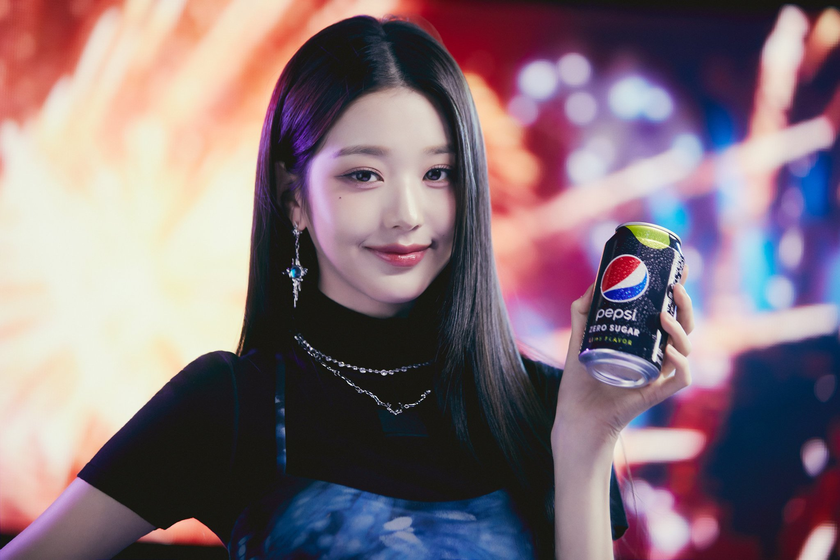

Pepsi capitalizes on the rise of K-pop through its own Pepsi-Cola songs and innovative marketing campaigns with world-famous industry stars.
Examples of Pepsi’s engagement within the K-pop industry
  Pepsi Zero at the center of advertisement
  Ideal market environment due to strict beauty standards in Asian countries
  Korean market for zero-sugar sodas grew by 140% from 61 M€ in 2016 to 148M€ in 2022
  BlackPink as Pepsi’s APAC brand ambassador
  Most followed K-Pop artists on Instagram,
  8 songs with over 1 billion views on YouTube
  Trend-setters in regard to beauty, fashion, and lifestyle, particularly for young girls
  Promotion of Pepsi Cola’s own K-pop songs
  Collaboration with major music label Starship Entertainment since 2019
  10 Pepsi songs totaling 78.7 M views on YouTube, of which 31 M from recently trending girl group ‘IVE’
Pepsi succeeds in blending advertisement and entertainment by relying on the trending K-Pop industry.

