Slide 1
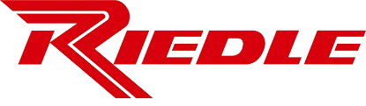
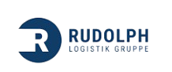
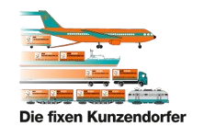
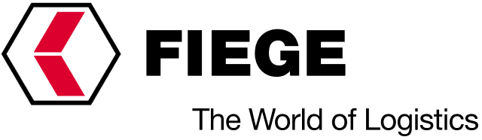

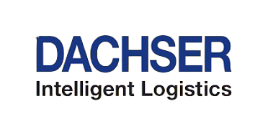
Long-List Potential Buyers
Company
Category
Description
Reasons
1 – Strategic (Direct Competitor)
A family-owned German logistics firm focused on general cargo and LTL/FTL transport. With a strong regional presence, Riedle serves various industries and aims to grow its network.
Regional proximity enables immediate customer base expansion and higher network density
Service portfolios align in contract logistics and specialized transpor
Synergies in fleet, dispatch, and routing offer clear efficiency gains
Mid-sized, family-run structures ensure smooth cultural integration
1 – Strategic (Direct Competitor)
A family-run logistics provider offering contract logistics and transport services. Active across industries, the company emphasizes long-term partnerships and national/international operations.
Strong overlap in contract logistics and transport enables high integration potential
Geographic fit allows for network densification in key German regions
Mid-sized structures ensure cultural and operational compatibility
Schuon strengthens Rudolph’s scale and flexibility in core segments
1 – Strategic (Direct Competitor)
A mid-sized, family-owned logistics firm in Southern Germany, focused on part-load and general cargo with regional strength and customer-oriented service.
Both focus on part-load and general cargo in Southern Germany, enabling synergies
Schuon expands Kunzendorf’s regional coverage and customer base
Strong cultural fit as mid-sized, family-run logistics firms
Combined fleet and staff increase capacity and flexibility
2 – Strategic (Horizontal Integration)
Privately owned German logistics provider specializing in contract logistics, warehousing, and customized supply chain solutions across Europe.
Enhances FIEGE’s Southern Germany footprint and closes regional gaps
Strong operational fit in contract and transport logistics
Aligned sector focus in FMCG and industrial clients
Scalable platform with fleet and infrastructure for growth
2 – Strategic (Horizontal Integration)
International logistics provider based in Germany, active in contract logistics, transport, and warehousing, with a focus on strategic acquisitions to expand its network.
Proven interest in mid-sized logistics firms aligns with Schuon’s profile
Schuon enhances regional network and densifies customer base
High compatibility in contract logistics and general cargo services
Integration supports Rhenus’ growth and service scalability goals
2 – Strategic (Horizontal Integration)
Family-owned German logistics provider with a strong European presence, focused on groupage, contract logistics, and sector-specific supply chains.
Strong Southern Germany footprint strengthens DACHSER’s regional density
High business model compatibility in LTL and contract logistics
Complementary customer base in FMCG and industrial sectors
Scalable assets enable efficient network integration and growth
1/3
23/06/2025

Slide 2
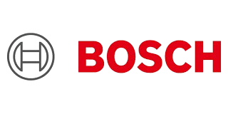
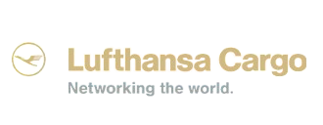
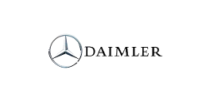
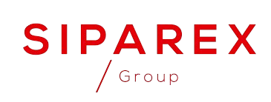


Long-List Potential Buyers
Company
Category
Description
Reasons
3 – Strategic (Vertical Integration)
A global tech company based in Germany, active in mobility and industry. Its supply chains drive interest in logistics efficiency, especially for spare parts transport.
Ownership of Schuon reduces Bosch’s dependency on third-party logistics
Schuon optimizes spare parts and component distribution
Strong fit with Bosch’s industrial and automotive supply chains
Enables cost savings and faster, more resilient deliveries
3 – Strategic (Vertical Integration)
The air freight unit of Lufthansa, operating globally. It relies on ground logistics partners to secure stable pre- and post-air freight connections.
Existing supplier relationship makes Schuon a logical integration target
Ownership improves control over pre- and post-air cargo transport
Closes gap between air and road logistics for better reliability
Supports Lufthansa Cargo’s scalable European distribution network
3 – Strategic (Vertical Integration)
A leading truck manufacturer with complex supply chains. The company seeks greater logistics control to boost efficiency and reduce risks.
Schuon secures reliable capacity in Daimler’s key supply chains
Ownership enables control and optimization of just-in-time transport
Existing collaboration ensures low integration risk
In-house logistics boosts efficiency and supply chain resilience
4 – Financial (Private Equity)
Siparex Mezzanine is a France-based investor specializing in flexible mezzanine and minority deals. Strong presence in the DACH region with experience in logistics and industrial sectors.
Focus on SME growth financing aligns with Schuon’s size
Experience in supporting logistics and industrial firms
Flexible minority structures suit founder-led businesses
Strong presence in German-speaking and neighboring markets
4 – Financial (Private Equity)
Platinum Equity Small Cap Fund targets lower mid-market firms, with a focus on logistics and industry. It drives scalable growth through operational improvements and add-on acquisitions.
Focus on lower mid-market logistics firms with proven buy-in in Europe
Strong operational playbook suited for scalable logistics targets
Targets add-ons and regional growth in fragmented sectors
Flexible investment structure with global support capabilities
4 – Financial (Private Equity)
AUCTUS is a Munich-based private equity firm specializing in profitable mid-sized companies. Known for its entrepreneurial mindset and buy-and-build focus, including in the logistics sector.
Strong experience with mid-sized logistics acquisitions
Focus on scalable, growth-ready businesses
Schuon fits with its logistics and regional strategy
Clear potential for add-on acquisitions and scaling
2/3
23/06/2025

Slide 3
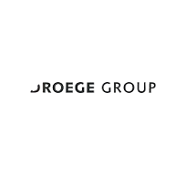
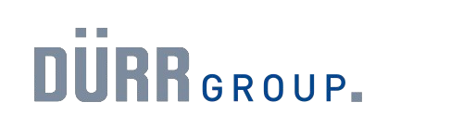
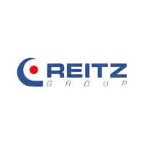
Long-List Potential Buyers
Company
Category
Description
Reasons
5 – Financial (Family Offices)
German family office focused on mid-sized companies with a long-term, entrepreneurial investment approach and experience in service industries.
Strong track record in scaling mid-sized German firms matches Schuon’s profile
Long-term horizon fits Schuon’s family-business culture
Financial and operational support enables scalable growth
Strategic focus on service industries aligns with Schuon
5 – Financial (Family Offices)
Value-driven family office with strategic interest in sustainable development, supporting long-term growth without short-term pressure.
Focus on sustainable logistics fits Schuon’s long-term direction
Family-backed capital suits Schuon’s value-driven culture
Regional development mindset complements Schuon’s legacy
Supports innovation and growth without exit pressure
5 – Financial (Family Offices)
Family-backed investor seeking stable, scalable assets in logistics and industry, aligned with cultural and operational continuity.
Interest in stable logistics assets fits Schuon’s business model
Strategic mindset ensures long-term backing
Family office structure aligns with Schuon’s scale and culture
Potential to grow portfolio with reliable operator
3/3
23/06/2025

