Slide 1

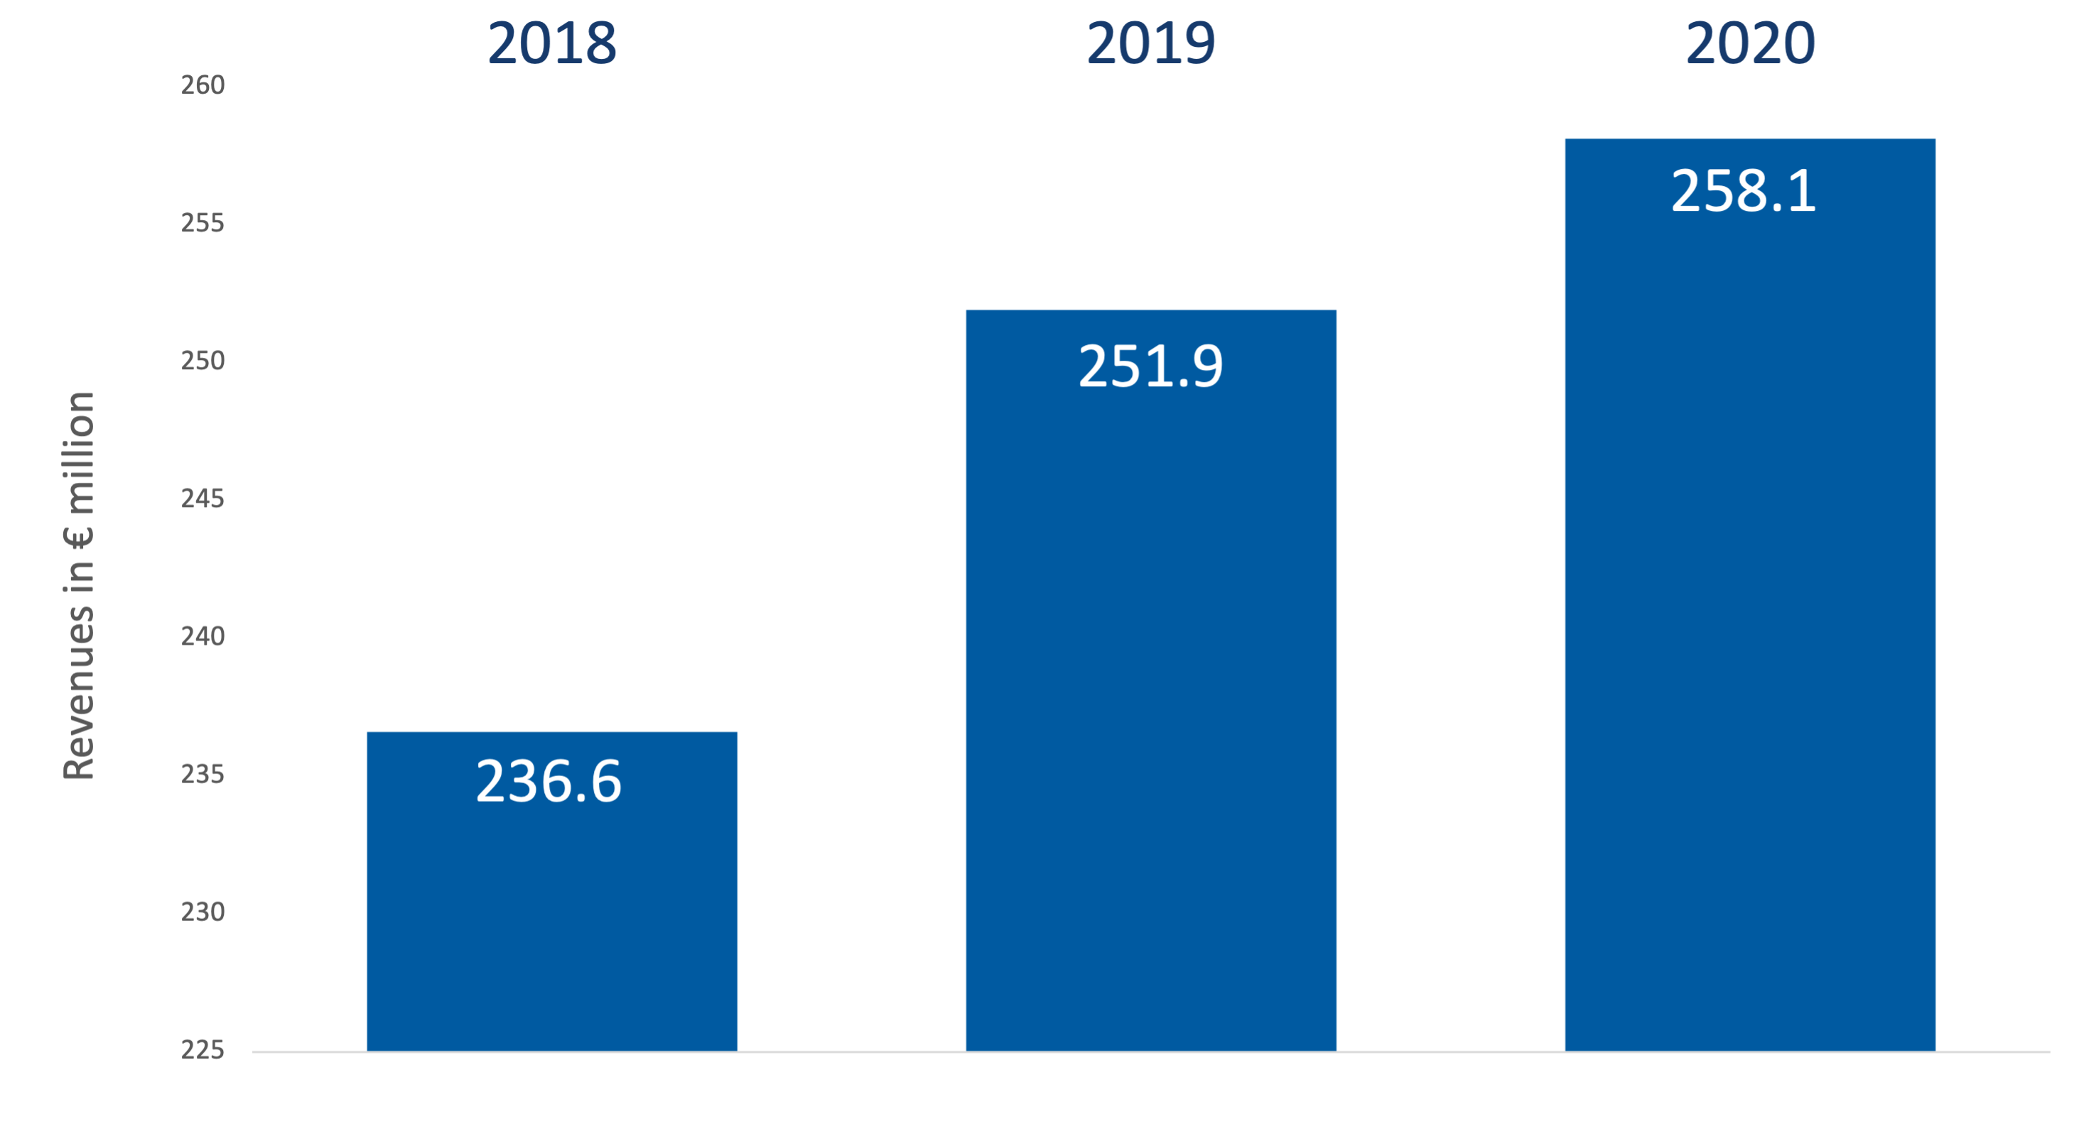
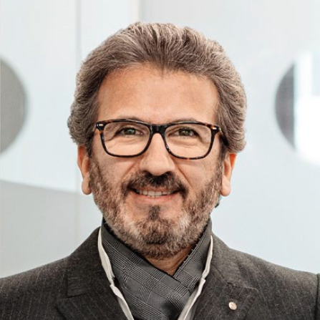
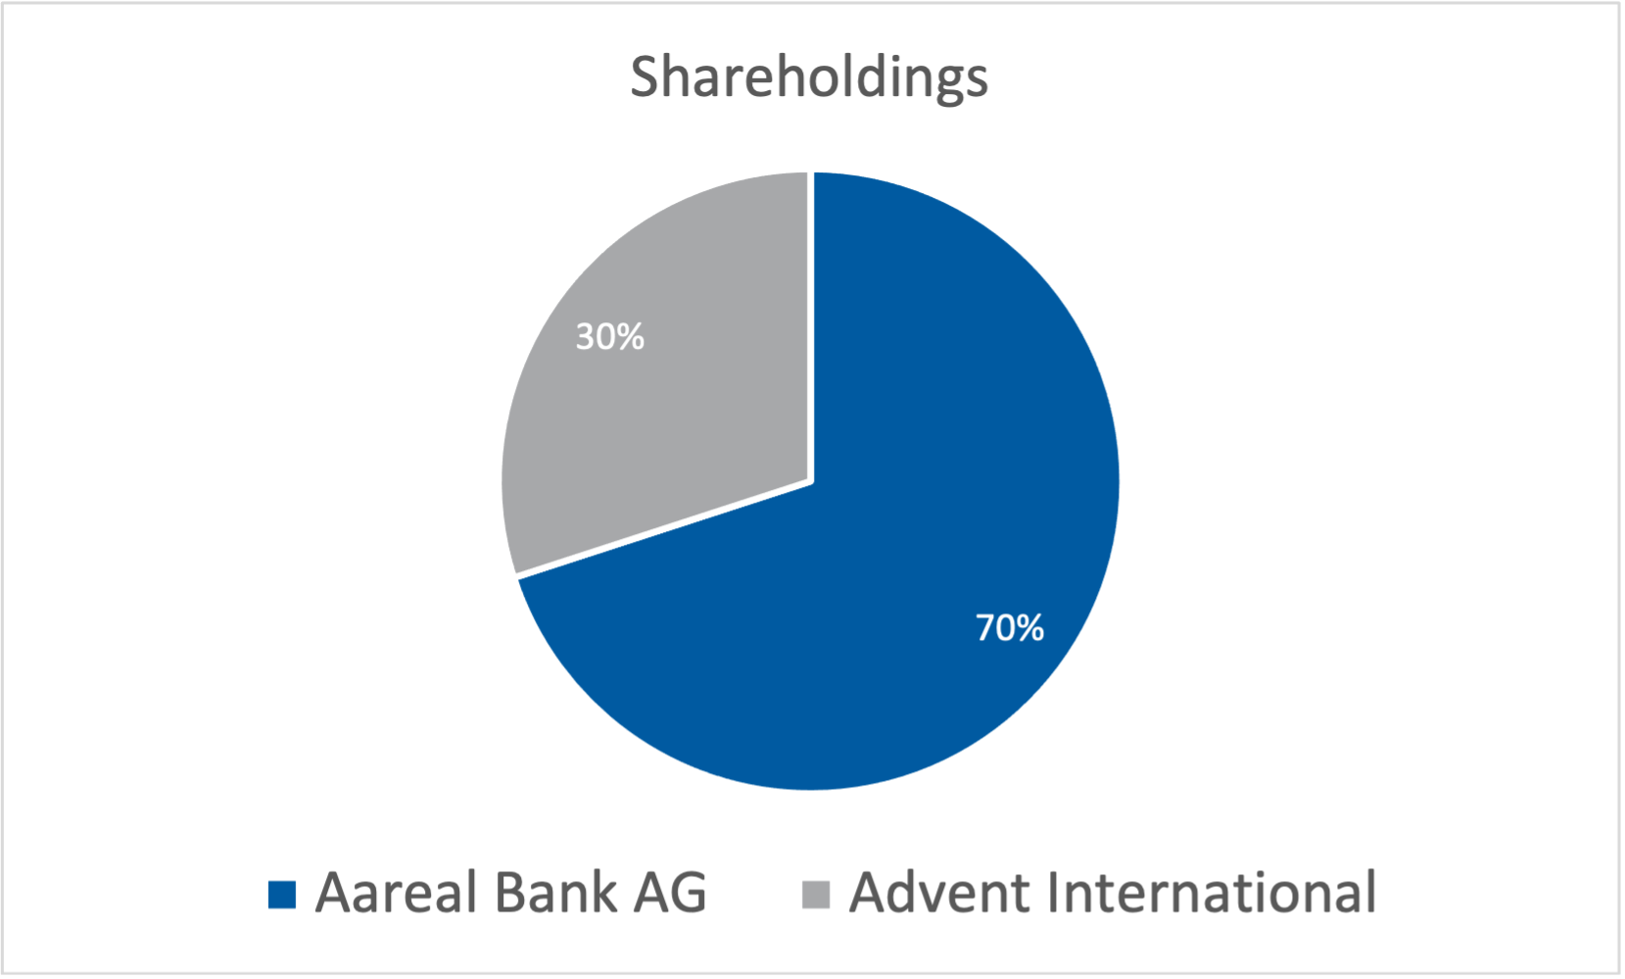
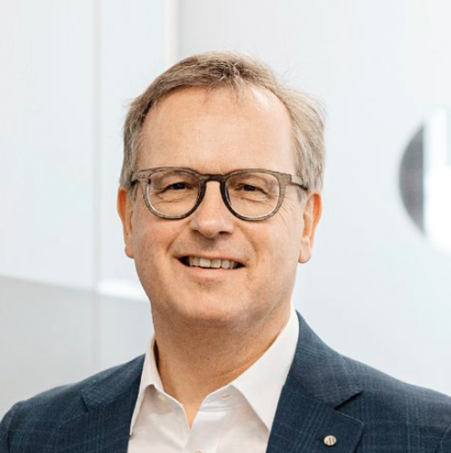
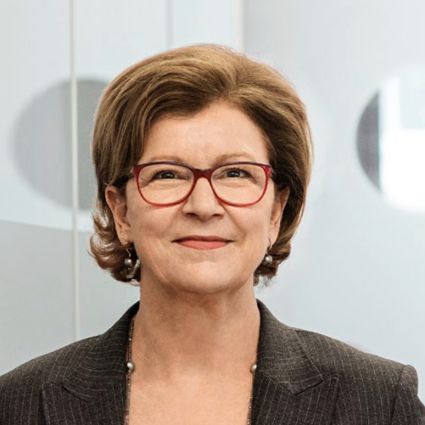
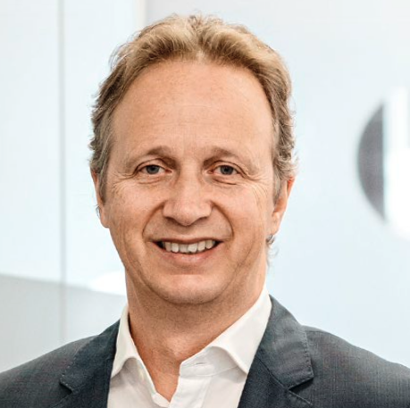
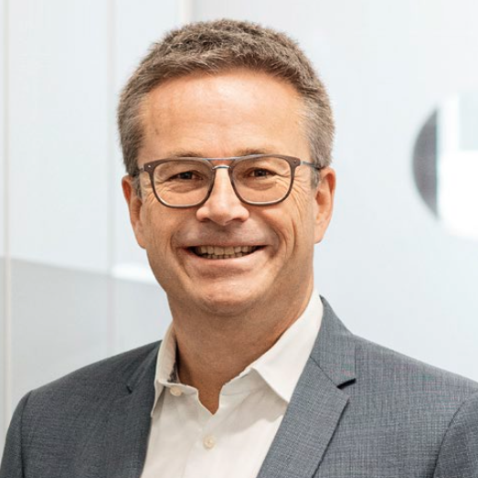
Company Profile Aareon
Company Description
Key Financials
Aareon, founded in 1957 and headquartered in Mainz, Germany, is the leading provider of enterprise resource planning systems for the European real estate sector..
In 2020 3.000 customers have bin served, which manage more than 3 Million entities with Aaron products
Aareon serves customers in the DACH region as well as Finland, France, Great-Britain, the Netherlands and Sweden.
Aareon currently occupies around 1795 employees of different nationalities and cultures.
News: Aareal Bank AG sold a minority stake (30%) of Aareon to Advent International in 2020. The Partnership with Advent hopes to strengthen the market position of Aareon.
Management
Shareholdings
Dr. Imad Abdallah, Chief Digital and Venture Officer
Dr. Manfred Alflen, CEO
Sabine Fischer, CMO
Christian M. Schmal, CFO
Dr. André Rasquin, COO
Sources:
Management: Annual Report 2020 page 17
Company description: Annual Report 2020 page 6
Sources:
Key Financials: Annual Report page 4
Shareholdings: Aareal Homepage: https://www.aareon.com/sixcms/detail.php/141023
Notes:
Sources:
Management: Annual Report 2020 page 17
Shareholdings: Aareal Homepage: https://www.aareon.com/sixcms/detail.php/141023
Key Financials: Annual Report page 4
Company description: Annual Report 2020 page 6

