Slide 1
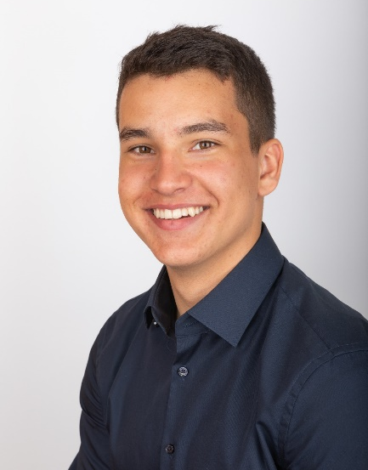








Lucas van Kesteren
Dual Studies
Start 09.2020
Graduation 03.2024
Eurofighter FCC SAT:
Regression Testing
ADS IC/O:
Support in eMRTT offer for Brazil and Process optimization
Semester abroad:
One Semester at UFSC, Florianopolis, Brazil in portuguese
Regional ADS Sales in Singapore: Strategic Market Research for Southeast asian markets and wide ADS portfolio including CI, Space, MRO,…
Engineering and Management (B.Eng.)
Eurofighter Sales – Bid Management:
Process Optimization
Ger.; Port.; Eng.; Spa.; Fra.
Eurodrone Chief Engineering:
Optimization of Design to Value process
Lucas.van_kesteren@airbus.com
linkedin.com/in/lucas-van-kesteren-b10278182
Programms & Tools
Competencies
Extracurricular
Hobbies
Python basics
VBA and SQL basics
Atlassian Confluence & Jira
G-Suite
MS-Office
Ecosystem Mappings
Market Research
Competitors-analysis
Agile PM
Confluence implementations
consult.IN (Students Consultancy):
One Period as CEO
several internal and external Projects
Baan Gerda (Orphanage in Thailand):
Child care support
Teaching activities
House keeping support
Sports:
Tennis
Soccer
Climbing
Surfing
Other:
Travelling
Politics

Slide 2


Lucas van Kesteren
Dual Studies
Start 09.2020
Graduation 03.2024
Eurofighter FCC SAT:
Regression Testing
ADS IC/O:
Support in eMRTT offer for Brazil and Process optimization
Semester abroad:
One Semester at UFSC, Florianopolis, Brazil in portuguese
Regional ADS Sales in Singapore: Strategic Market Research for Southeast asian markets and wide ADS portfolio including CI, Space, MRO,…
Engineering and Management (B.Eng.)
Eurofighter Sales – Bid Management:
Process Optimization
Ger.; Port.; Eng.; Spa.; Fra.
Eurodrone Chief Engineering:
Optimization of Design to Value process
Lucas.van_kesteren@airbus.com
linkedin.com/in/lucas-van-kesteren-b10278182
Programms & Tools
Competencies
Extracurricular
Hobbies
Python basics
VBA and SQL basics
Atlassian Confluence & Jira
G-Suite
MS-Office
Ecosystem Mappings
Market Research
Competitors-analysis
Agile PM
Confluence implementations
consult.IN (Students Consultancy):
One Period as CEO
several internal and external Projects
Baan Gerda (Orphanage in Thailand):
Child care support
Teaching activities
House keeping support
Sports:
Tennis
Soccer
Climbing
Surfing
Other:
Travelling
Politics

