Slide 1

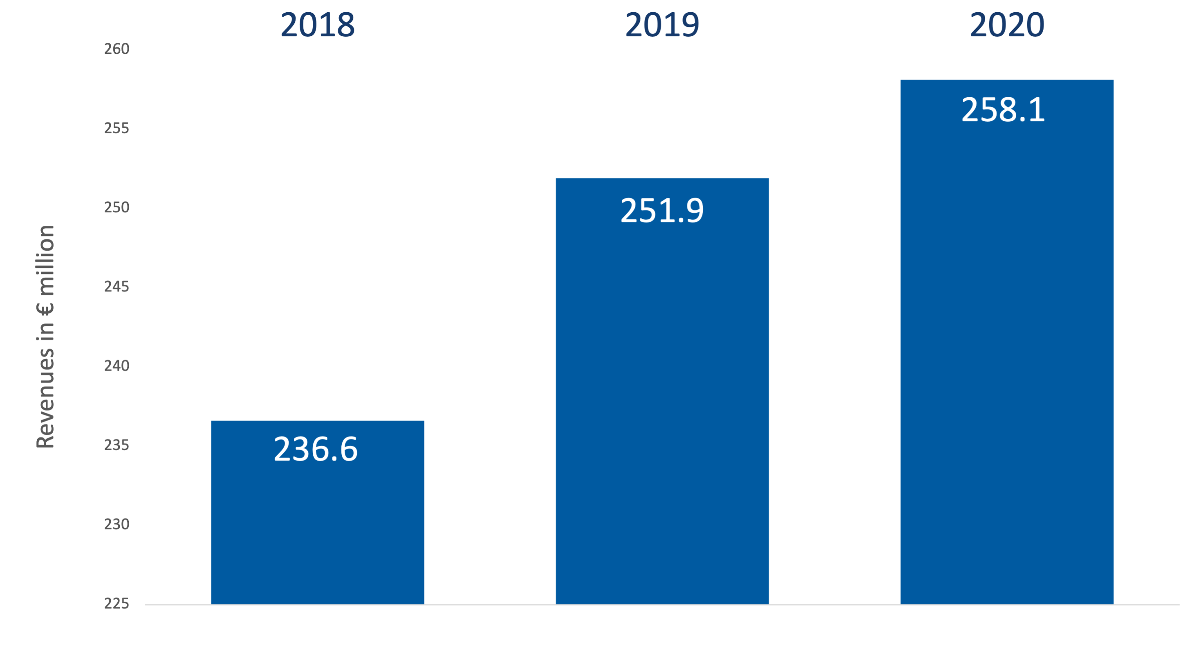

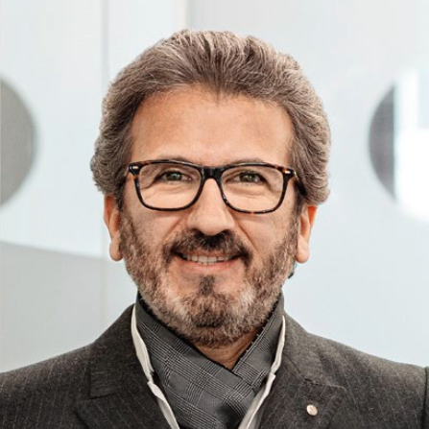
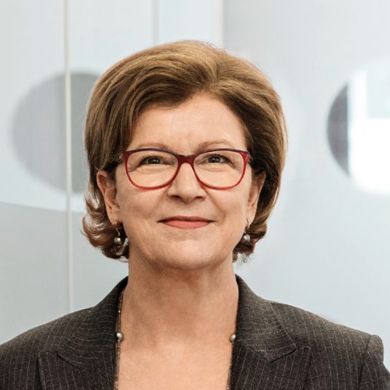
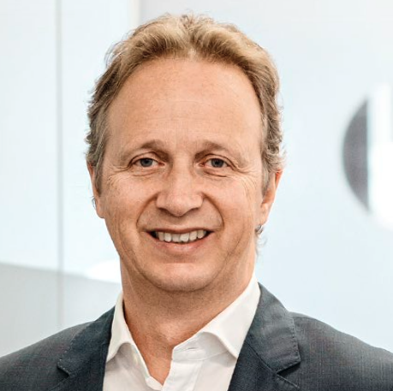

Company Profile Aareon
Company Description
Key Financials
Aareon, founded in 1957 and headquartered in Mainz, Germany, is the leading provider of enterprise resource planning systems for the European real estate sector
In 2020, 3,000 customers have bin served, which manage more than 3 Million entities with Aaron products
Aareon serves customers in the DACH region as well as Finland, France, Great Britain, the Netherlands, and Sweden.
Aareon currently occupies around 1,795 employees of different nationalities and cultures
70% of Aaron’s shares are held by their parent Company Aareal Bank. Since August 2020 the PE-Fund Advent International holds a 30% minority stake
Management
FY | 2019 | 2020
Revenue | 258’055.00 € | 251,877.00 €
EBIT | 28’989.00 € | 38’811.00 €
EBIT margin | 11% | 15%
Net income | 17’858 | 25’900
Net income margin | 7% | 10%
Dr. Imad Abdallah, Chief Digital and Venture Officer
Dr. Manfred Alflen, CEO
Sabine Fischer, CMO
Christian M. Schmahl, CFO
Dr. André Rasquin, COO
Revenues from the DACH region make up 63% of revenue, while International Business make up the other 37% of revenue
With 55% of revenue in 2020 are staff costs the biggest expenses.
Sources: Management: Annual Report 2020 page 17; Shareholdings: Aareal Homepage: https://www.aareon.com/sixcms/detail.php/141023; Key Financials: Annual Report page 4 and 54; Company description: Annual Report 2020 page 6; Annual Report: https://www.aareon.com/Company/Latest_Annual_Report_Pioneering_Work.2753.html.
Notes:
Sources:
Management: Annual Report 2020 page 17
Shareholdings: Aareal Homepage: https://www.aareon.com/sixcms/detail.php/141023
Key Financials: Annual Report page 4
Company description: Annual Report 2020 page 6

Slide 2
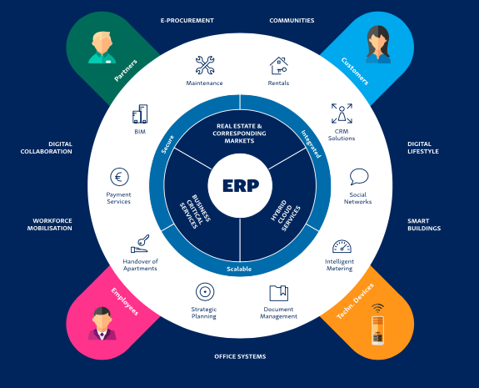
Product
Aareon Smart World
Aareon Smart World, a digital ecosystem enables property companies and their employees to link up with customers and business partners. It interconnects technical devices, both individual apartments and entire buildings. It also allows processes to be redesigned and optimised. Aareon Smart World adds value by lowering costs, creating new business models and facilitating the dialogue between customers and property-industry employees.
Source:
Annual Report 2020, page 7

Slide 3
General economic and industry environment

