Slide 1


AIESEC in Augsburg
Welcome to the AIESEC
Info Event

Slide 2

JOIN THE TEAM
AIESEC in Augsburg

Slide 3
AGENDA
Get2know
What is AIESEC?
What does AIESEC offer?
What can you work on?
What are the requirements?
What’s next?
GET-TOGETHER

Slide 4
Get 2 Know
What’s your name and where are you from?
Why are you at AIESEC or here today :)?
Which countries are on your bucket list?
Which historical Figure- living or passed - would you like to go out to dinner with?

Slide 5
What is AIESEC?

Slide 6




Slide 7


Slide 8


Slide 9


Slide 10



Slide 11

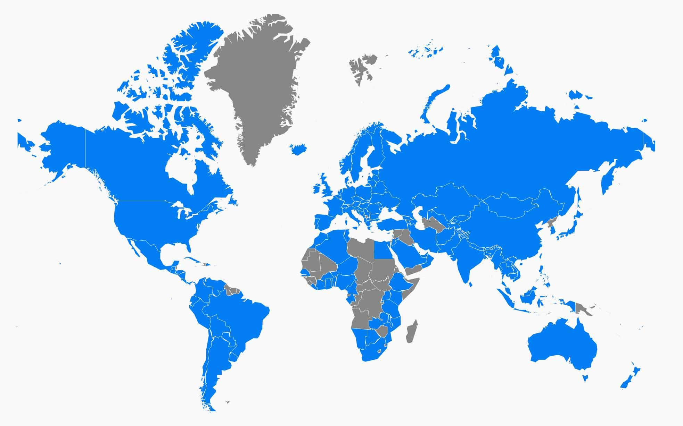




30,579+
Members worldwide
120+
Countries and territories
7,978+
Partner organizations
106,454+
Experiences in the last year
1,000,000+
AIESEC Alumni

Slide 12
Your opportunity with AIESEC

Slide 13
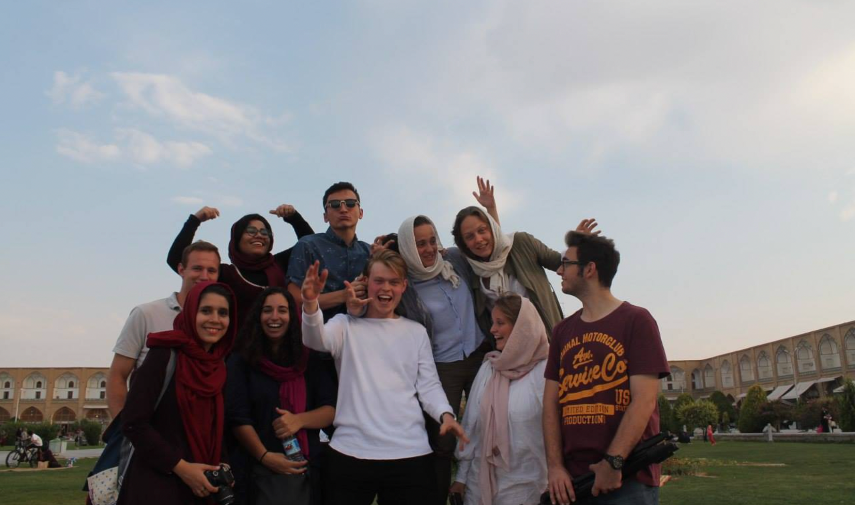
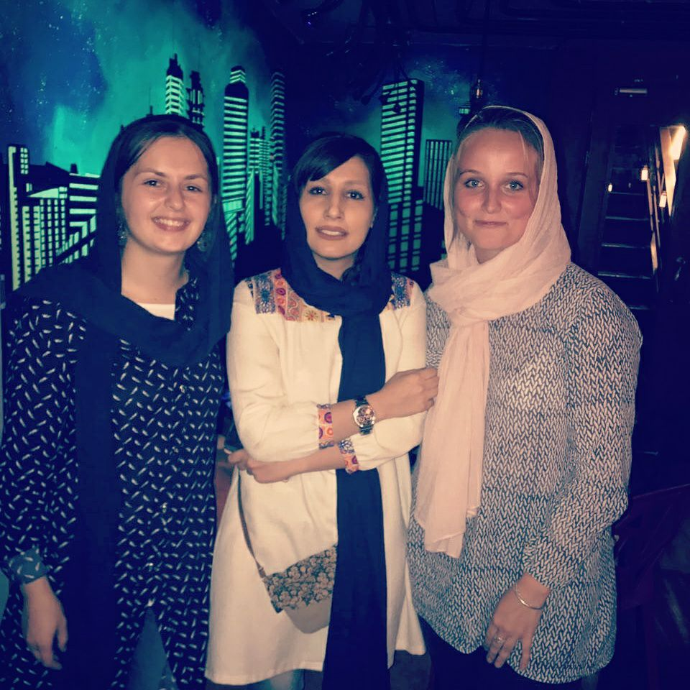
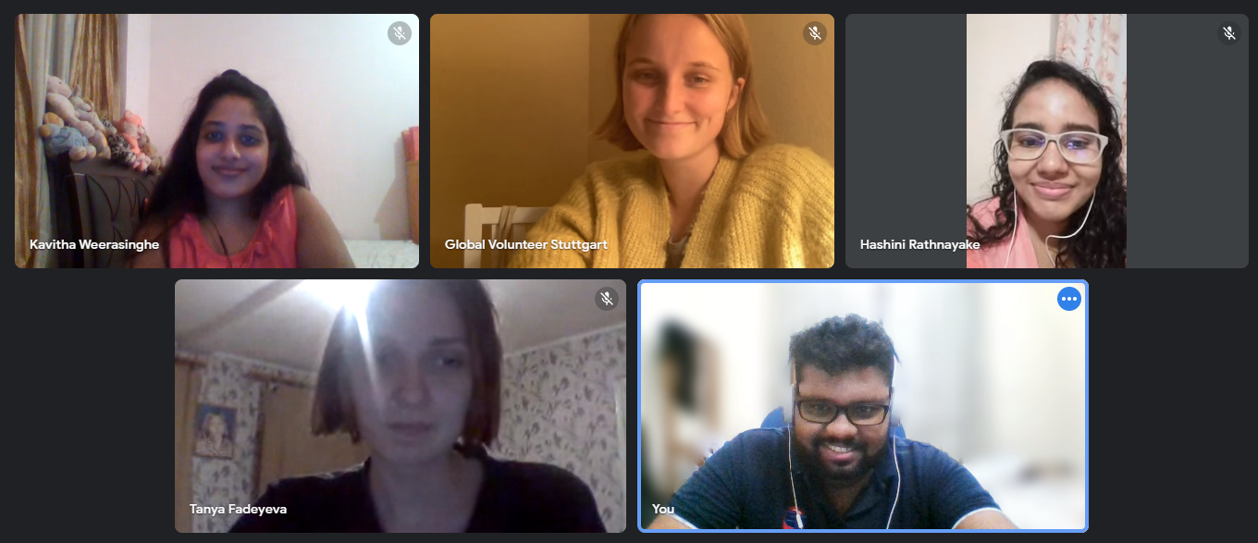
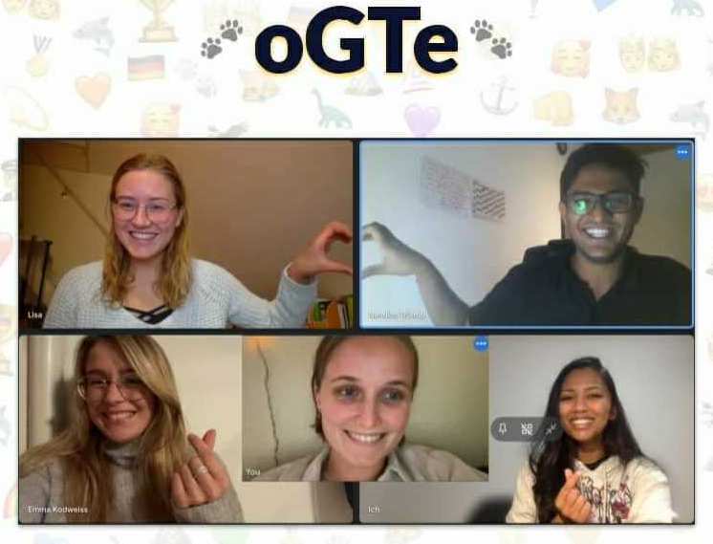
Meline
Went on a Global Volunteer Experience to Iran 2017
Joined AIESEC Stuttgart in March 2021
Team Leader of oGTe (outgoing Global Teacher)
  Just managed to find a 7 months Teaching opportunity for a girl in Ecuador
  Had contact to people from over 15 countries
And: Working for AIESEC Belarus to stabilize their team

Slide 14


In an era of globalisation, AIESEC's programmes have helped young people around the world to develop a broader understanding of cultural socio-economic and business management issues. — Kofi Annan

Slide 15
What do you achieve?
Entrepreneurial thinking
Presentation and communication skills
Time and project management
Improve English language skills
Worldwide and lifelong network

Slide 16
Which team can you
work on?

Slide 17
Teams
oGV
MKT
TM
FIN
Outgoing Global Volunteer
Member Experience
Finance
Marketing

Slide 18

Experience Management
Outgoing
Be responsible for ensuring that students find the right project and have sustainable experience abroad.

Slide 19

Marketing
Social Media
& Events
Work with us to improve our market presence and thus our influence on society.

Slide 20
Talent Management
Member experience
Select the new generation of members and assure a great experience inside the organization

Slide 21
Finance
Money
Handle the income and expenses of the LC and create the monthly and yearly review.

Slide 22
REQUIREMENTS
8-10 hours per week
Accountability
Attend team and local committee meetings
Participation in conferences

Slide 23
What’s next?

Slide 24
What’s next?
Interview with
one of our
members
First local committee meeting
To be announced
Sign-up on aiesec.de/join
Kick-off Meeting
With the team

Slide 25
GET-TOGETHER

Slide 26
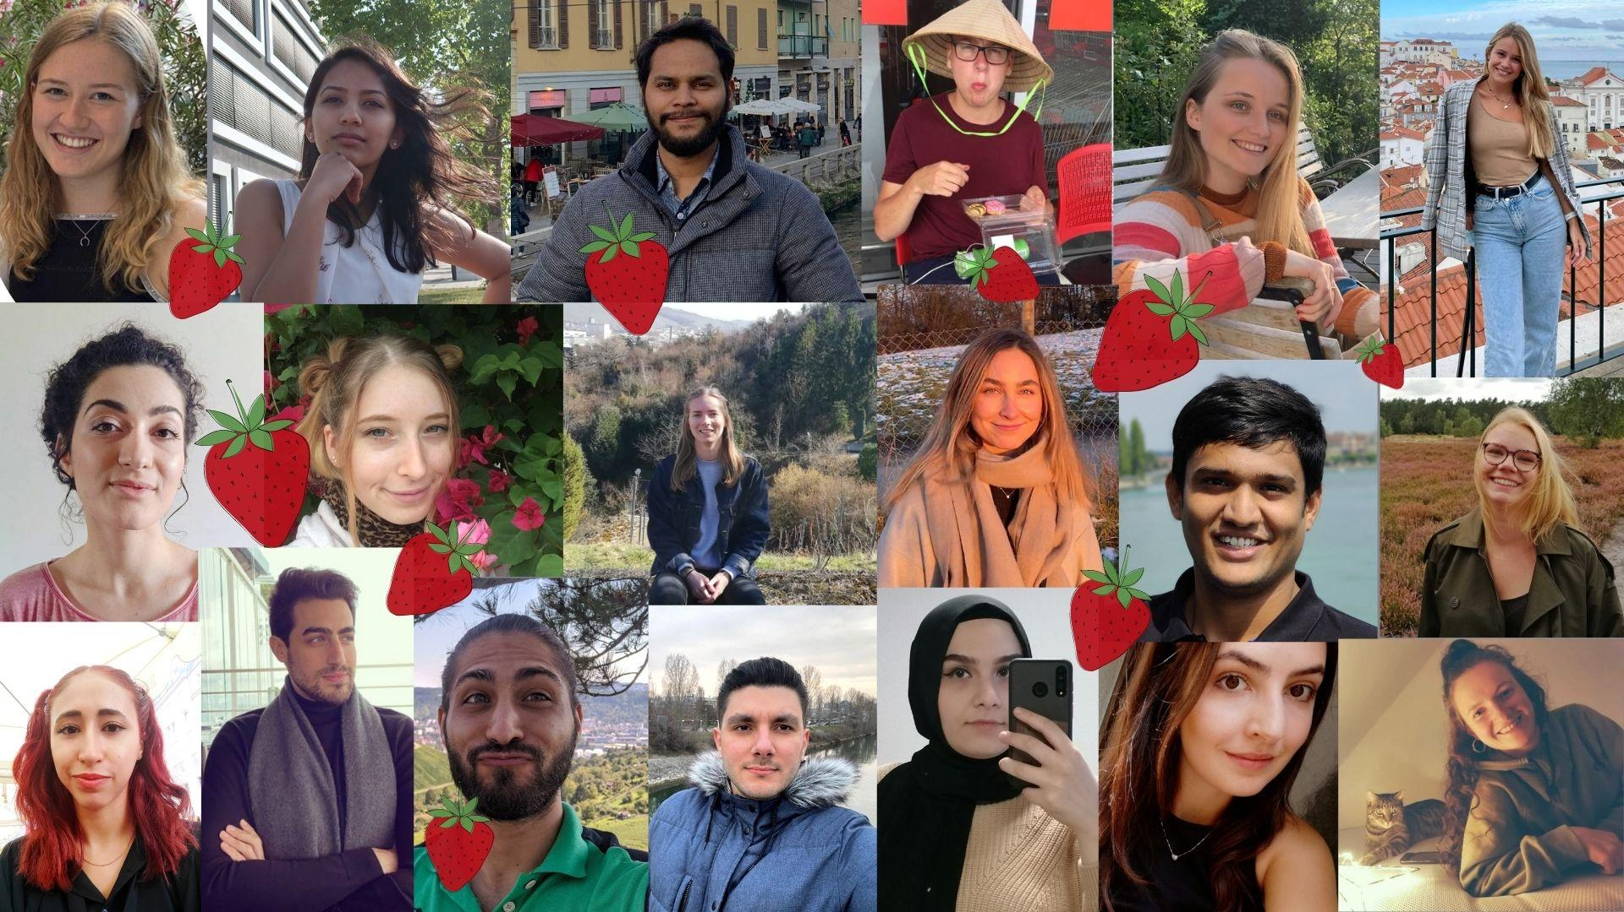
Get-together - what are your questions?
AIESEC.DE/JOIN

