Slide 1
Project FOUR
Julian, Terence, Elang, Henri, Ahmad

Slide 2
Mosquito Map
01
02
03
04
05
06
Problem Statement
EDA
Feature Engineering
Pre- Processing
Modelling
Cost Benefit Analysis

Slide 3
01
Problem Statement
Given weather, location, testing, and spraying data, predict when and where different species of mosquitoes will test positive for West Nile virus.

Slide 4
02
EDA

Slide 5
Exploratory Data Analysis
Trap
Species
Spray
WNV
Weather
Overall

Slide 6
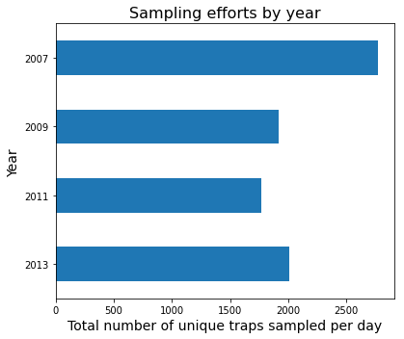
Trap
The number of sampling efforts are inconsistent each year. 2007 has the hughes followed by 2013, 2009, 2011

Slide 7
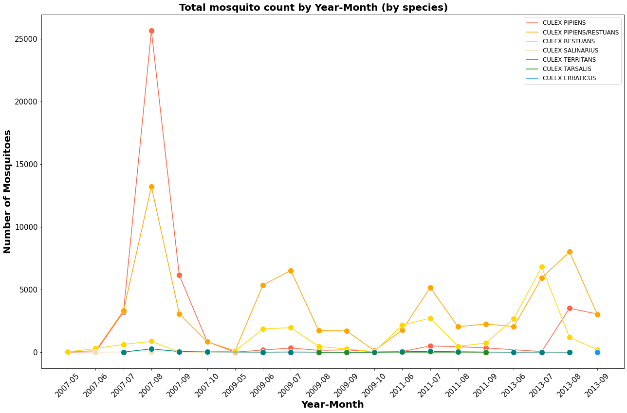
Species

Slide 8
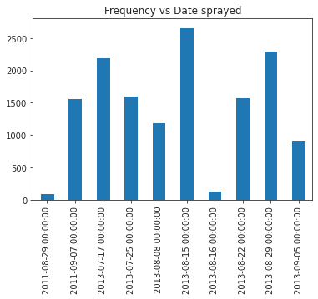
Spray
We will go through this later

Slide 9
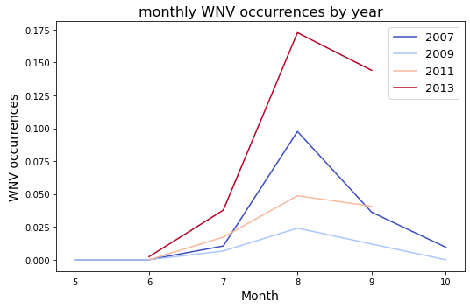
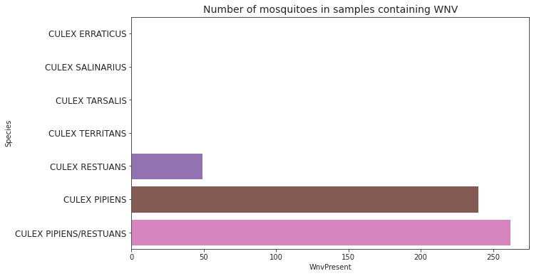
WNV
WNV occurrence has a significant increase in certain species and
certain month of the year

Slide 10
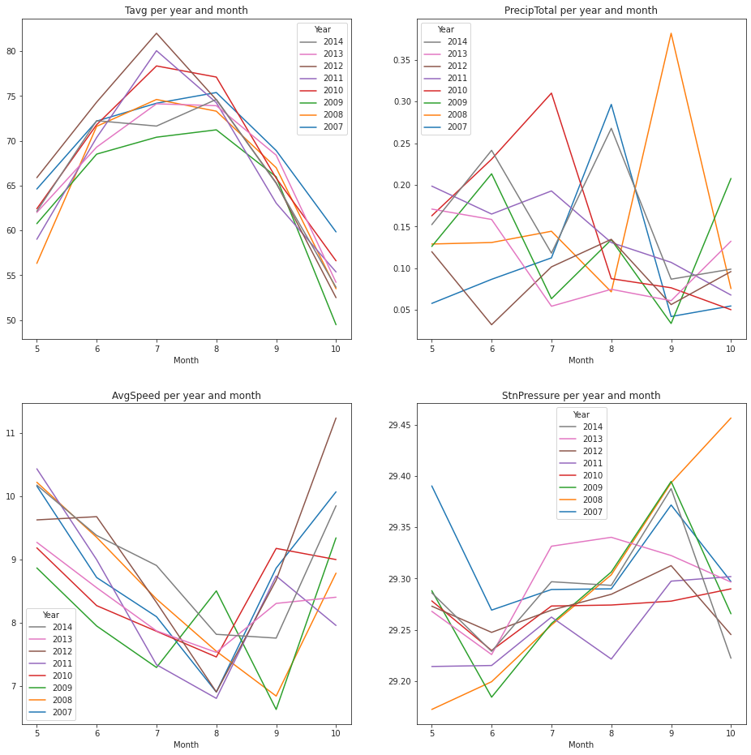
During 7 - 9th month particularly the Wind Speed is slowest and the Temperature is hottest
Weather

Slide 11

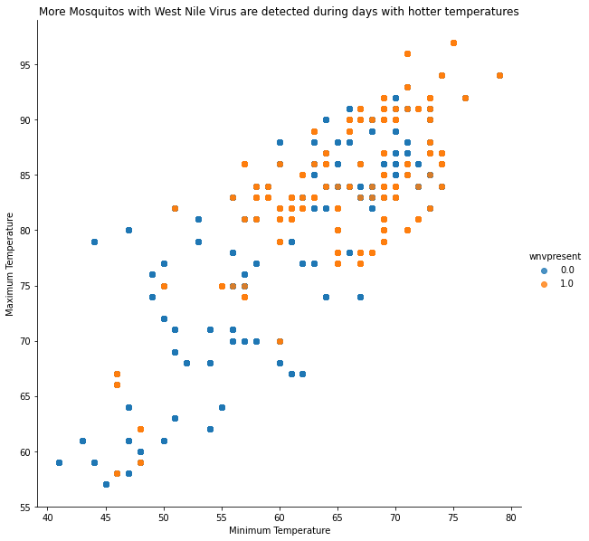
AVG. Temp

Slide 12
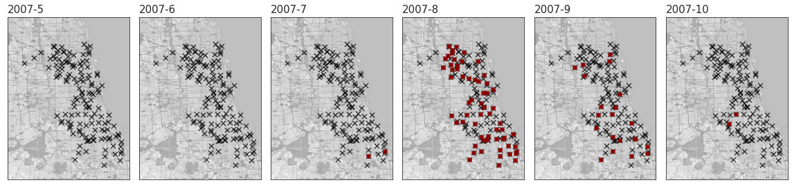
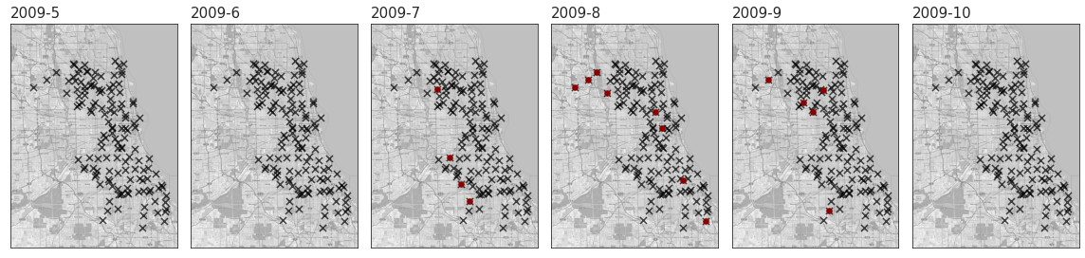
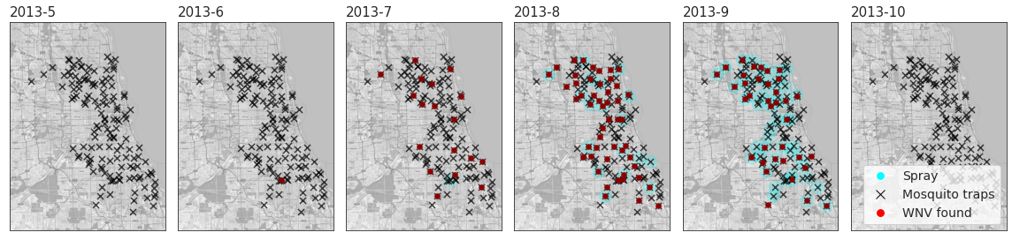
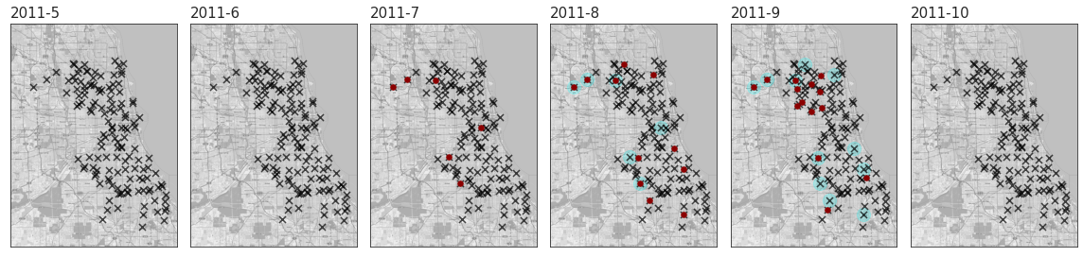
Overall

Slide 13
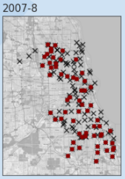
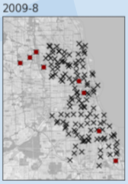
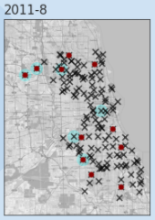
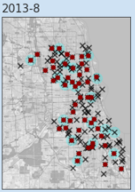
Temperature
Aug 2007
Aug 2009
Aug 2011
Aug 2013
Average Temp
73.46° F
70.15° F
73.58° F
74.28° F
Min Temp
68.87° F
64.68° F
65.9° F
67.9° F

Slide 14
03
Pre-Processing
Duplicates
Drop columns
Splitting data set
SMOTE

Slide 15
Pre-Processing
Duplicates
Trap #35 appeared 2 times
Trap #9 appeared 2 times
4100 N OAK PARK AVE, Chicago, IL appeared 150 times
Split Dataset
Conversion of date to year, month, and week
'Depart'
'Depth'
'SnowFall'
'AvgSpeed'
'ResultSpeed'
'ResultDir'
'SeaLevel'
'StnPressure'
'CodeSum'
'Heat'
'Cool'
Drop Columns
'AddressAccuracy'
'Address','Street'
'AddressNumberAndStreet'
'Water1'
Smote
Before SMOTE : [7963 441]
After SMOTE : [6476 6533]
Method : imblearn.combine.SMOTEENN

Slide 16
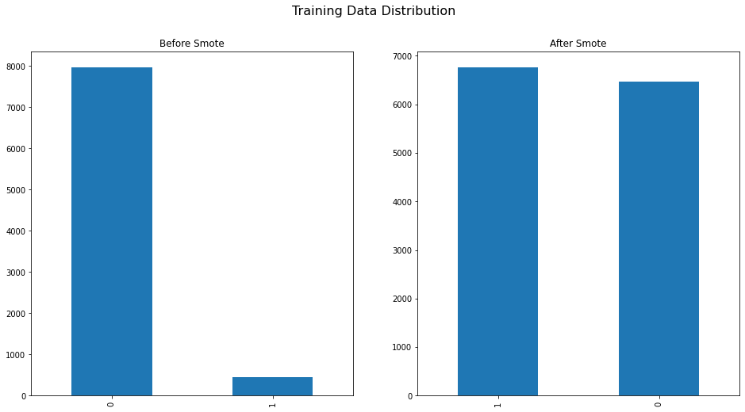
Data Imbalance

Slide 17
04
Feature Engineering
Dates
Sprayed
Weather

Slide 18
From the EDA it was determined that the mosquito population is dependent on the seasonal environments, therefore it is more relevant to process using year, month and week of year.
Dates
# Create feature Year
# Create feature Month
# Create feature WeekofYear (isocalendar().week)
Separate Month, Year, WeekofYear

Slide 19
The location of spray determines the affected area, therefore distance features are used to determine which traps were sprayed.
Sprayed
Effectiveness of spray is assumed to be 1000 m radius from the point of spray.
# Determine trap coordinate
# Determine spray coordinate
# Determine all trap locations within 1000 meters from the spray coordinate using shapely.nearest_points function, mark this trap as sprayed.
# Otherwise mark the trap as not sprayed.

Slide 20
The weather records show strong correlation between data from station 1 and station 2. Since station 2 data contains less missing values, it is selected as the weather feature.
Weather
Merged weather feature from station 1 and station 2.
# Replace trace and missing precip with 0s
# Impute Tavg manually (increases accuracy)
# Drop data from Station 1 in the analysis

Slide 21
05
Modelling

Slide 22
Model Summary
 | model | train_auc | test_auc | precision | specificity | recall | f1_score
0 | GB (No Smote) | 0.89 | 0.83 | 0.00 | 0.99 | 0.00 | 0.00
1 | GB(Smote) | 0.99 | 0.81 | 0.17 | 0.86 | 0.53 | 0.26
2 | RFC (No Smote) | 0.98 | 0.75 | 0.33 | 0.97 | 0.21 | 0.26
3 | RFC (Smote) | 1.00 | 0.75 | 0.22 | 0.92 | 0.39 | 0.28
4 | XGB (No Smote) | 0.88 | 0.83 | 0.00 | 1.00 | 0.00 | 0.00
5 | XGB (Smote) | 0.99 | 0.82 | 0.18 | 0.85 | 0.57 | 0.27
Notes:
We have experimented with Boosting and Tree algo in this project. For each model , we did a baseline without smote and compare the result with smote. Clearly , with an initial imbalance data

Slide 23
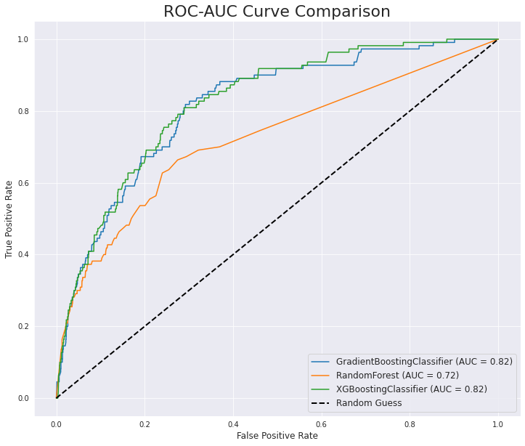
ROC
(Smote Model)

Slide 24
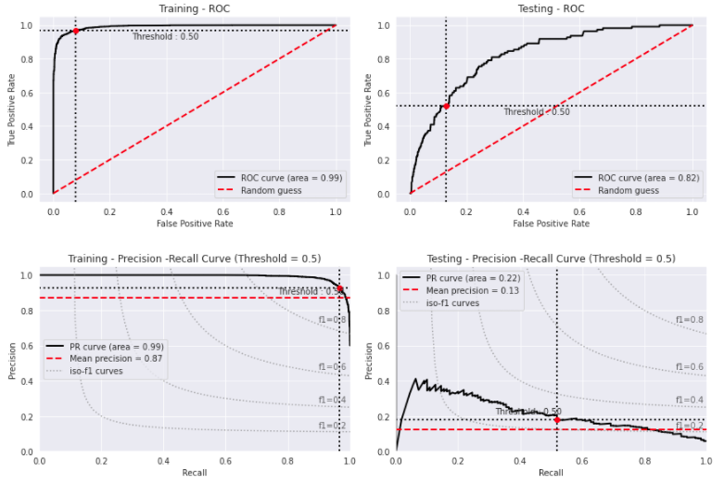
XGB Classifier Model

Slide 25
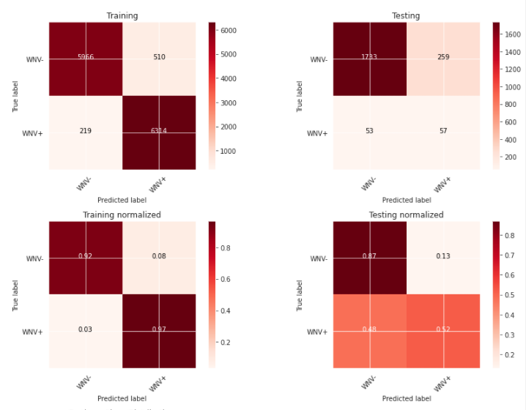
XGB Classifier Model

Slide 26
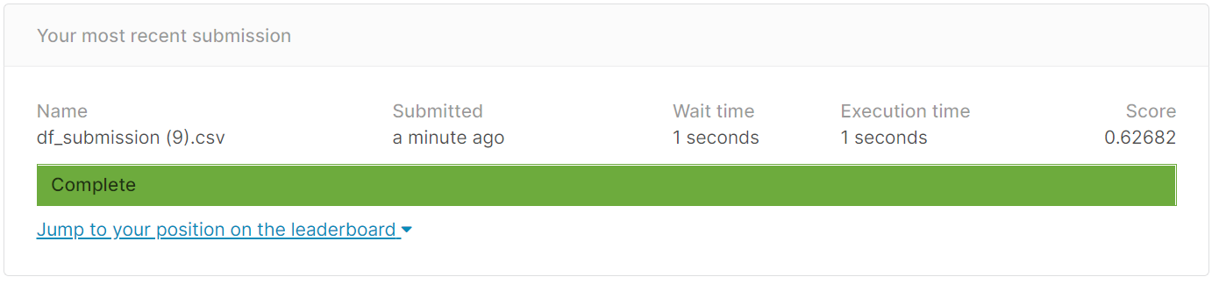
Kaggle Score

Slide 27
o6
Cost Benefit Analysis

Slide 28
Spray Occurrence
Spray
Only 2 years of spraying with majority in 2013
Spraying is only useful for killing adult mosquitoes. The effects will be short lived because there will still be an uptick of germinated mosquito larvae
Solutions must be persistent with using adult pesticide

Slide 29
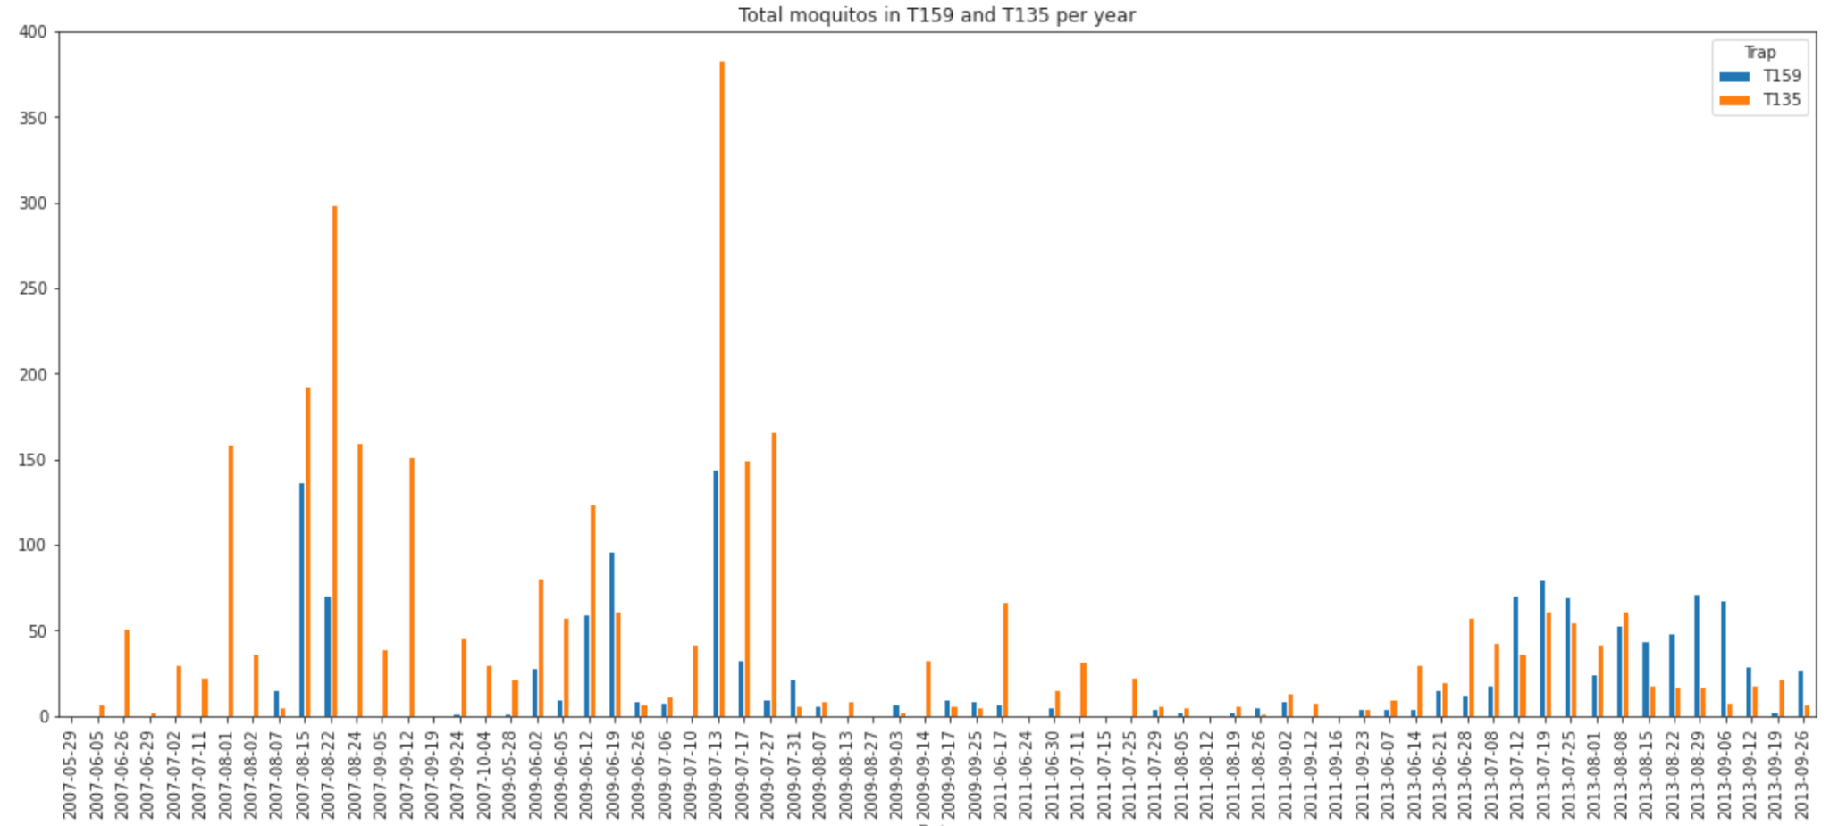
Spray Effectiveness
Total mosquitos recorded per day
Total mosquitos recorded per day
T159 sprayed on 2013-07-17
Comparing two specified traps
T159, sprayed on 2013-07-17 has decreasing trend
T135, not sprayed is decreasing trend
2013-08: strong resurgence, so even if the pesticide is effective, it is not persistent
Notes:
Need to spray consistently
One time spray not sufficient : supporting evidence → resurgent

Slide 30
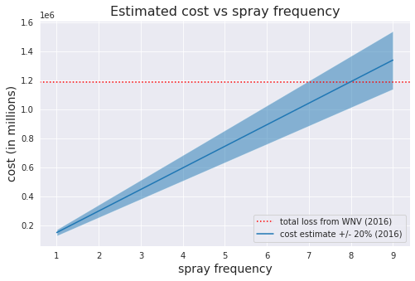
Cost Benefit Analysis
● Costs (using pesticide Zenivex E4^{[1]}):
based on estimates of $500 for a session for 0.5 acre of land^{[2]}
Cost is $149,000 for 0.6 km^2 ^{[3]}
● Benefits:
○Fewer people dying/falling ill —> increased workplace productivity and healthcare savings (average $11,000)^{[4]}
○108 WNV cases in 2016:^{[5]}
medical bill ~ $1,190,000
● Since the benefits outweigh the costs the county should socialise the cost and share the prevention costs with the community as a whole.
Breakeven at 7-8 sprays

Slide 31
Resources
Pesticide info https://www.cmmcp.org/pesticide-information/pages/zenivex-e4-etofenprox
Cost of spray
https://www.callnorthwest.com/2020/05/how-much-does-a-mosquito-treatment-cost/
Chicago spray strategy https://www.chicago.gov/city/en/depts/cdph/provdrs/healthy_communities/news/2020/august/city-to-spray-insecticide-thursday-to-kill-mosquitoes.html
WNV cost
https://bmcinfectdis.biomedcentral.com/articles/10.1186/s12879-019-4596-9
No. of WNV 2016 Chicago https://www.ncbi.nlm.nih.gov/pmc/articles/PMC7241786/

