Slide 1
Project FOUR
Group 1: Julian, Terence, Elang, Henri, Ahmad

Slide 2
Mosquito Map
01
02
03
04
05
06
Problem Statement
EDA
Pre- Processing
Feature Engineering
Modelling
Cost Benefit Analysis

Slide 3
01
Problem Statement
Given weather, location, testing, and spraying data, predict when and where different species of mosquitoes will test positive for West Nile virus.
Conduct a cost benefit analysis

Slide 4
02
EDA

Slide 5
Exploratory Data Analysis
Trap
Species
Spray
WNV
Weather
Overall

Slide 6
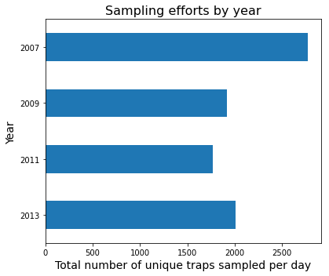
Trap
The number of sampling efforts are inconsistent each year. 2007 has the highest followed by 2013, 2009, 2011

Slide 7
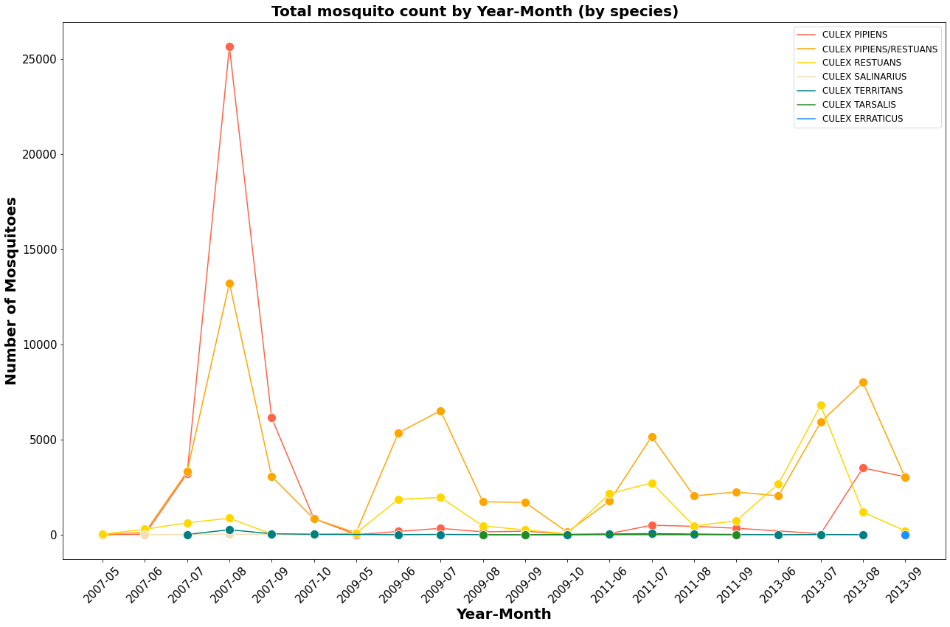
Species
Pipiens and Restuans mostly found species

Slide 8
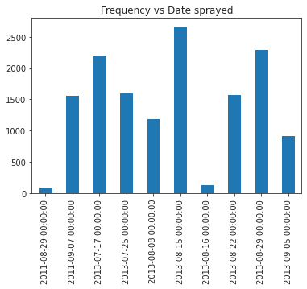
Spray
We will go through this later

Slide 9
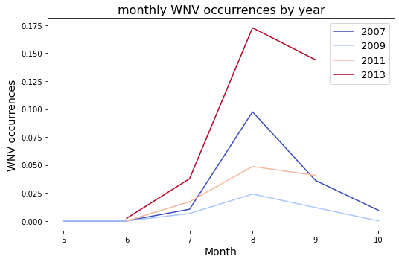
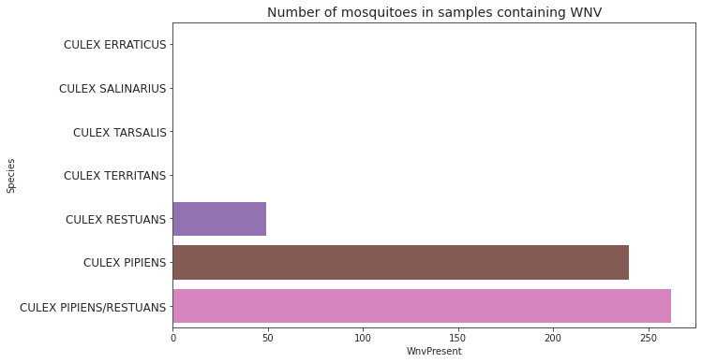
WNV
WNV occurrence has a significant increase in certain species and
certain month of the year

Slide 10
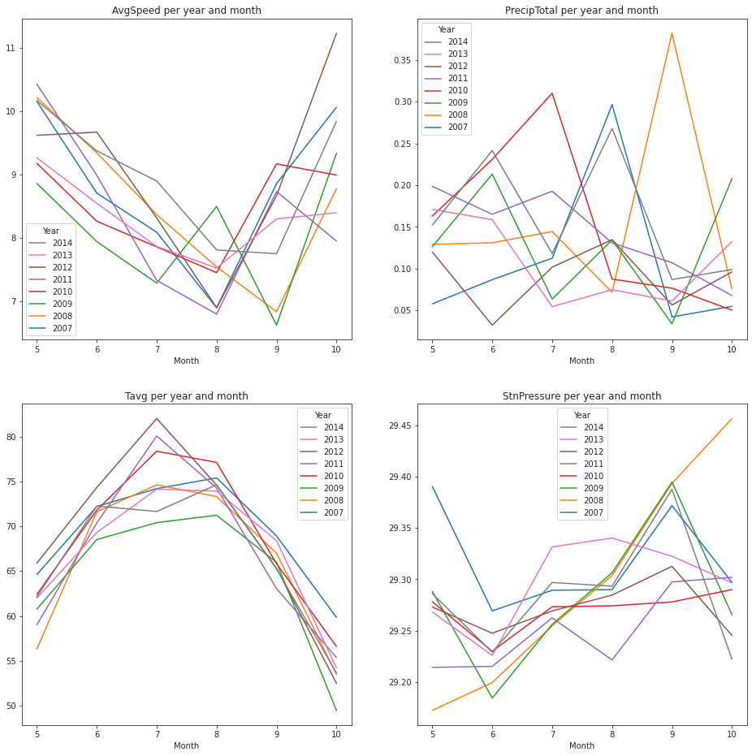
During 7 - 9th month particularly the Wind Speed is lowest and the Temperature is warmest
Weather

Slide 11
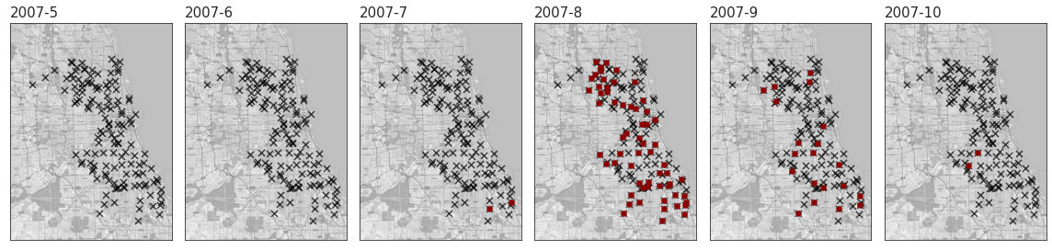
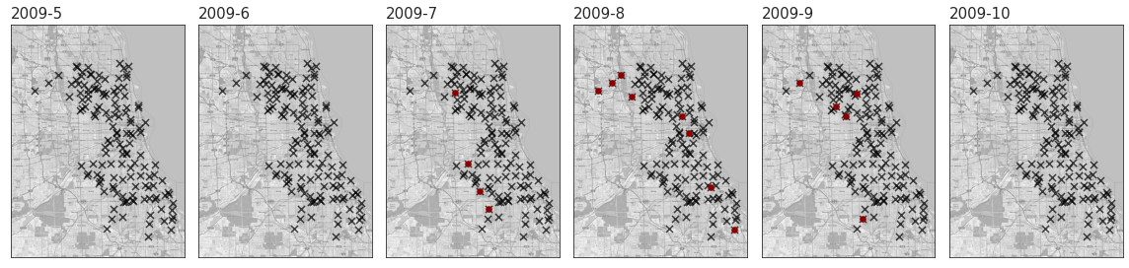
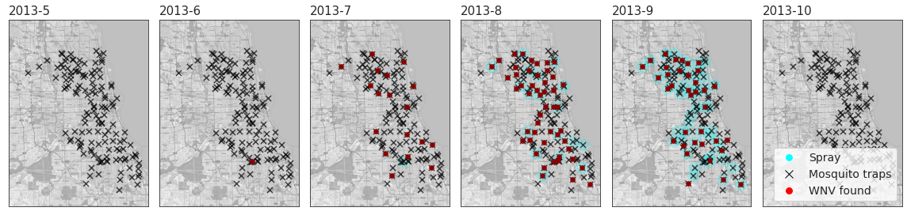
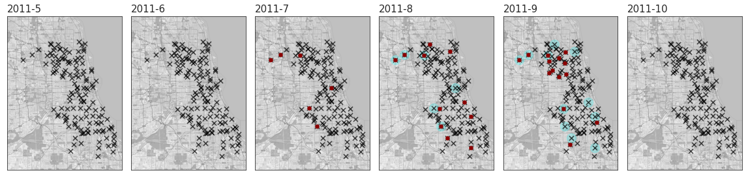
Overall

Slide 12
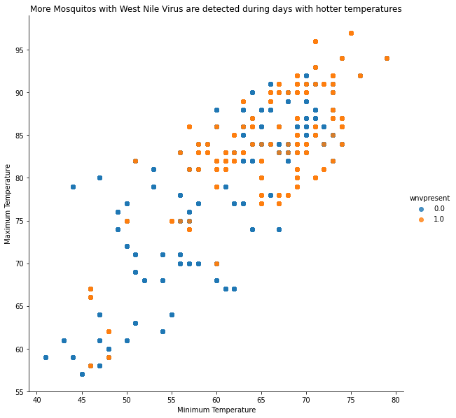
Overall

Slide 13
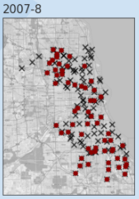
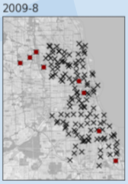
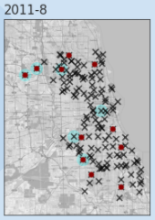
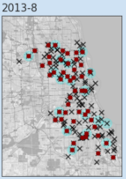
Overall
Aug 2007
Aug 2009
Aug 2011
Aug 2013
Average Temp
73.46° F
70.15° F
73.58° F
74.28° F
Min Temp
68.87° F
64.68° F
65.9° F
67.9° F

Slide 14
03
Pre-Processing
Duplicates
Drop columns
Split dataset
SMOTE

Slide 15
Pre-Processing
Duplicates
Trap #35 appeared 2 times
Trap #9 appeared 2 times
4100 N OAK PARK AVE, Chicago, IL appeared 150 times
Split Dataset
Method: sklearn.model_selection.train_test_split (80:20)
'Depart'
'Depth'
'SnowFall'
'AvgSpeed'
'ResultSpeed'
'ResultDir'
'SeaLevel'
'StnPressure'
'CodeSum'
'Heat'
'Cool'
Drop Columns
'AddressAccuracy'
'Address','Street'
'AddressNumberAndStreet'
'Water1'
Smote
Before SMOTE : [7963 441]
After SMOTE : [6476 6533]
Method : imblearn.combine.SMOTEENN

Slide 16
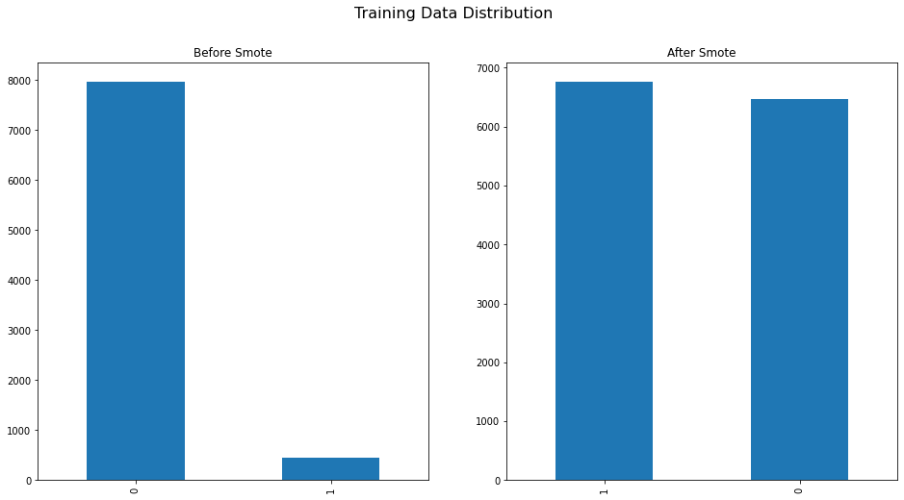
Data Imbalance

Slide 17
04
Feature Engineering
Dates
Sprayed
Weather

Slide 18
From the EDA it was determined that the mosquito population is dependent on the seasonal environments, therefore it is more relevant to process using year, month and week of year.
Dates
# Create feature Year
# Create feature Month
# Create feature WeekofYear (isocalendar().week)
Separate Month, Year, WeekofYear

Slide 19
The location of spray determines the affected area, therefore distance features are used to determine which traps were sprayed.
Sprayed
Effectiveness of spray is assumed to be 1000 m radius from the point of spray.
# Determine trap coordinate
# Determine spray coordinate
# Determine all trap locations within 1000 meters from the spray coordinate using shapely.nearest_points function, mark this trap as sprayed.
# Otherwise mark the trap as not sprayed.

Slide 20
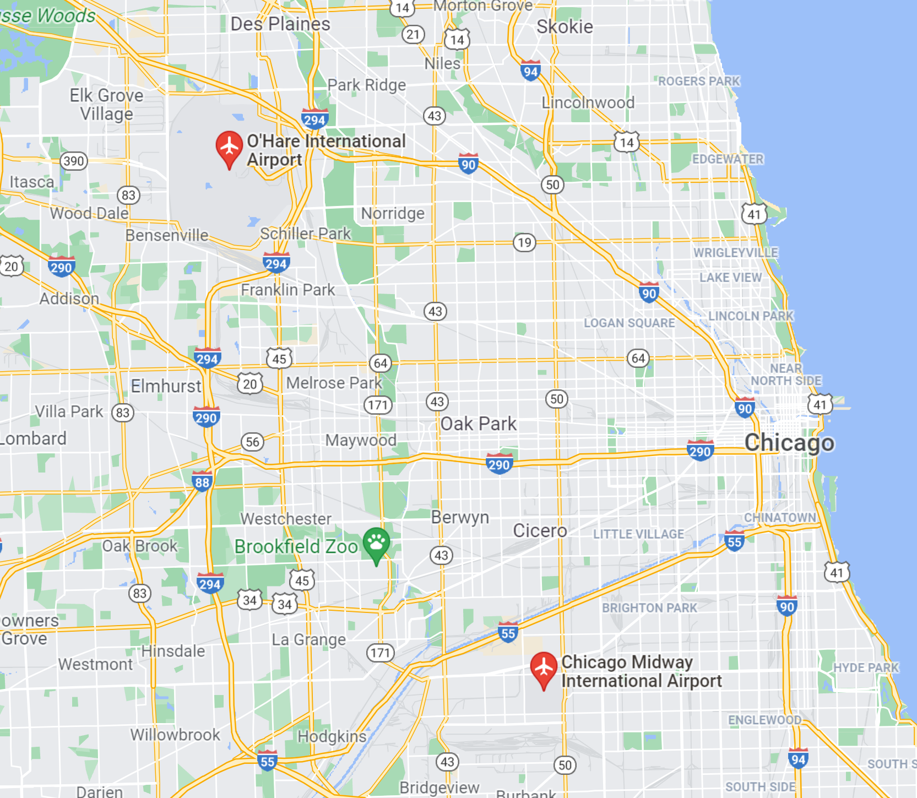
The weather records show strong correlation between data from station 1 and station 2. Since station 2 data contains less missing values, it is selected as the weather feature. Missing data is imputed from the station 1.
Weather
Merged weather feature from station 1 and station 2.

Slide 21
05
Modelling
Train -Test Split
SMOTE Train Only
StandardScaler
Grid Search (Appendix)
Evaluation Metric:
ROC
F1 , Recall

Slide 22
Model Summary
 | model | train_auc | test_auc | precision | specificity | recall | f1_score
0 | GB (No Smote) | 0.89 | 0.83 | 0.00 | 0.99 | 0.00 | 0.00
1 | GB(Smote) | 0.99 | 0.81 | 0.17 | 0.86 | 0.53 | 0.26
2 | RFC (No Smote) | 0.98 | 0.75 | 0.33 | 0.97 | 0.21 | 0.26
3 | RFC (Smote) | 1.00 | 0.75 | 0.22 | 0.92 | 0.39 | 0.28
4 | XGB (No Smote) | 0.88 | 0.83 | 0.00 | 1.00 | 0.00 | 0.00
5 | XGB (Smote) | 0.99 | 0.82 | 0.18 | 0.85 | 0.57 | 0.27
Notes:
We have experimented with Boosting and Tree algo in this project. For each model , we did a baseline without smote and compare the result with smote , with a datasplit of 80:20 (Train : Val). Clearly , with an initial imbalance data of around 95% , we had expected a high bias toward the true negative , resulting in a low precision (precision = tp / tp + fp) and high specificity (true negative). By doing a smote , we managed to pull up the recall score and f1 score to 0.6 and 0.3 respectively. We will be using the XGB classifier SMOTE model to run the test dataframe and submit to kaggle for scoring.
Note that we only SMOTE only the train data.

Slide 23
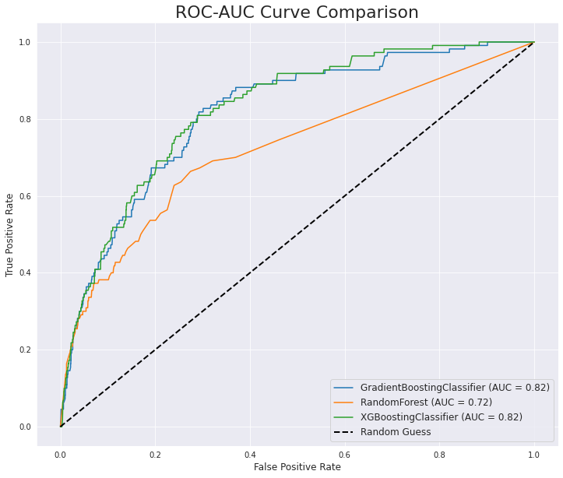
ROC
(Smote Model)
Notes:
This is our stacked roc curve for the 3 smote model we had run. These 3 models had scored around the range of ~0.8

Slide 24
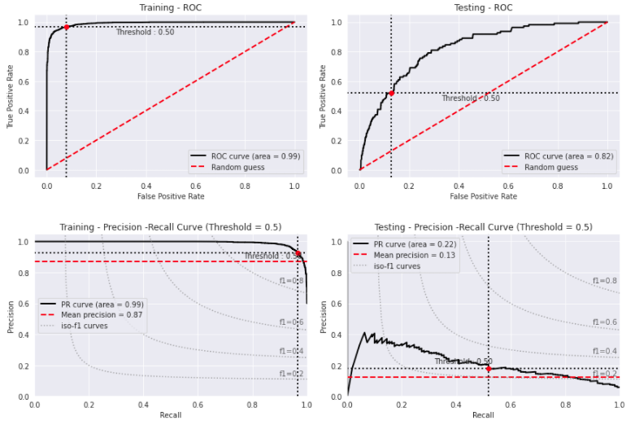
XGB Classifier Model
Notes:
This is an extract for the XGB classifier model.
On the top left is the train ROC. The high training ROC is expected as such due to the large synthetic data created from the true positive. The extra true data dilutes the false prediction and greatly prop up both the sensitivity and specificity and therefore roc score
On the top right is the test ROC with a score of around 0.82 , where the val_data is not smote
Note that we only SMOTE only the train data

Slide 25
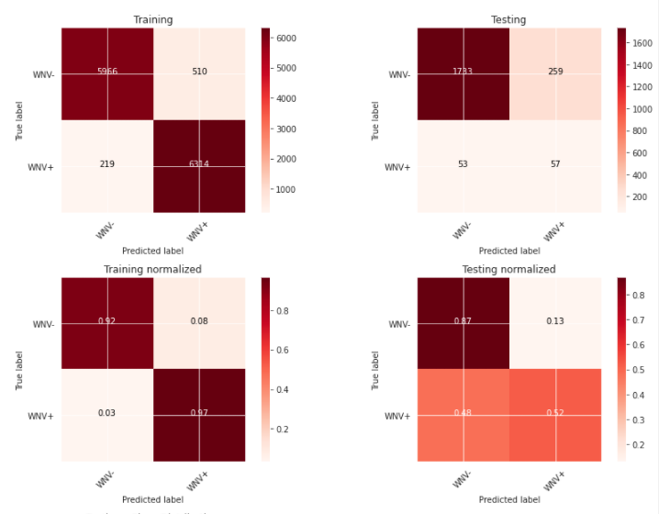
XGB Classifier Model
Notes:
This is the summary for the confusion matrix for the train and test after SMOTE.
- As mentioned in previous slide , due to the increase of synthetic data in the true positive, the effect of the false predictions are greatly reduced and thus prop up the both the sensitivity and specificity.
Note that again, we only SMOTE the train data and not the test data.

Slide 26
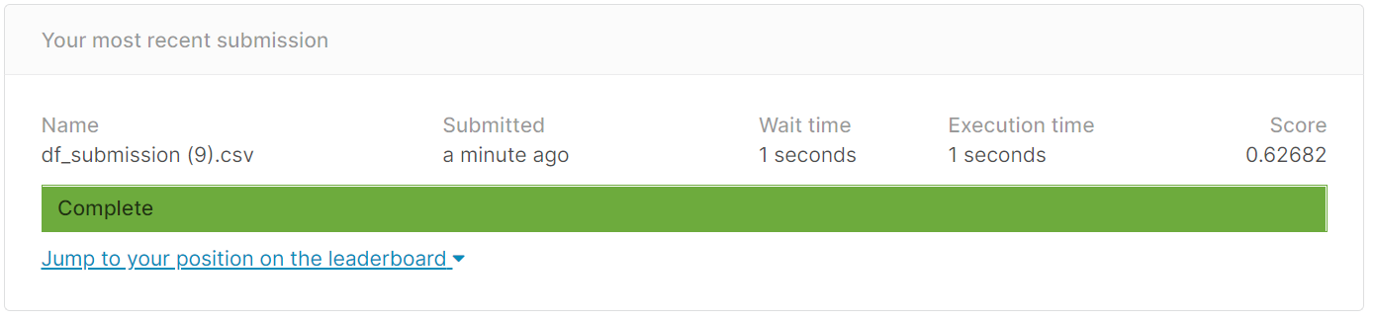
Kaggle Score
Notes:
Using our model , we parse the test df into our boosting algo and score a roc score of 0.63
So while we are able to predict the presence of Wnv presence using our model , how effective is the spray essentially? From our analysis , we note that the spray , for most of the time is a one time occurrence and it does not really reduce the subsequent surge. Was the spray minimal because of the consideration to save the spraying cost and ignore the intangible cost from healthcare and productivity cost? Julian will touch more on this analysis.

Slide 27
o6
Cost Benefit Analysis

Slide 28
Spray Occurrence
Spray
Only 2 years of spraying with majority in 2013
Spraying is only useful for killing adult mosquitoes. The effects will be short lived because there will still be an uptick of germinated mosquito larvae
Solutions must be persistent with using adult pesticide

Slide 29
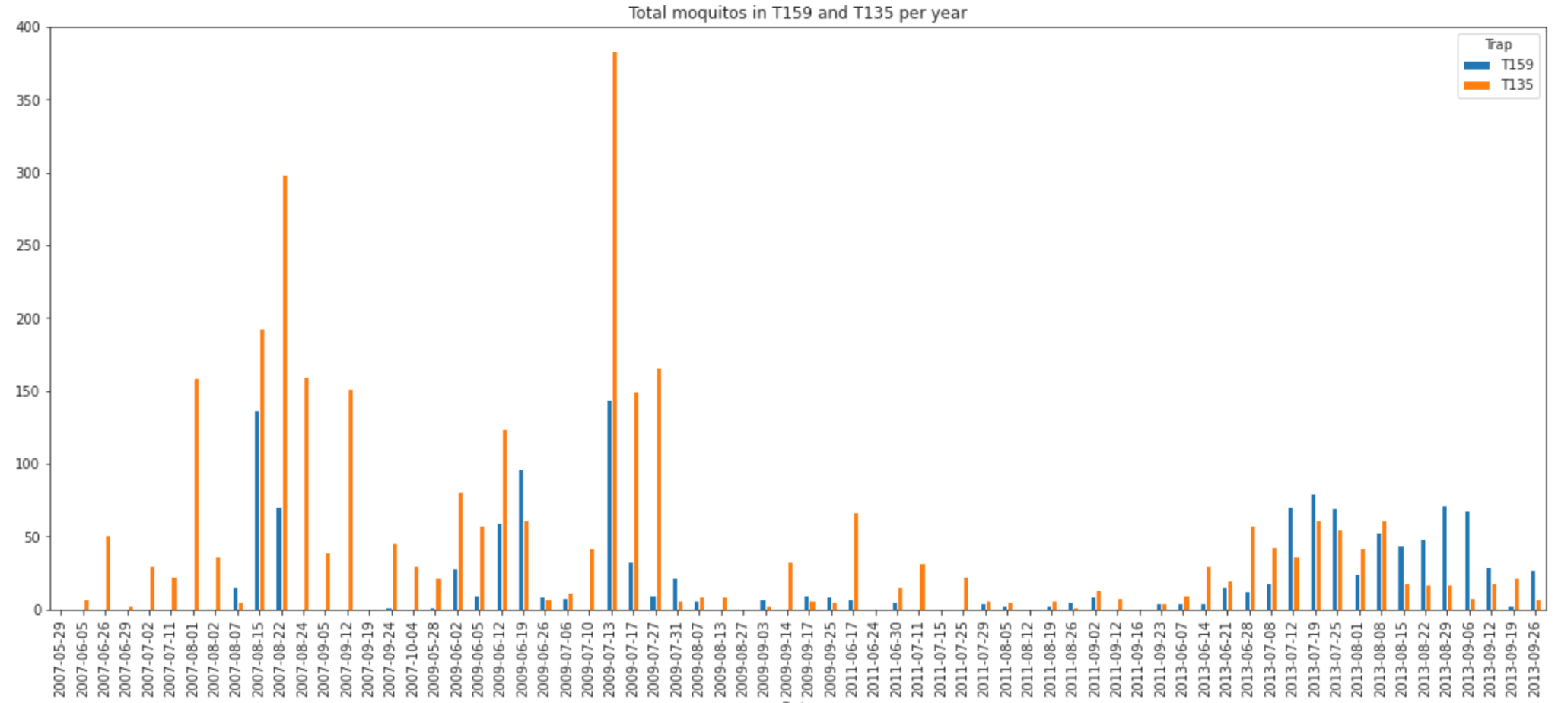
Spray Effectiveness
Total mosquitos recorded per day
Total mosquitos recorded per day
T159 sprayed on 2013-07-17
Comparing two specified traps
T159, sprayed on 2013-07-17 has decreasing trend
T135, not sprayed is decreasing trend
2013-08: strong resurgence, so even if the pesticide is effective, it is not persistent
Notes:
Need to spray consistently
One time spray not sufficient : supporting evidence → resurgent

Slide 30
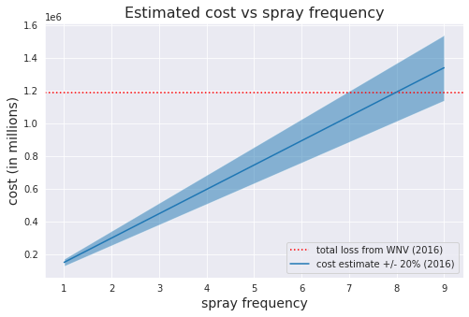
Cost Benefit Analysis
● Costs (using pesticide Zenivex E4^{[1]}):
based on estimates of $500 for a session for 0.5 acre of land^{[2]}
Cost is $149,000 for 0.6 km^2 (Size of Chicago 600km^2) ^{[3]}
● Benefits:
○Fewer people dying/falling ill —> increased workplace productivity and healthcare savings (average $11,000)^{[4]}
○108 WNV cases in 2016:^{[5]}
medical bill ~ $1,190,000
● Since the benefits outweigh the current prevention cost, therefore the county should socialise the cost
Breakeven at 7-8 sprays

Slide 31
Resources
Pesticide info https://www.cmmcp.org/pesticide-information/pages/zenivex-e4-etofenprox
Cost of spray
https://www.callnorthwest.com/2020/05/how-much-does-a-mosquito-treatment-cost/
Chicago spray strategy https://www.chicago.gov/city/en/depts/cdph/provdrs/healthy_communities/news/2020/august/city-to-spray-insecticide-thursday-to-kill-mosquitoes.html
WNV cost
https://bmcinfectdis.biomedcentral.com/articles/10.1186/s12879-019-4596-9
No. of WNV 2016 Chicago https://www.ncbi.nlm.nih.gov/pmc/articles/PMC7241786/

Slide 32
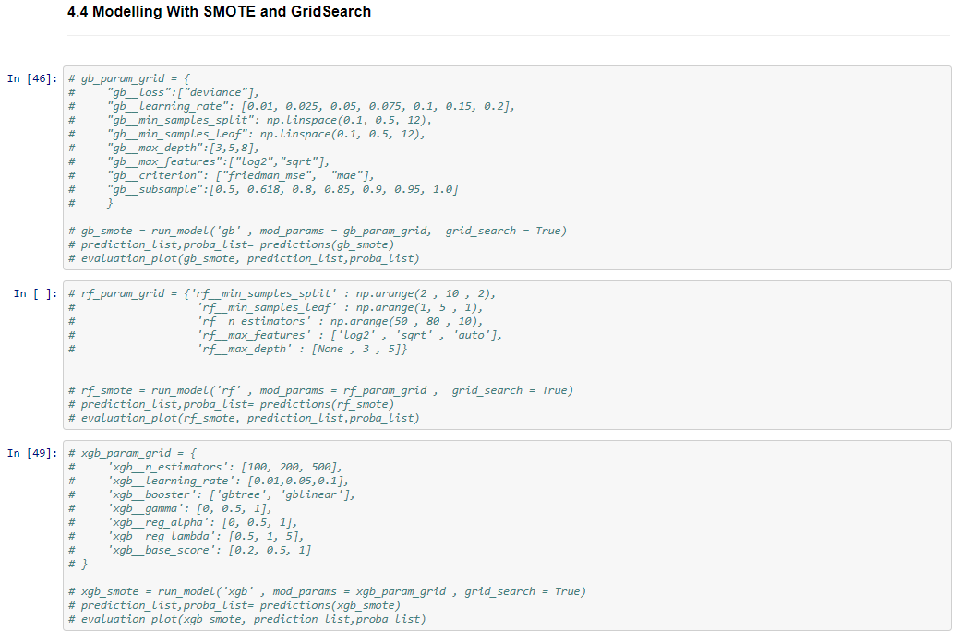
Appendix : GridSearch

Slide 33
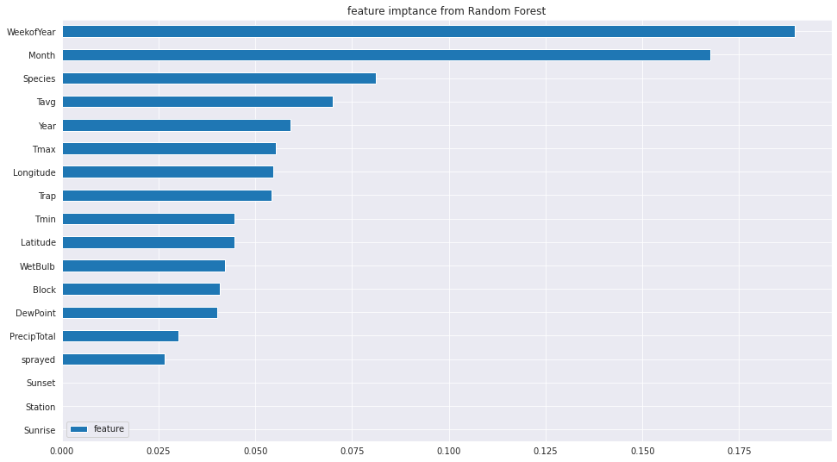
Appendix : Feature Impt (RFC)

Slide 34
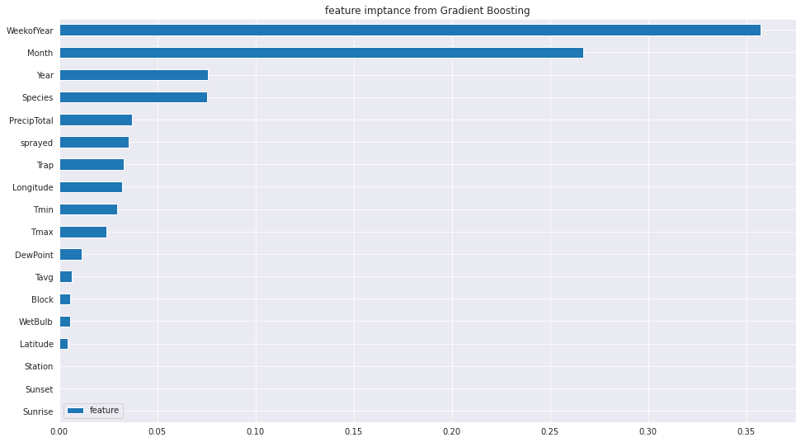
Appendix : Feature Impt (GB)

Slide 35
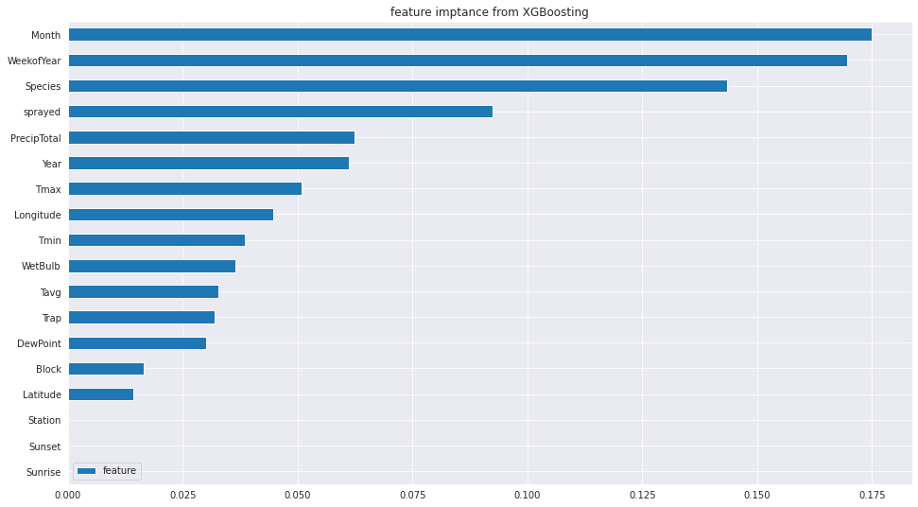
Appendix : Feature Impt (XGB)

