Slide 1

Impact of health on cost

Slide 2
Problem Statement
The objective of this project is to use various means and techniques to find insights about the key drivers with respect to the cost of care.

Slide 3




Overall Workflow
Import Data
Data Processing
Overall EDA
In Depth Analysis

Slide 4
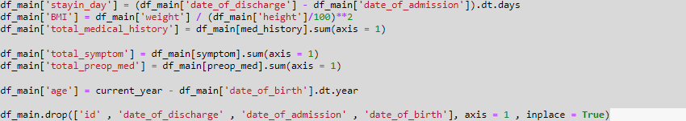
Data Processing
Standardise Value
Merge Dataset
Drop & Create Features
Bill Amount
Rows : 13600
Columns : 2
Bill ID
Rows : 13600
Columns : 3
Clinical Data
Rows : 3400
Columns : 26
Demographic
Rows : 3000
Columns : 5
Rows : 13600
Columns : 35
Notes:
Created a column for total medical history , symptom , preop med
Creates a column for age
Created a col for BMI
Created a column for hospitalisation stay in date
Remove all date column after this

Slide 5
Data Processing
3000
Patient
3400 Visits
Each Visit correspond to 4 Bill ID (13,600)
Notes:
General observation :
3000 patient ID
There are 3400 visits in total
And each visit correspond to 4 bill ID
Therefore there are 3400 x 4 = 13600 rows for the bill id

Slide 6
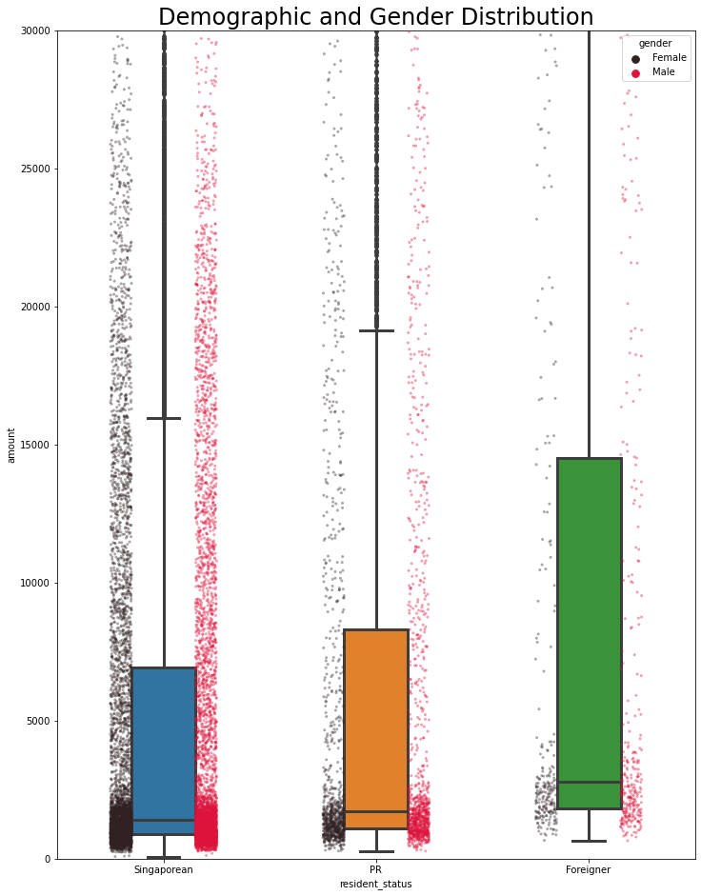
EDA : General Demographic
Foreigner typically pay close to 2x to local
PR typically pay close to 1.1x – 1.2x to local
Sample size of male & female equal.
Notes:
Gender : Fairly 50-50 distribution (~6.8k for both difference of 16)
Residence : 80% SG , 15% PR , 5% Foreigner
SG Mean amount = 5k , foreigner = 10k , PR ~6k
SG Max amount = 42k , foreigner = 82k , PR ~47K

Slide 7
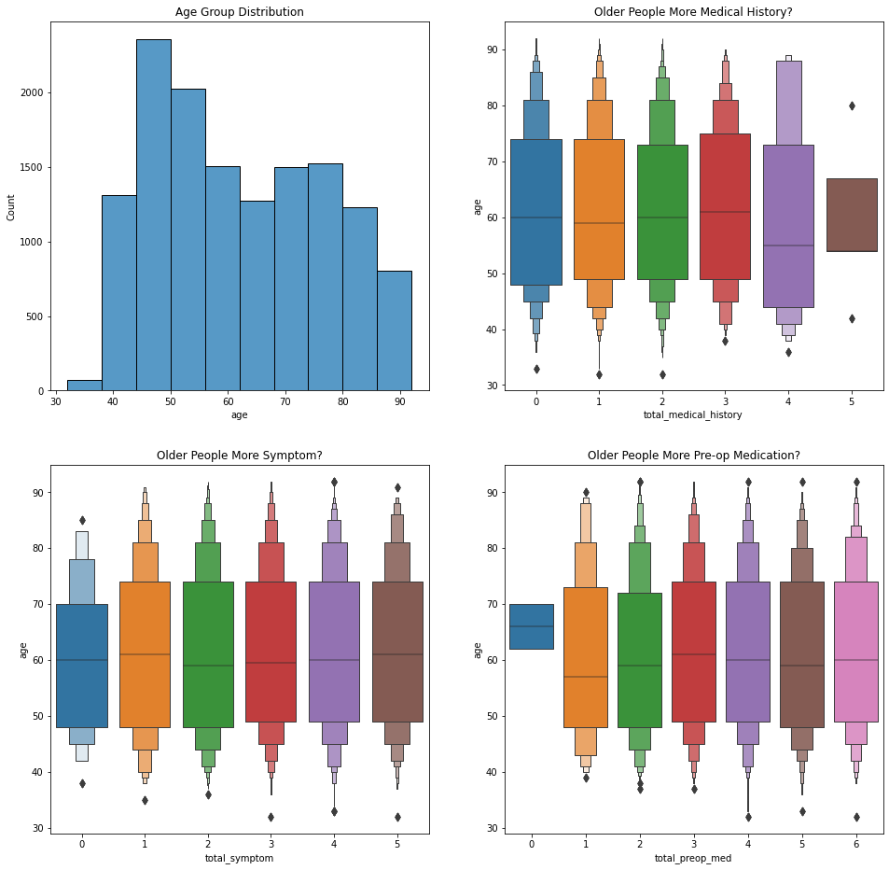
EDA : Age Distribution
Age Group fairly even between age 40 – 80.
Does not clearly indicate older people having more medical history , symptoms or pre-op medications

Slide 8
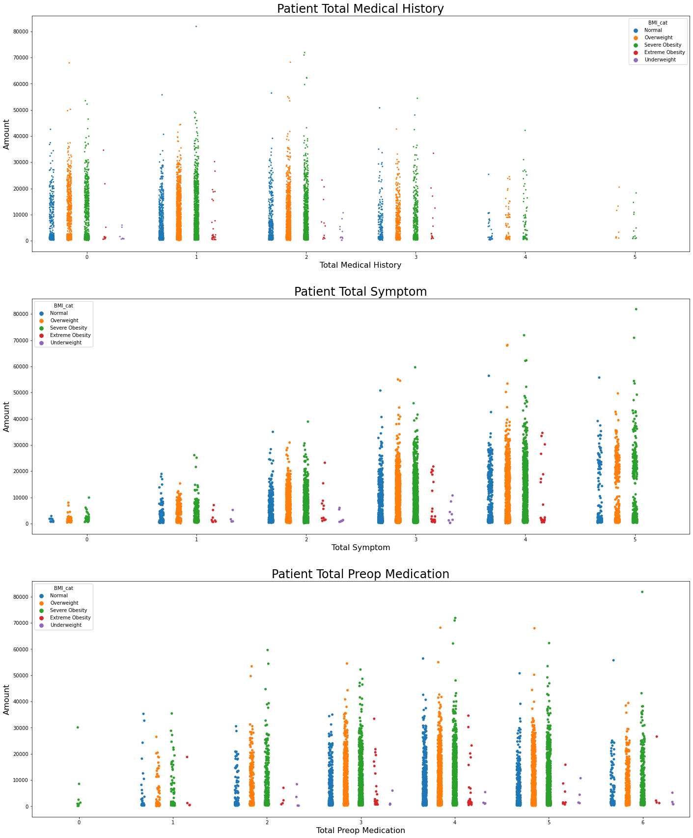
EDA : Clinical Data
Does a patient BMI correlate to more medical history or more symptoms or more preop medication?
Notes:
Apparently no. The correlation coef wrt BMI is less than 0.05 for these overall features
Most of the patient is overweight and severe obesity ~40% in each category.

Slide 9
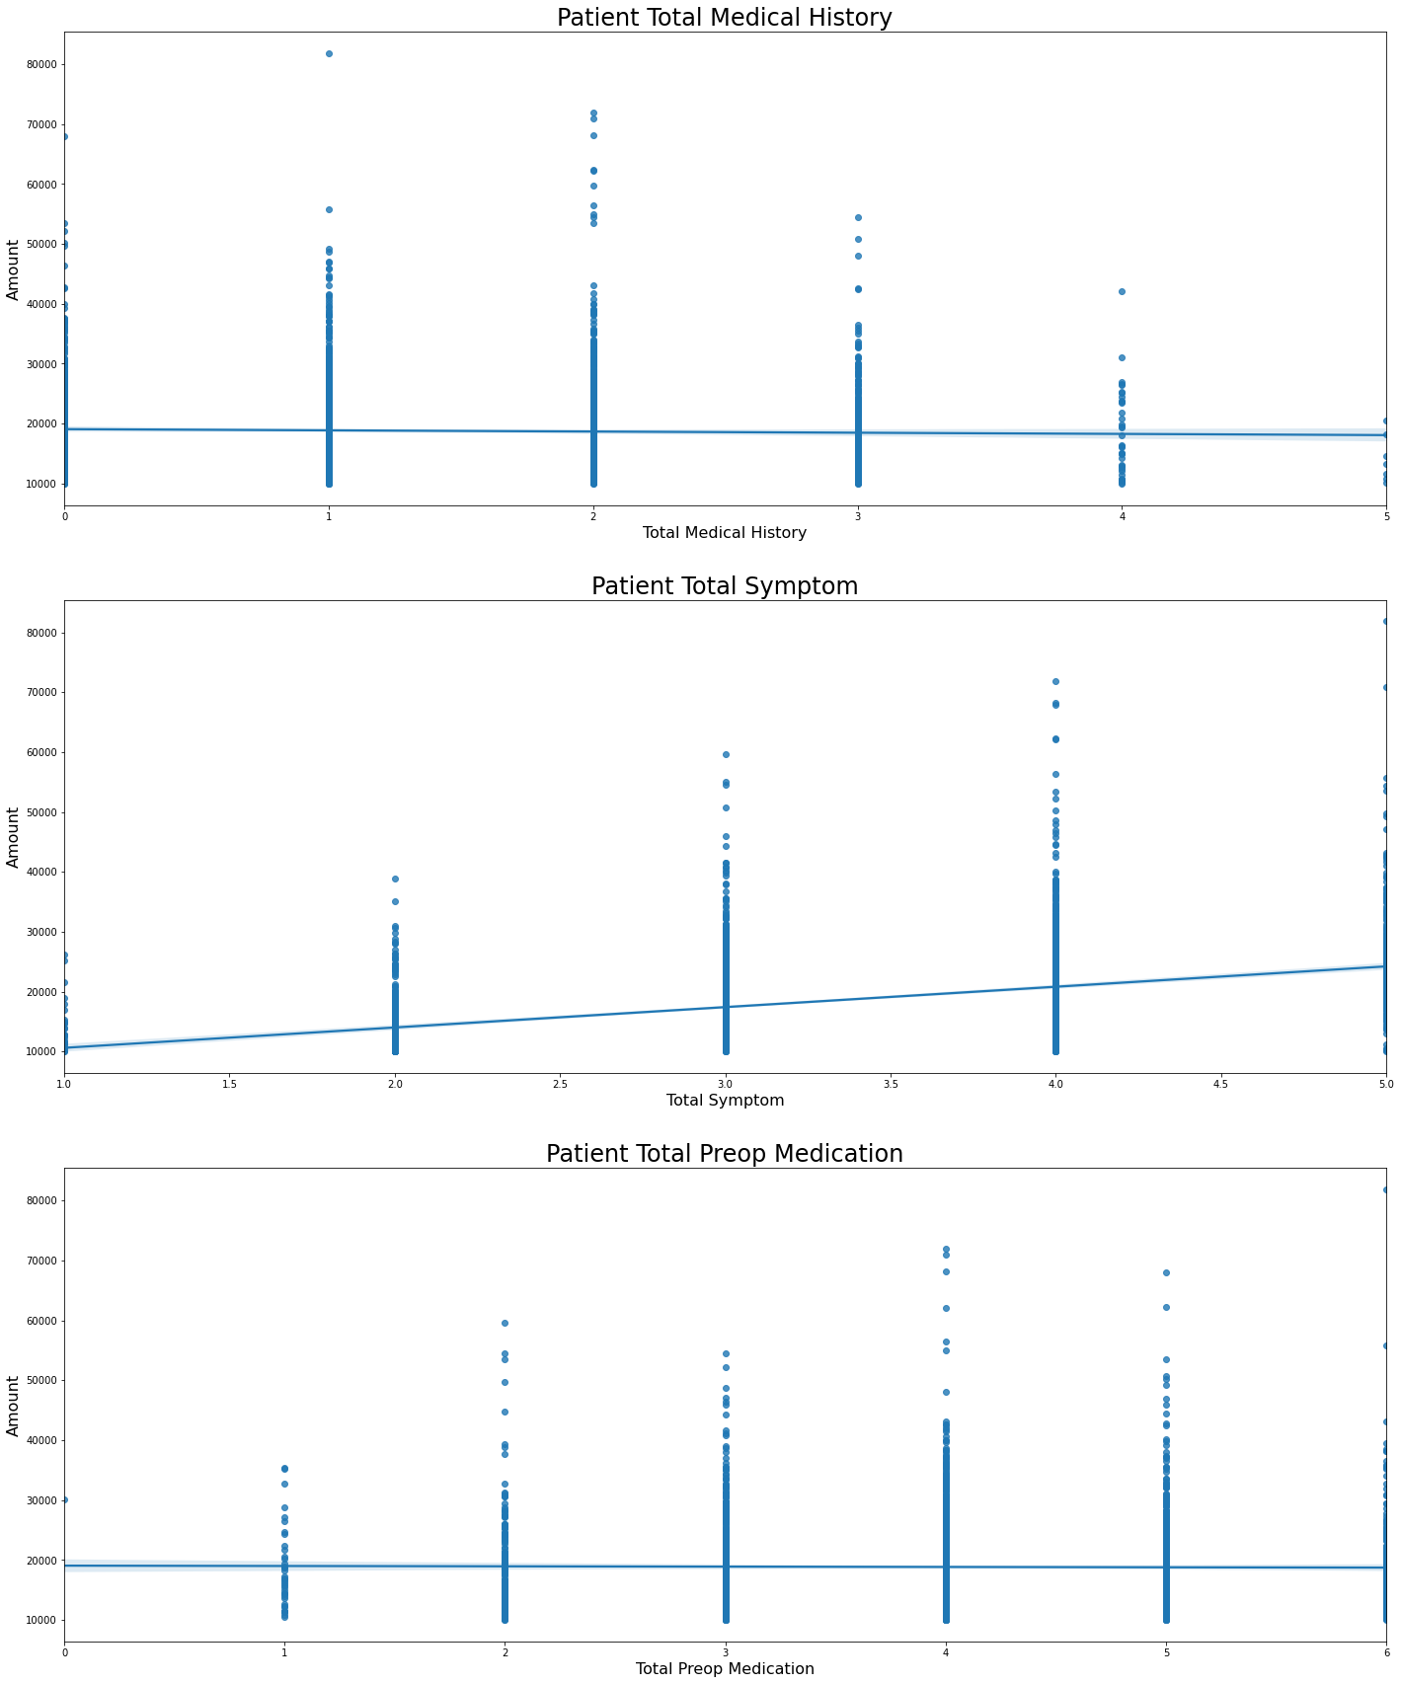
EDA : Clinical Data
If a patient have more instances of medical history , does this complicate the treatment and increase the cost?
What about having more symptom or preop medication?
Notes:
Having more medical history ,symptom or preop medication does not seem to clearly indicate a more complex operations or medication which will lead to a more complex and expensive procedures.

Slide 10
In-depth Analysis
So might there be a
specific clinical condition
that drive up the cost?
Notes:
The overall big picture does not seem to point a very clear indication.
- For example , older people will have more conditions. Coincidently , It might had been intended as it during the filtering of the data
- Also I will have thought that having more symptoms or medical history or pre-op medications will complicate the operations , and thus drive up the cost, but apparently it does not indicate so.

Slide 11
In-depth Analysis
Features Studied | Technique Utilised | Findings
Lab Results | Stats Model Polynomial Feature Correlation | No conclusive findings
Preop Medication | Stats Model Correlation EDA Feature Importance | No conclusive findings
Medical History | Stats Model Correlation | No conclusive findings
Symptoms |  | Symptom 5
Passed the data through a Linear Regression OLS to explore the significant feature.
Attempt to train a model to extract the feature importance.
Notes:
Base on various technique , I had tried to find whether there might be any strong feature that is correlated with regards to the cost.
Out of this various methodlogy , symptom 5 standout the most amongst the remaining.

Slide 12
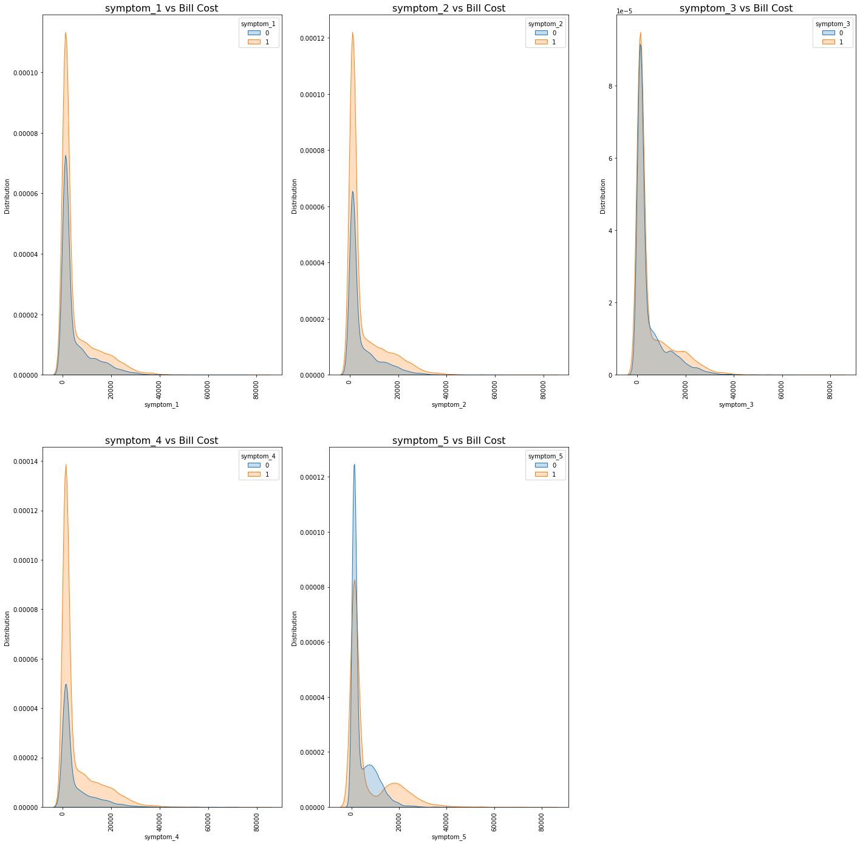
In-depth Analysis : Symptom on all patient bill
Individual Symptoms WRT ALL Patient Bill

Slide 13
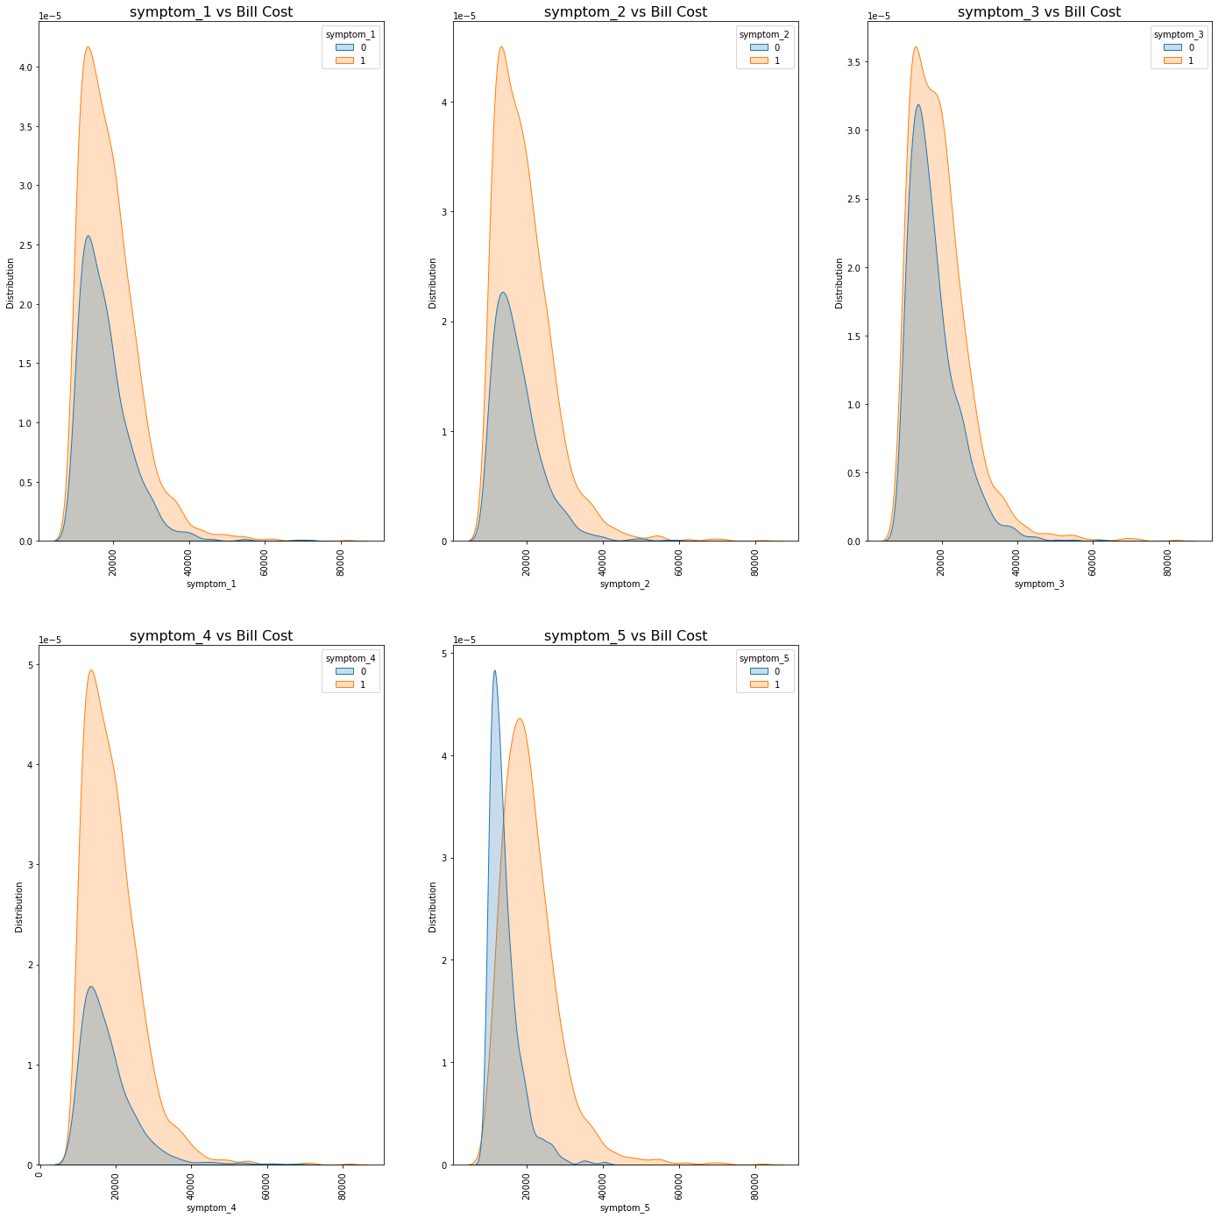
In-depth Analysis : Symptom on top 20% patient bill
Individual Symptoms WRT top 20% Patient Bill

Slide 14
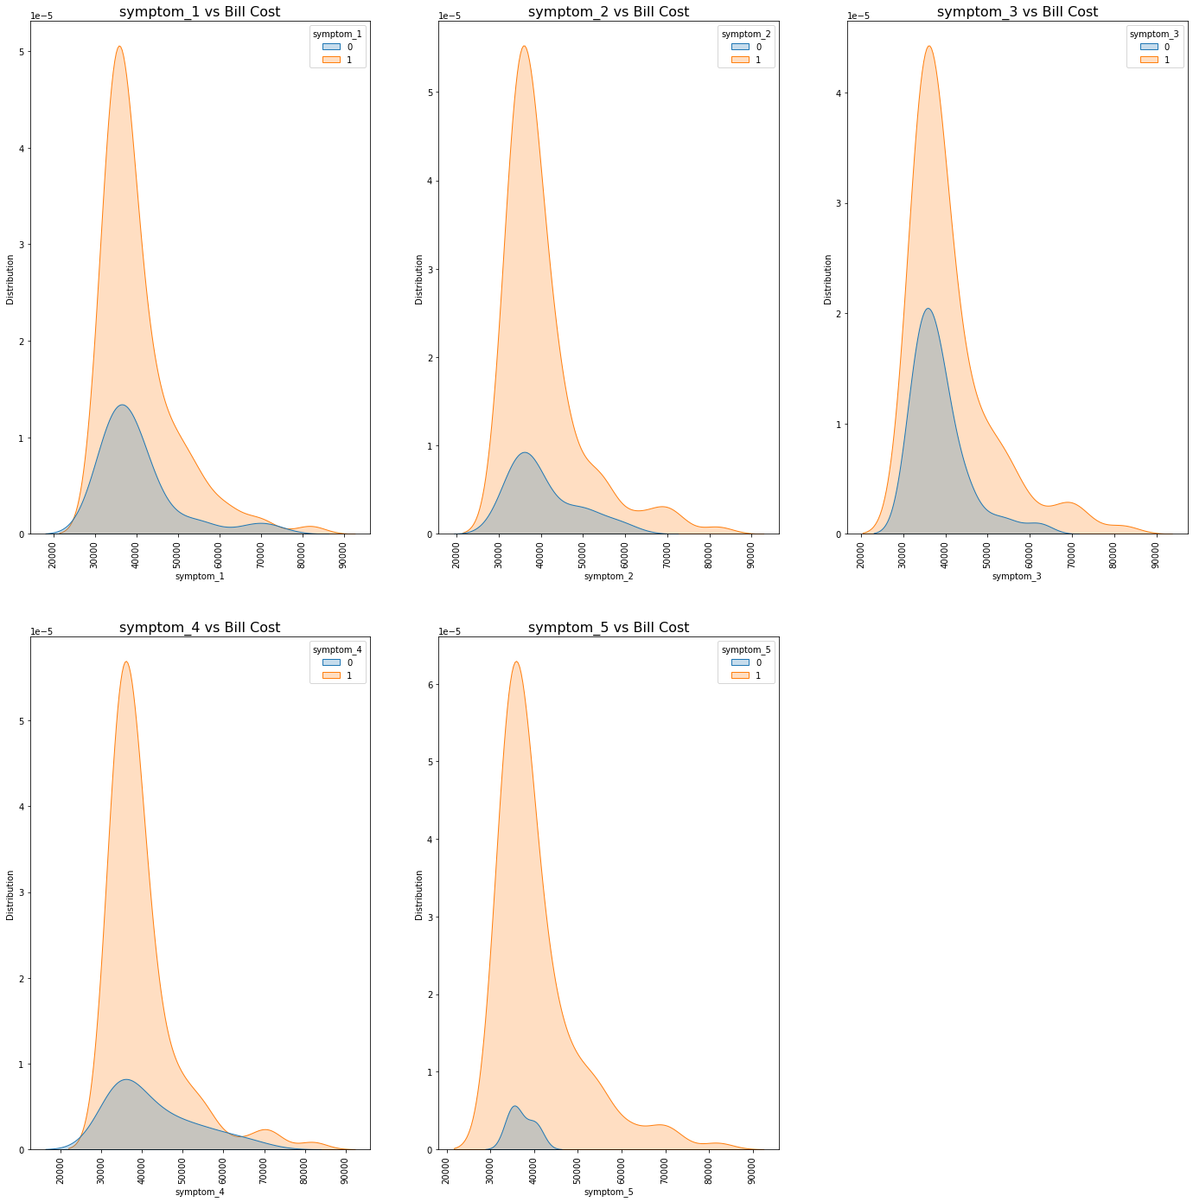
In-depth Analysis : Symptom on top 1% patient bill
Individual Symptoms WRT top 1% Patient Bill

Slide 15
Next Step
Grouping patient ID and reanalysing the feature score.
Performing PCA and clustering studies on Grouped Data frame.
Notes:
- Could we have fine tune our ML model to get a better score so that the feature importance could be a more accurate indicator? Prelim exploration had yield better results by grouping the patient ID together. The non group patient ID did not give a better score because it originate back to how the patient bill is being generated. A single patient visit generate 4 different bill with mostly the same clinical data , thus the model might be confused with regards to a bill vs the patient id.
- Could we have perform clustering on the grouped dataset and explore further? Initial studies using PCA on the non-group patient ID had not yield very meaningful clusters.

Slide 16
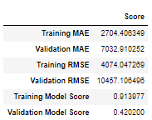
Next Step : feature Importance
Grouping the patient ID yield better score
Linear Base Model is overfit at the moment.
Could further fine tune with regularisation.
Group Patient ID
Notes:
Could we have fine tune our ML model to get a better score so that the feature importance could be a more accurate indicator? Prelim exploration had yield better results by grouping the patient ID together. The non group patient ID did not give a better score because it originate back to how the patient bill is being generated. A single patient visit generate 4 different bill with mostly the same clinical data , thus the model might be confused with regards to a bill vs the patient id.

Slide 17
In-depth Analysis
Appendix
Notes:
The overall big picture does not seem to point a very clear indication.
- For example , older people will have more conditions. Coincidently , It might had been intended as it during the filtering of the data
- Also I will have thought that having more symptoms or medical history or pre-op medications will complicate the operations , and thus drive up the cost, but apparently it does not indicate so.

Slide 18
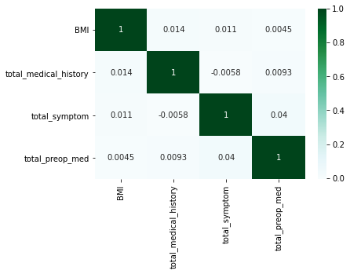
Appendix : BMI vs Clinical
Notes:
Having more medical history ,symptom or preop medication does not seem to clearly indicate

Slide 19
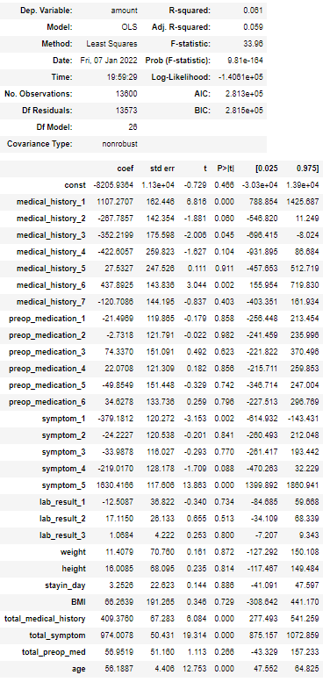
Appendix : Stats Model on Main DF
Notes:
Having more medical history ,symptom or preop medication does not seem to clearly indicate

Slide 20
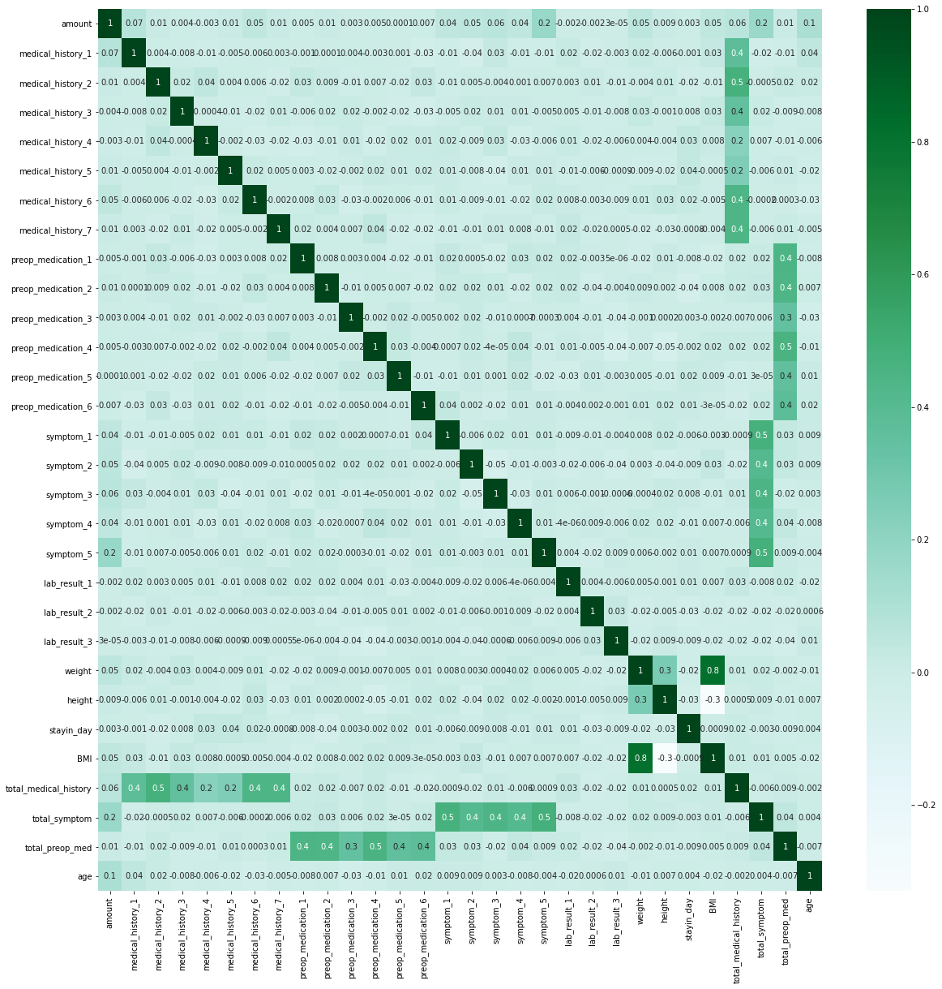
Appendix : Heat map on Main DF
Notes:
Having more medical history ,symptom or preop medication does not seem to clearly indicate

Slide 21
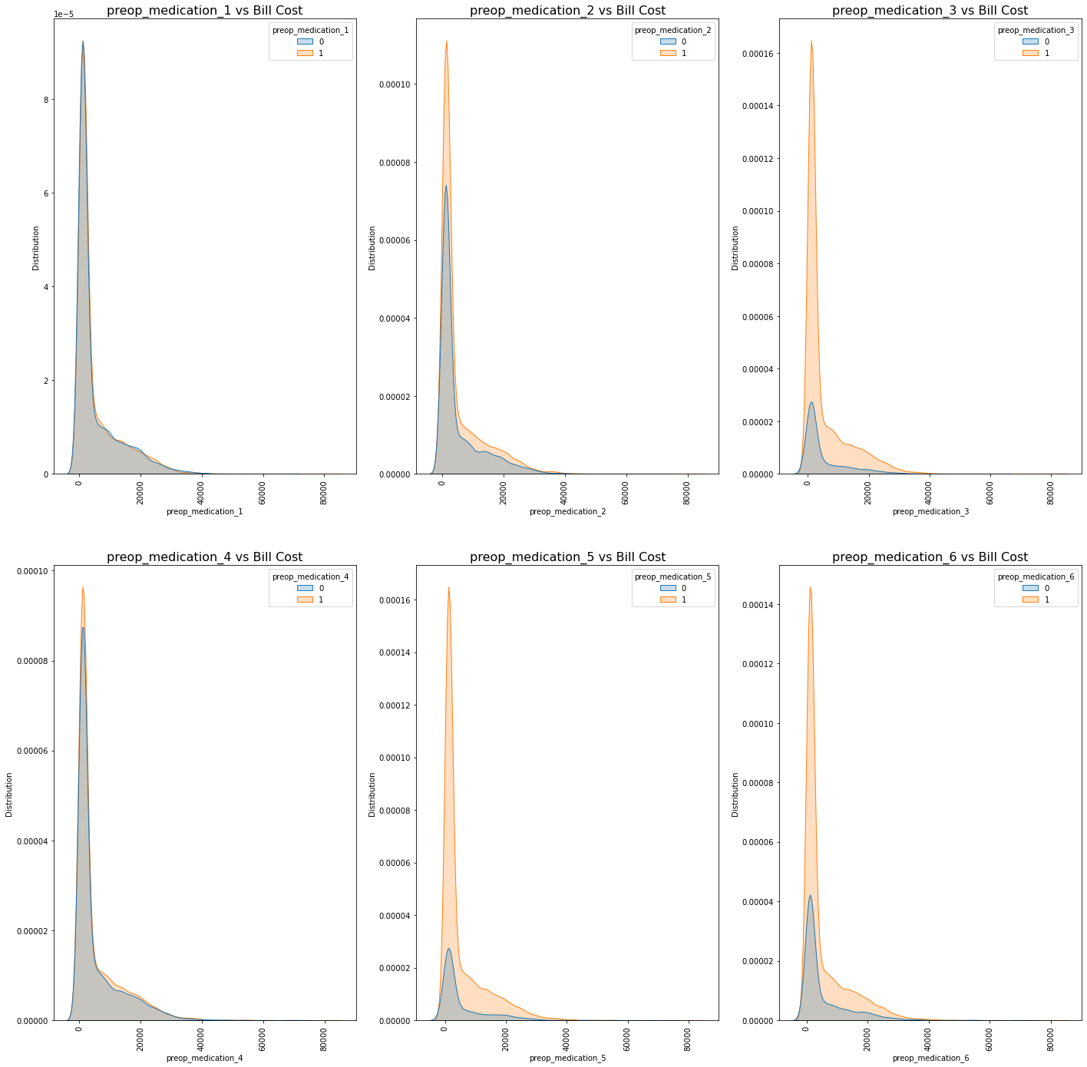
Appendix : Preop Med on all patient bill

Slide 22
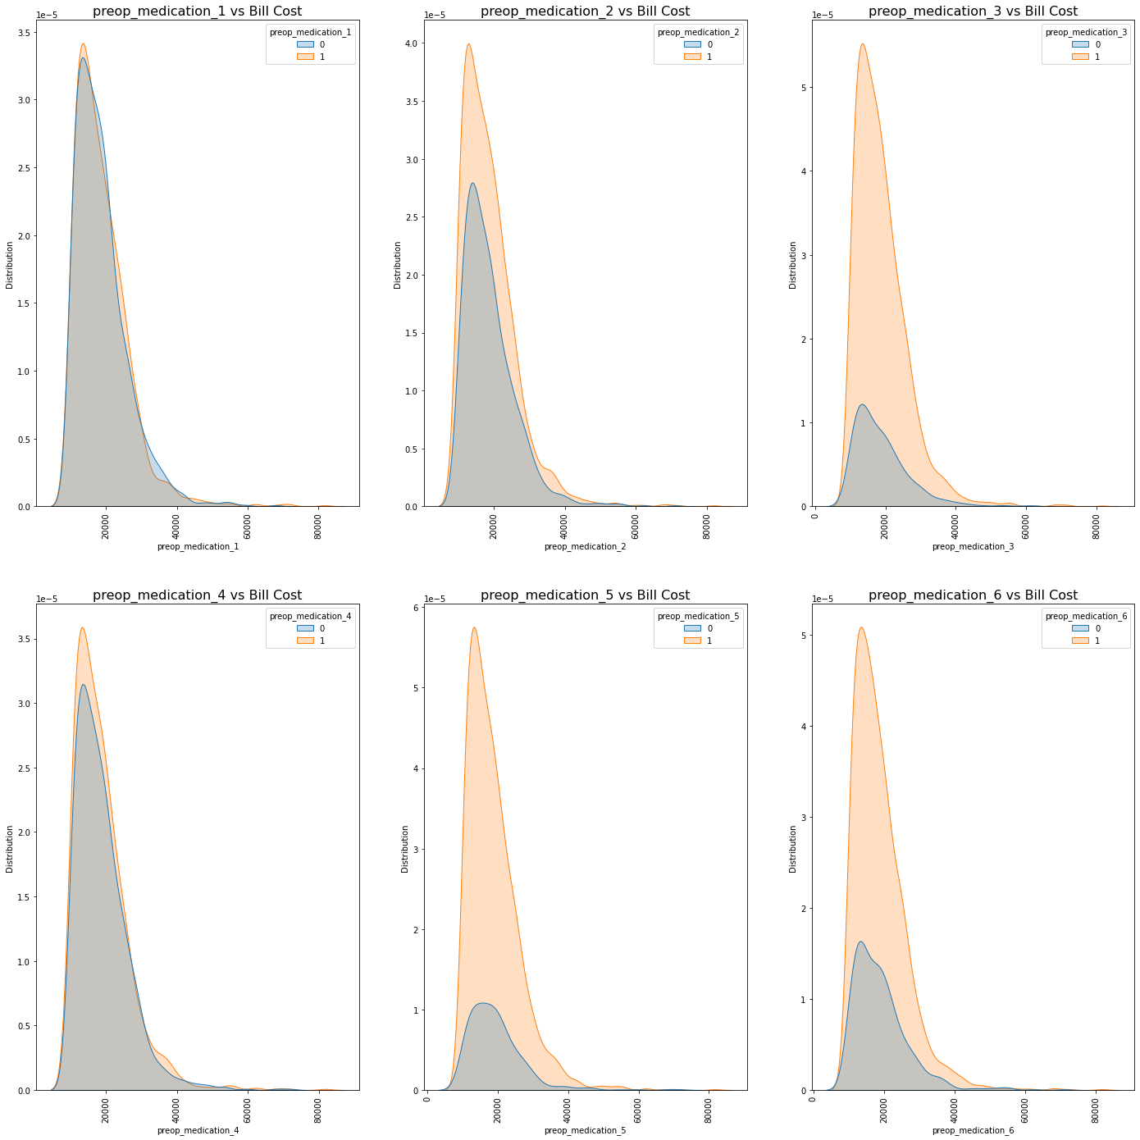
Appendix : Preop Med on top 20% patient bill

Slide 23
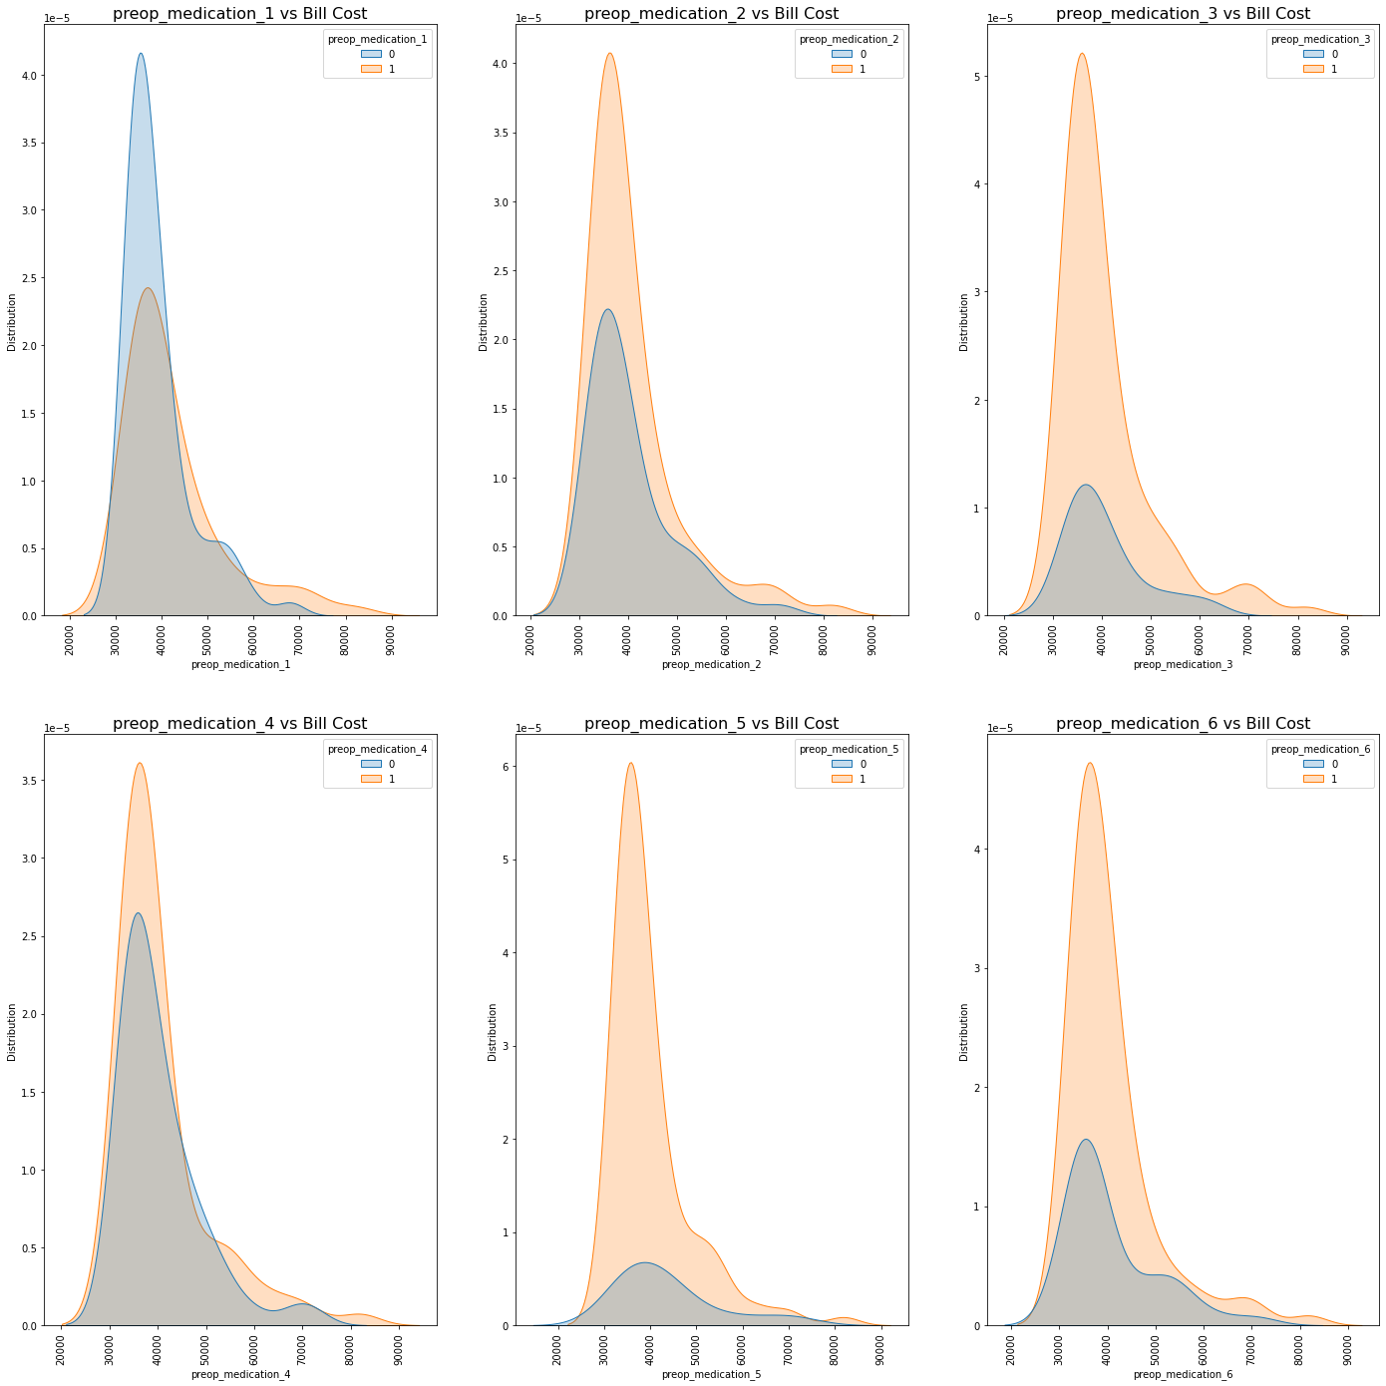
Appendix : Preop Med on top 1% patient bill

Slide 24
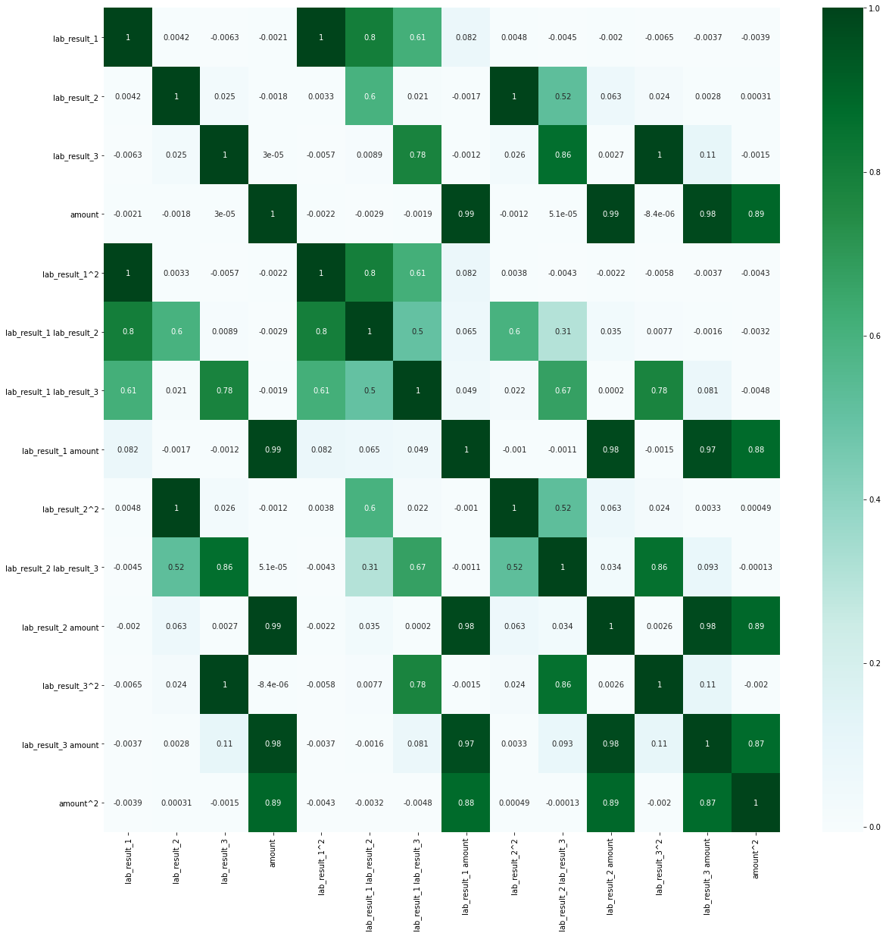
Appendix : Polynomial Feature on Lab Result
Notes:
Having more medical history ,symptom or preop medication does not seem to clearly indicate

Slide 25
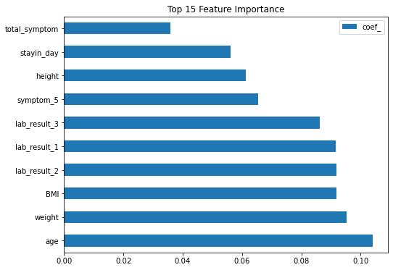
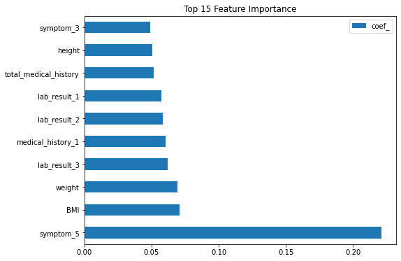
Appendix : Feature Importance
Non Group Patient ID
Group Patient ID
Notes:
Having more medical history ,symptom or preop medication does not seem to clearly indicate

