Slide 1


SAVITRIBAI PHULE PUNE UNIVERSITY
SMT.KASHIBAI NAVALE COLLEGE OF ENGINEERING,PUNE
Project Presentation on
Electric Steering Mechanism
Name of Candidates :
Shubham Bothikar
Pratik Bhise
Dhananjay Jadhav
Mayur Kamthe
Guided by: Prof.J.U.Marathe
Department of Mechanical Engineering
A.Y. 2017-18

Slide 2
Contents
1: Introduction
2: Objective
3: Problem Statement
4: Components
5: Experimental Setup
6: Methodology
7: Conclusion
07/06/2018
SMT.KASHIBAI NAVALE COLLEGE OF ENGINEERING,PUNE

Slide 3
Introduction
With continuous development of vehicle, Electric steering mechanism gaining importance
The main requirement is that the steering should be precise, smooth, compact and light.
Minimum force to steer the vehicle.
Quick and stable response of system for steering.
To minimize power requirement.
07/06/2018
SMT.KASHIBAI NAVALE COLLEGE OF ENGINEERING,PUNE

Slide 4
Objective
Compatible design of steering system for electric vehicles.
Use of motor , sensors and controller to reduce the number of parts, complexity and linkages.
Minimization of driver’s effort of steering in rough terrain or in heavy duty vehicles.
To increase the efficiency of the vehicle by using rechargeable batteries for DC motor.
07/06/2018
SMT.KASHIBAI NAVALE COLLEGE OF ENGINEERING,PUNE

Slide 5
Problem Statement:
Designing of Simple electric steering mechanism with simple operations.
As Hydraulic Power Steering System extracts power from engine for hydraulic pump & it’s complicated, weighs & costs more as compared with Electric Power Steering.
07/06/2018
SMT.KASHIBAI NAVALE COLLEGE OF ENGINEERING,PUNE

Slide 6
Components
Equipment | Specification
1 D.C Motor 2 Battery 3 Limit Switch | 12 V, 7.5 amp, 60-100 rpm 12 V, 7.5 amp, Lead Acid Battery Physical Contact Type
Circuitry used in System:
Ultrasonic Sensor in assistance with limit switches
8 Bit AVR Microcontroller
Relay Circuit
07/06/2018
SMT.KASHIBAI NAVALE COLLEGE OF ENGINEERING,PUNE

Slide 7
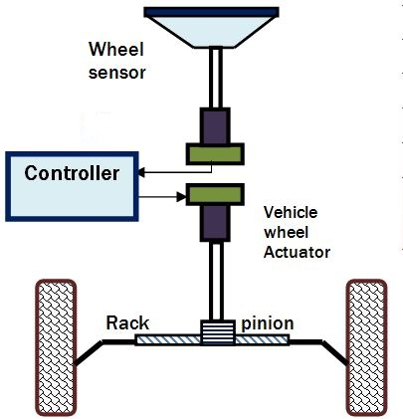
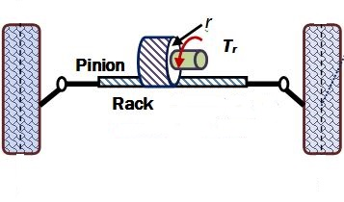
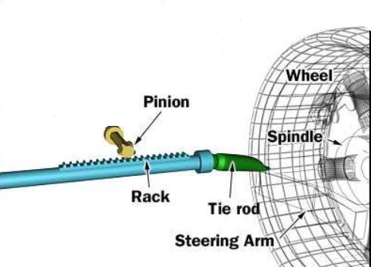
Experimental Setup
2
1
Radiator
3
07/06/2018
SMT.KASHIBAI NAVALE COLLEGE OF ENGINEERING,PUNE

Slide 8
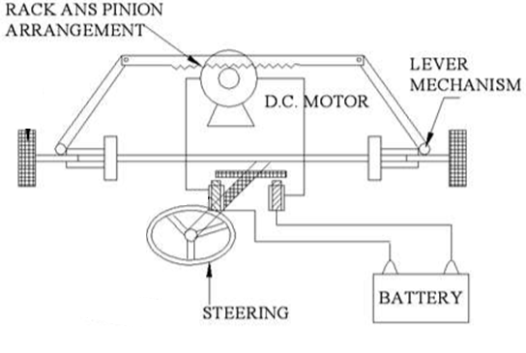
Experimental Setup
07/06/2018
SMT.KASHIBAI NAVALE COLLEGE OF ENGINEERING,PUNE

Slide 9
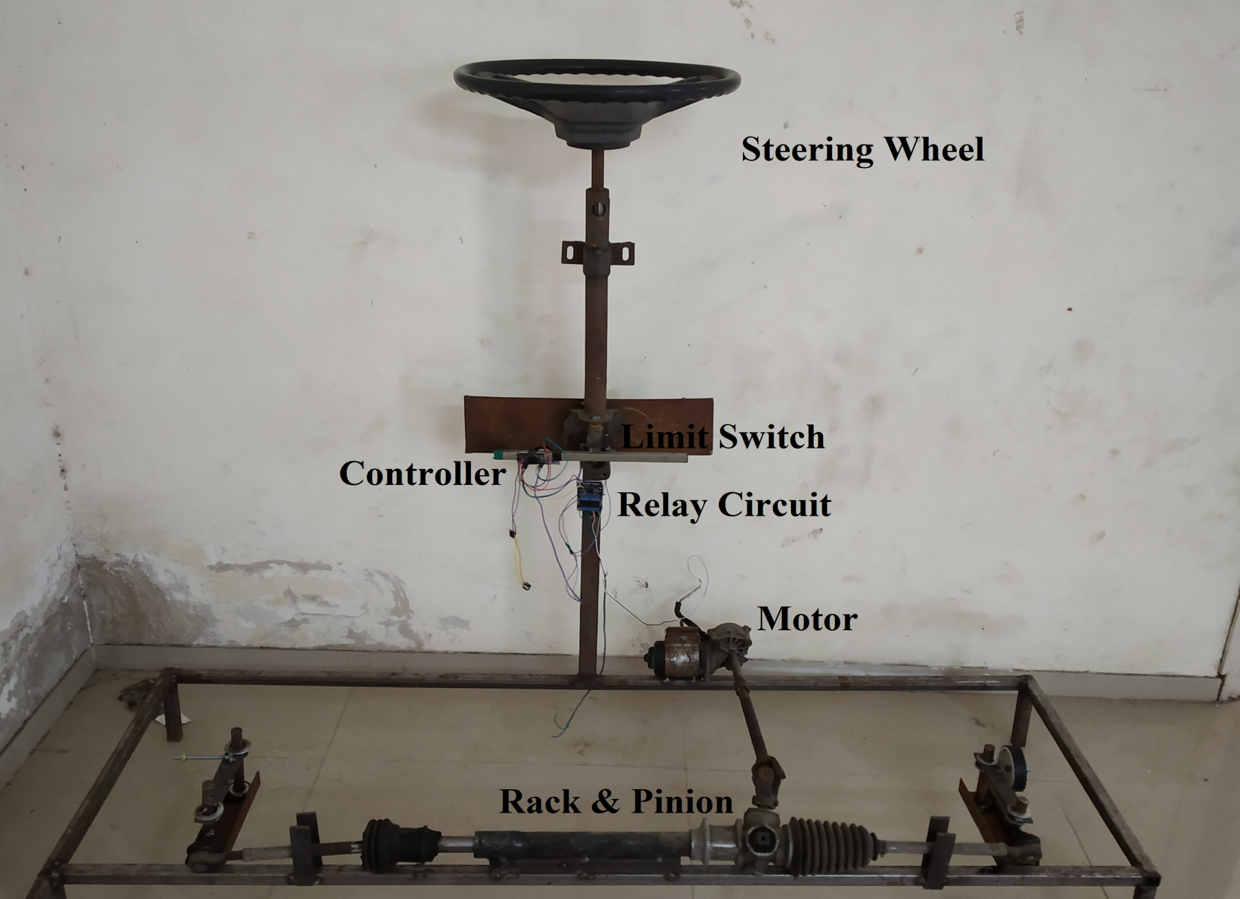
Actual setup
Centrifugal pump
07/06/2018
SMT.KASHIBAI NAVALE COLLEGE OF ENGINEERING,PUNE

Slide 10
Methodology
Numerical calculation
Sample calculation
Motor selection calculations
Calculating mechanical power requirements
Working Principle :
D.C motor shaft is drawn supply from the battery through limit switch & sensor controller arrangement.
07/06/2018
SMT.KASHIBAI NAVALE COLLEGE OF ENGINEERING,PUNE

Slide 11
Conclusion
More Cost Effective.
Less Components, Requires less Maintenance and Lubrication is not required.
Less Prone to Problems , lesser Faults and more Durable.
Minimization of driver’s effort of steering in rough terrain or in heavy duty vehicles.
Increase the efficiency of the vehicle by using rechargeable batteries for DC motor.
More sensitivity due to use of limit switches and sensors.
More efficient, safe and reliable steering system and easy operation.
07/06/2018
SMT.KASHIBAI NAVALE COLLEGE OF ENGINEERING,PUNE

Slide 12
References
A New Reference Modal For Steer-By-Wire Applications with Embedded Vehicle Dynamics by Coundon, J., Canudas,C., Claeys, X
Study on Steering by wire Controller Based on improved H Algorthium, Chen, Huipeng , Yu Q., Zhu, L., Chen, G., School of Mechanical Engineering, HangZhou DianZi University, Hangzhou .
Modeling and control of steering actuator for heavy duty vehicle ,X. Claeys, C. Canudas de Wit, and H. Bechart. In European Control Conference.
Modelling and characteristics curves of Electric Power Steering System.H.Zhang, Z.Yuzhi, L.Jinhong ,R.Jing, In Proc.PEDS 2009.International Conference on Power Electronics and Drive System,2009,pp.1390-1393.
Electric Power Assisted Steering by Vishal N. Sulakhe, Mayur A. Ghodeswar, Meghsham D. Gite et al Int. Journal of Engineering Research and Applications ISSN : 2248-9622, Vol. 3, Issue 6, Nov-Dec 2013, pp.661-666
Analysis of Power Steering System Assembly Bhushan Akhare, Sanjeev S Chouhan, International Journal of Engineering and Innovative Technology
07/06/2018
SMT.KASHIBAI NAVALE COLLEGE OF ENGINEERING,PUNE

Slide 13
Thank you
07/06/2018
SMT.KASHIBAI NAVALE COLLEGE OF ENGINEERING,PUNE

