Slide 1

Chapter 4: Maven

Slide 2
package greetings; public class Hello { public static void main(String[] args) { for (int i=0; i < args.length; i++) { System.out.println("Hello " + args[i]); } } }
C:\>javac greetings\Hello.java C:\>dir greetings /B Hello.class Hello.java C:\>java greetings.Hello World Universe Everyone Hello World Hello Universe Hello Everyone

Slide 3



Slide 5
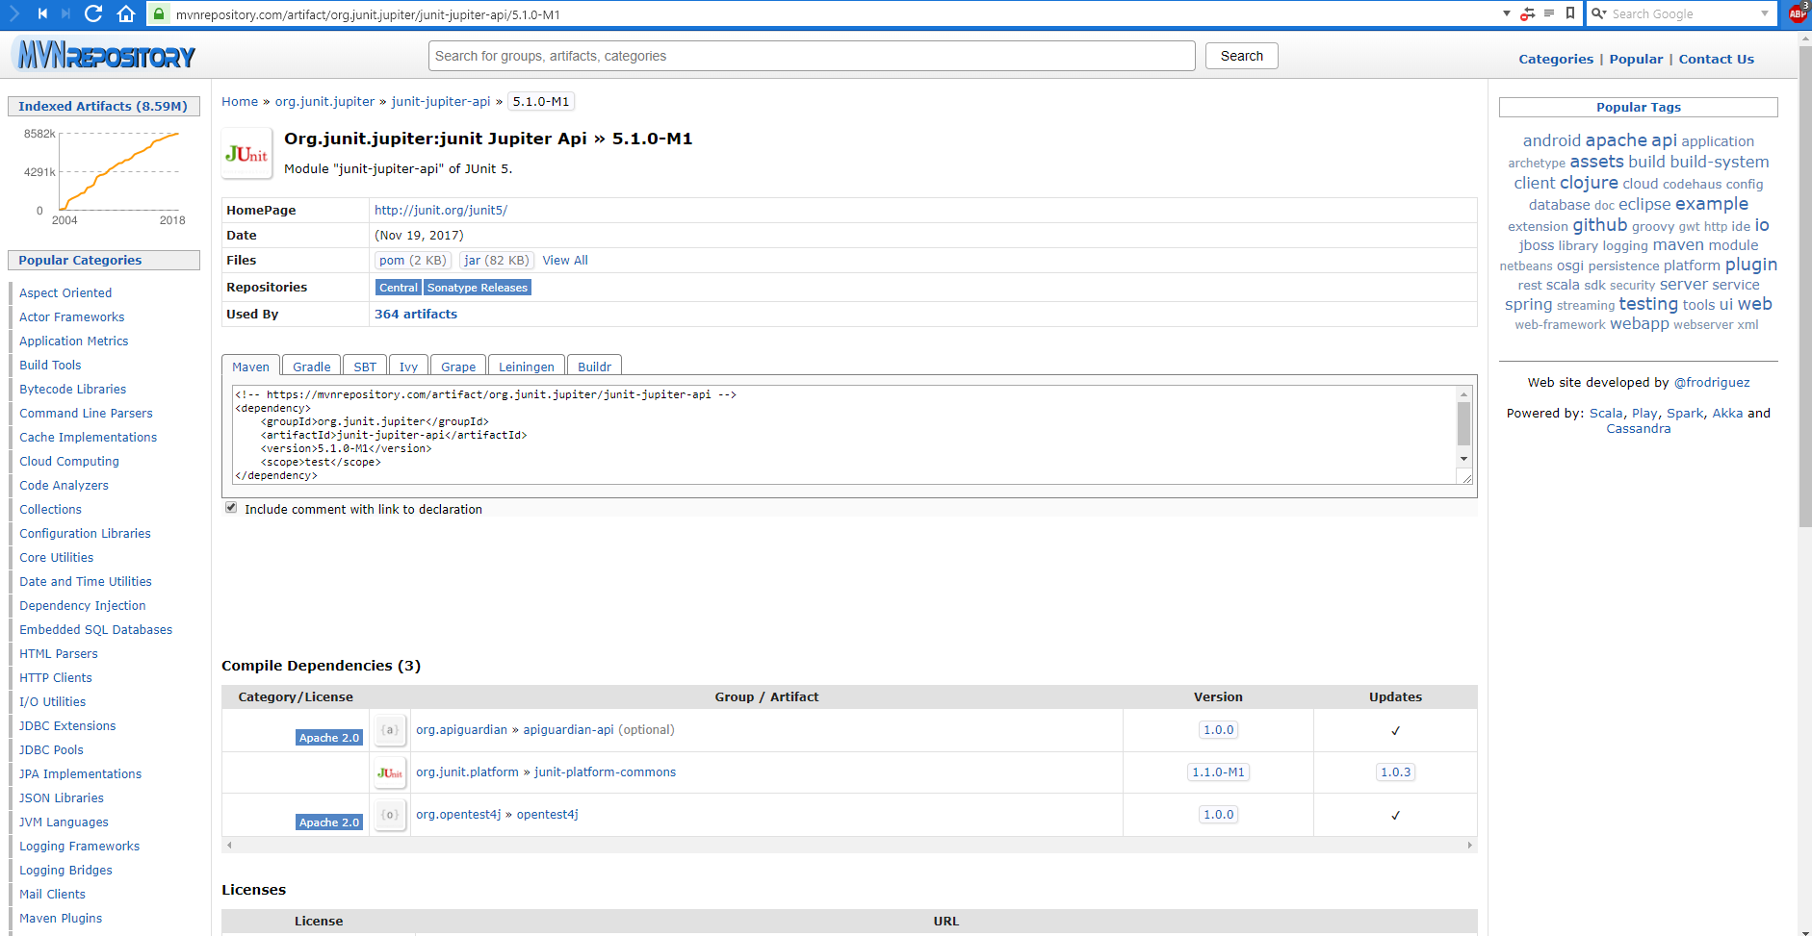

Slide 6
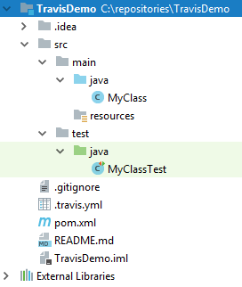

Slide 7
<?xml version="1.0" encoding="UTF-8"?> <project xmlns="http://maven.apache.org/POM/4.0.0" xmlns:xsi="http://www.w3.org/2001/XMLSchema-instance" xsi:schemaLocation="http://maven.apache.org/POM/4.0.0 http://maven.apache.org/xsd/maven-4.0.0.xsd"> <modelVersion>4.0.0</modelVersion> <groupId>de.stevenschwenke.java</groupId> <artifactId>maventest</artifactId> <version>1.0-SNAPSHOT</version> <packaging>jar</packaging> <name>MavenTestApp</name> <build> <plugins> <plugin> <groupId>org.apache.maven.plugins</groupId> <artifactId>maven-compiler-plugin</artifactId> <configuration> <source>1.8</source> <target>1.8</target> </configuration> </plugin> </plugins> </build> <dependencies> <dependency> <groupId>org.junit.jupiter</groupId> <artifactId>junit-jupiter-api</artifactId> <version>5.0.0</version> </dependency> </dependencies> </project>

Slide 8
<?xml version="1.0" encoding="UTF-8"?> <project xmlns="http://maven.apache.org/POM/4.0.0" xmlns:xsi="http://www.w3.org/2001/XMLSchema-instance" xsi:schemaLocation="http://maven.apache.org/POM/4.0.0 http://maven.apache.org/xsd/maven-4.0.0.xsd"> <modelVersion>4.0.0</modelVersion> <groupId>de.stevenschwenke.java</groupId> <artifactId>maventest</artifactId> <version>1.0-SNAPSHOT</version> <packaging>jar</packaging> <name>MavenTestApp</name> <build> <plugins> <plugin> <groupId>org.apache.maven.plugins</groupId> <artifactId>maven-compiler-plugin</artifactId> <configuration> <source>1.8</source> <target>1.8</target> </configuration> </plugin> </plugins> </build> <dependencies> <dependency> <groupId>org.junit.jupiter</groupId> <artifactId>junit-jupiter-api</artifactId> <version>5.0.0</version> </dependency> </dependencies> </project>

Slide 9
<?xml version="1.0" encoding="UTF-8"?> <project xmlns="http://maven.apache.org/POM/4.0.0" xmlns:xsi="http://www.w3.org/2001/XMLSchema-instance" xsi:schemaLocation="http://maven.apache.org/POM/4.0.0 http://maven.apache.org/xsd/maven-4.0.0.xsd"> <modelVersion>4.0.0</modelVersion> <groupId>de.stevenschwenke.java</groupId> <artifactId>maventest</artifactId> <version>1.0-SNAPSHOT</version> <packaging>jar</packaging> <name>MavenTestApp</name> <build> <plugins> <plugin> <groupId>org.apache.maven.plugins</groupId> <artifactId>maven-compiler-plugin</artifactId> <configuration> <source>1.8</source> <target>1.8</target> </configuration> </plugin> </plugins> </build> <dependencies> <dependency> <groupId>org.junit.jupiter</groupId> <artifactId>junit-jupiter-api</artifactId> <version>5.0.0</version> </dependency> </dependencies> </project>

Slide 10
<?xml version="1.0" encoding="UTF-8"?> <project xmlns="http://maven.apache.org/POM/4.0.0" xmlns:xsi="http://www.w3.org/2001/XMLSchema-instance" xsi:schemaLocation="http://maven.apache.org/POM/4.0.0 http://maven.apache.org/xsd/maven-4.0.0.xsd"> <modelVersion>4.0.0</modelVersion> <groupId>de.stevenschwenke.java</groupId> <artifactId>maventest</artifactId> <version>1.0-SNAPSHOT</version> <packaging>jar</packaging> <name>MavenTestApp</name> <build> <plugins> <plugin> <groupId>org.apache.maven.plugins</groupId> <artifactId>maven-compiler-plugin</artifactId> <configuration> <source>1.8</source> <target>1.8</target> </configuration> </plugin> </plugins> </build> <dependencies> <dependency> <groupId>org.junit.jupiter</groupId> <artifactId>junit-jupiter-api</artifactId> <version>5.0.0</version> </dependency> </dependencies> </project>

Slide 11
<?xml version="1.0" encoding="UTF-8"?> <project xmlns="http://maven.apache.org/POM/4.0.0" xmlns:xsi="http://www.w3.org/2001/XMLSchema-instance" xsi:schemaLocation="http://maven.apache.org/POM/4.0.0 http://maven.apache.org/xsd/maven-4.0.0.xsd"> <modelVersion>4.0.0</modelVersion> <groupId>de.stevenschwenke.java</groupId> <artifactId>maventest</artifactId> <version>1.0-SNAPSHOT</version> <packaging>jar</packaging> <name>MavenTestApp</name> <build> <plugins> <plugin> <groupId>org.apache.maven.plugins</groupId> <artifactId>maven-compiler-plugin</artifactId> <configuration> <source>1.8</source> <target>1.8</target> </configuration> </plugin> </plugins> </build> <dependencies> <dependency> <groupId>org.junit.jupiter</groupId> <artifactId>junit-jupiter-api</artifactId> <version>5.0.0</version> </dependency> </dependencies> </project>

Slide 12
Validate
Compile Test
Package Verify Install Deploy

