Slide 1

Chapter 3:
JUnit

Slide 2
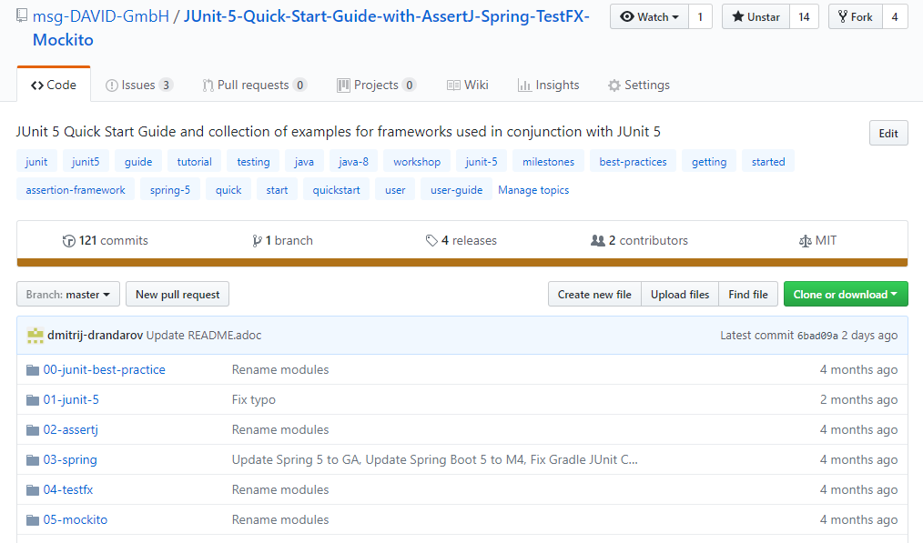

Slide 3
TDD Test Cycle
Red
Refactor
Green

Slide 4
<2 Underpopulation
= 2,3 Survival
>3 Overcrowding
=3 Reproduction

Slide 5


Slide 6
TESTS ARE IMPORTANT!

