Slide 1
20190516
Data Mining / Machine Learning
Supplement

Slide 2
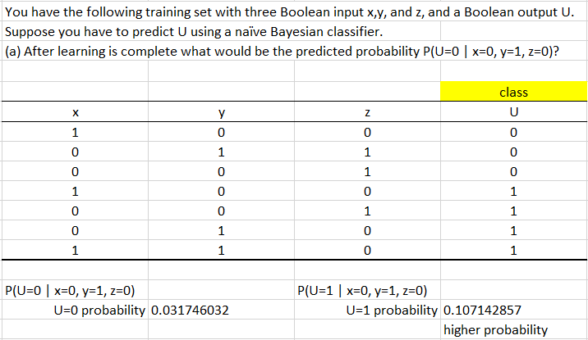
Naïve Bayesian Classifier

Slide 3
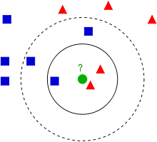
K Nearest Neighbors (KNN) Classifier
Example of k-NN classification.
The test sample (green dot) should be classified either to the first class of blue squares or to the second class of red triangles?
If k = 3 (solid line circle) it is assigned to the second class because there are 2 triangles and only 1 square inside the inner circle.
If k = 5 (dashed line circle) it is assigned to the first class (3 squares vs. 2 triangles inside the outer circle).

Slide 4
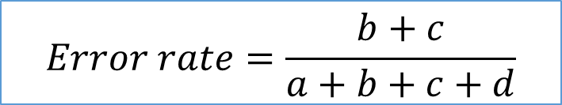
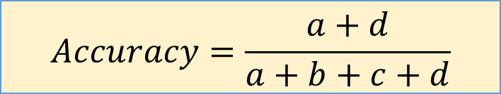
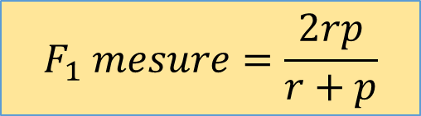
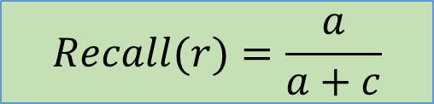
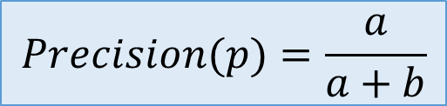
Classification Assessment
Confusion Matrix
$$Accuracy=\frac{a+d}{a+b+c+d}$$
 |  | Actual
 |  | C₀ | C₁
Predict | C₀ | a | b
 | C₁ | c | d
$$Error rate=\frac{b+c}{a+b+c+d}$$
$$Precision(p)=\frac{a}{a+b}$$
$$Recall(r)=\frac{a}{a+c}$$
$$F_{1} mesure=\frac{2rp}{r+p}$$

Slide 5
Decision Tree Classifier
X2
X2
X1
X1
▲
X2
▲
●
▲
●
X1

Slide 6
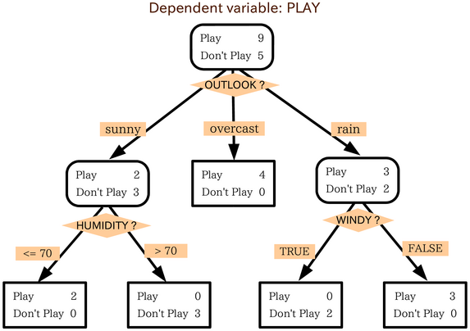
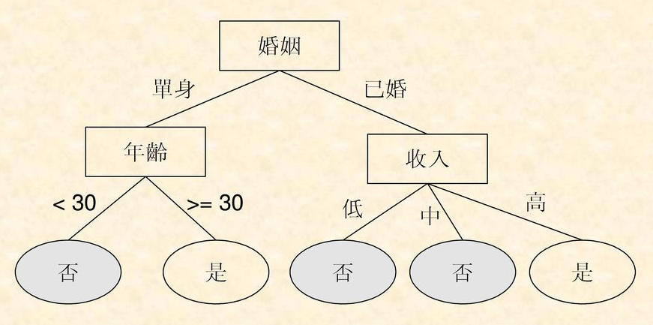
Decision Tree Classifier

Slide 7


Metrics
$$Gini\left(t\right)=1−\sum_{i=0}^{c−1}{{\left[p\left(i | t\right)\right]}^{2}}$$
$$Entropy\left(t\right)=−\sum_{i=0}^{c−1}{p\left(i | t\right)\log_{2}{p\left(i | t\right)}}$$

Slide 8

Random Forest

