Slide 1
Data Mining, Summer 2019 Department of Business Administration National Central University
Neural Network
2019/7/30

Slide 2
Outline
AI/ML/DL
Neural Network (ANN)
MLP/DNN
Convolutional Neural Network (CNN)
Python-code

Slide 3
Outline
AI/ML/DL
Neural Network (ANN)
DNN/MLP
Convolutional Neural Network (CNN)
Python-code

Slide 4
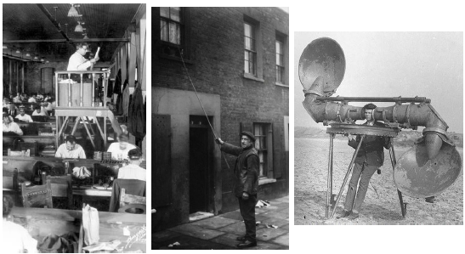
Technology and Information….
From 中央研究院 / 人工智慧民主化在台灣

Slide 5
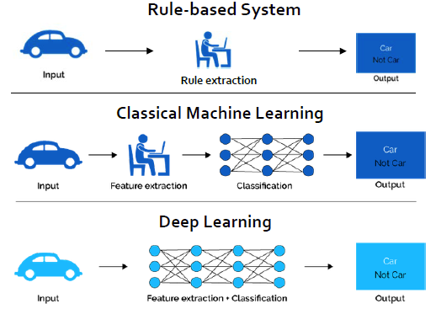
AI / ML / DL Development
From 中央研究院 / 人工智慧民主化在台灣

Slide 6
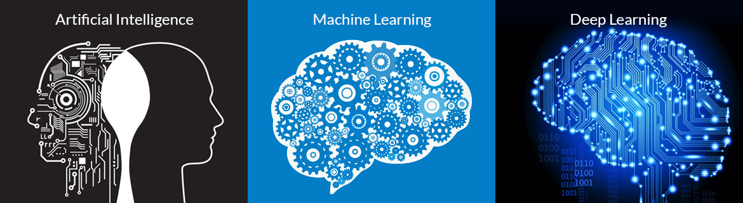
AI / ML / DL Development
AI involves machines that can perform tasks that are characteristic of human intelligence.
Machine learning (ML) is the scientific study of algorithms and statistical models that computer systems use in order to perform a specific task effectively without using explicit instructions, relying on patterns and inference instead. It is seen as a subset of artificial intelligence.
https://www.techsophy.com/blog-artificial-intelligence-machine-learning-deep-learning/

Slide 7
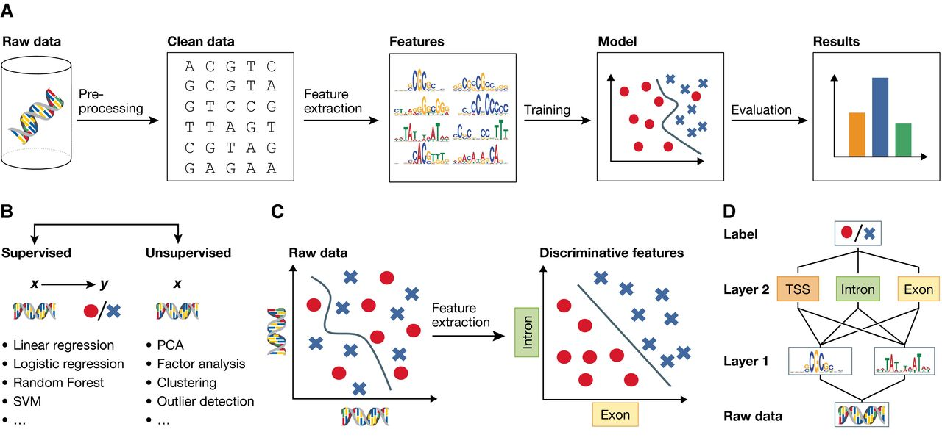
Machine learning and representation learning
http://msb.embopress.org/content/12/7/878.figures-only

Slide 8
Outline
AI/ML/DL
Neural Network (ANN)
DNN/MLP
Convolutional Neural Network (CNN)
Python-code

Slide 9
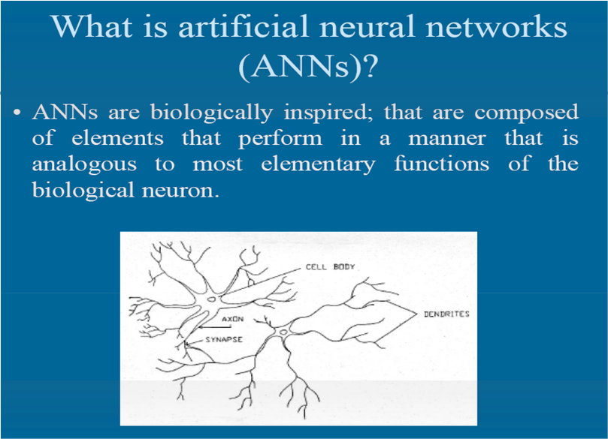
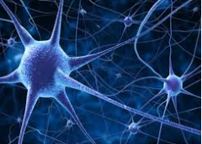
Artificial neural networks (ANNs) are statistical models directly inspired by, and partially modeled on biological neural networks.

Slide 10
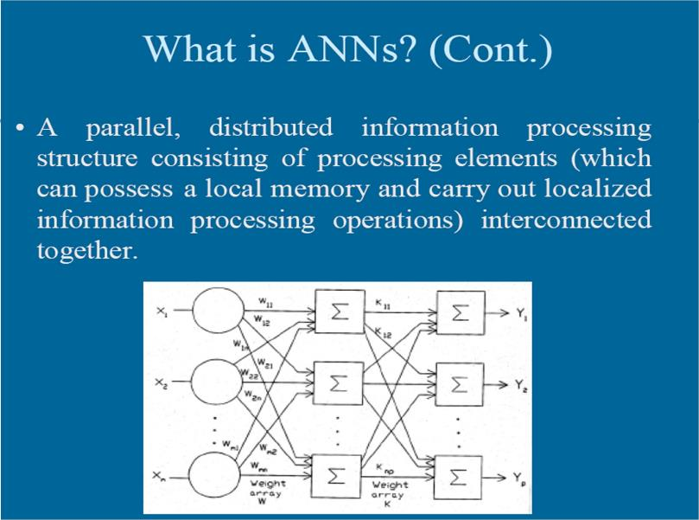
An ANN is a massive parallel distributed processor made up of simple processing units. It has the ability to learn experiential knowledge expressed through connection strengths, and can make such knowledge available for use.

Slide 11
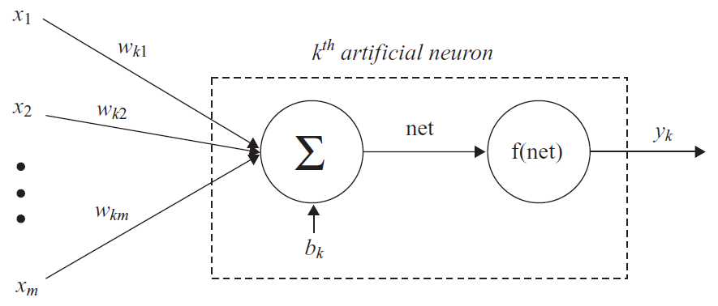
MODEL OF AN ARTIFICIAL NEURON
Three basic elements:
A set of connecting links from different inputs x_{i} (or synapses), each of which is characterized by a weight or strength w_{ki}.
An adder for summing the input signals x_{i} weighted by the respective synaptic strengths w_{ki}.
An activation function: f(net).
bias

Slide 12
Activation (Transfer) Functions - I
In artificial neural networks, the activation function of a node defines the output of that node given an input or set of inputs.
1
1. Hard Limit Y =
1 if net ≥ 0
0 if net < 0
1
2. Symmetrical Y =
Hard Limit
1 if net ≥ 0
-1 if net < 0
-1
3. Linear
Y = net
1
4. Saturating Linear Y= net
0
if net > 1 if 0≤net≤1 if net < 0
1
1

Slide 13
Activation (Transfer) Functions - II
1 if net >1
Y = net if -1≤net≤1
-1 if net < -1
1
5. Symmetrical Saturating Linear
-1
1
6. Log-Sigmoid
Y = 1 / ( 1 + e ^{–net} )
7. Hyperbolic Tangent Sigmoid
_{Y= (e}net_{-e}–net_{)/(e}net_{+e}–net₎
1
-1

Slide 14
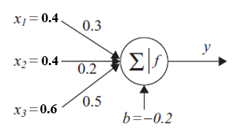
Below Figure shows a neuron with Bias b= - 0.2, weight factors W = [w1, w2, w3] = [0.3, 0.2, 0.5], and input vector [x1, x2, x3] = [0.4, 0.4, 0.6].
Please Calculate the neuron’s output for the following activation functions:
(a) Linear
(b) Log - sigmoid

Slide 15
Outline
AI/ML/DL
Neural Network (ANN)
MLP/DNN
Convolutional Neural Network (CNN)
Python-code

Slide 16
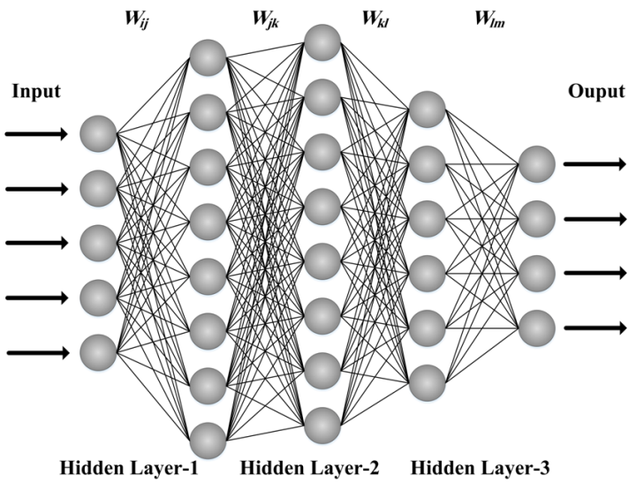
MLP/DNN
Multilayer perception stands for a neural network with one or more hidden layer
Properties of multilayer neural networks:
The model of each neuron in the network includes a nonlinear activation function that’s differentiable.
Network contains one or more hidden layer.
Network exhibits a high degree of connectivity through its weights.
http://pubs.sciepub.com/ajmm/3/3/1/figure/5

Slide 17

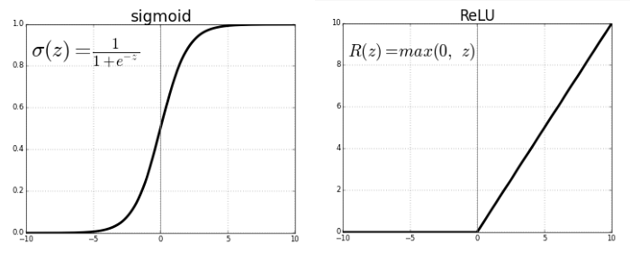


Activation Function
Relu (Rectified Linear Units)：
sigmoid：
softmax：multiclass classification

Slide 18
Outline
AI/ML/DL
Neural Network (ANN)
DNN/MLP Python-code
Convolutional Neural Network (CNN)

Slide 19
Outline
AI/ML/DL
Neural Network (ANN)
DNN/MLP
Convolutional Neural Network (CNN)
Python-code

Slide 20
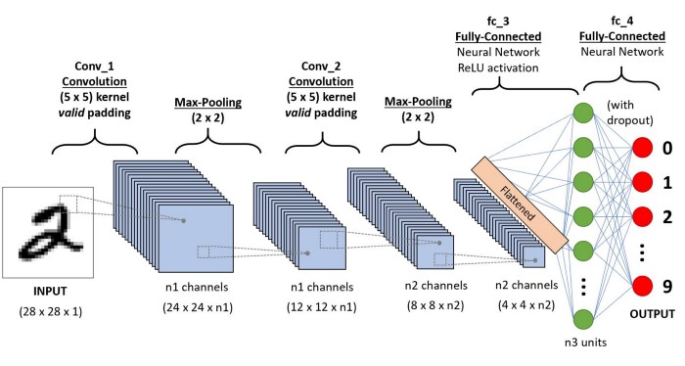
Convolutional Neural Network
In deep learning, a convolutional neural network (CNN) is a class of deep neural networks, most commonly applied to analyzing visual imagery.
https://towardsdatascience.com/a-comprehensive-guide-to-convolutional-neural-networks-the-eli5-way-3bd2b1164a53

Slide 21
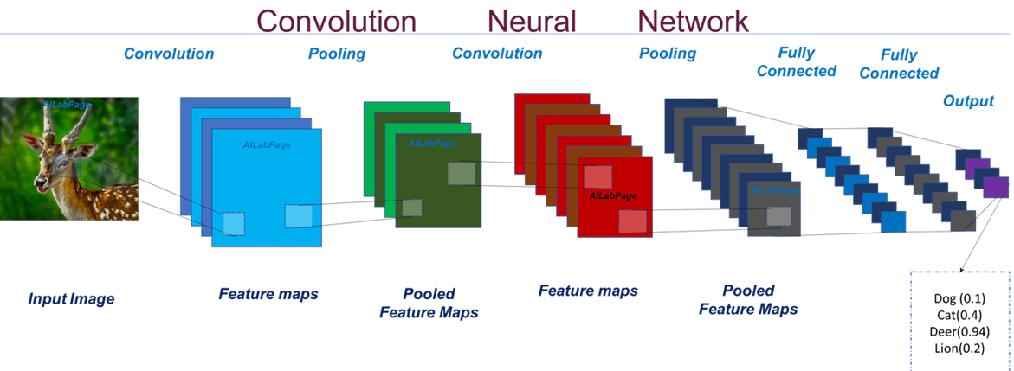
Convolutional Neural Network
In deep learning, a convolutional neural network (CNN) is a class of deep neural networks, most commonly applied to analyzing visual imagery.
https://vinodsblog.com/2018/10/15/everything-you-need-to-know-about-convolutional-neural-networks/

Slide 22
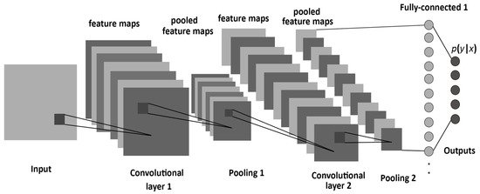
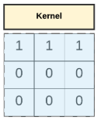
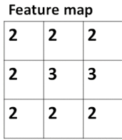

Convolutional Neural Network
Convolution + Pooling → Maintain shape information and avoid to increase the parameters
https://www.mdpi.com/1099-4300/19/6/242

Slide 23
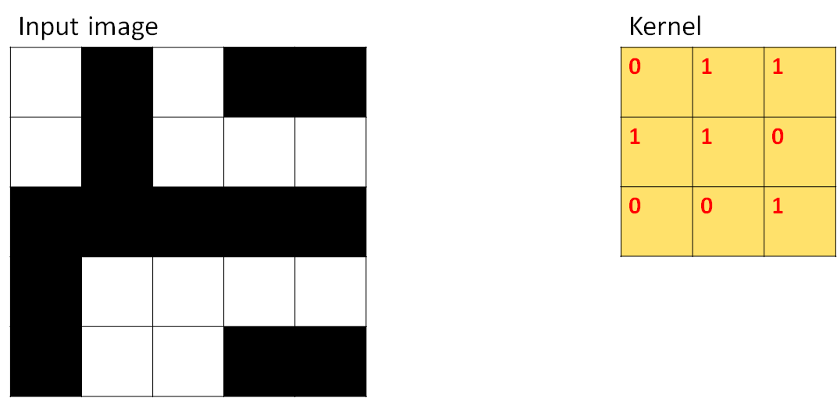
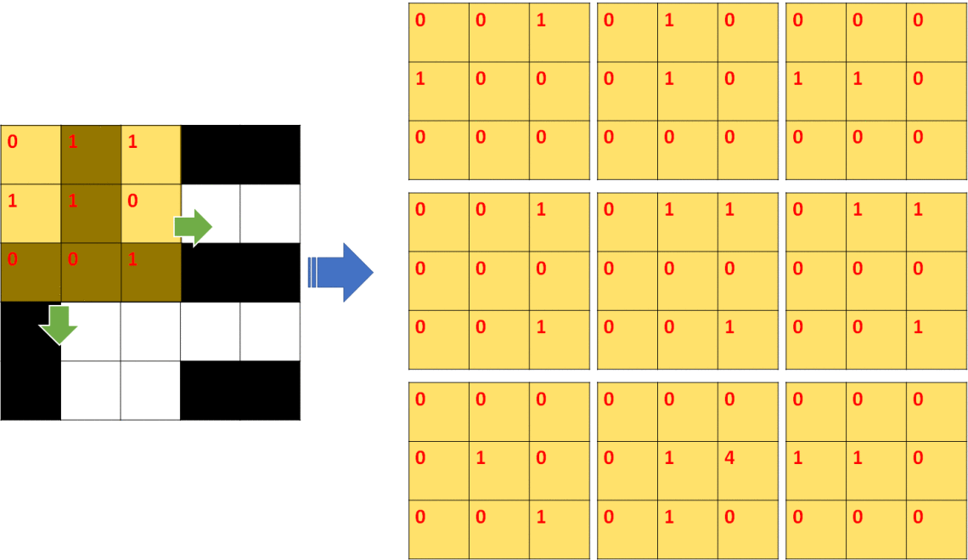
Convolutional
Sliding window
Padding=‘SAME’

Slide 24
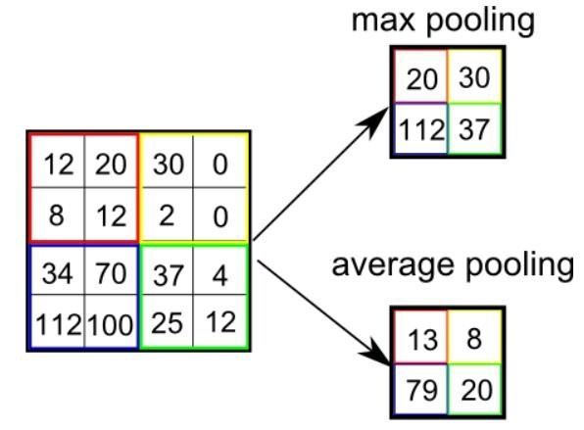
Pooling

Slide 25
Activation Function
Relu (Rectified Linear Units)：
sigmoid：
softmax：multiclass classification

Slide 26
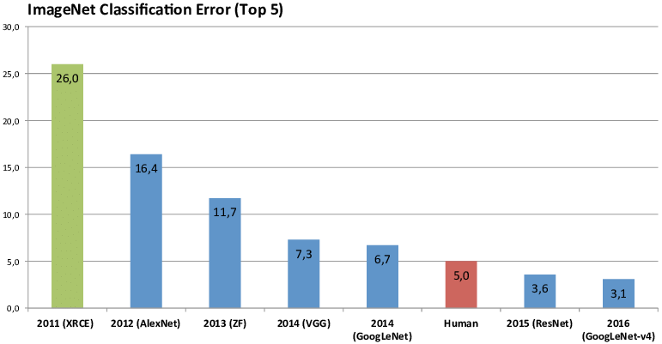
ImageNet
http://image-net.org/about-overview
https://www.researchgate.net/figure/Winner-results-of-the-ImageNet-large-scale-visual-recognition-challenge-LSVRC-of-the_fig7_324476862

Slide 27
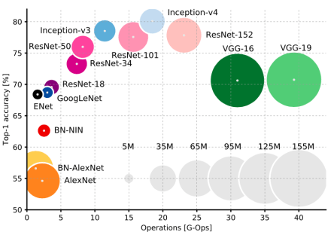
ImageNet
https://sefiks.com/2017/12/10/transfer-learning-in-keras-using-inception-v3/

Slide 28
Outline
AI/ML/DL
Neural Network (ANN)
DNN/MLP
Convolutional Neural Network (CNN)
CNN Python-code

