Slide 1
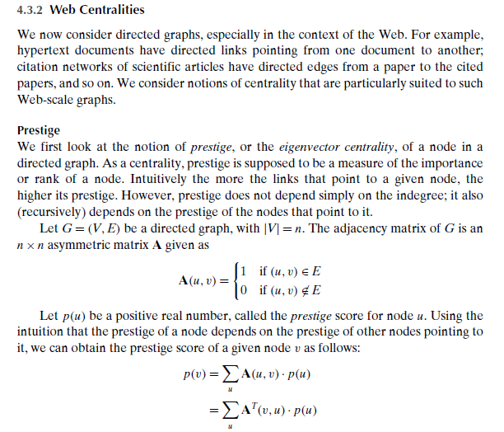
Centralities and Prestige

Slide 2
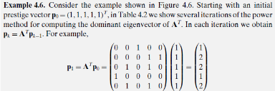
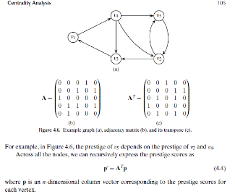
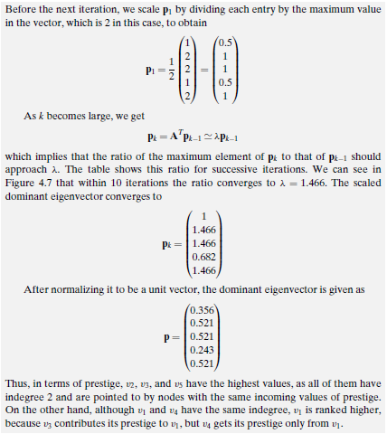
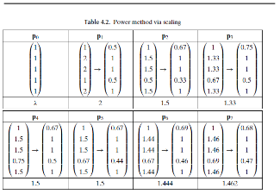

Slide 3
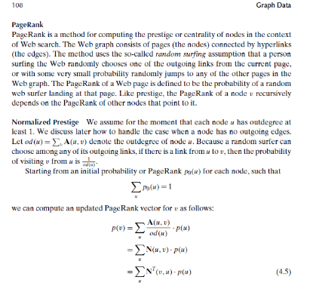
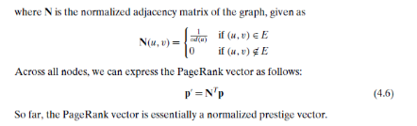
PageRank

Slide 4
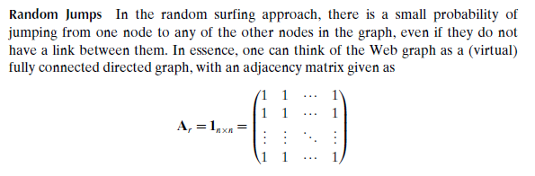
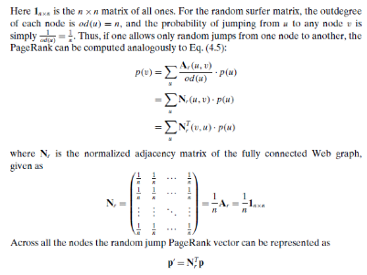
PageRank
Initial Random Jump

Slide 5
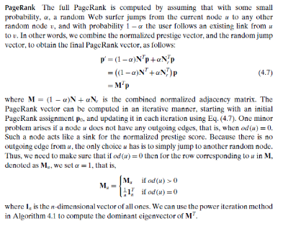
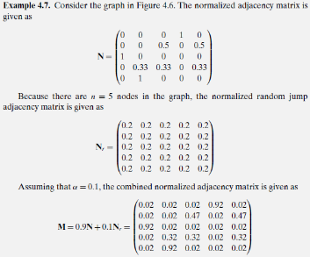
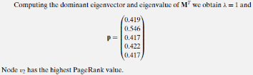
PageRank

Slide 6

Data Mining and Analysis: Fundamental Concepts and Algorithms
dataminingbook.info
Mohammed J. Zaki¹ Wagner Meira Jr.²
¹ Department of Computer Science Rensselaer Polytechnic Institute, Troy, NY, USA
² Department of Computer Science Universidade Federal de Minas Gerais, Belo Horizonte, Brazil
Chapter 8: Itemset Mining
Chapter 8: Itemset Mining 6 / 32

Slide 7




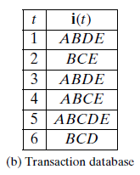

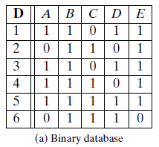
Example: Transaction records for a store
Transaction 1:
Transaction 2:
Transaction 3:
Transaction 4:
Transaction 5:
Transaction 6:

Slide 8
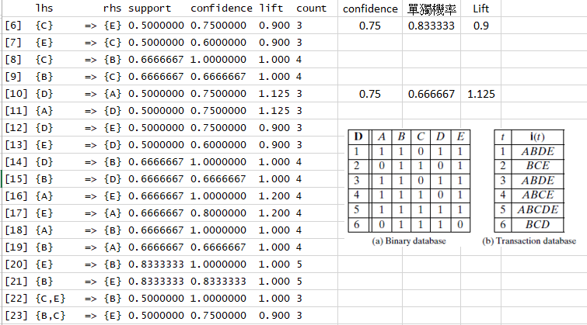
Example

Slide 9

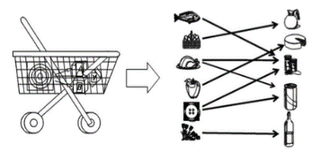

Frequent Itemset Mining
In many applications one is interested in how often two or more objects of interest co-occur, the so-called itemsets.
The prototypical application was market basket analysis, that is, to mine the sets of items that are frequently bought together at a supermarket by analyzing the customer shopping carts (the so-called “market baskets”).
Frequent itemset mining is a basic exploratory mining task, since the basic operation is to find the co-occurrence, which gives an estimate for the joint probability mass function.
Once we mine the frequent sets, they allow us to extract association rules among the itemsets, where we make some statement about how likely are two sets of items to co-occur or to conditionally occur.
Chapter 8: Itemset Mining 9 / 32

Slide 10
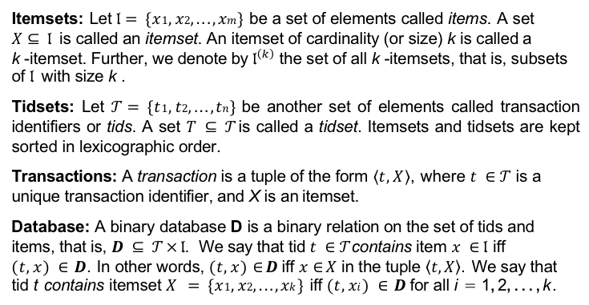
Frequent Itemsets: Terminology
Itemsets: Let $𝔩= \{x1, x2, . . . , xm \}$be a set of elements called items. A set
$X⊆ 𝔩$is called an itemset. An itemset of cardinality (or size) k is called a
k -itemset. Further, we denote by $𝔩^{\left(k\right)}$ the set of all k -itemsets, that is, subsets of $𝔩$ with size k .
Tidsets: Let $𝒯= \{t1, t2, . . . , tn \}$be another set of elements called transaction identifiers or tids. A set $T ⊆ 𝒯$is called a tidset. Itemsets and tidsets are kept sorted in lexicographic order.
Transactions: A transaction is a tuple of the form $\left\langle t,X\right\rangle$, where $t ∈ 𝒯$ is a unique transaction identifier, and X is an itemset.
Database: A binary database D is a binary relation on the set of tids and items, that is, $D ⊆ 𝒯 × 𝔩$. We say that tid $t ∈ 𝒯$contains item $x ∈ 𝔩$ iff
$(t, x ) ∈ D$. In other words, $(t, x )∈D$iff $x∈X$ in the tuple $\left\langle t,X\right\rangle$. We say that tid t contains itemset $X = \{x1, x2, . . . , xk \}$iff $(t, xi ) ∈ D$for all i = 1, 2, . . . , k .
Chapter 8: Itemset Mining 10 / 32

Slide 11
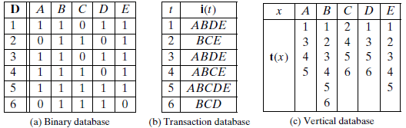
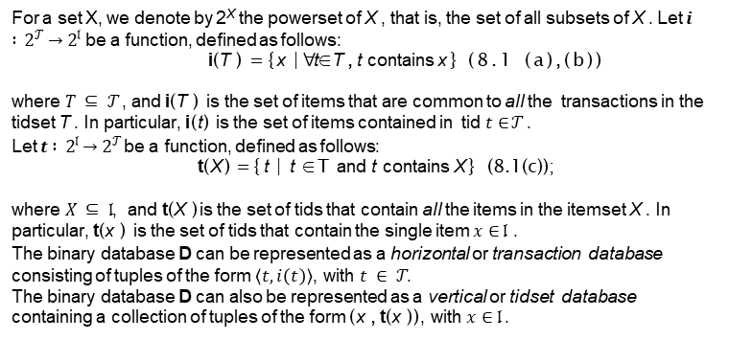
Database Representation
For a set X, we denote by 2^{X} the powerset of X , that is, the set of all subsets of X . Let $i : 2^{𝒯}→2^{𝔩}$be a function, defined as follows:
i(T ) = {x | ∀t ∈ T , t contains x } (8.1 (a),(b))
where $T ⊆ 𝒯$, and i(T ) is the set of items that are common to all the transactions in the tidset T . In particular, i(t) is the set of items contained in tid $t∈𝒯$ .
Let $t : 2^{𝔩}→2^{𝒯}$be a function, defined as follows:
t(X ) = {t | t ∈ T and t contains X } (8.1(c));
where $X ⊆ 𝔩$, and t(X ) is the set of tids that contain all the items in the itemset X . In particular, t(x ) is the set of tids that contain the single item $x∈ 𝔩$ .
The binary database D can be represented as a horizontal or transaction database consisting of tuples of the form $\left\langle t,i\left(t\right)\right\rangle$, with $t ∈ 𝒯$.
The binary database D can also be represented as a vertical or tidset database containing a collection of tuples of the form (x , t(x )), with $x ∈ 𝔩$.
Chapter 8: Itemset Mining 11 / 32

Slide 12
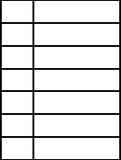
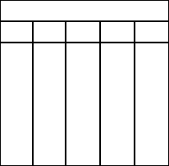
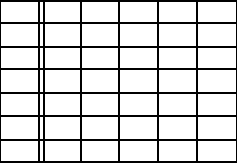
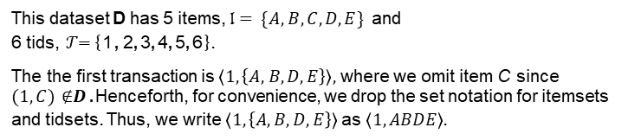
Binary Database: Transaction and Vertical Format
t(x )
D | A | B | C | D | E
1 | 1 | 1 | 0 | 1 | 1
2 | 0 | 1 | 1 | 0 | 1
3 | 1 | 1 | 0 | 1 | 1
4 | 1 | 1 | 1 | 0 | 1
5 6 | 1 0 | 1 1 | 1 1 | 1 1 | 1 0
t | i(t)
1 | ABDE
2 | BCE
3 | ABDE
4 | ABCE
5 6 | ABCDE BCD
A | B | C | D | E
1 | 1 | 2 | 1 | 1
3 | 2 | 4 | 3 | 2
4 | 3 | 5 | 5 | 3
5 | 4 | 6 | 6 | 4
 | 5 |  |  | 5
 | 6
Binary Database
Transaction Database
Vertical Database
This dataset D has 5 items, $𝔩= \{A, B, C, D, E \}$ and
6 tids, $𝒯$= {1, 2, 3, 4, 5, 6}.
The the first transaction is $\left\langle 1,\left\{A, B, D, E\right\}\right\rangle ,$where we omit item C since
$(1, C)∉D$ .Henceforth, for convenience, we drop the set notation for itemsets and tidsets. Thus, we write $\left\langle 1,\left\{A,B,D,E\right\}\right\rangle$as $\left\langle 1,ABDE\right\rangle$.
Chapter 8: Itemset Mining 12 / 32

Slide 13

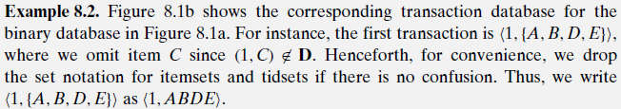

Examples

Slide 14
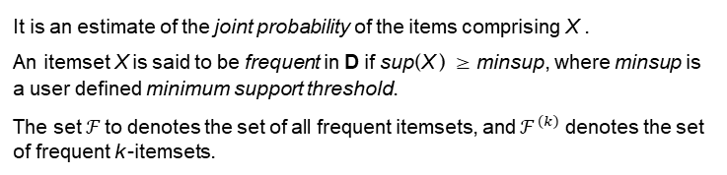

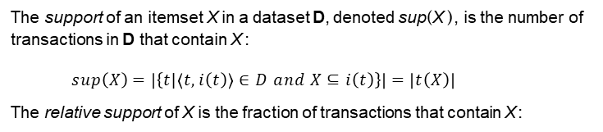
Support and Frequent Itemsets
The support of an itemset X in a dataset D, denoted sup(X ), is the number of transactions in D that contain X :
$sup\left(X\right)=\left|\left\{t|\left\langle t,i\left(t\right)\right\rangle ∈D and X⊆i\left(t\right)\right\}\right|=\left|t\left(X\right)\right|$
The relative support of X is the fraction of transactions that contain X :
$$rsup\left(X\right) =\frac{sup\left(X\right)}{\left|D\right|}$$
It is an estimate of the joint probability of the items comprising X .
An itemset X is said to be frequent in D if sup(X ) ≥ minsup, where minsup is a user defined minimum support threshold.
The set $ℱ$to denotes the set of all frequent itemsets, and $ℱ^{\left(k\right)}$ denotes the set of frequent k -itemsets.
Chapter 8: Itemset Mining 14 / 32

Slide 15
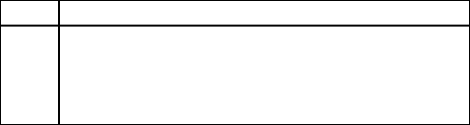
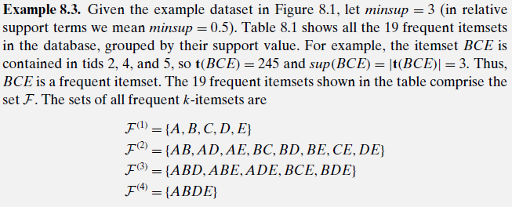
Frequent Itemsets
Minimum support: minsup = 3
t 1 | i(t) ABDE
2 | BCE
3 | ABDE
4 | ABCE
5 | ABCDE
6 | BCD
sup | itemsets
6 | B
5 | E , BE
4 | A, C, D, AB, AE , BC, BD, ABE
3 | AD, CE , DE , ABD, ADE , BCE , BDE , ABDE
Transaction Database
Frequent Itemsets
Chapter 8: Itemset Mining 15 / 32

Slide 16
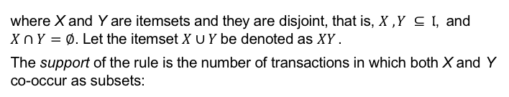

Association Rules
An association rule is an expression
$$X\underset{→}{s,c}Y$$
where X and Y are itemsets and they are disjoint, that is, $X , Y ⊆ 𝔩$, and
$X∩Y=∅$. Let the itemset $X∪ Y$be denoted as $XY$ .
The support of the rule is the number of transactions in which both X and Y
co-occur as subsets:
$$s=sup⁡(X→Y )=|t(XY )|=sup⁡(XY )$$
The relative support of the rule is defined as the fraction of transactions where X and Y co-occur, and it provides an estimate of the joint probability of X and Y :
$$rsup(X→ Y) =\frac{sup\left(XY\right)}{\left|D\right|} =P(X∧ Y )$$
The confidence of a rule is the conditional probability that a transaction contains Y given that it contains X :
$$c = conf (X→ Y)=P(Y|X )=\frac{P\left(X∧Y\right)}{P\left(X\right)}=\frac{sup\left(XY\right)}{sup\left(X\right)}$$
Chapter 8: Itemset Mining 16 / 32

Slide 17
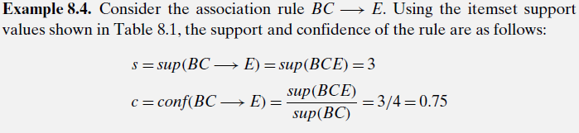
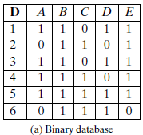
Example
Itemset and Rule Mining
From the definition of rule support and confidence, we can observe that to generate frequent and high confidence association rules, we need to first enumerate all the frequent itemsets along with their support values. Formally, given a binary database D and a user defined minimum support threshold minsup, the task of frequent itemset mining is to enumerate all itemsets that are frequent, i.e., those that have support at least minsup. Next, given the set of frequent itemsets F and a minimum confidence value minconf, the association rule mining task is to find all frequent and strong rules.

Slide 18
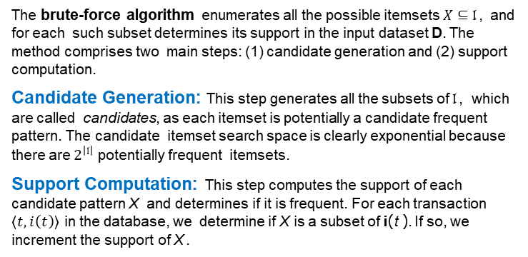
Itemset Mining Algorithms: Brute Force
The brute-force algorithm enumerates all the possible itemsets $X⊆𝔩$, and for each such subset determines its support in the input dataset D. The method comprises two main steps: (1) candidate generation and (2) support computation.
Candidate Generation: This step generates all the subsets of $𝔩$, which are called candidates, as each itemset is potentially a candidate frequent pattern. The candidate itemset search space is clearly exponential because there are $2^{\left|𝔩\right|}$ potentially frequent itemsets.
Support Computation: This step computes the support of each candidate pattern X and determines if it is frequent. For each transaction $\left\langle t,i\left(t\right)\right\rangle$ in the database, we determine if X is a subset of i(t ). If so, we increment the support of X .
Chapter 8: Itemset Mining 18 / 32

Slide 19
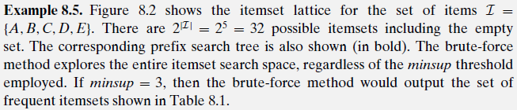
Itemset lattice and prefix-based search tree
Itemset search space is a lattice where any two itemsets X and Y are connected by a link iff X is an immediate subset of Y , that is,
X ⊆ Y and |X | = |Y | − 1.
∅
A
B
C
D
E
Frequent itemsets can enumerated using either a BFS or DFS search on the prefix tree, where two itemsets X , Y are connected by a link iff X is an immediate subset and prefix of Y . This allows one to enumerate itemsets starting with an empty set, and adding one more item at a time.
AB
AC
AD
AE
BC
BD
BE
CD
CE
DE
ABC
ABD
ABE
ACD
ACE
ADE
BCD
BCE
BDE
CDE
ABCD
ABCE
ABDE
ACDE
BCDE
ABCDE

Slide 20
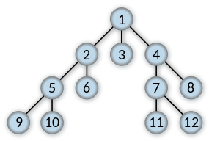
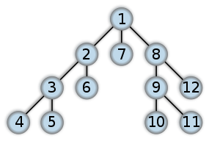
Concept
Breadth-first search
Depth-first search

Slide 21
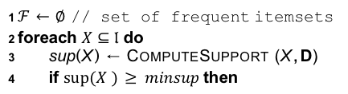

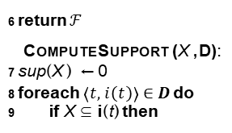
Brute Force Algorithm
BRUTEFORCE (D, $𝔩$, minsup):
1 $ℱ←∅$ // set of frequent itemsets
2 foreach $X⊆𝔩$do
3 sup(X ) ← COMPUTESUPPORT (X , D)
4 if $sup⁡(X ) ≥ minsup$then
t | i(t)
1 | ABDE
2 | BCE
3 | ABDE
4 | ABCE
5 6 | ABCDE BCD
5
$$ℱ←ℱ∪\left\{\left(X,sup\left(X\right)\right)\right\}$$
6 return $ℱ$
COMPUTESUPPORT (X , D):
7 sup(X ) ← 0
8 foreach $\left\langle t,i\left(t\right)\right\rangle ∈ D$do
9 if X ⊆ i(t) then
sup | itemsets
6 | B
5 | E , BE
4 | A, C, D, AB, AE , BC, BD, ABE
3 | AD, CE , DE , ABD, ADE , BCE , BDE , ABDE
10
sup(X )← sup(X ) + 1
11 return sup(X )
The approach is impractical from an I/O perspective as well.

Slide 22
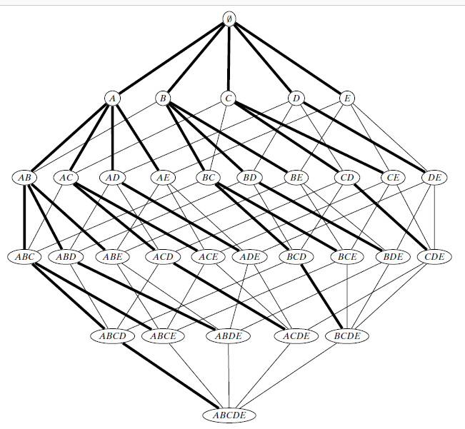
Brute Force Algorithm
t | i(t)
1 | ABDE
2 | BCE
3 | ABDE
4 | ABCE
5 6 | ABCDE BCD
The approach is impractical from an I/O perspective as well.

Slide 23
Level-wise Approach: Apriori Algorithm
The brute force approach enumerates all possible itemsets in its quest to determine the frequent ones. This results in a lot of wasteful computation because many of the candidates may not be frequent.
If X ⊆ Y , then sup(X ) ≥ sup(Y ), which leads to the following two observations: (1) if X is frequent, then any subset Y ⊆ X is also frequent, and
(2) if X is not frequent, then any superset Y ⊇ X cannot be frequent.
The Apriori algorithm utilizes these two properties to significantly improve the brute-force approach. It employs a level-wise or breadth-first exploration of the itemset search space, and prunes all supersets of any infrequent candidate, as no superset of an infrequent itemset can be frequent. It also avoids generating any candidate that has an infrequent subset.
In addition to improving the candidate generation step via itemset pruning, the Apriori method also significantly improves the I/O complexity. Instead of counting the support for a single itemset, it explores the prefix tree in a breadth-first manner, and computes the support of all the valid candidates of size k that comprise level k in the prefix tree.

Slide 24
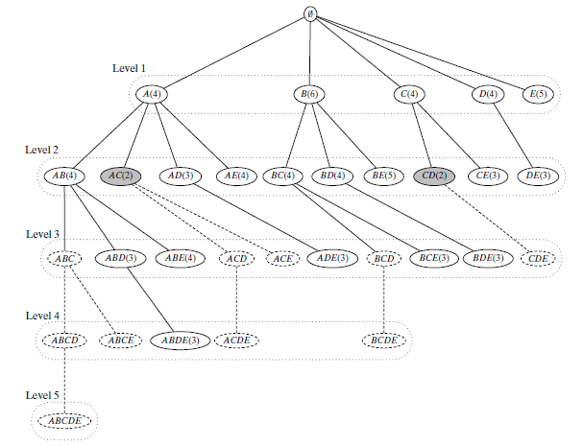
Apriori Algorithm: Prefix Search Tree and Pruning
Example 8.6. Consider the example dataset in Figure 8.1; let minsup = 3. Figure 8.3 shows the itemset search space for the Apriori method, organized as a prefix tree where two itemsets are connected if one is a prefix and immediate subset of the other. Each node shows an itemset along with its support, thus AC(2) indicates that sup(AC) = 2. Apriori enumerates the candidate patterns in a level-wise manner, as shown in the figure, which also demonstrates the power of pruning the search space via the two Apriori properties. For example, once we determine that AC is infrequent, we can prune any itemset that has AC as a prefix, that is, the entire subtree under AC can be pruned. Likewise for CD. Also, the extension BCD from BC can be pruned, since it has an infrequent subset, namely CD.

Slide 25
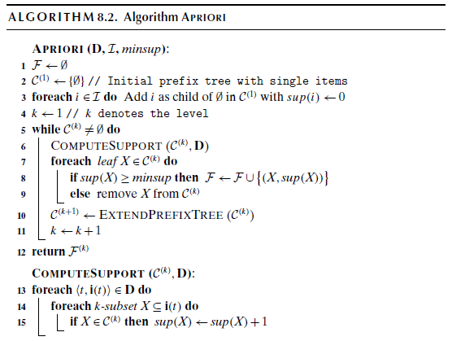
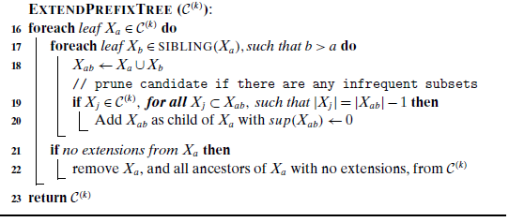
The Apriori Algorithm

Slide 26
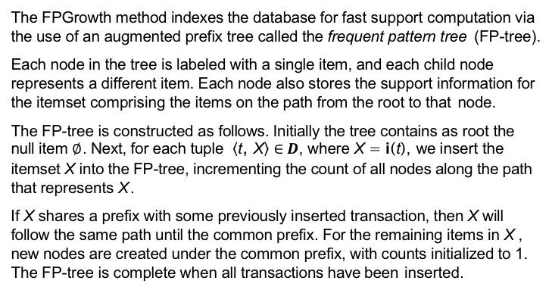
Frequent Pattern Tree Approach: FPGrowth Algorithm
The FPGrowth method indexes the database for fast support computation via the use of an augmented prefix tree called the frequent pattern tree (FP-tree).
Each node in the tree is labeled with a single item, and each child node represents a different item. Each node also stores the support information for the itemset comprising the items on the path from the root to that node.
The FP-tree is constructed as follows. Initially the tree contains as root the null item $∅$ . Next, for each tuple $\left\langle \text{t}\text{, }\text{X}\right\rangle ∈ D$, where X = i(t), we insert the itemset X into the FP-tree, incrementing the count of all nodes along the path that represents X .
If X shares a prefix with some previously inserted transaction, then X will follow the same path until the common prefix. For the remaining items in X , new nodes are created under the common prefix, with counts initialized to 1. The FP-tree is complete when all transactions have been inserted.

Slide 27
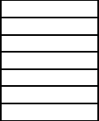
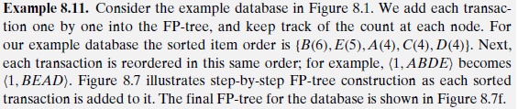
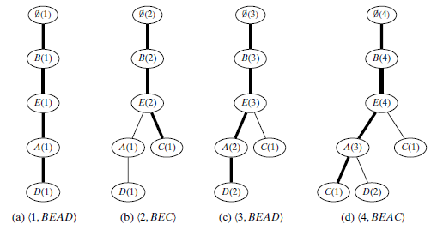
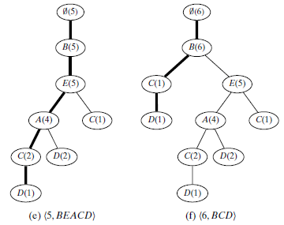
Frequent Pattern Tree
The FP-tree is a prefix compressed representation of D. For most compression items are sorted in descending order of support.
Transactions BEAD
BEC BEAD BEAC BEACD
BCD

Slide 28
Dataset
Example
Raw Data
Candidate 1-Itemset
Large 1-Itemset
TID | Item
1 | a b c d
2 | a c d f
3 | c d e g a
4 | a d f b
5 | b c g
6 | d f g
7 | a b g
8 | c d f g
C1 | Count
a | 5
b | 4
c | 5
d | 6
e | 1
f | 4
g | 5
L1 | Count
d | 6
a | 5
c | 5
g | 5
b | 4
f | 4
Support = 3

Slide 29
Dataset
Example
Raw Data
Raw Data ordered by L1
TID | Item
1 | a b c d
2 | a c d f
3 | c d e g a
4 | a d f b
5 | b c g
6 | d f g
7 | a b g
8 | c d f g
TID | Item
1 | d a c b
2 | d a c f
3 | d a c g
4 | d a b f
5 | c g b
6 | d g f
7 | a g b
8 | d c g f

Slide 30
Construct FP-Tree
Example
TID | Item
1 | d a c b
2 | d a c f
3 | d a c g
4 | d a b f
5 | c g b
6 | d g f
7 | a g b
8 | d c g f
root
d: 1
a: 1
c: 1
b: 1

Slide 31
Construct FP-Tree
Example
TID | Item
1 | d a c b
2 | d a c f
3 | d a c g
4 | d a b f
5 | c g b
6 | d g f
7 | a g b
8 | d c g f
root
d: 2
a: 2
c: 2
b: 1
f: 1

Slide 32
Construct FP-Tree
Example
TID | Item
1 | d a c b
2 | d a c f
3 | d a c g
4 | d a b f
5 | c g b
6 | d g f
7 | a g b
8 | d c g f
root
d: 3
a: 3
c: 3
b: 1
f: 1
g: 1

Slide 33
Construct FP-Tree
Example
TID | Item
1 | d a c b
2 | d a c f
3 | d a c g
4 | d a b f
5 | c g b
6 | d g f
7 | a g b
8 | d c g f
root
d: 4
a: 4
c: 3
b: 1
b: 1
f: 1
g: 1
f: 1

Slide 34
Construct FP-Tree
Example
TID | Item
1 | d a c b
2 | d a c f
3 | d a c g
4 | d a b f
5 | c g b
6 | d g f
7 | a g b
8 | d c g f
root
d: 4
c: 1
a: 4
g: 1
c: 3
b: 1
b: 1
b: 1
f: 1
g: 1
f: 1

Slide 35
Construct FP-Tree
Example
TID | Item
1 | d a c b
2 | d a c f
3 | d a c g
4 | d a b f
5 | c g b
6 | d g f
7 | a g b
8 | d c g f
root
d: 5
c: 1
a: 4
g: 1
g: 1
c: 3
b: 1
f: 1
b: 1
b: 1
f: 1
g: 1
f: 1

Slide 36
Construct FP-Tree
Example
TID | Item
1 | d a c b
2 | d a c f
3 | d a c g
4 | d a b f
5 | c g b
6 | d g f
7 | a g b
8 | d c g f
root
d: 5
c: 1
a: 1
a: 4
g: 1
g: 1
g: 1
c: 3
b: 1
f: 1
b: 1
b: 1
b: 1
f: 1
g: 1
f: 1

Slide 37
Construct FP-Tree
Example
TID | Item
1 | d a c b
2 | d a c f
3 | d a c g
4 | d a b f
5 | c g b
6 | d g f
7 | a g b
8 | d c g f
root
d: 6
c: 1
a: 1
a: 4
g: 1
c: 1
g: 1
g: 1
c: 3
b: 1
f: 1
g: 1
b: 1
b: 1
b: 1
f: 1
g: 1
f: 1
f: 1

Slide 38
Construct FP-Tree
Example
TID | Item
1 | d a c b
2 | d a c f
3 | d a c g
4 | d a b f
5 | c g b
6 | d g f
7 | a g b
8 | d c g f
root
d: 6
c: 1
a: 1
a: 4
g: 1
c: 1
g: 1
g: 1
c: 3
b: 1
f: 1
g: 1
b: 1
b: 1
b: 1
f: 1
g: 1
f: 1
f: 1

Slide 39
Construct FP-Tree
Example
root
Head Table
d | 6
a | 5
c | 5
g | 5
b | 4
f | 4
d: 6
c: 1
a: 1
a: 4
g: 1
c: 1
g: 1
g: 1
c: 3
b: 1
f: 1
g: 1
b: 1
b: 1
b: 1
f: 1
g: 1
f: 1
f: 1

Slide 40
Projection of { f }
Example
root
Frequent Itemset:
{ d, f }
Head Table
d | 4
a | 2
c | 2
g | 2
b | 1
f
d: 4
c: 1
a: 1
a: 2
g: 1
c: 1
g: 1
g: 1
c: 1
b: 1
f: 1
g: 1
b: 1
b: 1
b: 1
f: 1
g: 1
f: 1
f: 1

Slide 41
Projection of { b }
Example
root
Frequent Itemset:
{ a, b }
Head Table
d | 2
a | 3
c | 2
g | 2
b
f
d: 2
c: 1
a: 1
a: 2
g: 1
c: 1
g: 1
g: 1
c: 1
b: 1
f: 1
g: 1
b: 1
b: 1
b: 1
f: 1
g: 1
f: 1
f: 1

Slide 42
Projection of { g }
Example
root
Frequent Itemset:
{ d, g }
{ c, g }
Head Table
d | 3
a | 2
c | 3
g
b
f
d: 3
c: 1
a: 1
a: 1
g: 1
c: 1
g: 1
g: 1
c: 1
b: 1
f: 1
g: 1
b: 1
b: 1
b: 1
f: 1
g: 1
f: 1
f: 1

Slide 43
Projection of { c, g }
Example
root
Frequent Itemset:
{ }
Head Table
d | 2
a | 1
c
g
b
f
d: 2
c: 1
a: 1
a: 1
g: 1
c: 1
g: 1
g: 1
c: 1
b: 1
f: 1
g: 1
b: 1
b: 1
b: 1
f: 1
g: 1
f: 1
f: 1

Slide 44
Projection of { c }
Example
root
Frequent Itemset:
{ a, c } { d, c }
Head Table
d | 4
a | 3
c
g
b
f
d: 4
c: 1
a: 1
a: 3
g: 1
c: 1
g: 1
g: 1
c: 3
b: 1
f: 1
g: 1
b: 1
b: 1
b: 1
f: 1
g: 1
f: 1
f: 1

Slide 45
Projection of { a, c }
Example
root
Frequent Itemset:
{ d, a, c }
Head Table
d | 3
a
c
g
b
f
d: 3
c: 1
a: 1
a: 3
g: 1
c: 1
g: 1
g: 1
c: 3
b: 1
f: 1
g: 1
b: 1
b: 1
b: 1
f: 1
g: 1
f: 1
f: 1

Slide 46
Projection of { a }
Example
root
Frequent Itemset:
{ d, a }
Head Table
d | 4
a
c
g
b
f
d: 4
c: 1
a: 1
a: 4
g: 1
c: 1
g: 1
g: 1
c: 3
b: 1
f: 1
g: 1
b: 1
b: 1
b: 1
f: 1
g: 1
f: 1
f: 1

Slide 47
Frequent Itemsets
Example
Suffix | Frequent Itemsets
f | { f }, { d, f }
b | { b }, { a, b }
g | { g }, { d, g }, { c, g }
c | { c }, { a, c }, { d, c }, { d, a, c }
a | { a }, { d, a }
d | { d }

Slide 48

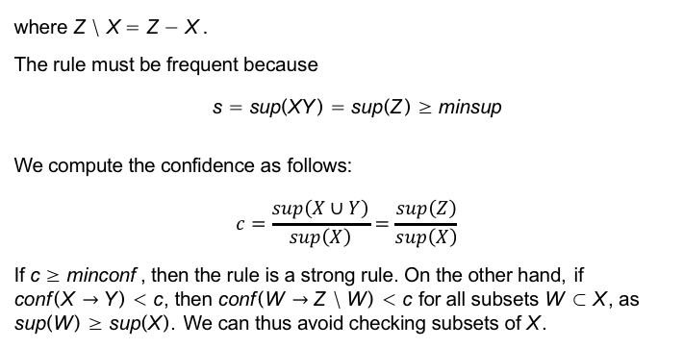

Generating Association Rules
Given a frequent itemset $Z ∈ ℱ$, we look at all proper subsets X ⊂ Z to compute rules of the form
X $\underset{→}{s,c}$Y , where Y = Z \ X
where Z \ X = Z − X .
The rule must be frequent because
s = sup(XY ) = sup(Z ) ≥ minsup
We compute the confidence as follows:
$$c=\frac{sup\left(X∪Y\right)}{sup\left(X\right)}=\frac{sup\left(Z\right)}{sup\left(X\right)}$$
If c ≥ minconf , then the rule is a strong rule. On the other hand, if
conf (X $→$ Y ) < c, then conf (W $→$ Z \ W ) < c for all subsets W ⊂ X , as
sup(W ) ≥ sup(X ). We can thus avoid checking subsets of X .

Slide 49
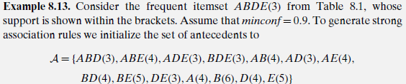
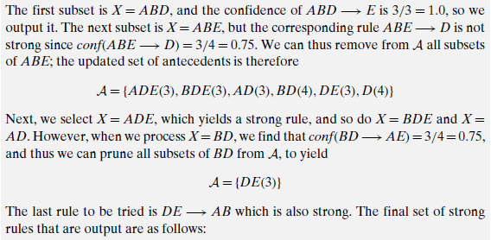
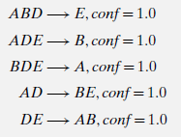
Association Rule Mining Algorithm
t | i(t)
1 | ABDE
2 | BCE
3 | ABDE
4 | ABCE
5 6 | ABCDE BCD

Slide 50

Association Rule Mining Algorithm
 | ASSOCIATIONRULES ($ℱ$, minconf ):
1 | foreach Z ∈ $ℱ$, such that |Z | ≥ 2 do
2 | $$𝒜←\left\{X|X⊂Z,X≠φ\right\}$$
3 | while $𝒜≠φ$ do
4 | X ← maximal element in $𝒜$
5 | $𝒜$ ←$𝒜$\ X // remove X from $𝒜$
6 | c ← sup(Z )/sup(X )
7 | if c ≥ minconf then
8 | print X $→$ Y , sup(Z ), c
9 | else
10 | $$𝒜←𝒜\backslash \left\{W|W⊂X\right\}$$ // remove all subsets of X from $𝒜$
t | i(t)
1 | ABDE
2 | BCE
3 | ABDE
4 | ABCE
5 6 | ABCDE BCD

Slide 51






Academic Thinking
Product/Transaction
Key Customer
Behavior
Business Goal

