Slide 1

Heartbleed
By: Jace Alexander

Slide 2
What is Heartbleed?
Heartbleed Bug is a serious vulnerability in the popular OpenSSL cryptographic software library. This weakness allows stealing the information protected, under normal conditions, by the SSL/TLS encryption used to secure the Internet.

Slide 3
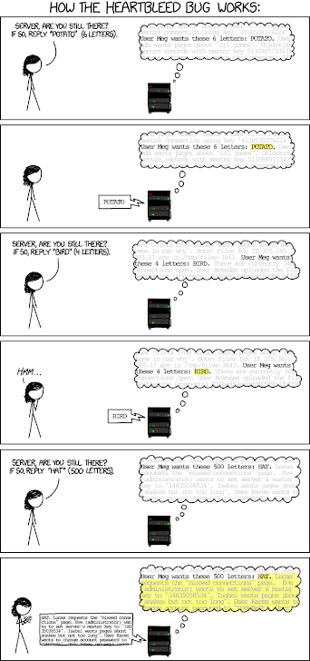
How it works?
Heartbleed attack allows an attacker to retrieve a block of memory of the server up to 64kb in response directly from the vulnerable server via sending the malicious heartbeat and there is no limit on the number of attacks that can be performed.

Slide 4
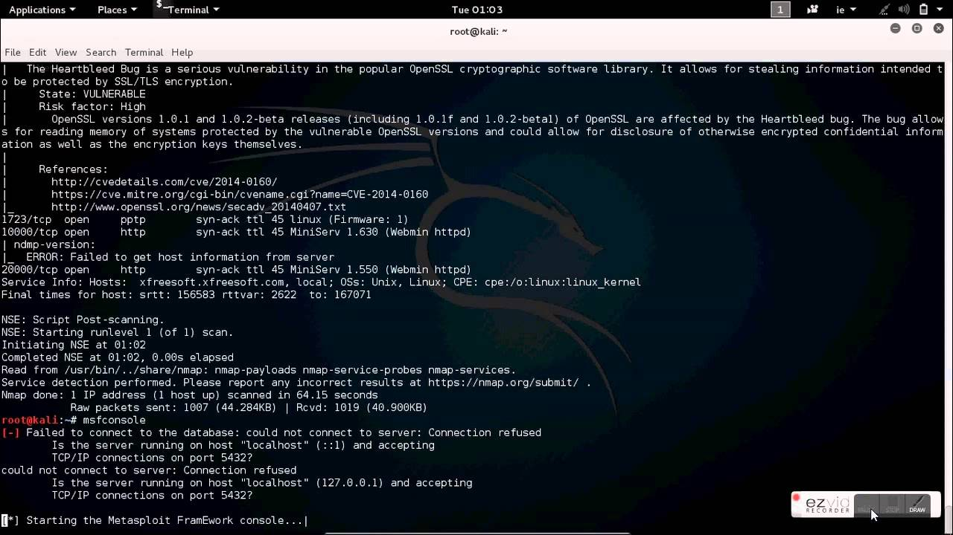
Where was it used?
It was used in the OpenSSL’s implementation of the TLS/DTLS heartbeat extension that allows attackers to read portions of the affected server’s memory, potentially revealing users data that the server did not intend to revel.

Slide 5
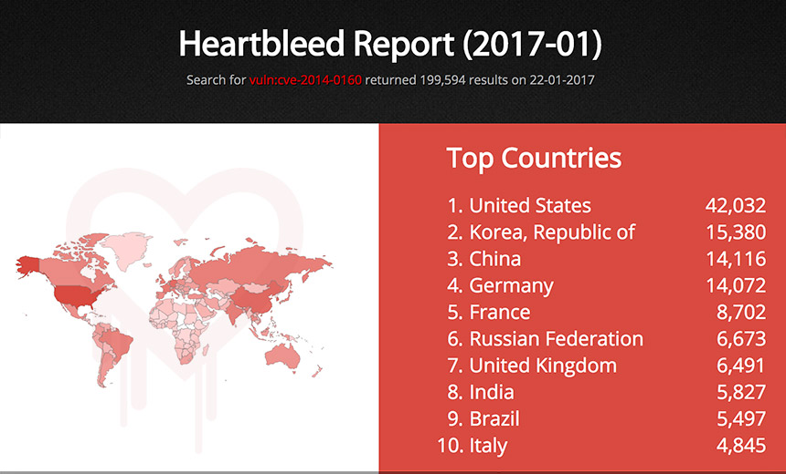
Why was it made?
Bug is in the OpenSSL's implementation of the TLS/DTLS (transport layer security protocols) heartbeat extension (RFC6520). When it is exploited it leads to the leak of memory contents from the server to the client and from the client to the server.

Slide 6
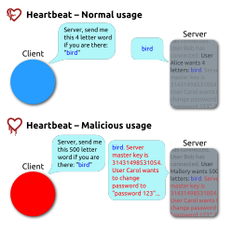
What was being leaked?
Encryption is used to protect secrets that may harm your privacy or security if they leak. In order to coordinate recovery from this bug we have classified the compromised secrets to four categories: 1) primary key material, 2) secondary key material and 3) protected content and 4) collateral.

Slide 7
Resources
Fruhlinger, J. (2017, September 13). What is the Heartbleed bug, how does it work and how was it fixed? Retrieved from https://www.csoonline.com/article/3223203/vulnerabilities/what-is-the-heartbleed-bug-how-does-it-work-and-how-was-it-fixed.html
Kumar, M. (2014, April 17). HeartBleed Bug Explained - 10 Most Frequently Asked Questions. Retrieved from https://thehackernews.com/2014/04/heartbleed-bug-explained-10-most.html
Synopsys, Inc. http://www.synopsys.com/. (n.d.). Heartbleed Bug. Retrieved from http://heartbleed.com/

