Slide 1

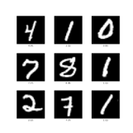
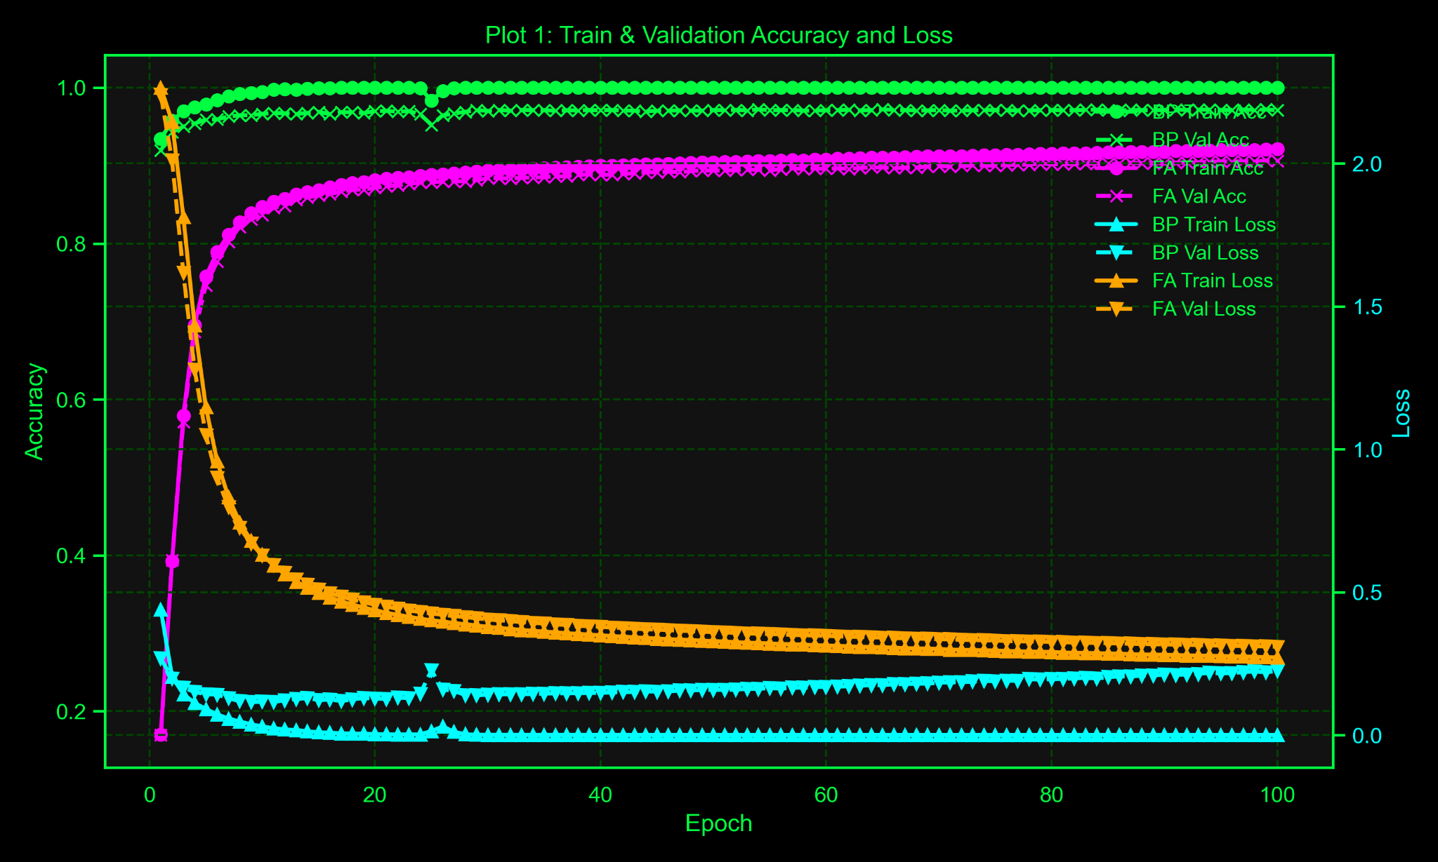
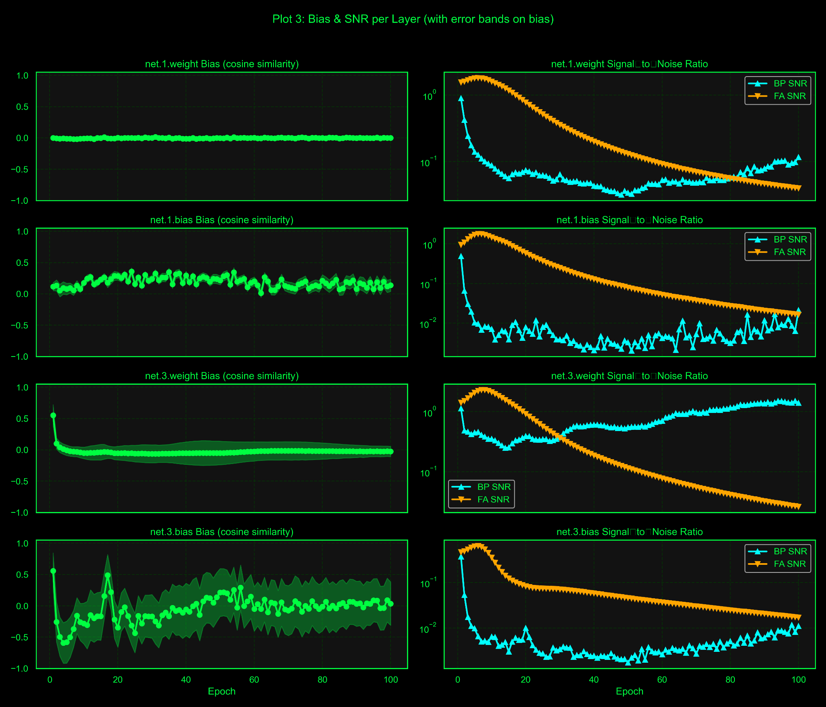
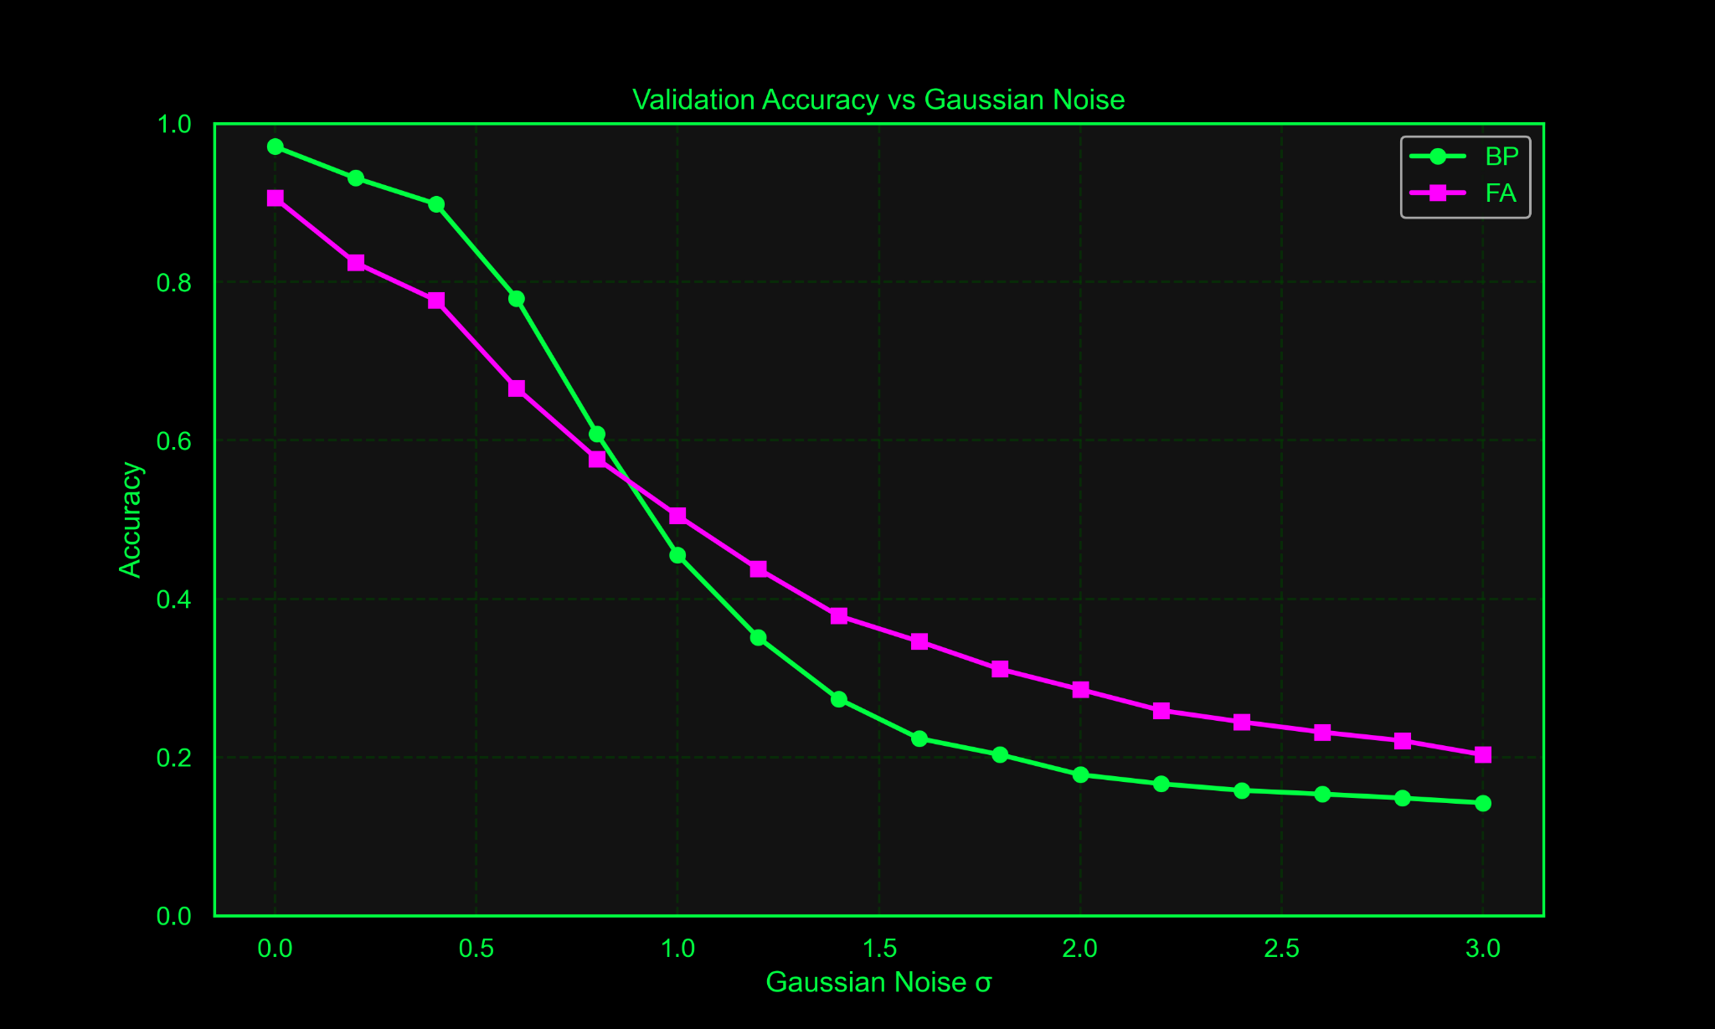
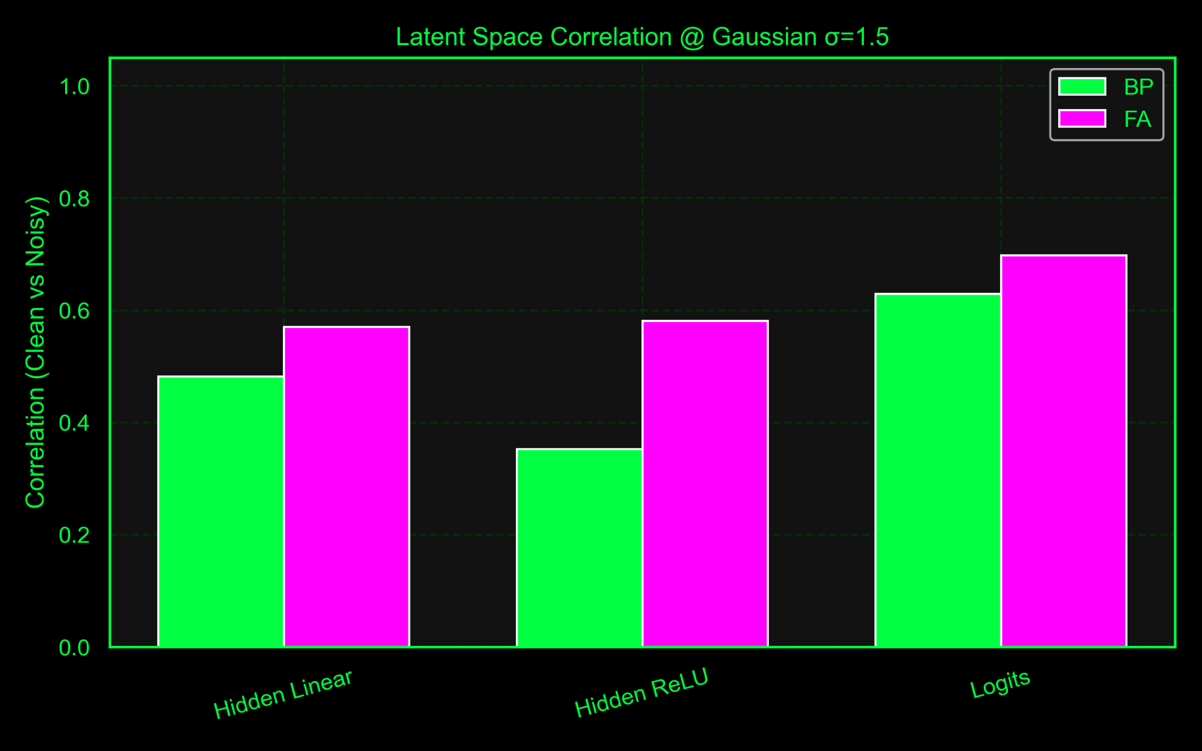
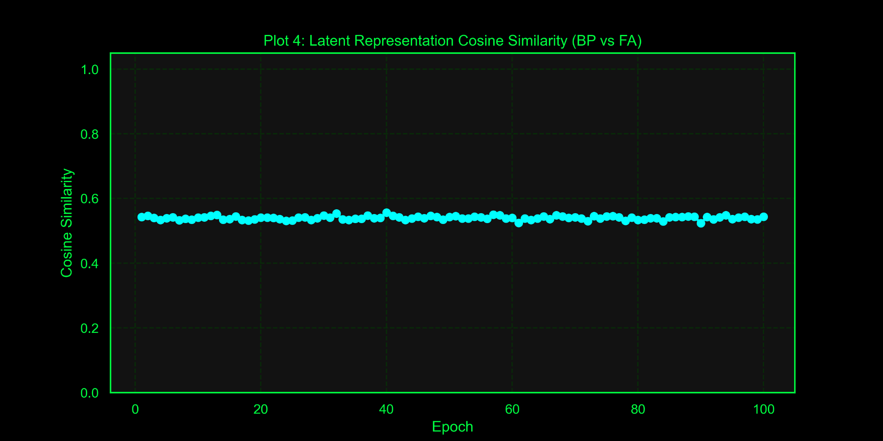
How Close is Close Enough? Quantifying the Gap Between Feedback Alignment and Backpropagation
By: Avisa Fallah, Melina Mostafa, Alireza AlaeiFaradonbeh, Yasaman Malahzadeh, Morteza Hashemi, Mobina Golsefatan, Sina Pirmoradian
BACKGROUND
METHODS
Training Setup: • Optimizer: Adam (BP) • Epochs: 10, 50, 100 • Batch size: 128 • Learning rate: 1e-3
CONCLUSIONS
Backpropagation (BP) is the standard method for training deep neural networks, but its reliance on exact gradient feedback makes it biologically implausible. Feedback Alignment (FA) offers a more realistic alternative by using fixed random feedback weights. This project investigates how well FA can approximate BP in terms of performance, learning dynamics, and robustness.
Hidden (ReLU)
FA shows competitive performance and increasing similarity to BP in wider networks. While BP learns faster and more stably, FA scales well and approximates similar internal representations. We've already explored robustness to noise, update alignment, and architectural changes. Ongoing work includes deeper models and extended training.
input
output
Added Noise
Learning Dynamics
Learning rules
LIMITATIONS
Gaussian
Salt & Pepper
Cosine
Similarity
SNR
FA requires more tuning and converges slower than BP, with noisier and less stable updates in early training.
Limited training time and computational constraints restricted deeper architectures and simultaneous hyperparameter exploration.
FA is more robust to input noise and showed lower gradient alignment with BP, especially during early stages of learning.
BP
FA
Robustness Test
Validation Test under Increasing noise levels (σ, α)
OBJECTIVES
Compare BP and FA on MNIST in terms of:
Convergence speed and final accuracy
Robustness under input noise (Gaussian, salt-and-pepper)
RESULTS
Analyze learning signals:
Update alignment & Bias (cosine similarity)
Variance (signal-to-noise ratio (SNR))
Understand how closely FA approximates gradient descent and internal representations compared to BP.
REFERENCES
[1] Konishi & Miura (2024). Biologically Plausible CNNs and Autoencoders with Feedback Alignment.
[2] Li & Benna (2024). Deep Learning without Weight Symmetry (Product Feedback Alignment).
[3] Bacho & Chu (2024). Low-Variance Forward Gradients using Direct Feedback Alignment.
[4] Nakajima et al. (2024). Reservoir Direct Feedback Alignment: Deep Learning by Physical Dynamics.
[5] Nayebi et al. (2020). Identifying learning rules from activity and weight statistics in biological systems.

