Slide 1
TRACK YOUR STOCK
BY
D.DAMIN
C22UG132CSC006

Slide 2
OBJECTIVES
Effective shop management involves planning, organizing, staffing, directing, and controlling all activities within the shop.
A Track Your Stock (TYS) is a software solution designed to streamline and manage the daily operations of a retail store or shop.
It provides an efficient way to handle various aspects of shop management, including inventory control, sales tracking, customer management, billing, and employee supervision.

Slide 3
SYNOPSIS
Effective stock management is a cornerstone of any successful retail business.
A well-maintained inventory system ensures that a shop can meet customer demand, minimize overstock, and optimize operational efficiency.
This mini project focuses on developing a shop stock management system designed to streamline the tracking and control of inventory in a retail setting.
The system is built to manage various aspects of stock, including stock levels, product categories, sales tracking, and stock replenishment.

Slide 4
EXISTING SYSTEM
Requires a person to note all the details.
Takes a long time to evaluate the result.
Can’t able to view an abstract description of transactions.
The details which are recorded may lead to confusion while billing.
Doesn’t helpful for large organizations.
Any small mistake in any process may include much confusion.
The existing system is time consuming.
The maintenance process takes long time.
Lack of accuracy

Slide 5
PROPOSED SYSTEM
The system is more user friendly
It is equipped with powerful GUI( Graphical User Interface)
The interrelated data are grouped into different input screens.
Provides a high uniformity among all screens format.
The system works in high speed and accuracy.
It generates neat formatted report, based on which the decision is possible.
It handles bulk amount of data.

Slide 6
HARDWARE REQUIREMENTS
Component | Description
Laptop | To run the application.
Processor | Minimum 2.0 GHz or above.
RAM | Minimum 4 GB.
Hard Disk | At least 20 GB of storage.

Slide 7
SOFTWARE REQUIREMENTS
Software | Description
Python 3.8+ | Programming environment.
SQLite | Database for attendance logs.
Visual Studio Code | IDE for development.

Slide 8
MODULES
USER MODULE
PRODUCTS MASTER
SALES ENTRY
STOCK DETAILS
REPORTS

Slide 9
MODULE DESCRIPTION
1. User Module:
. Fields like username, full name, email, phone number, and password.
Optional details such as address, job title (for staff), or customer preferences.
Profile photo upload (for identification or personalization).
Self-registration for customers via a front-end interface (e.g., a website or app).
Admin-added users for employees, with pre-assigned roles.
Profile editing to update personal details or reset passwords.

Slide 10
2. Products Master:
Stock Quantity (e.g., "50 units in stock").
Low Stock Threshold (e.g., "Alert when below 5 units").
Warehouse/Location Data (e.g., "Store A: 20 units, Store B: 30 units").
Real-time stock updates after sales or restocks.
Auto-hide out-of-stock products from customer-facing interfaces.
Stock transfer options between locations.
Centralizes product data for consistency across sales, inventory, and marketing.
Saves time with bulk operations and automation.
Enhances customer experience with detailed, accurate product info.
Supports business growth by handling complex catalogs and analytics.

Slide 11
3.Sales entry:
Entry of customer details .
Product or service selection with details like quantity, unit price, and discounts.
Automatic calculation of totals, taxes, and freight charges.
Customizable templates for quotes.
Pricing based on predefined price lists or customer-specific rates.
Approval workflows for quotations exceeding certain thresholds.
Tracking of quotation status (e.g., pending, accepted, rejected).
Enhances sales forecasting and customer communication.

Slide 12
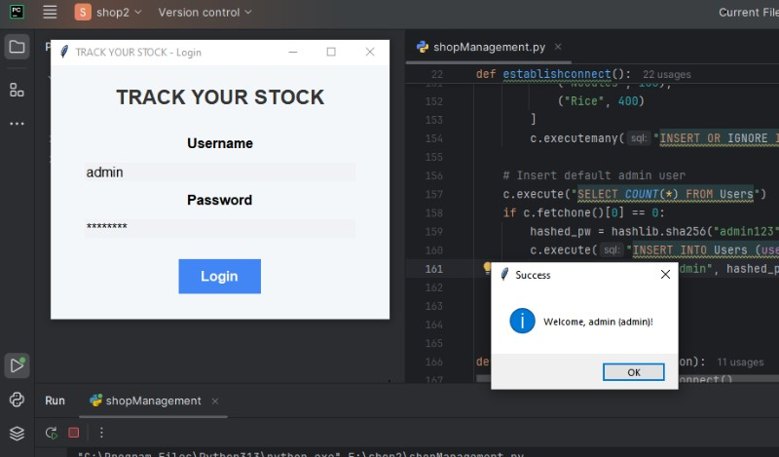
SAMPLE INPUT AND OUTPUT USER LOGIN

Slide 13
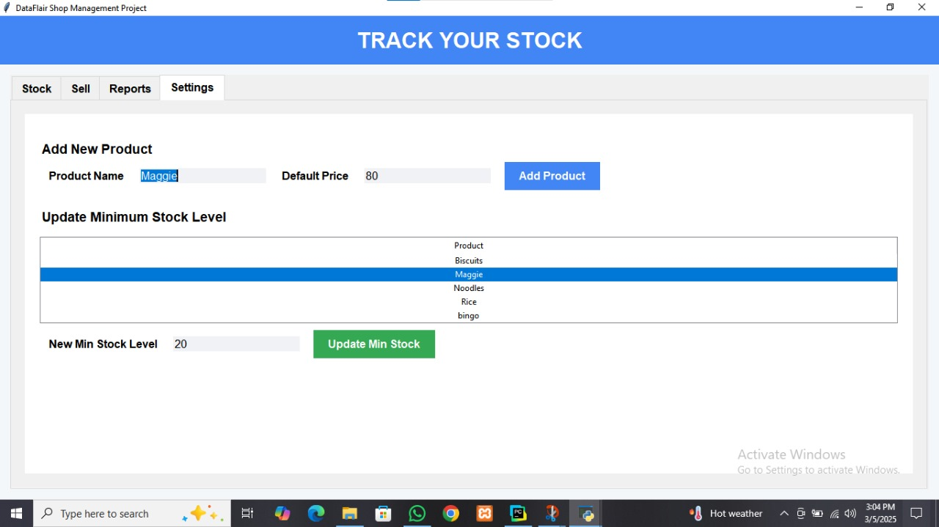
ADD THE NEW PRODUCT

Slide 14
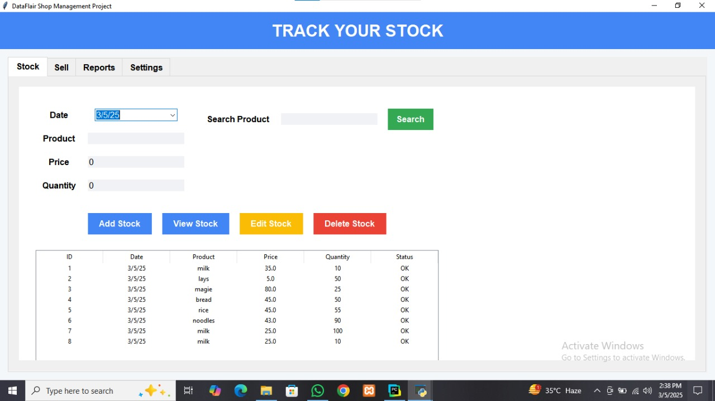
VIEW STOCK

Slide 15
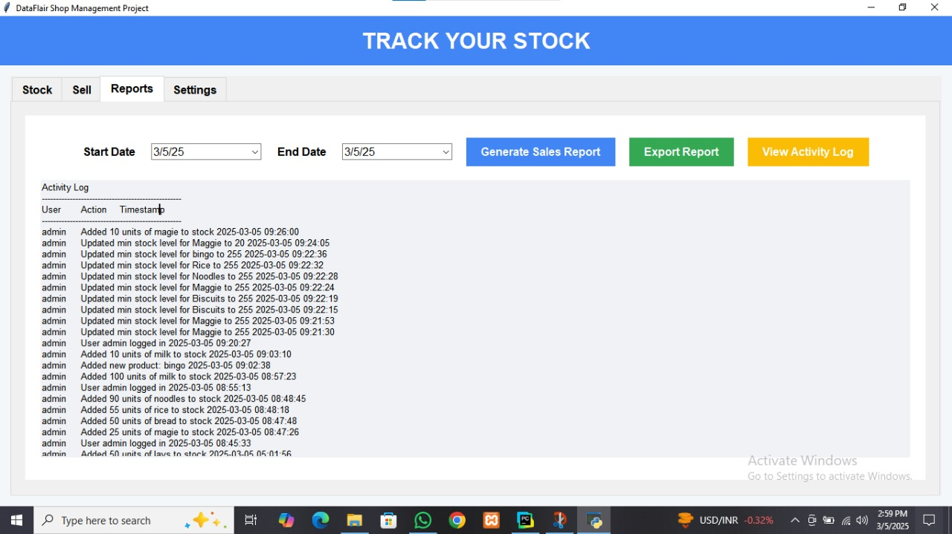
REPORT DETAILS

Slide 16
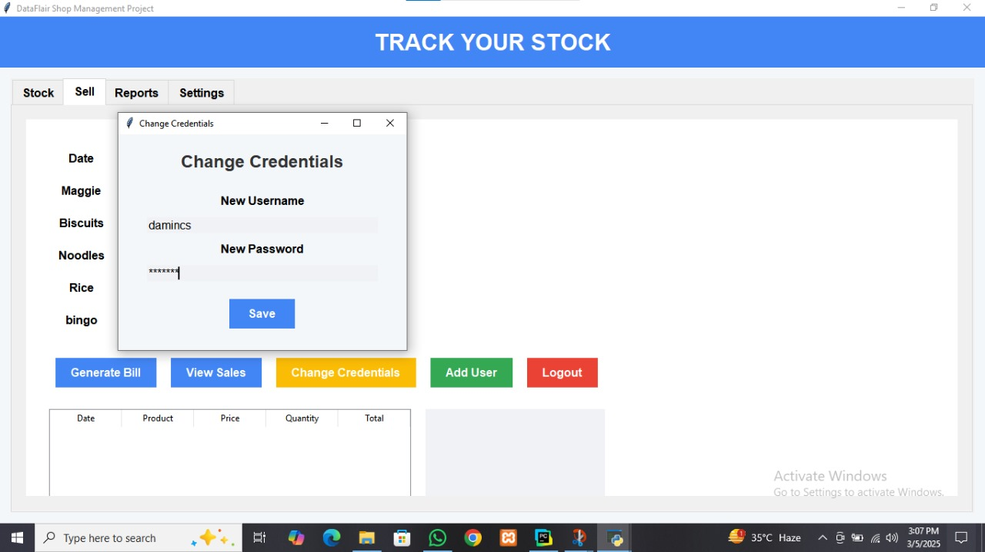
CHANGE USERNAME

Slide 17
CONCLUSION
Effective shop management is the cornerstone of any successful retail operation. Throughout this report, we have explored various facets of managing a shop, including inventory control, customer service, financial management, staff coordination, and the integration of modern technology. This conclusion synthesizes these elements and underscores the importance of adopting a holistic approach to ensure the shop’s sustained growth and profitability.

Slide 18
THANK YOU

