Slide 1
Flood Disaster Fund Access Control
Presented by,
S. DINESHVARMA( C22UG132CSC010 )

Slide 2
SYNPOSIS
It is very difficult for them to go directly to the town when they are trying to help.
So considering these issues, this project is dealing with a new system, people who come to the aid of victims can easily fund.
This project creates a web application for that reason; it includes details about the affected people, such as their photos.
All of these actions are done by PHP in this project.

Slide 3
EXISTING SYSTEM’s DRAWBACKS
In existing method, it is very difficult to know whether the funds and materials needed for flood victims are available.
This is because the functionality is not implemented properly.
And, in that way, it is impossible to accurately look at the victims' recovery and whether their survey was correct.

Slide 4
PROPOSED SYSTEM’s FEATURES
In this new way, people can see clearly, accurately and easily what kinds of products are being given to victims.
The agent will take care of information about the victims and their goods.
Agent will take care of it and record it in one as document and hand it over to the owner.
And the agent will take care and forbid of any kind of corruption. The system therefore benefits the victim and the owner.

Slide 5
SYSTEM REQUIREMENTS
HARDWARE REQUIREMENTS
System : Pentium IV 2.4 GHz.
Hard Disk : 500 GB.
Monitor : 15 VGA Colour.
RAM : 4 GB.

Slide 6
SOFTWARE REQUIREMENTS
SOFTWARE REQUIREMENTS
Operating System : Windows-10/11.
Frontend Languages : HTML, CSS and JavaScript
IDE Tool : Visual Studio Code 1.7
Backend Languages : PHP 7.0.
Database : MYSQL 10.0.

Slide 7
MODULES
Administrator Module
Govt. Officer Module
User Module
Fund Collection Module
Feedback Module
Fund Report Module

Slide 8
ADMINISTRATOR MODULE
The Administrator of the System will be divided to several privileges on how they can use the System.
Administrator for example, has all the privileges such as Adding type of product to be sell, Adding type of fund, Update price list, Adding Downloadable Material, Registration Module, etc.
The administrator has to make sure the system do not have problem and the govt. officer do not have problem when using the system.

Slide 9
GOVT. OFFICER MODULE
The govt. officer can search the data by id number or name of flood victims.
The administrator is the govt. officer they have high level authority of using the system.
The officer also can add update and search for the related data by the way.
Officer also can delete the data that related to the registration.

Slide 10
USER MODULE
Before using the system the user need to log in.
After success they can proceed with the system.
The user of the flood victim System will be divided into officers.
The user can add new user or officer including the details into the database.
The user can delete the data of the victims. It includes the details of them.

Slide 11
SCREEN SHOTS

Slide 12
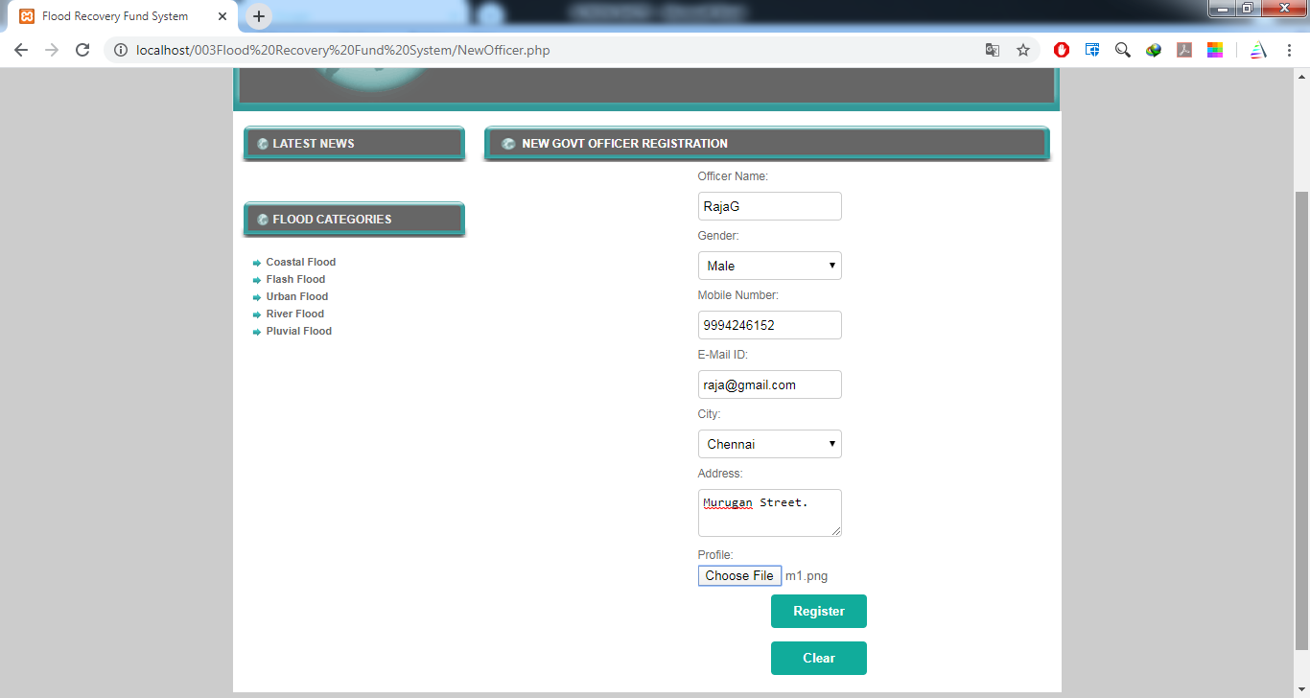
New Officer Register

Slide 13
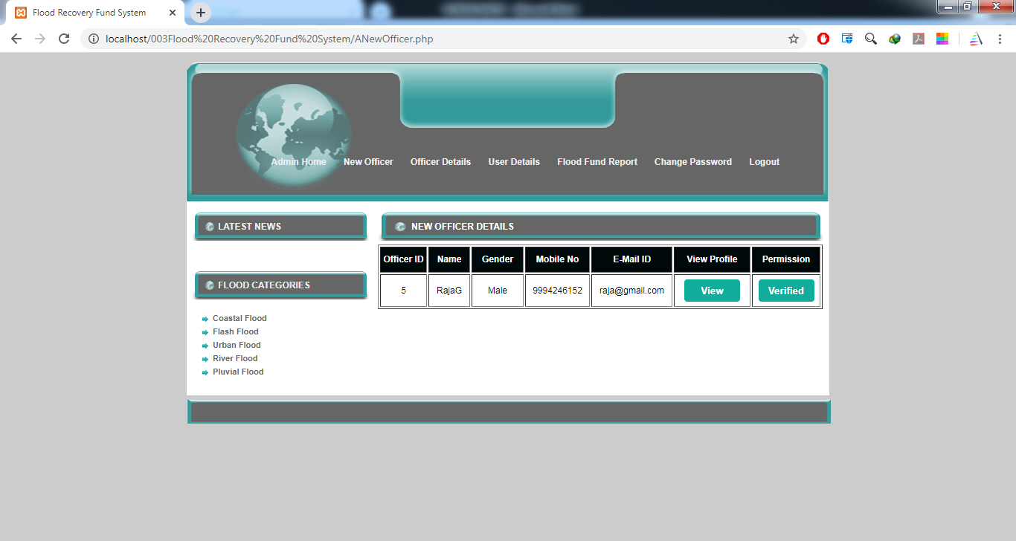
Admin View New Officer Details

Slide 14
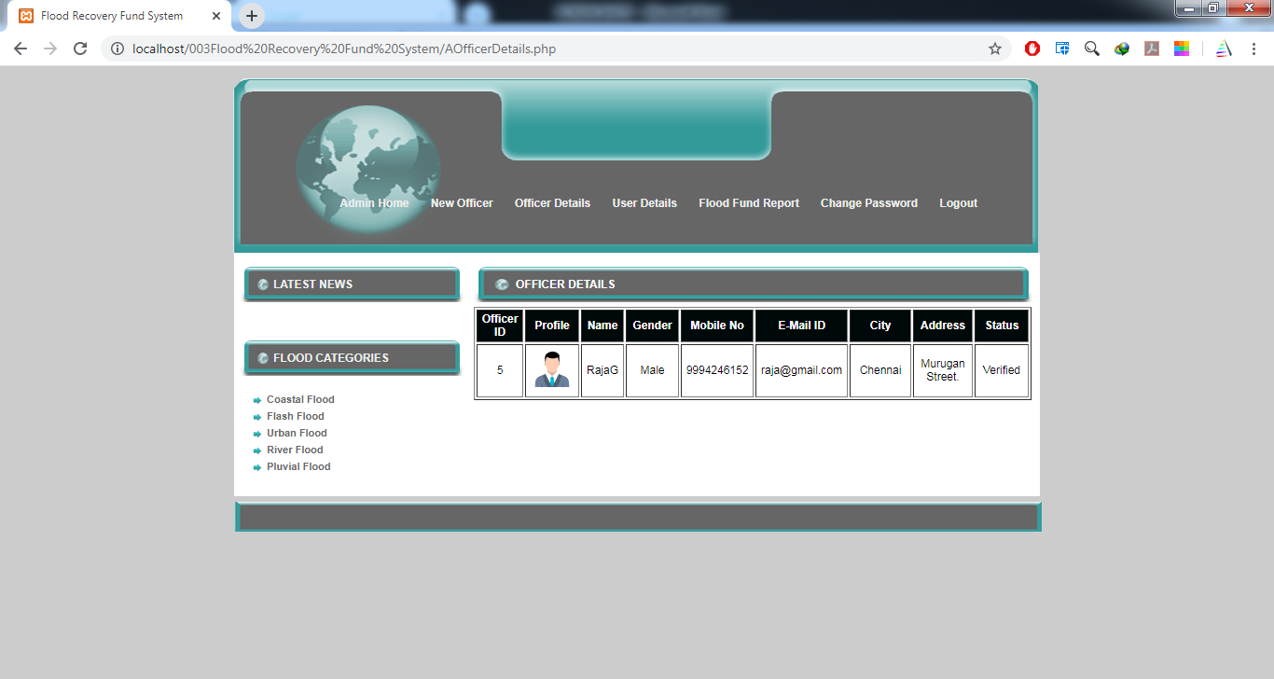
Admin - New Officer Account Activated

Slide 15
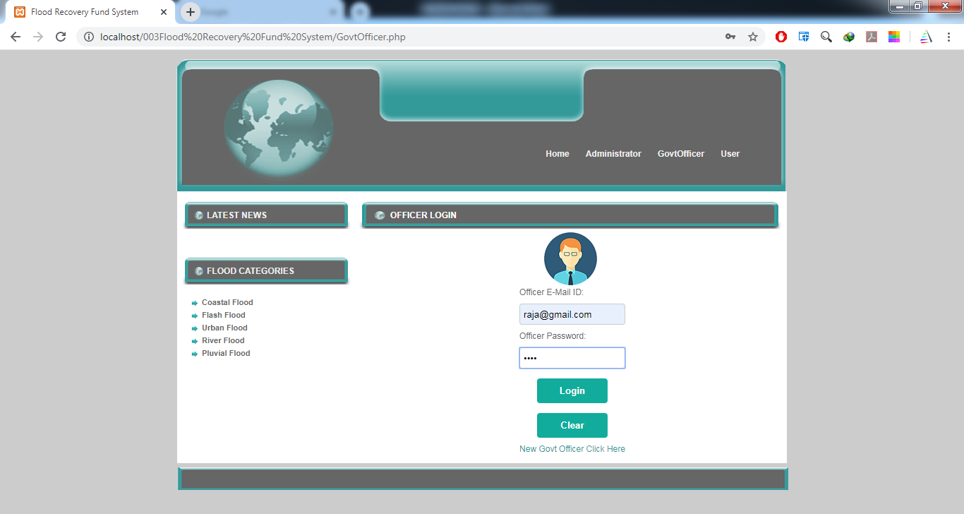
Officer Login

Slide 16
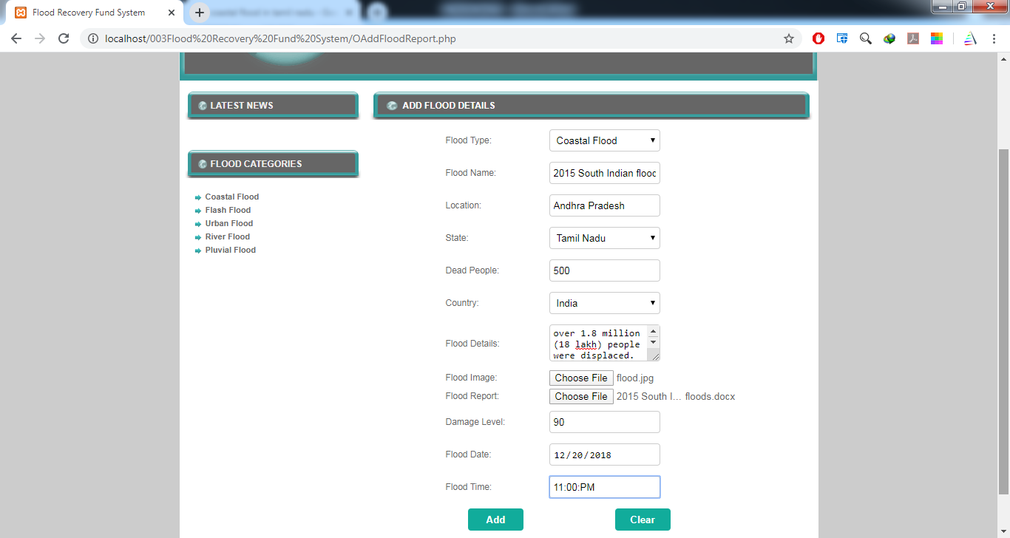
Add Flood Report

Slide 17
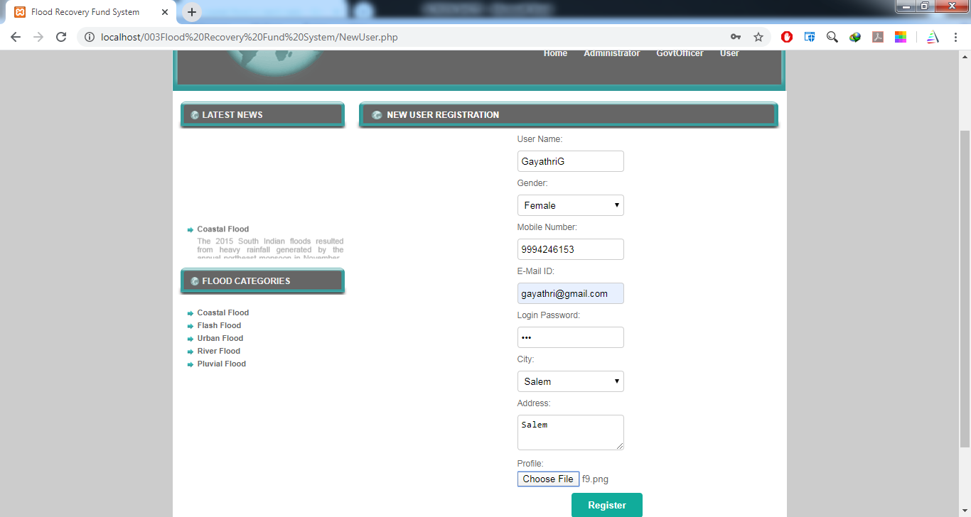
User Register

Slide 18
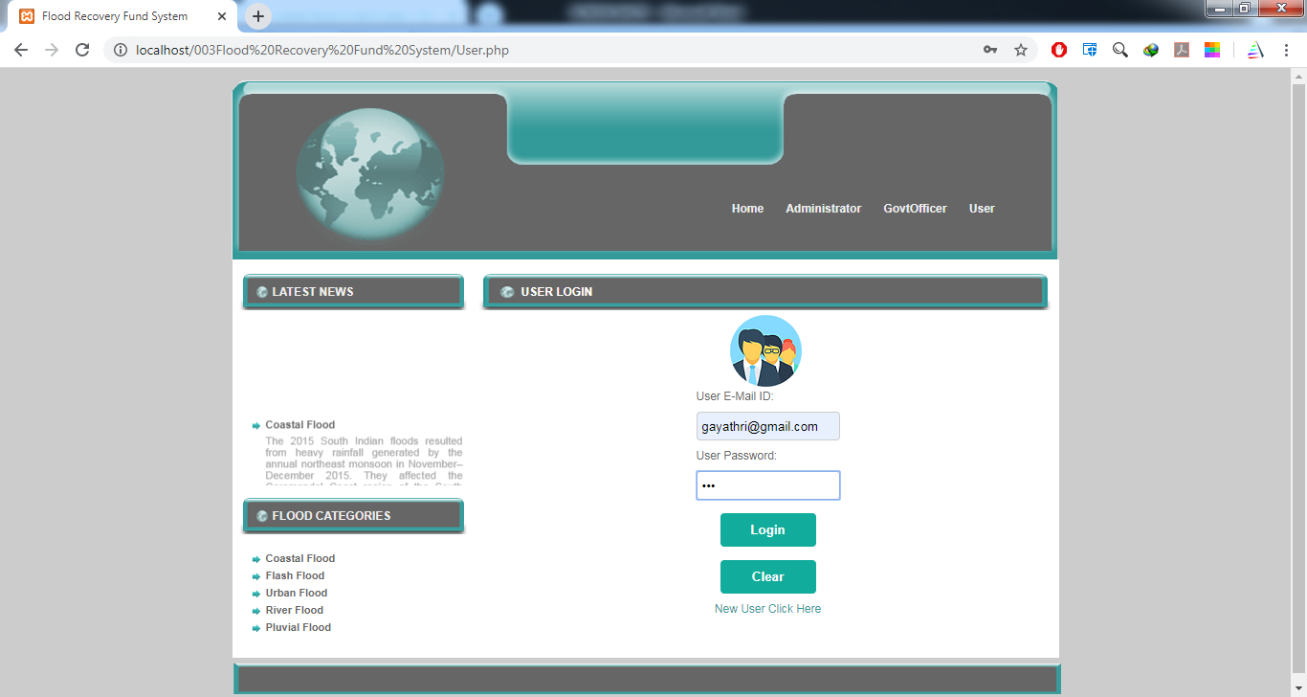
User Login

Slide 19
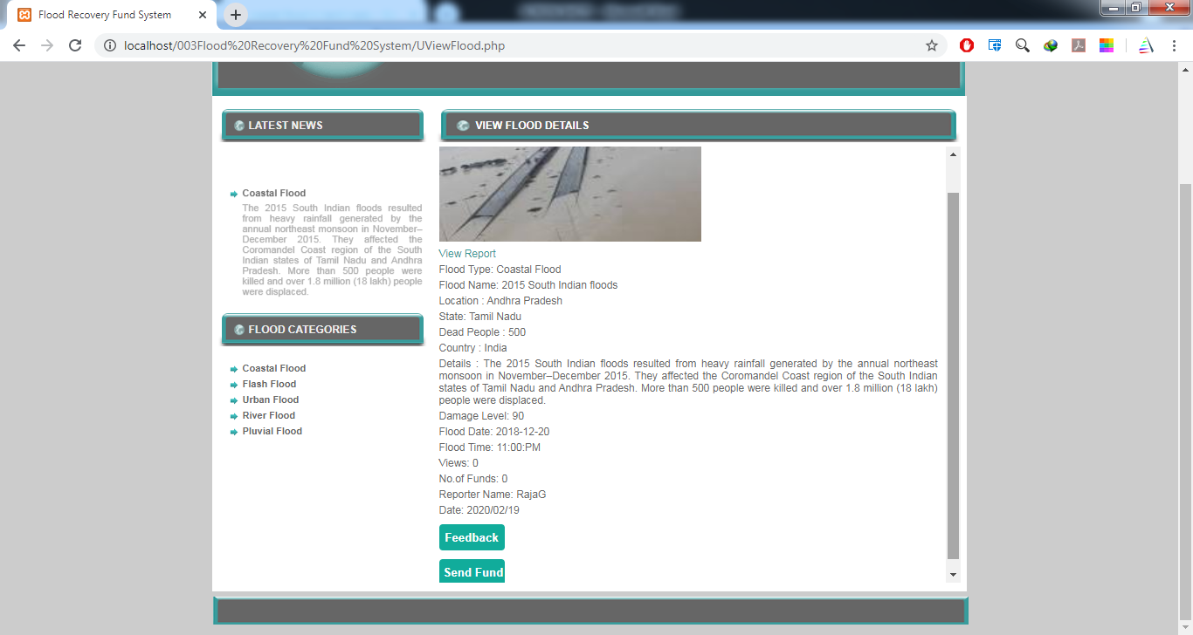
User View Flood Report

Slide 20
CONCLUSION
The increasing trend of urbanization and development though enhances quality of life of the communities, at the same time encourages ‘disaster risk’ due to poor adoption of preparedness and mitigation measures.
The ﬂood occurred recently in the State of J&K presented another instance of a volatile disaster which has challenged the developments made so far.
In light of these trends, the need to improve disaster recovery and long-term ﬂood resilience planning are mandated.

Slide 21
THANK YOU

