Slide 1
Flood Disaster Fund Access Control
Presented by,
R.RAGUL ( C22UG132CSC036 )

Slide 2
SYNPOSIS
It is very difficult for them to go directly to the town when they are trying to help.
So considering these issues, this project is dealing with a new system, people who come to the aid of victims can easily fund.
This project creates a web application for that reason; it includes details about the affected people, such as their photos.
All of these actions are done by PHP in this project.

Slide 3
EXISTING SYSTEM’s DRAWBACKS
In existing method, it is very difficult to know whether the funds and materials needed for flood victims are available.
This is because the functionality is not implemented properly.
And, in that way, it is impossible to accurately look at the victims' recovery and whether their survey was correct.

Slide 4
PROPOSED SYSTEM’s FEATURES
In this new way, people can see clearly, accurately and easily what kinds of products are being given to victims.
The agent will take care of information about the victims and their goods.
Agent will take care of it and record it in one as document and hand it over to the owner.
And the agent will take care and forbid of any kind of corruption. The system therefore benefits the victim and the owner.

Slide 5
SYSTEM REQUIREMENTS
HARDWARE REQUIREMENTS
System : Pentium IV 2.4 GHz.
Hard Disk : 500 GB.
Monitor : 15 VGA Colour.
RAM : 4 GB.

Slide 6
SOFTWARE REQUIREMENTS
SOFTWARE REQUIREMENTS
Operating System : Windows - 10/11.
Frontend Languages : HTML, CSS and JavaScript
IDE Tool : Visual Studio Code 1.7
Backend Languages : PHP 7.0.
Database : MYSQL 10.0.

Slide 7
MODULES
Administrator Module
Govt. Officer Module
User Module
Fund Collection Module
Feedback Module
Fund Report Module

Slide 8
FUND COLLECTION MODULE
This fund will be directed towards the organization via net banking or credit card/debit card transactions in a secure environment.
The intention is to develop a database which is a comprehensive one in which all aspects of online transactions are covered and donations are made in secure way.

Slide 9
FEEDBACK MODULE
Users can post their feedback on this website.
For posting, users can open the feedback option on the website and sign up.
The administrator and the officer will view those feedbacks.
The administrators and govt. officers will resolve that grievances

Slide 10
FUND REPORT MODULE
This fund report module is to maintain the entire record properly about user’s and their donation.
Administrator or Govt. Officer can generate the reports of particular details and the anal, report.
Administrator can also print the report and file it.

Slide 11
SCREEN SHOTS

Slide 12
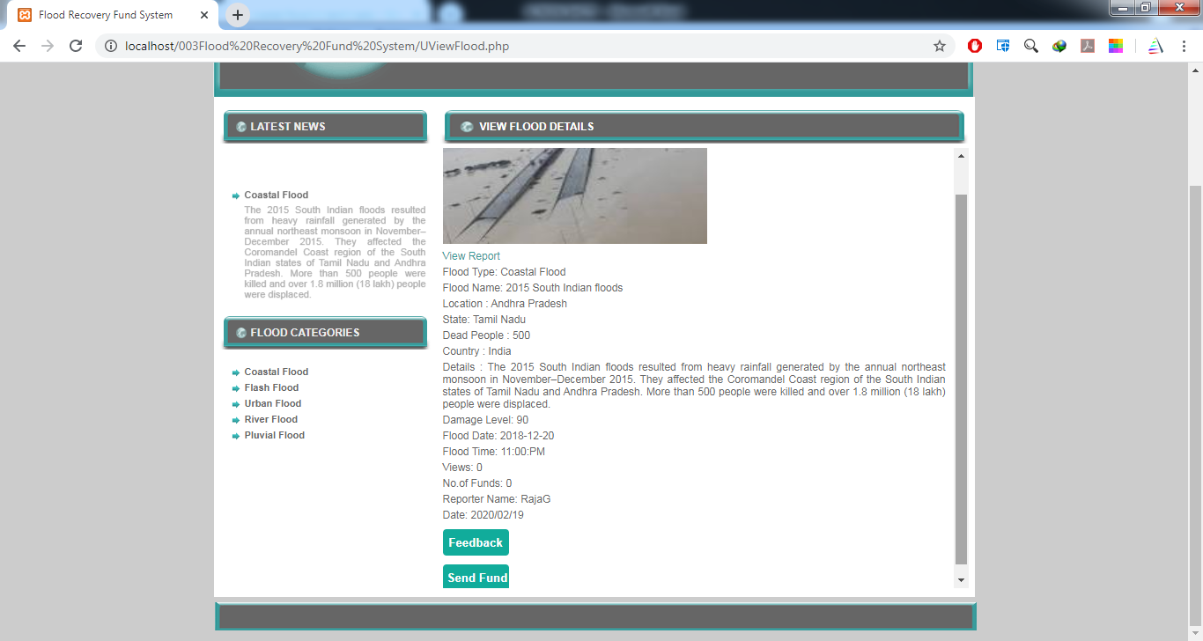
User View Flood Report

Slide 13
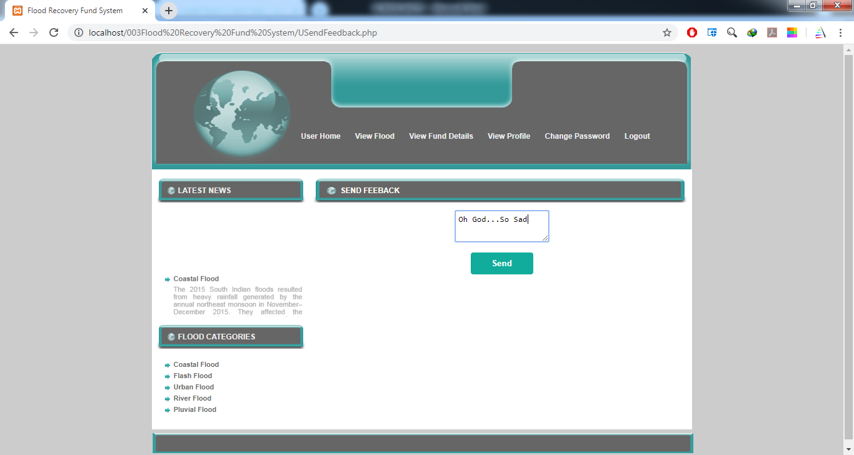
Send Your Feedback

Slide 14
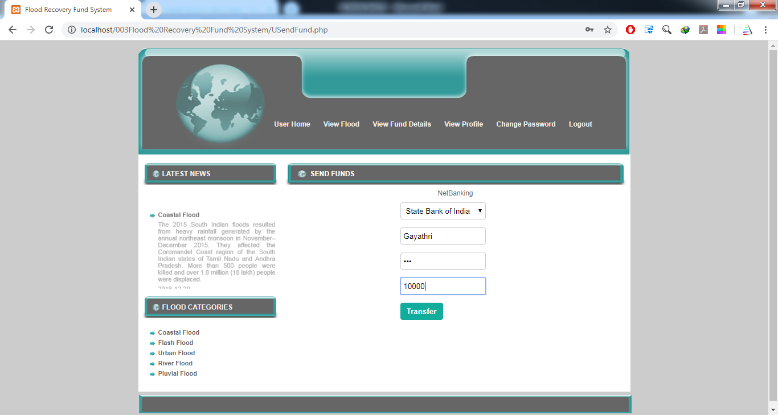
Send Fund Amount

Slide 15
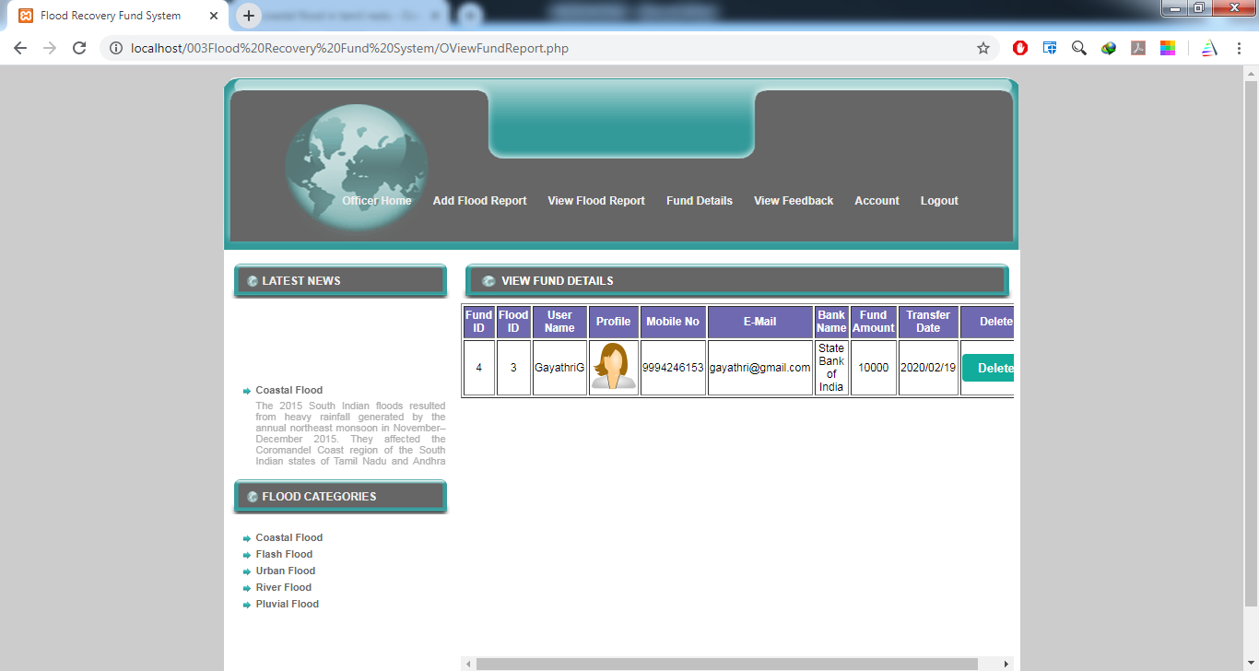
User Fund Details Check Officer

Slide 16
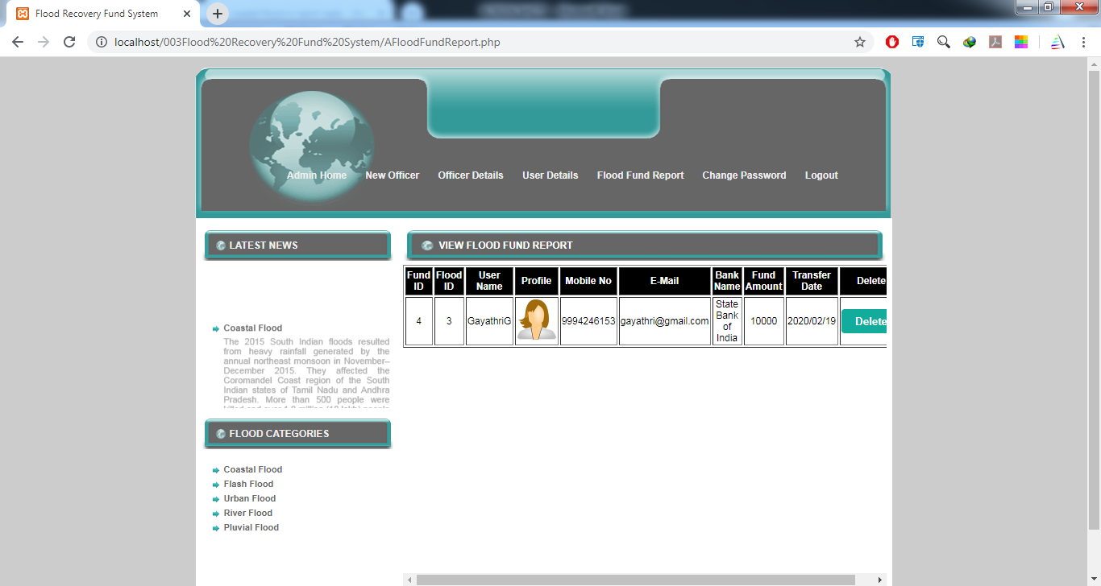
Admin View User Fund Details

Slide 17
CONCLUSION
The increasing trend of urbanization and development though enhances quality of life of the communities, at the same time encourages ‘disaster risk’ due to poor adoption of preparedness and mitigation measures.
The ﬂood occurred recently in the State of J&K presented another instance of a volatile disaster which has challenged the developments made so far.
In light of these trends, the need to improve disaster recovery and long-term ﬂood resilience planning are mandated.

Slide 18
THANK YOU

