Slide 1
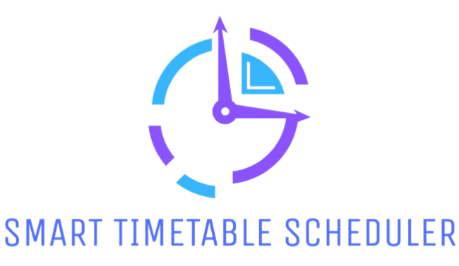
By
S.GAUTHAM
C22UG132CSC014

Slide 2
SYNOPSIS
Automated Timetable Generation
Flexible Constraints & Resource Optimization
User-Friendly Interface & Visualization
Export & Accessibility Features
Secure and Safe

Slide 3
INTRODUCTION
The Smart TimeTable Scheduler is an innovative web-based solution designed to automate and streamline the scheduling of academic timetables for educational institutions. The project aims to replace traditional, manual timetable preparation with a dynamic system that adapts to changes in staff availability, subject requirements, and time constraints. The system ensures efficient allocation of resources while maintaining fairness and reducing administrative workload.

Slide 4
WHY SMART TIMETABLE SCHEDULER ?
Easy Access
Time Saving
Efficient Resource Allocation
Reduce Administrative Burden

Slide 5









SYSTEM REQUIREMENTS
MINIMUM REQUIREMENT
Processor: Dual-Core Processor or higher (e.g., Intel Core i3 or equivalent) with a clock speed of 2.0 GHz or higher.
RAM: Minimum 4 GB
Storage: Minimum 80 GB free disk
Stable internet
OPERATING SYSTEM
BROWSERS

Slide 6
EXISTING SYSTEM
CURRENT SCENARIO
Manual scheduling via spreadsheets.
More chances for Conflict.
Challenges in staff availability and chances of clashes.
DRAWBACKS
Human Errors
Time-consuming
Scalability issues
Facing difficulties while adding new classes.

Slide 7
PROPOSED SYSTEM
Automated Scheduling
User-Friendly Interfaces
Optimal Resource Utilization
Scalability and Reliability
Timetable can be Exported in PDF

Slide 8





TECHNOLOGIES USED
<%= EJS %>

Slide 9
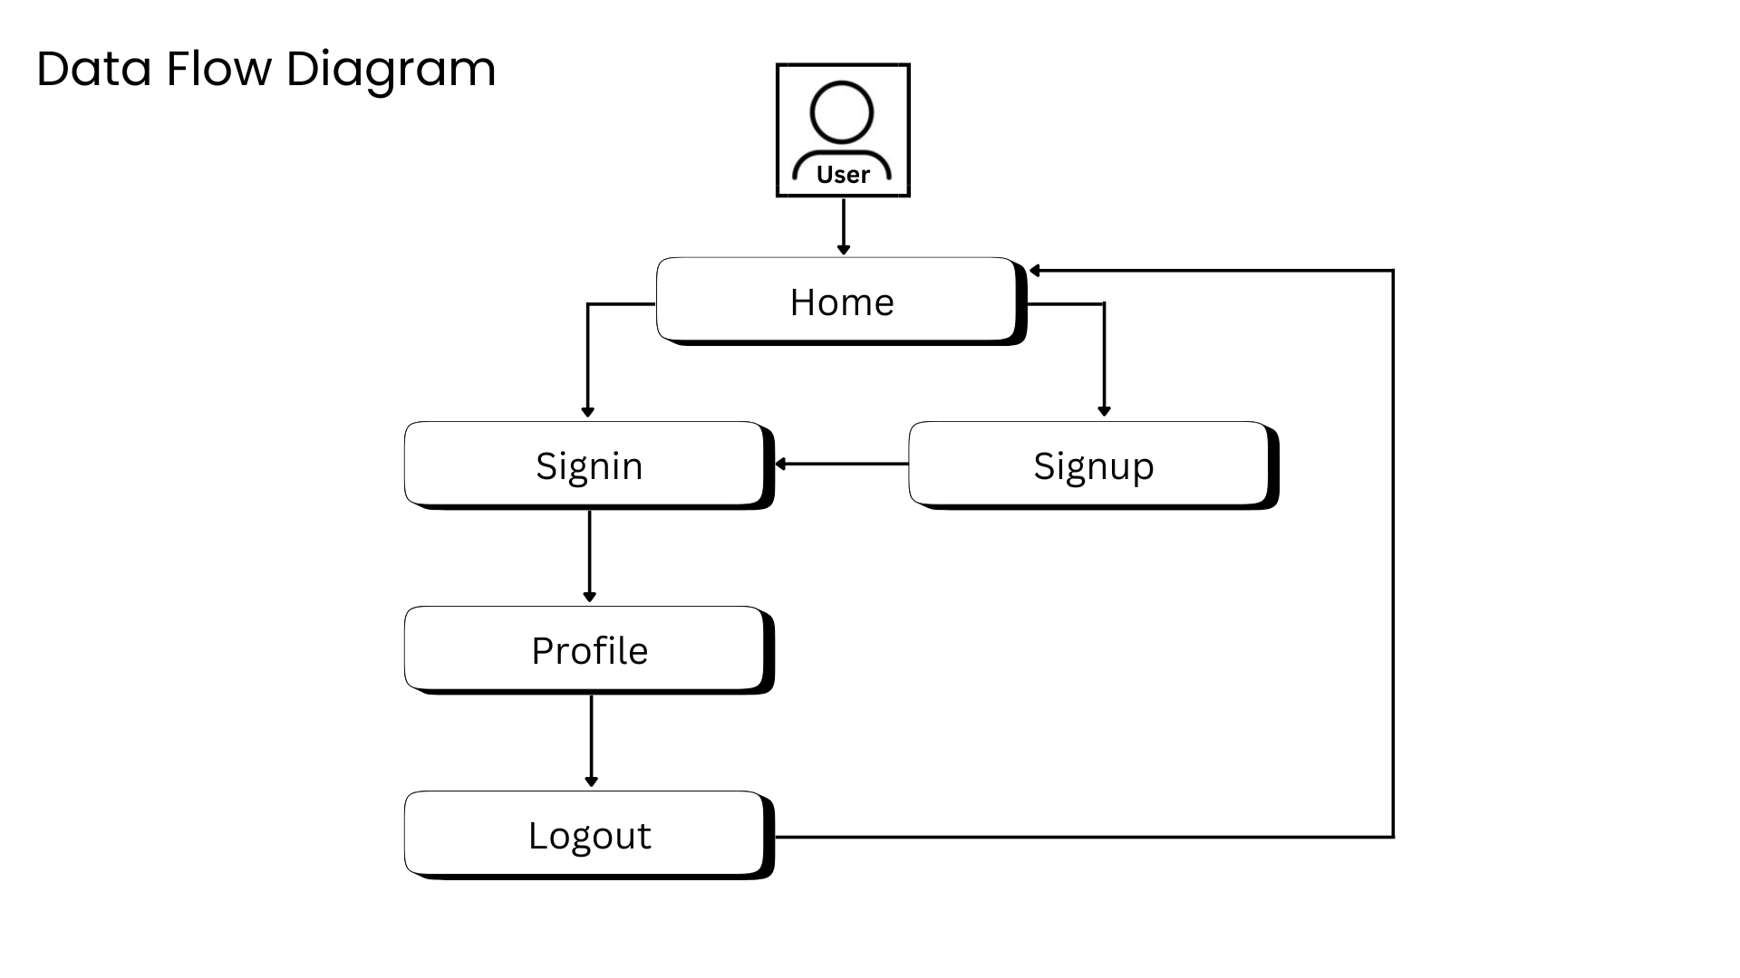

Slide 10
HOME PAGE
Easy Navigation
About Section
Sign Up for New Users
Feedback Section (for user interaction)
Profile Access for Signed-in Users
Responsive

Slide 11
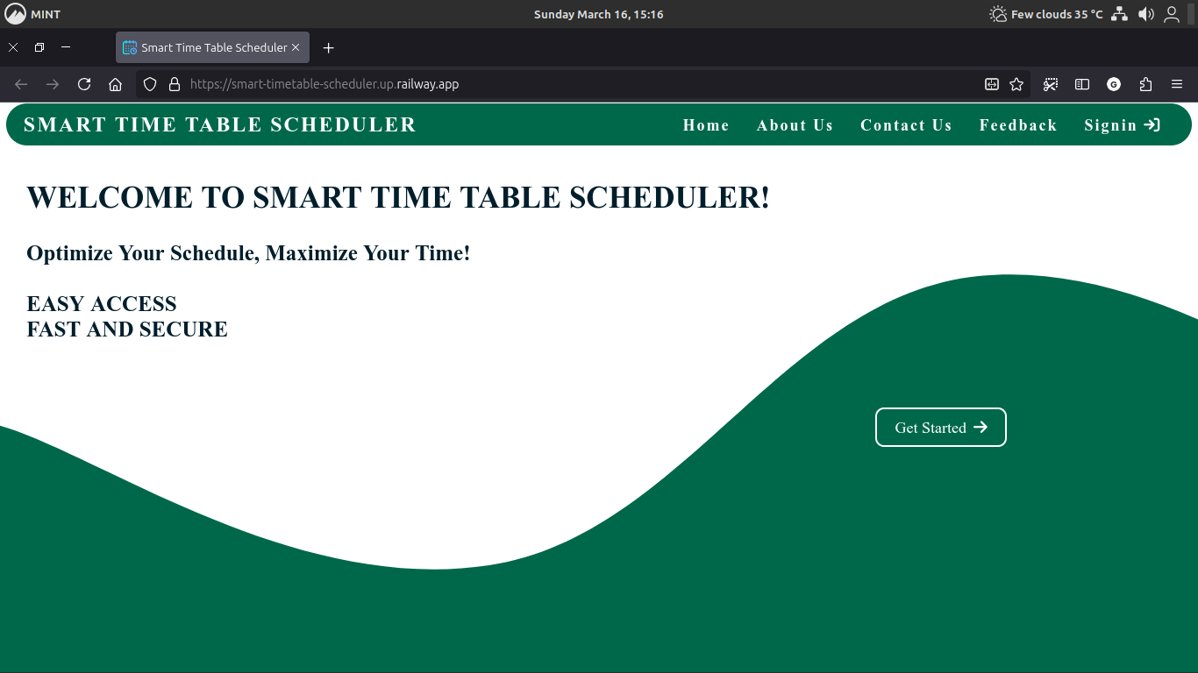
HOME PAGE

Slide 12
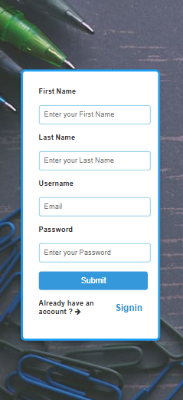
SIGN UP
Easy user registration anytime.
Stores user data in database.
Collects email, name, password.
Enforces strong password check.
Uses Bcrypt for password hashing.
Provides real-time input validation.

Slide 13
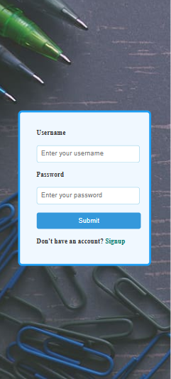
SIGN IN
Secure session-based login.
MongoDB verifies credentials.
Prevents brute-force attacks.
Redirects users after login.
Existing users log in easily.
Compares input with database.
Checks username and password.

Slide 14
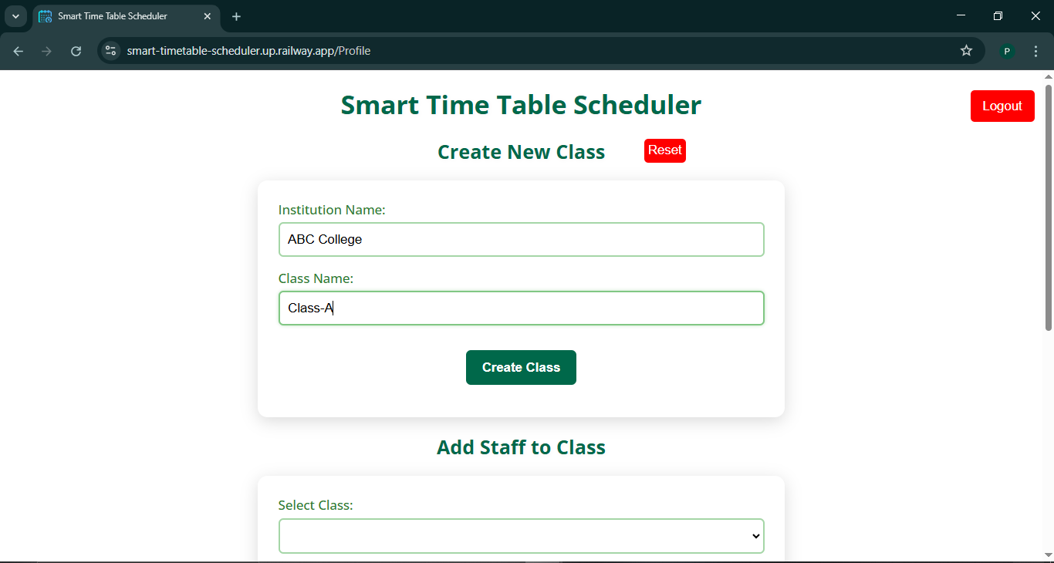
PROFILE PAGE

Slide 15
PROFILE PAGE
Add Classes – Create and manage class lists.
Assign Staff – Link staff to classes.
Generate Timetable – Auto-assign subjects & staff.
Remove Entries – Delete staff or classes.
Download PDF – Export timetable as PDF.
User Interaction – Validate inputs and show alerts.

Slide 16

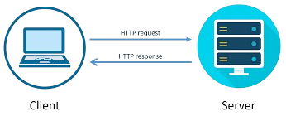
SERVER MODULE
Handles requests & routing.
Manages timetable & auth.
Session & middleware security.
Built with Node.js & Express.

Slide 17


STAFF MANAGEMENT
Add & assign Staff.
Prevents duplicate.
Weekly class limits.
Real-time modification.

Slide 18

PDF EXPORT
Generates timetable PDFs.
Grid format clarity.
Uses PDF Kit.

Slide 19
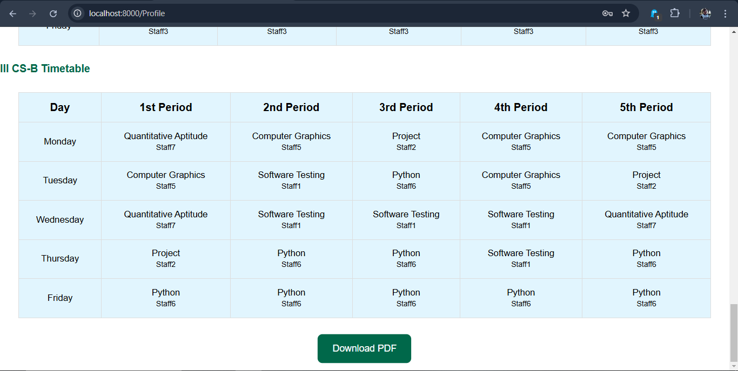
PDF EXPORT

Slide 20
CONCLUSION
Our system offers automated scheduling, eliminating conflicts and optimizing class and staff assignments. It ensures a fair and balanced approach by considering maximum weekly classes and free periods. With easy management, administrators can effortlessly add, update, and control staff, subjects, and scheduling constraints. Built with Node.js, Express, MongoDB, and EJS, it provides a secure and accessible experience with real-time updates, PDF exports, and user authentication.
Visit our Website : https://smart-timetable-scheduler.up.railway.app

Slide 21
THANK YOU

