Slide 1
CODE OUTPUT
By Nayiga Flavia
2023-B222-32339

Slide 2
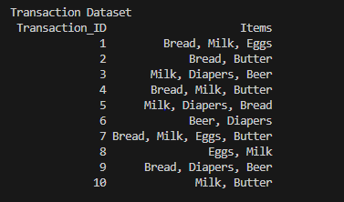
PART A

Slide 3
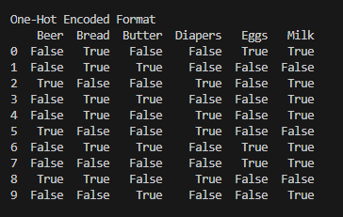

Slide 4
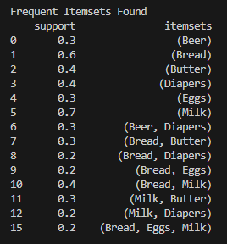
PART B

Slide 5
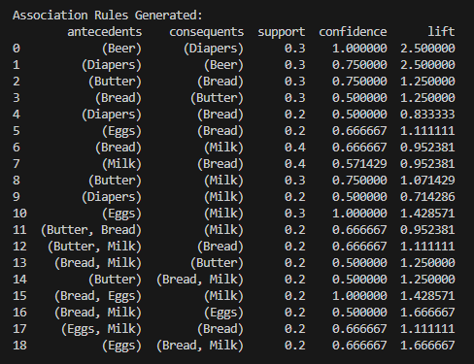

Slide 6
PART C
Strongest three rules based on lift
1. Beer → Diapers
Support = 0.3
Confidence =1
Lift = 2.5
Explanation: This means that beer buyers may also buy diapers.
2. (Bread, Milk) → Eggs
Support = 0.2
Confidence =0.6667
Lift = 1.6667
Explanation: This means that customers who purchase milk and bread are likely to buy eggs too

Slide 7
3. Eggs → Milk
Support = 0.2
Confidence =0.6667
Lift = 1.6667
Explanation: This means that customers who purchase eggs are likely to buy milk
BUSINESS RECOMMENDATION
The supermarket should place beer shelves close to the diaper section to increase customer convenience
They can offer a conditional discount where customers who purchase more than two items such as milk, bread and eggs receive a small price reduction on eggs or any other item, encouraging complementary purchases

