Slide 1
Bus Pass System
Prajapati Praveen - 240160510037

Slide 2
Existing System
-> Go to a bus stop or office physically
-> Take a physical form
-> Fill the form by hand
-> Submit it to the offices
-> Wait for several days
-> Come back and collect the pass manually
2.Existing System Problems
Slow – Takes time to get the pass.
Travel Required – Need to go to the bus stop or office.
Paperwork – Manual forms are easy to lose.
No Tracking – Cannot check pass status.
Physical Pass – Pass can be lost or damaged

Slide 3
3.New System
-> Users can fill out the form and get the pass online.
-> The form and pass are digital. Once filled out online, the pass is automatically generated and available in a secure, downloadable PDF format.
4. Need for a New System
Faster process – No waiting for days.
Convenience – Access the system from anywhere.
Automation – Reduces manual work and errors.
Real-time tracking – Know the status of your pass.
Digital pass – No physical form to lose or damage.
Cost-effective – Saves paper and manual effort.
Security – Digital passes are more secure.

Slide 4
5. Entity Relationship Diagram

Slide 5
6 Use case :

Slide 6
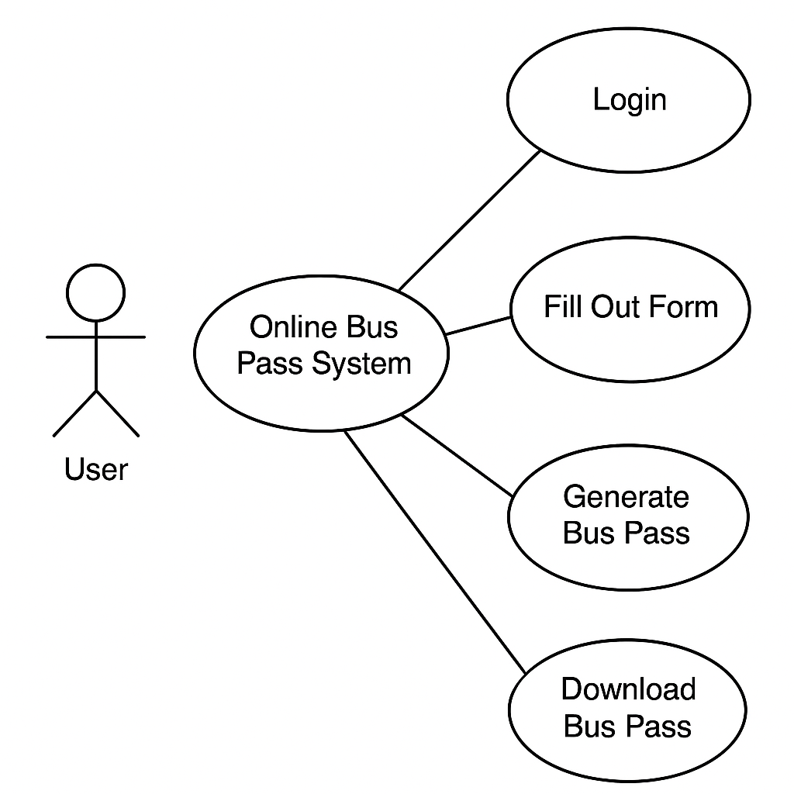
Bus

Slide 7
7.Activity Diagram:
Login
Credenti
match
Admin
User
check request
apply for pass
download pass pdf
verification documents
check verification
Logout
Send reject message
create passformat
Logout

