Slide 1
Traffic Violation Report System
Submitted By:
Binit Maharjan (37802046)
Notes:
Title slide. Traffic Violation Report System, BCA 8th semester final project.

Slide 2
Introduction to Project
Rapid urbanization and a sharp rise in registered vehicles are straining Nepal’s manual, in-person traffic enforcement.
Citizens usually report violations informally through social media, with no structure, tracking, or accountability.
Reading Devanagari license plates by hand is slow, and off-the-shelf OCR is built mainly for Latin-script plates.
The Traffic Violation Reporting System lets citizens report violations with photo and location, while authorities verify and analyze reports centrally.
Built with React Native, React, Express, MongoDB, and a custom TensorFlow/OpenCV plate-recognition pipeline.
2
Notes:
Set the context: informal reporting today, no structure, and Nepali plates are hard for existing OCR.

Slide 3
Problem Statement
• Traffic violations often go unreported due to lack of an easy, accessible reporting
channel for the public.
• Traffic authorities lack a centralized system to track, analyse, and act on violation
trends across different locations.
• Manual identification of vehicle license plates from reported images is time-
consuming and error-prone.
• There is no effective mechanism to identify violation hotspots or repeat offenders
(flagged vehicles) using existing data.
2
Notes:
Set the context: informal reporting today, no structure, and Nepali plates are hard for existing OCR.

Slide 4

Objectives of the Project
• To develop a cross platform mobile application that allows citizens to report traffic
violations with photo evidence and location data.
• To implement an automated Nepali license plate recognition (OCR) pipeline to
assist in identifying vehicles from violation images.
• To provide data-driven insights such as violation hotspot mapping and analytics for
informed traffic enforcement decisions.
4
Notes:
Three main objectives.

Slide 5
Scope and Limitations
Scope
Limitations
Mobile app for citizens to submit reports with images, location, and details.
Admin dashboard to manage reports, view analytics, and track hotspots on an interactive map.
Backend and OCR pipeline for storage, business logic, real-time communication, and plate recognition.
The custom OCR model may struggle with poor lighting, blur, odd angles, dirty plates, or non-standard formats, especially visually similar Devanagari characters.
No link to Nepal’s official vehicle registration database, so ownership and registration cannot be verified. Plates are only stored and flagged as reported.
5
Notes:
Scope versus limitations.

Slide 6
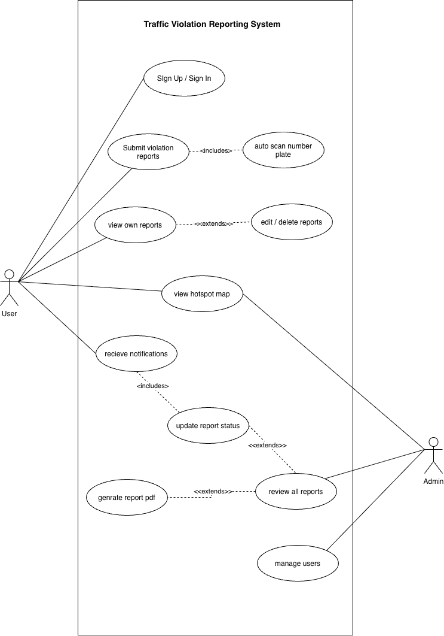
Functional Requirement
Sign up / sign in
Submit report, with optional auto-scan of the number plate
View, edit, and delete own reports
View DBSCAN hotspot map (user and admin)
Receive notifications on status changes
Admin: review all reports, update status, generate PDF, manage users
Figure: Use Case Diagram
6
Notes:
Two actors: User and Admin.

Slide 7
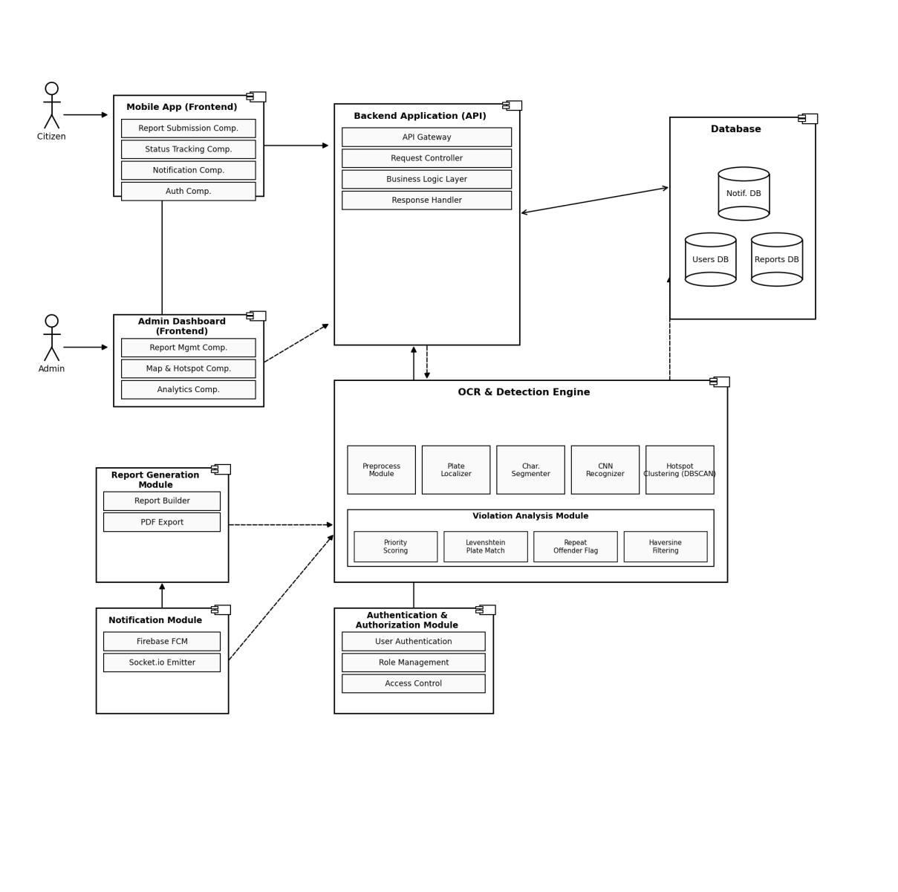
System Design: Component Diagram
13
Notes:
Component architecture.

Slide 8
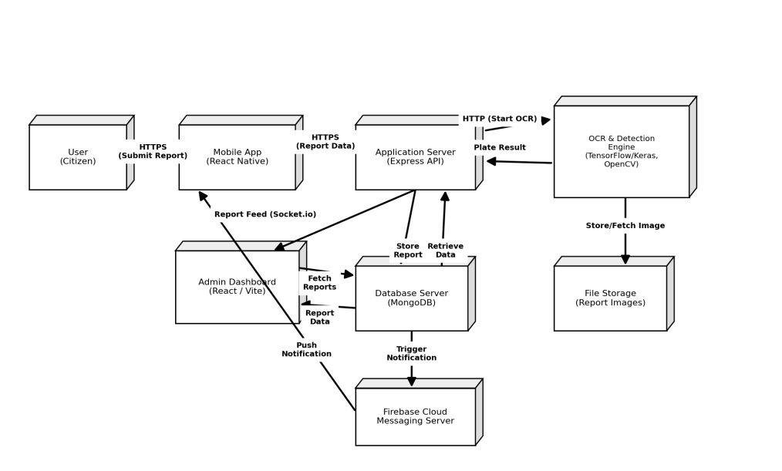
Deployment Diagram
Citizens submit reports over HTTPS to the Express application server, which calls the OCR engine, stores data in MongoDB and images in file storage, pushes live reports to the admin dashboard via Socket.io, and sends push notifications through Firebase Cloud Messaging.
14
Notes:
Deployment view.

Slide 9
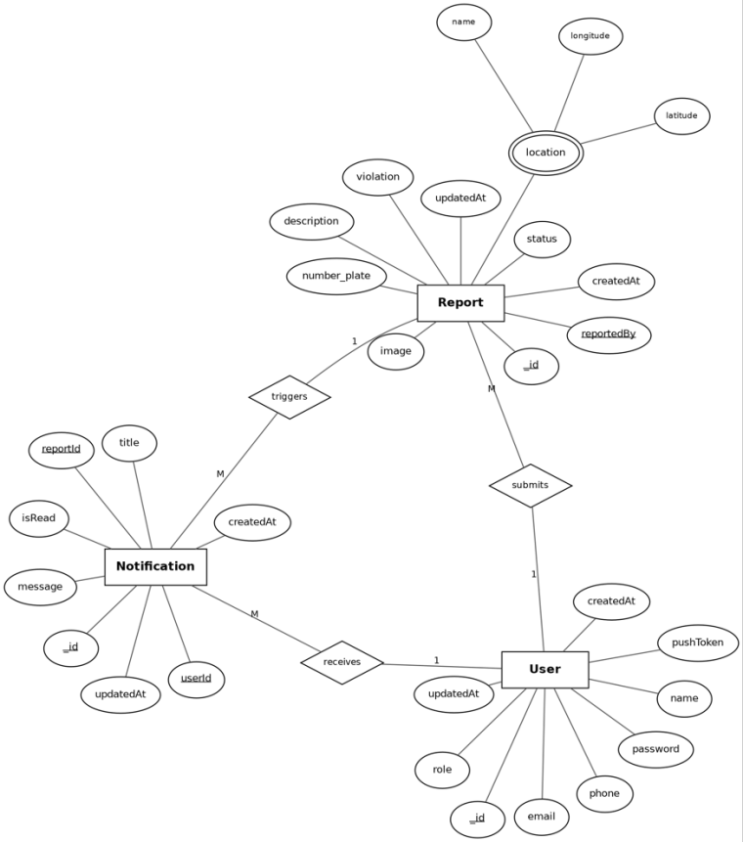
ER Diagram
15
Notes:
ER diagram and object model.

Slide 10
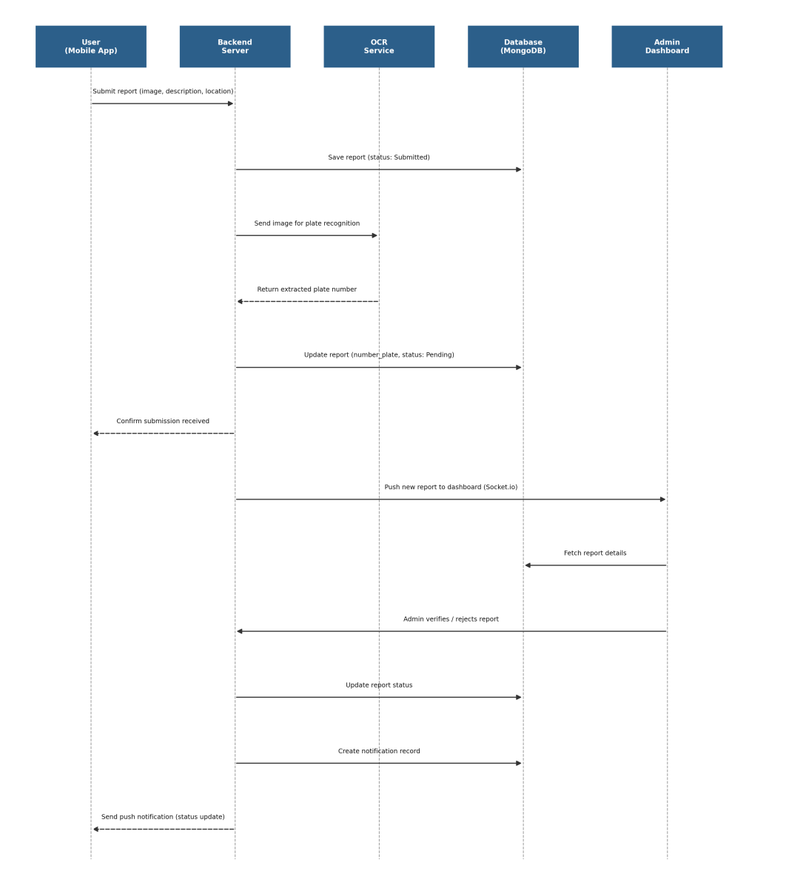
Sequence Diagram
16
Notes:
Report submission flow.

Slide 11
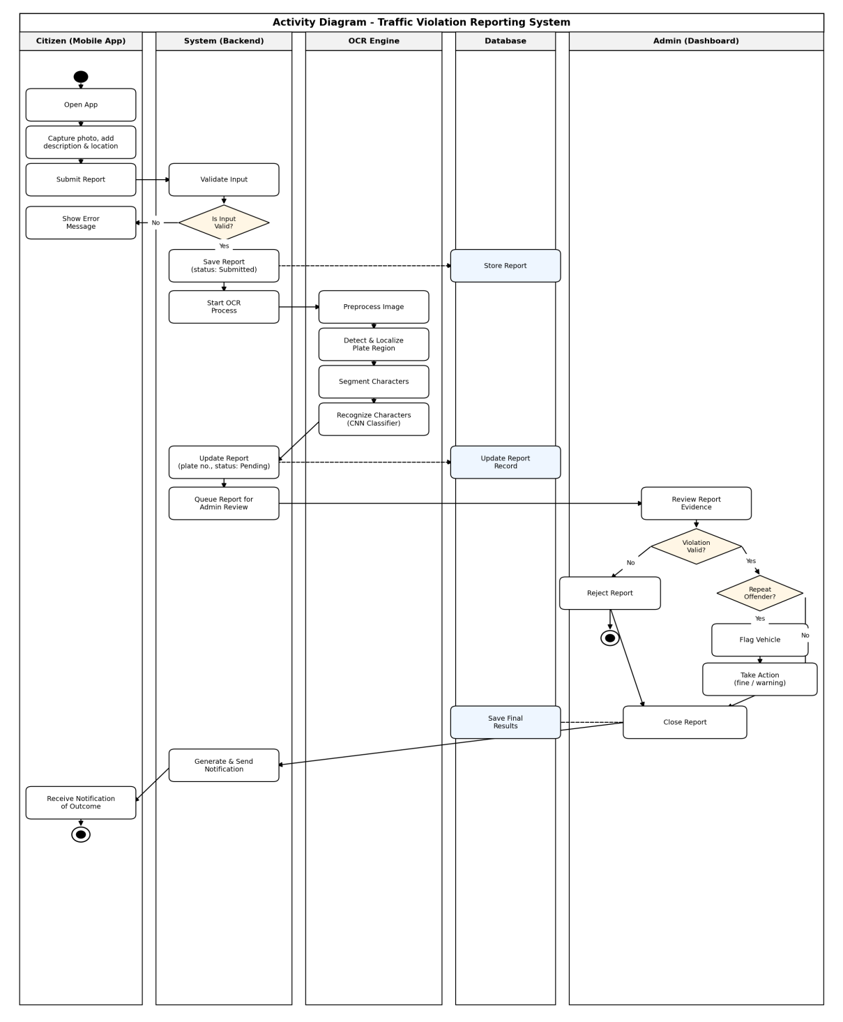
Activity Diagram
18
Notes:
Swimlane activity diagram.

Slide 12
Algorithm: Haversine Formula
a = sin²(Δφ/2) + cos(φ1) · cos(φ2) · sin²(Δλ/2)
c = 2 · atan2(√a, √(1−a))
d = R · c (R ≈ 6,371 km)
Steps:
1. Convert latitude and longitude of both points from degrees to radians.
2. Compute the differences Δφ and Δλ.
3. Apply the haversine formula to compute a.
4. Compute the angular distance c using atan2.
5. Multiply by Earth's radius to get the distance d in kilometers.
19
Notes:
Haversine steps.

Slide 13
Algorithm: DBSCAN
Finds violation hotspots, meaning areas with a high density of reports, without predefining the number of clusters.
eps
Max Haversine distance for two points to be neighbors
Find each point’s neighbors within eps.
If it has at least minPts neighbors, it is a core point and starts a cluster.
Add all density-reachable points to the cluster.
Points near a core point but with fewer neighbors are border points.
All other points are noise, not part of any hotspot.
Clusters are drawn on the admin map using Leaflet MarkerClusterGroup.
minPts
Minimum points needed to form a dense region
20
Notes:
DBSCAN parameters and steps.

Slide 14



Tools Used
Frontend
Backend
React Native (Expo)
React.js + Vite
Redux Toolkit & Redux Persist
Leaflet.js, Recharts
Node.js, Express.js
TypeScript
MongoDB + Mongoose
Socket.io, Firebase FCM
ML / OCR
Mapping
Python
TensorFlow / Keras
OpenCV
NumPy
OpenStreetMap
Nominatim (geocoding)
22
Notes:
Tools grouped by area.

Slide 15






Modules
Authentication
Report Submission
Sign up
JWT login
Role-based access
Photo
Violation type
Location
OCR & Plate Recognition
Hotspot Detection
Preprocess
Localize
Segment
Classify
Haversine
DBSCAN
Repeat Offenders
Notifications
Levenshtein match
Priority score
Socket.io
Firebase FCM
Admin Reports
User Management
Review
Status update
PDF export
Accounts
Roles
Report counts
23
Notes:
Main system modules.

Slide 16





Future Recommendations
Improve OCR
Government integration
Segmentation-free CRNN (CNN + BiLSTM + CTC)
More low-light, blurred, embossed samples
Link to the Department of Transport Management registration database
Fines and payments
Offline-first support
Digital fine issuance
Payment for verified violations
Draft and queue reports offline
Sync when connected
Security auditing
Video-based detection
Penetration testing before real-world deployment
YOLOv8 with object tracking
For CCTV or checkpoint use
31
Notes:
Future work.

