Slide 1
Traffic Violation Report System
Submitted By:
Binit Maharjan (37802046)
Notes:
Title slide. Traffic Violation Report System, BCA 8th semester final project.

Slide 2
Introduction to Project
The Traffic Violation Reporting System lets citizens report violations with photo and location, while authorities verify and analyze reports centrally.
Rapid urbanization and a sharp rise in registered vehicles are straining Nepal’s manual, in-person traffic enforcement.
Citizens usually report violations informally through social media, with no structure, tracking, or accountability.
Built with React Native, React, Express, MongoDB, and a custom TensorFlow/OpenCV plate-recognition pipeline.
Notes:
Set the context: informal reporting today, no structure, and Nepali plates are hard for existing OCR.

Slide 3
Problem Statement
• Traffic violations often go unreported due to lack of an easy, accessible reporting
channel for the public.
• Traffic authorities lack a centralized system to track, analyse, and act on violation
trends across different locations.
• Manual identification of vehicle license plates from reported images is time-
consuming and error-prone.
• There is no effective mechanism to identify violation hotspots or repeat offenders
(flagged vehicles) using existing data.
Notes:
Set the context: informal reporting today, no structure, and Nepali plates are hard for existing OCR.

Slide 4

Objectives of the Project
• To develop a cross platform mobile application that allows citizens to report traffic
violations with photo evidence and location data.
• To implement an automated Nepali license plate recognition (OCR) pipeline to
assist in identifying vehicles from violation images.
• To provide data-driven insights such as violation hotspot mapping and analytics for
informed traffic enforcement decisions.
Notes:
Three main objectives.

Slide 5
Scope and Limitations
Scope
Limitations
Mobile app for citizens to submit reports with images, location, and details.
Admin dashboard to manage reports, view analytics, and track hotspots on an interactive map.
Backend and OCR pipeline for storage, business logic, real-time communication, and plate recognition.
The custom OCR model may struggle with poor lighting, blur, odd angles, dirty plates, or non-standard formats, especially visually similar Devanagari characters.
No link to Nepal’s official vehicle registration database, so ownership and registration cannot be verified. Plates are only stored and flagged as reported.
Notes:
Scope versus limitations.

Slide 6
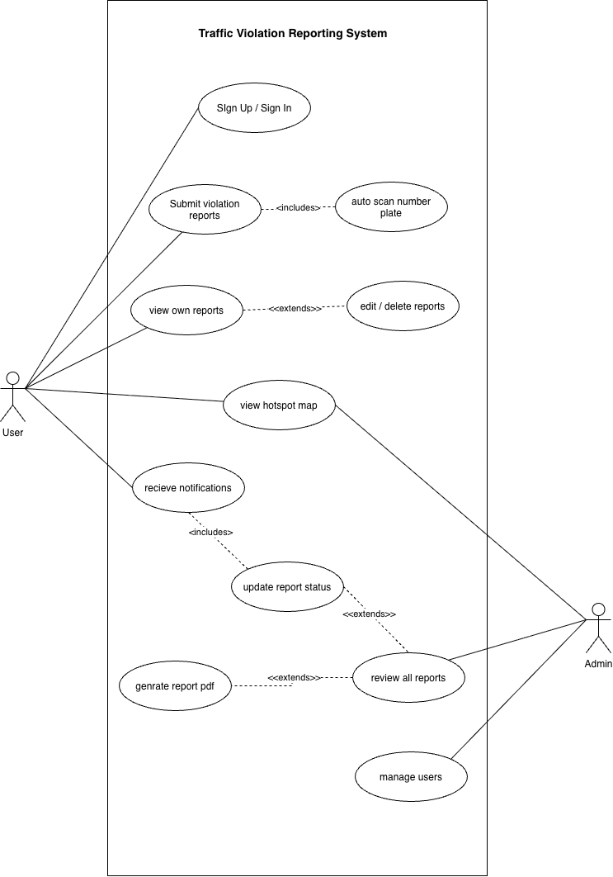
Functional Requirement
Sign up / sign in
Submit report, with optional auto-scan of the number plate
View, edit, and delete own reports
View DBSCAN hotspot map (user and admin)
Receive notifications on status changes
Admin: review all reports, update status, generate PDF, manage users
Figure: Use Case Diagram
6
Notes:
Two actors: User and Admin.

Slide 7
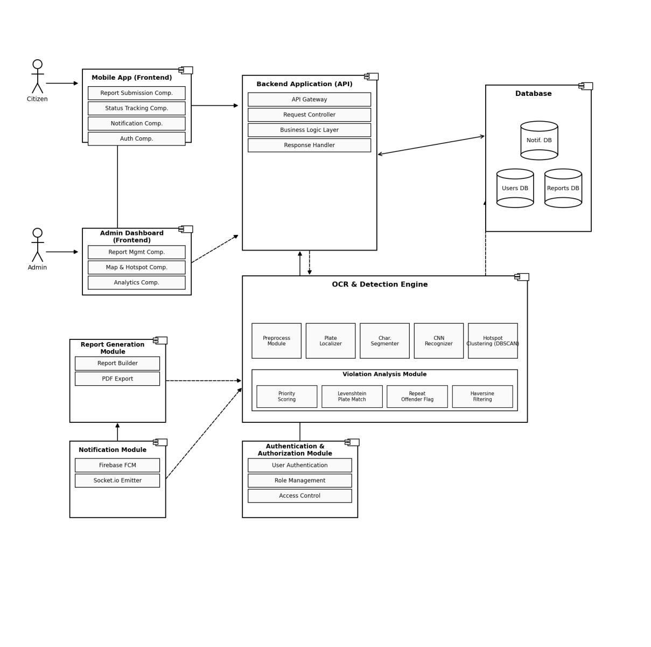
System Design: Component Diagram
Notes:
Component architecture.

Slide 8
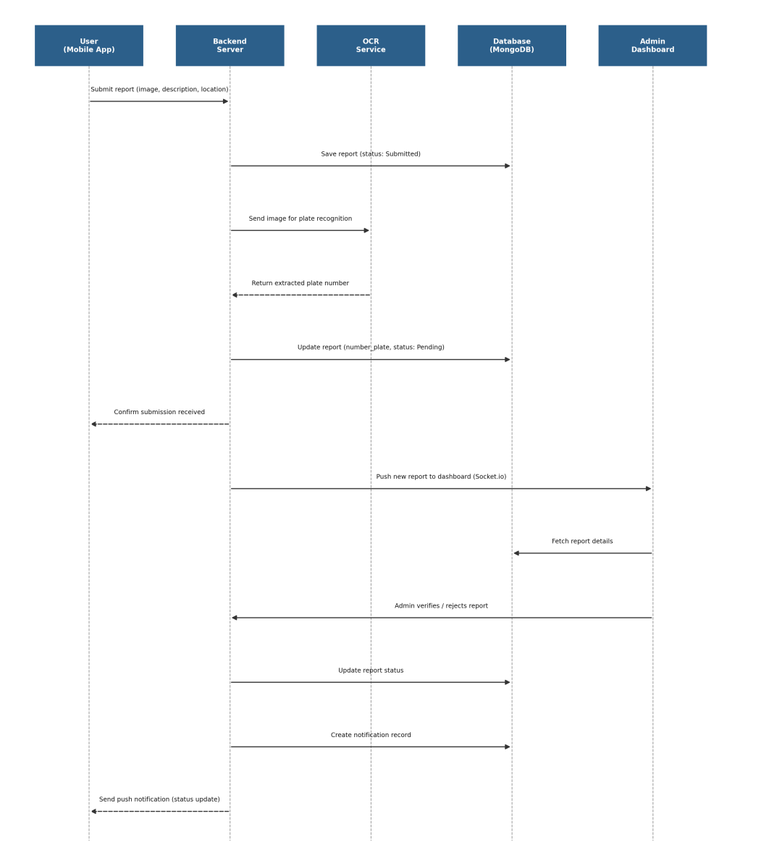
Sequence Diagram
Notes:
Report submission flow.

Slide 9
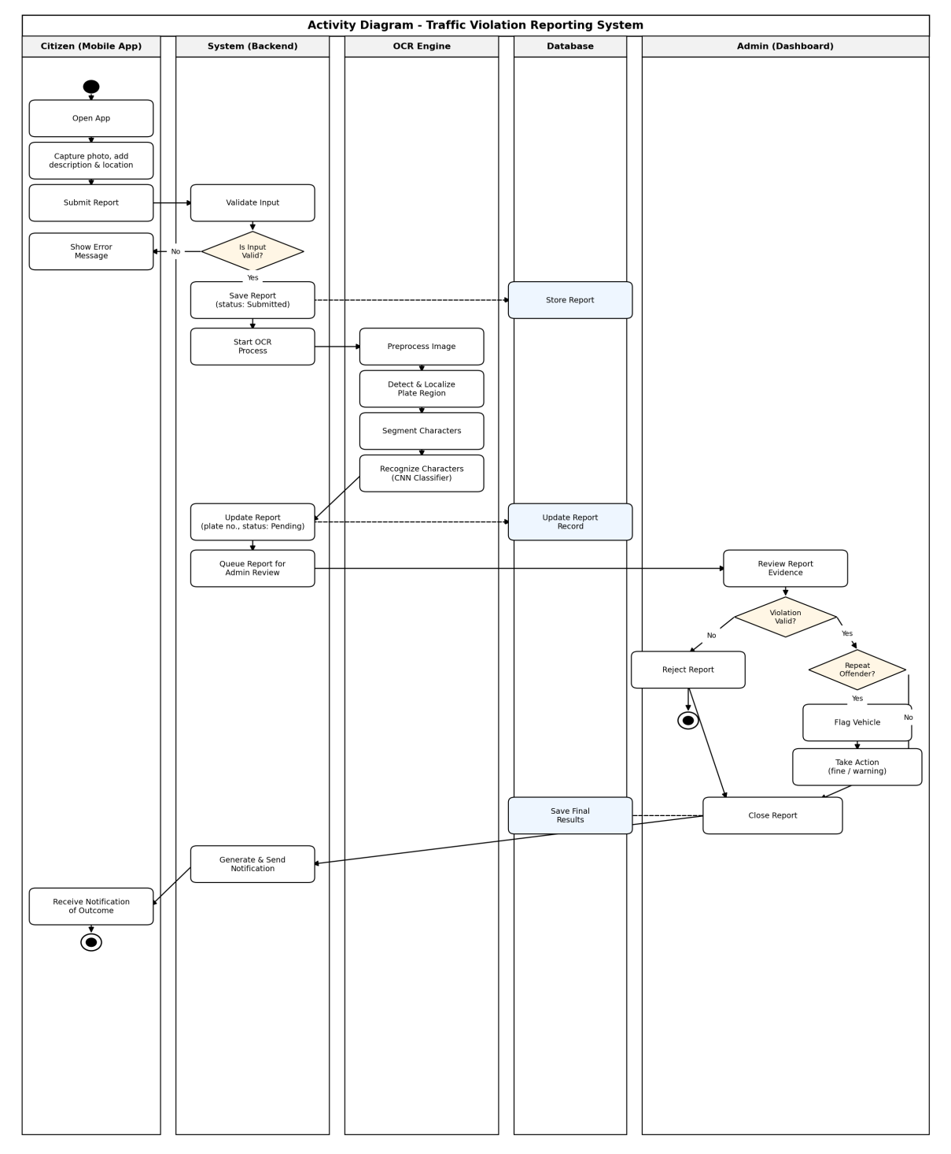
Activity Diagram
Notes:
Swimlane activity diagram.

Slide 10
Algorithm: Haversine Formula
Calculates the great-circle distance between two GPS coordinates on Earth's
surface — used for proximity-based filtering of reports
Steps:
1. Convert latitude and longitude of both points from degrees to radians.
2. Compute the differences Δφ and Δλ.
3. Apply the haversine formula to compute a.
4. Compute the angular distance c using atan2.
5. Multiply by Earth's radius to get the distance d in kilometers.
Notes:
Haversine steps.

Slide 11
Algorithm: DBSCAN
Purpose: Finds violation hotspots (areas with a high density of reports) without predefining the number of clusters.
Parameters
eps: the maximum Haversine distance for two points to be neighbors
minPts: the minimum number of points needed to form a dense region
Steps
Find each point's neighbors within eps.
If a point has at least minPts neighbors, it is a core point and starts a cluster.
Add all density-reachable points to the cluster.
Points near a core point but with fewer neighbors are border points.
All other points are noise and not part of any hotspot.
Draw the clusters on the admin map using Leaflet MarkerClusterGroup.
Notes:
DBSCAN parameters and steps.

Slide 12
Tools Used
Frontend
  React Native (Expo)
  React.js + Vite
  Leaflet.js, Recharts
  TypeScript
Backend
  Node.js, Express.js
  MongoDB + Mongoose
ML / OCR
  Python
  TensorFlow / Keras
  OpenCV
  NumPy
Mapping
  OpenStreetMap
  Nominatim (geocoding)
Notes:
Tools grouped by area.

Slide 13
Modules
Authentication: sign up, JWT login, role-based access
Report Submission: photo, violation type, location
OCR & Plate Recognition: preprocess, localize, segment, classify
Hotspot Detection: Haversine + DBSCAN
Repeat Offenders: Levenshtein match + priority score
Admin Reports: review, status update, PDF export
User Management: accounts, roles, report counts
Notes:
Main system modules.

Slide 14
Future Recommendations
Improve OCR: use a segmentation-free CRNN (CNN + BiLSTM + CTC) and add more low-light, blurred and embossed samples.
Government integration: link to the Department of Transport Management registration database.
Fines and payments: digital fine issuance and payment for verified violations.
Offline-first support: draft and queue reports offline, then sync when connected.
Security auditing: run penetration testing before real-world deployment.
Video-based detection: use YOLOv8 with object tracking for CCTV or checkpoint use.
Notes:
Future work.

